Slide 1


2016 Stormwater Code
SDCI Training
Seattle Municipal Tower,
Suite 4080
Presented by:
Eric Dripps
Eric.Dripps@Seattle.Gov
Matthew Bateman
Drainage Review
Ede Courtenay
Drainage Review Supervisor
Roger Moore
Site Inspection Supervisor

Slide 2
Agenda
Introductions
Review Thresholds
Onsite Stormwater Management – Using the calculator
Infiltration Testing
Standard Plans and Examples
Visit the Stormwater Code Page for all of the documents discussed in this presentation
http://www.seattle.gov/dpd/codesrules/codes/stormwater/default.htm
Notes:
Sherell
Welcome all
What is the project – why is it happening

Slide 3
Introductions
Name and Company
Specific Questions or Challenges meeting the Stormwater Code
  OSM Calculator?
  Selecting/Designing BMPs?
  Drainage Plan Requirements?
  Infiltration testing?
  Construction?
  Other?

Slide 4
Thresholds
Based on New Plus Replaced Hard Surface
All Projects | > 750 SF | >750 SF + New lot | >1,500 SF | >2,000 SF Parcel Based | >5,000 SF
Side Sewer Review | Drainage Review | Drainage Review and OSM | OSM All Projects | FC may apply | PE REQ WQ may apply
SS Conflicts Discharge Points | CSC Sheet DWC Sheet with OSM Project Info Completed Small PIT for no approved discharge point | OSM BMPs Complete Summary Sheet PDF of entire workbook Infiltration Testing
Notes:
Sherell

Slide 5
On-site Stormwater Management
Two Methods to Meet Requirement:
On-Site List Approach | On-site Performance Standard
Choose BMP in highest category feasible | Choose BMP’s to meet discharge requirements
BMPs are pre-sized except Rainwater Harvesting | Continuous Rainfall-Runoff Modeling Requires a report and sizing calculations (PE Required)
Notes:
Sherell

Slide 6
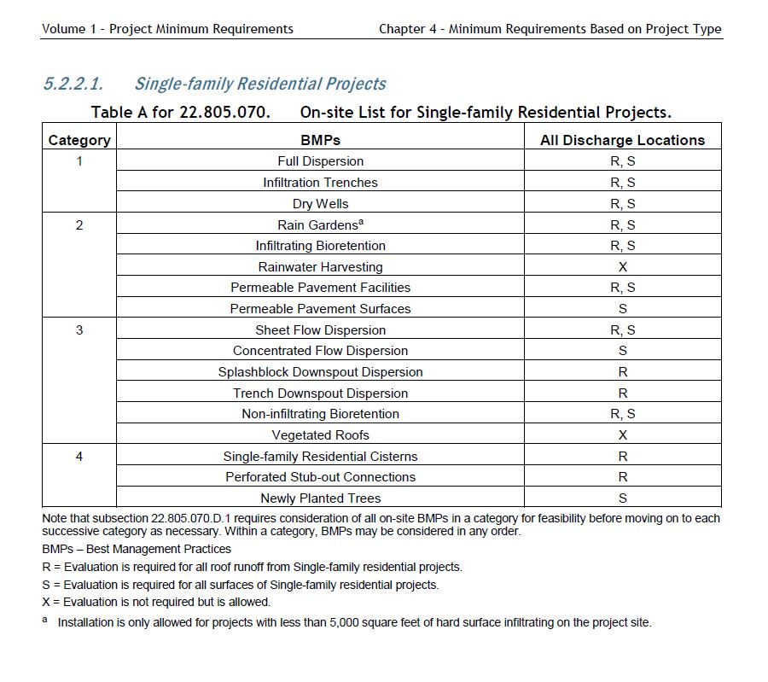

Slide 7
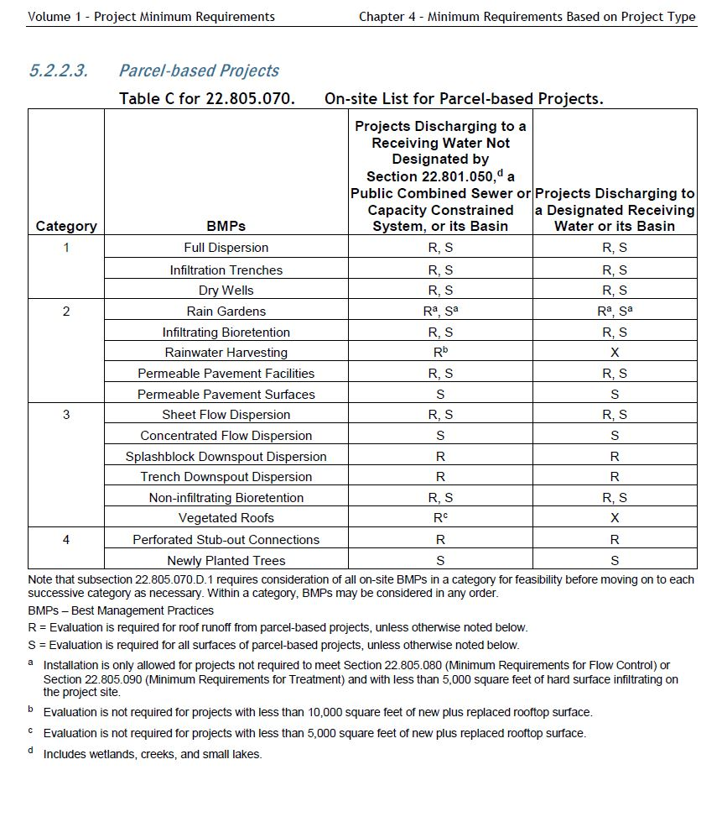

Slide 8
Onsite Stormwater
Management Calculator
http://www.seattle.gov/dpd/cs/groups/pan/@pan/documents/web_informational/p2385087.xlsm
  Updates periodically. Please use the most up-to-date version from the website.
  Use the Preliminary Assessment Report (PAR)
  Enable Content
  Combine as many surfaces as possible for clarity

Slide 9
Infiltration
The Manual
Volume 3, 3.2. Determine Infiltration Feasibility
Appendix D
http://www.seattle.gov/dpd/cs/groups/pan/@pan/documents/web_informational/p2358274.pdf
Simple Test Checklist
http://www.seattle.gov/dpd/cs/groups/pan/@pan/documents/web_informational/p2358611.pdf
Pilot Infiltration Test Checklist
http://www.seattle.gov/dpd/cs/groups/pan/@pan/documents/web_informational/p2358612.pdf

Slide 10
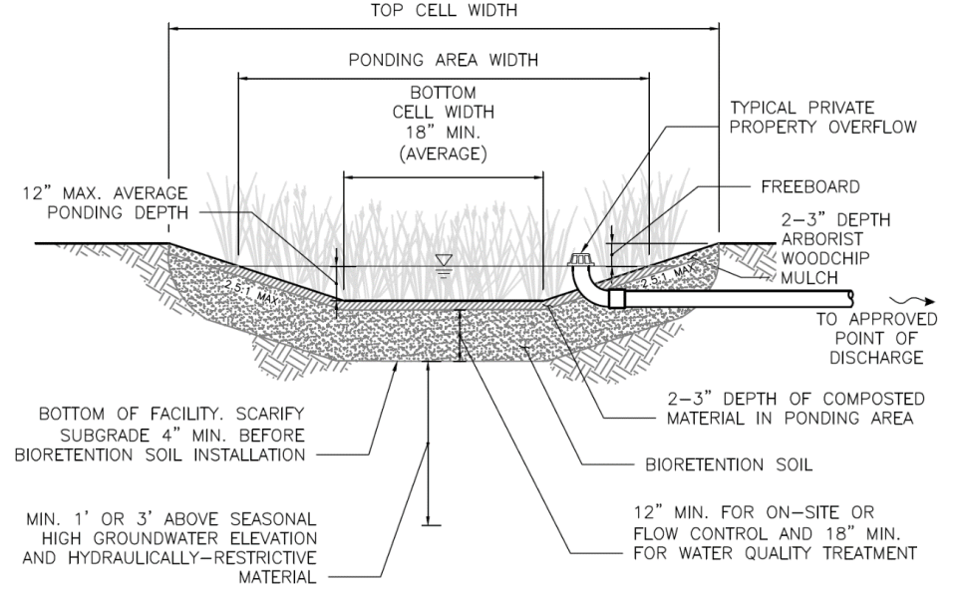
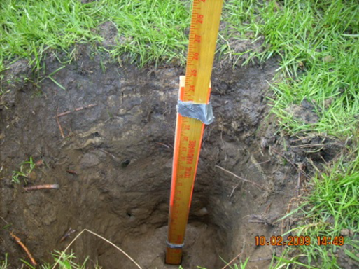
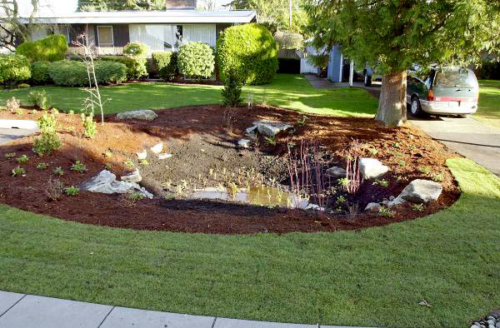
Infiltration
Design
Investigation and Testing
Construction
Notes:
Infiltration BMPs are designed to facilitate infiltration of stormwater into the ground.
Infiltration is feasible only where sufficiently porous soils are available and where other
site constraints are not limiting (e.g., steep slopes, high groundwater),

Slide 11
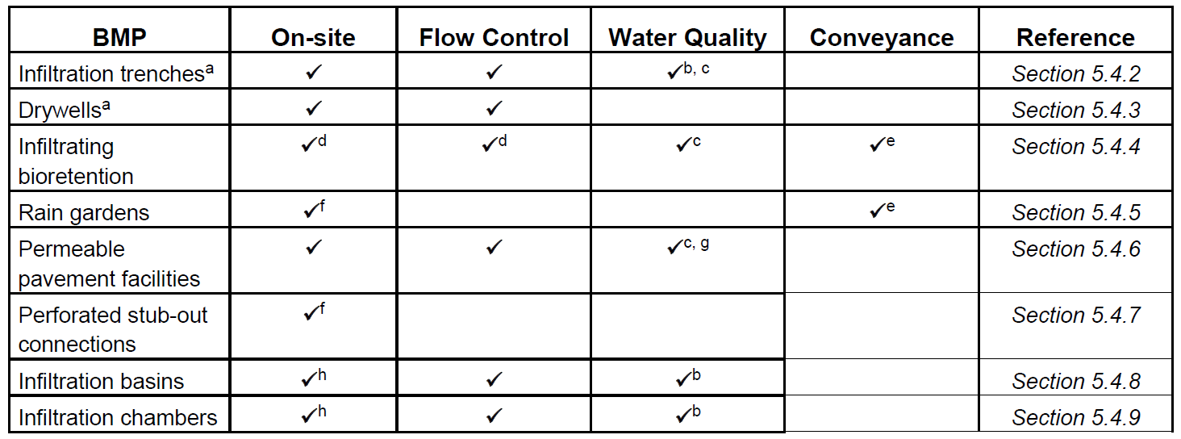
Infiltration BMPs
On-site Stormwater Management

Slide 12
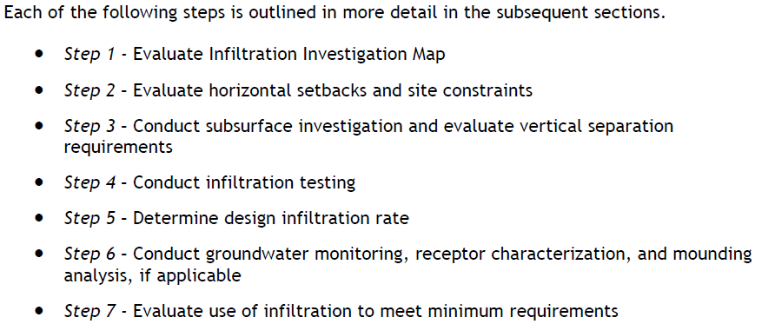
Infiltration Feasibility

Slide 13
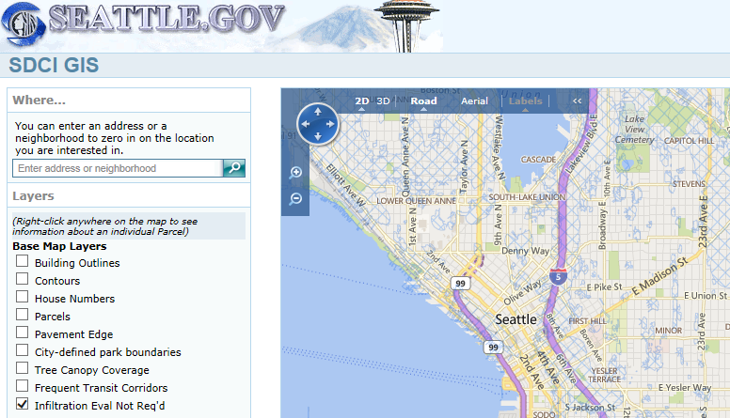
Infiltration Eval Not Req’d
http://web6.seattle.gov/DPD/Maps/dpdgis.aspx

Slide 14
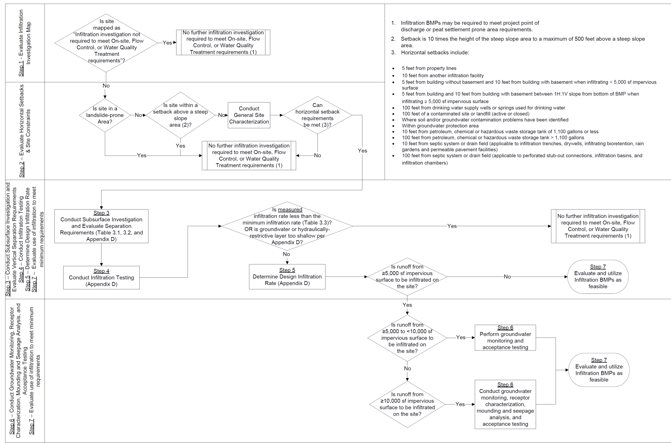

Slide 15
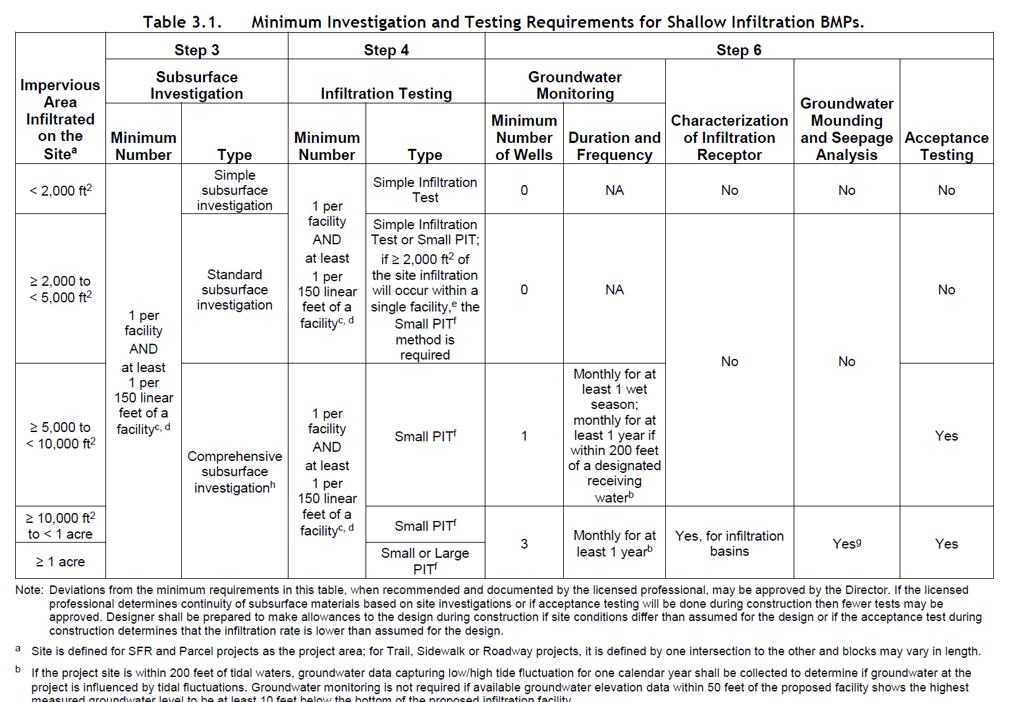

Slide 16
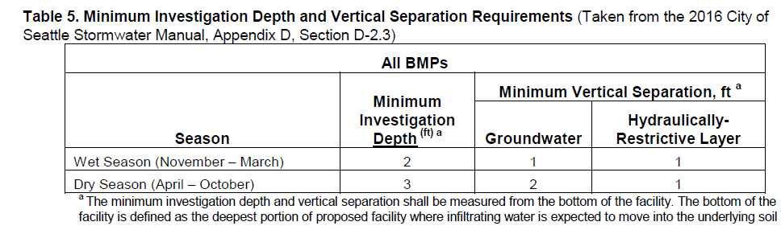
Subsurface Investigation
Simple
Map of investigation and testing locations
Soil Characteristics
Depth to Groundwater
Standard/ Comprehensive
Soil Strata Characteristics
Detailed Soil Logs
Comprehensive by licensed professional

Slide 17

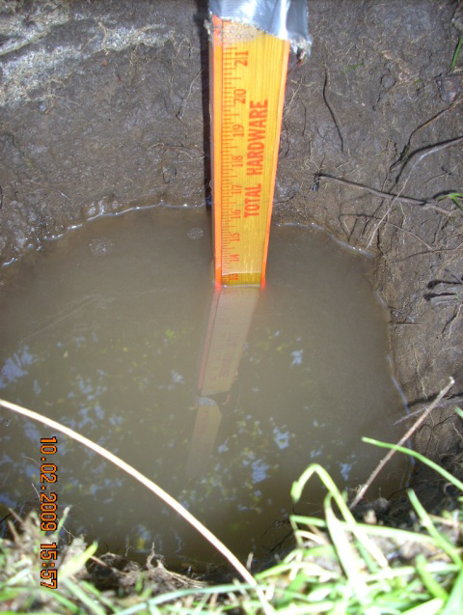
Simple Infiltration Test
Use Checklist
Dry Season vs Wet Season
Minimum 2-feet deep x 2 across-feet hole
Pre-soak
Testing
Measured Rate
Design Rate

Slide 18
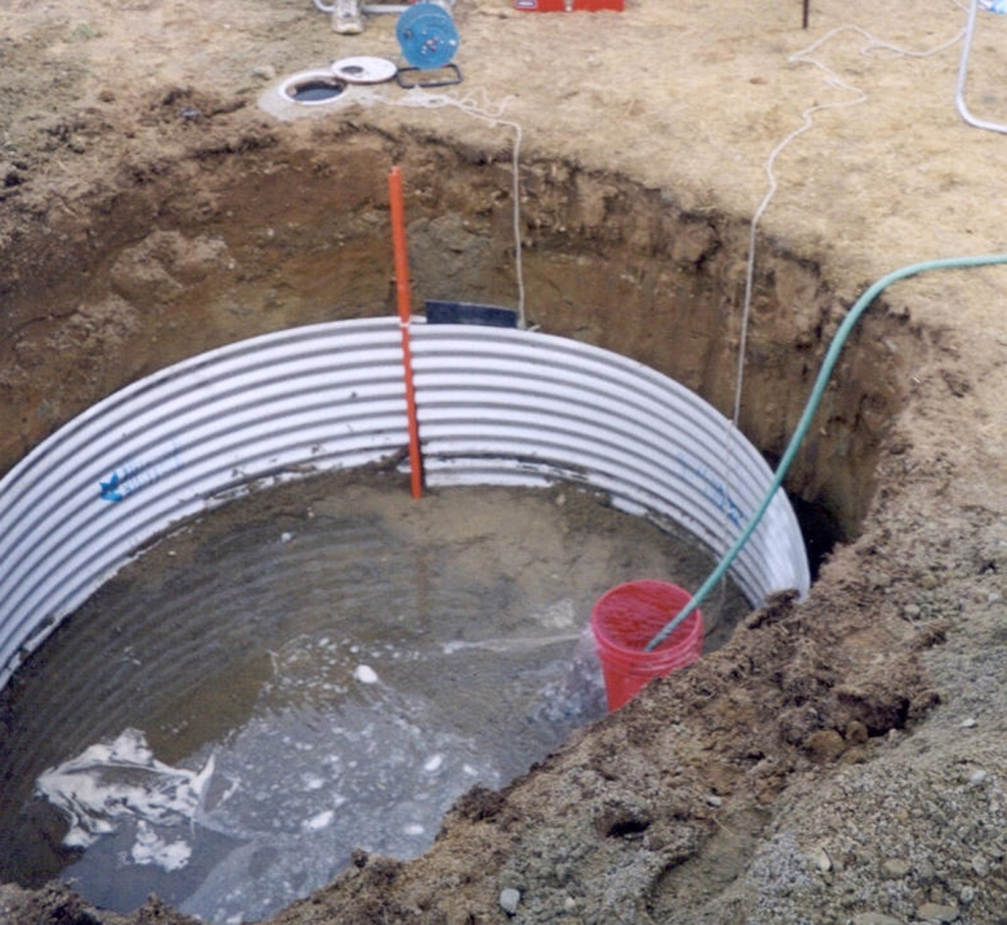
Pilot Infiltration Test (PIT)
Mimics constructed facility
Licensed Professional Required
Small vs Large PIT
Use Checklist

Slide 19
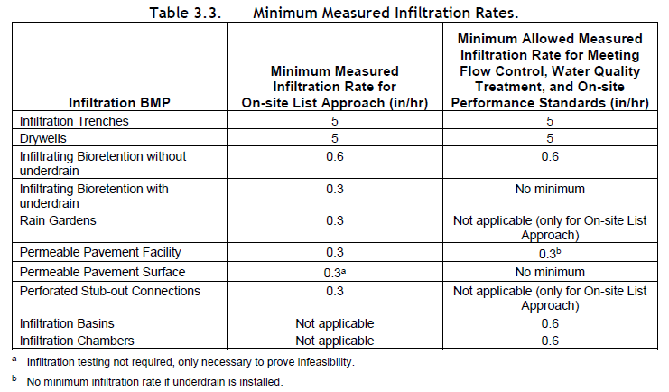

Slide 20

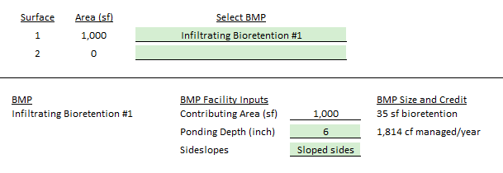
On-Site Calculator
Summary Sheet:
BMP Sizing:

Slide 21
Standard Plans
Drainage and Wastewater Control (DWC) Plan
Standard Construction Stormwater Control and Post Construction Soil Management Plan (CSC or CSC/SOIL Plan)

Slide 22
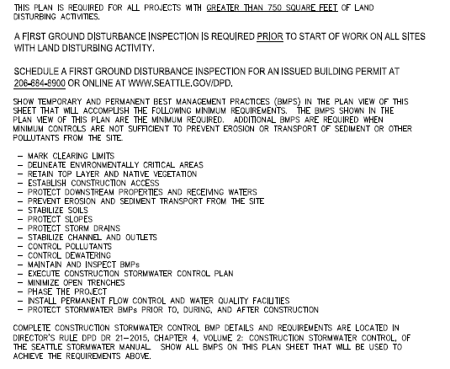

Slide 23
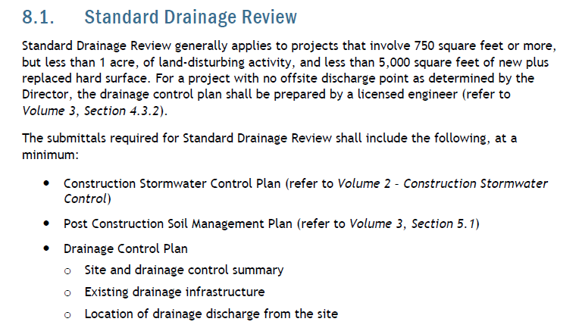
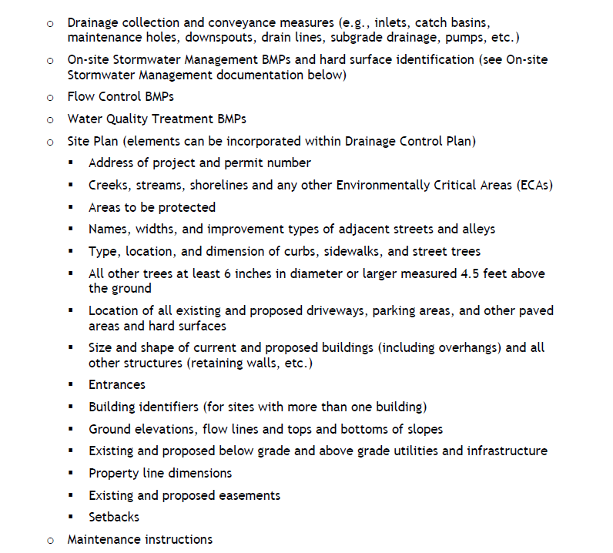

Slide 24
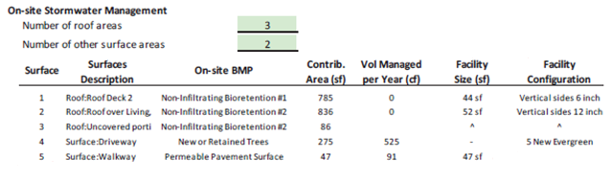
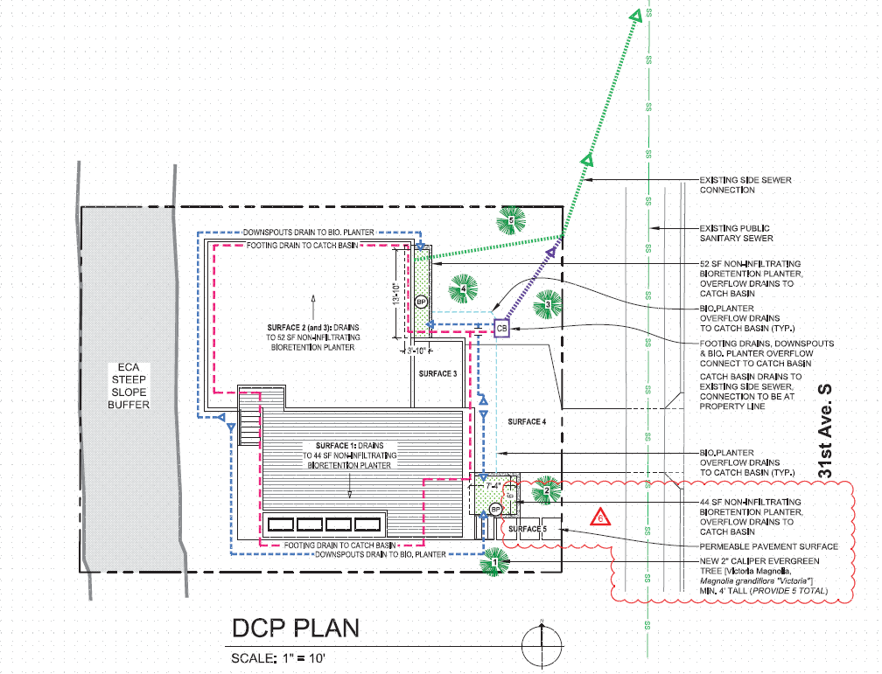

Slide 26
Example Key Plan

Slide 28
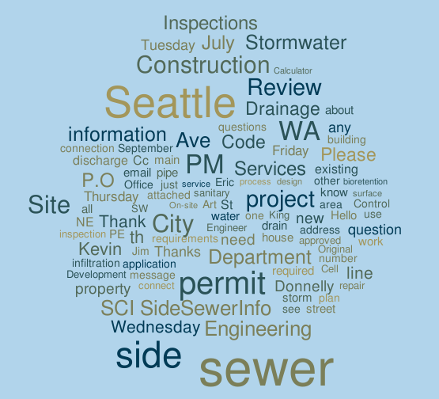
Questions
SideSewerInfo@seattle.gov
206-684-5362

