Slide 1

Secure Scheduling
Last updated 5/13/2017
City of Seattle
Office of Labor Standards
effective July 1, 2017

Slide 2
OLS Mission
Our mission is to advance labor standards through thoughtful community and business engagement, strategic enforcement and innovative policy development, with a commitment to race and social justice.

Slide 3
OLS HISTORY
2012 | PSST - Paid Sick and Safe Time Ordinance
2013 | FCE - Fair Chance Employment Ordinance
2014 | Mayor convened Income Inequality Advisory Committee to craft minimum wage policies
 | Mayor and City Council convened Labor Standards Advisory Group to address wage theft and suggest ways to strengthen labor standards implementation
 | City Council passed legislation creating Office of Labor Standards as a new division within the Seattle Office for Civil Rights
April 1, 2015 | OLS birthday MW & WT - Minimum Wage and Wage Theft Ordinances
2016 | Wage Theft Prevention and Labor Standards Harmonization Ordinance
 | HEHS - Hotel Employees Health and Safety Initiative
2017 | OLS becomes an independent office SS - Secure Scheduling Ordinance

Slide 4
OLS STAFF
May 2017 - 17 Core Staff
  Dylan Orr, Director
  Senior Policy Advisor
  Communications Manager
  Finance Operations Manager
  2 Business Liaisons
  Community Liaison
  Enforcement Supervisor
  6 Investigators
  Intake investigator
  Paralegal
  Administrative Assistant
Spring 2017
  OLS will move into a new office on the third floor, 810 3rd Avenue
  OLS will hire 5 additional staff by the end of 2017
  Policy & data analyst, three investigators, admin assistant

Slide 5


OLS STAFF

Slide 6



BUSINESS QUESTIONS
Darius Foster, Business Liaison
206-386-1238
Darius.foster@seattle.gov
Kerem Levitas, Business Liaison
206-386-9758
Kerem.levitas@seattle.gov
Karina Bull, Senior Policy Advisor
206-684-4536
Karina.bull@seattle.gov

Slide 7
OLS
Monthly dashboards

Slide 8
OLS Monthly dashboards
Information compiled from 2012 to present
Monthly compilations from June 2015 to present
http://www.seattle.gov/laborstandards/data

Slide 9
March 2017 - Dashboard
Employer Inquiries / total
Employee Inquiries / total

Slide 10
March 2017 - Dashboard
Employer Inquiries / March
Employee Inquiries / March

Slide 11
March 2017 - Dashboard
Investigations opened Total
Investigations closed Total

Slide 12
March 2017 - Dashboard
Investigations open
March
Monetary remedies assessed (wages, interest, and damages)
PSST | $180,992.53
FCE | $23,000
WT | $24,252.32
MW | $781,667.02
Total | $1,009,911.87
Total Number of Employees Awarded Monetary Remedies | 1,241

Slide 13
Secure scheduling
effective July 1, 2017

Slide 14
Predictable schedules that work.
New secure scheduling practices for
Race & social justice
Employee health, safety and welfare
Greater economic security
Increased employee input into scheduling; and
Reduced involuntary part-time work.

Slide 15

HOURLY EMPLOYEES

Slide 16


Large food services & Retail
Large food service & retail employers
Retail = 2012 NAICS code 441-453998
Food Service = 2012 NAICS code 722
500+ employees worldwide
Full Service Restaurants = additional requirement for 40+ full-service restaurant locations worldwide
NAICS Code = North American Industry Classification System
Employers must list the NAICS code when registering for a City of Seattle business license.

Slide 17
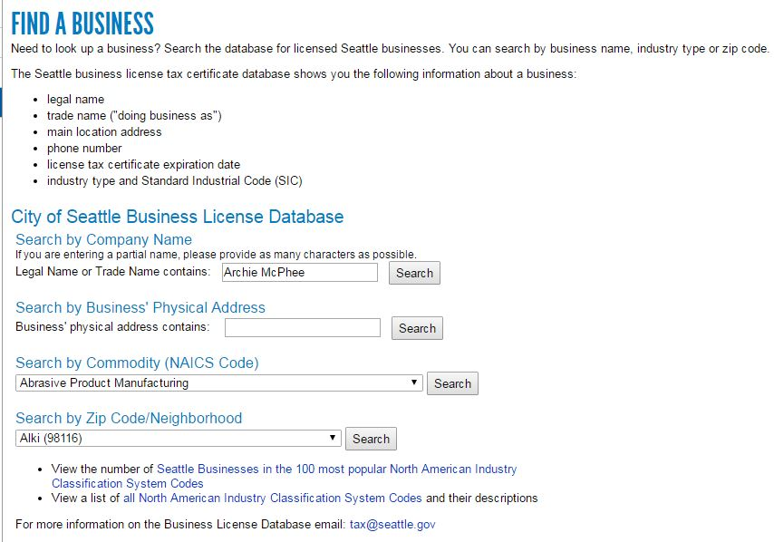
NAICS Code
http://www.seattle.gov/licenses/find-a-business

Slide 18
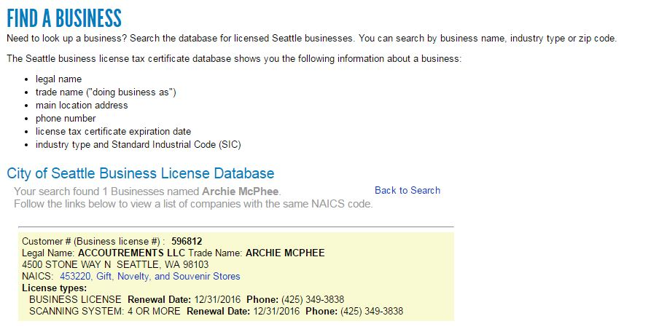
NAICS CODE

Slide 19
Scheduling requirements
Good faith estimate of work schedule
Right to request input into work schedule
Right to rest between work shifts
Advance notice of schedule
Compensation for schedule changes
Access to hours for existing employees

Slide 20
Good faith estimate
  Employer provides written estimate of median number of hours and on-call shifts.

Slide 21
Good faith estimate
  Employer provides written information - Median number of hours and whether employee will work on-call shifts over the course of one year (divided into three-month periods)
      New employees = at time of hire.
      Existing employees = revise once every year (calculated from the point of the last good faith estimate) and when there is a significant change.
      Translations required = must be provided in English and primary language of the employee.

Slide 22
Good faith estimate
  Employee can notify employer of a significant change.
      Significant change = difference of at least 30% between the GFE and median number of scheduled hours in written work schedules, over the one or more three-month periods.
  Upon notification of a significant change, employer must initiate an “interactive process” with employee.
  Employer must complete interactive process within three weeks.

Slide 23
Example – Good Faith estimate
Hire date: January 1, 2017
Median number of hours over the course of the year
On-call shifts
Year begins | January 2017
Quarter One (January – March) | 20 hours
Quarter Two (April – June) | 20 hours
Quarter Three (July – September) | 20 hours
Quarter Four (October – December) | 35 hours
Yes | ✓
No

Slide 24
EXAMPLES – 30% SIGNIFICANT CHANGE
Estimate Median Hours | Significant Change: Adding Hours | Significant Change: Subtracting Hours
40 | 52 | 28
30 | 39 | 21
20 | 26 | 14
10 | 13 | 7

Slide 25
Right to request
  Employee can request schedule preferences prior to posted
  work schedule.

Slide 26
Right to request
  Employee can request work schedule preferences & changes
      Requests for specific times and locations of work.
  Employer must engage in “interactive process”
      Must initiate discussion within one week of the request; complete the discussion within three weeks.
  Employer can ask for “verifying information”
      Must inform employee of ability to redact private information.
      Written statement from employee or documentation from third party (e.g. health care professional, school, landlord).
  Employer has increased obligations for requests due to “major life events”
      Must grant request unless the employer has a bona fide business reason for denying such request.
      Must provide a written response when granting or denying the request.

Slide 27
major life event
Employer has increased obligations for employee-requests for schedule changes due to a “major life event.”

Slide 28
major life event
Important, serious or significant event related to the employee's access to the workplace due to
    Changes in employee's transportation.
    Changes in employee’s housing.
    Employee's own serious health condition.
    Employee's responsibilities as a caregiver.
    Employee's enrollment in a career-related educational or training program.
    Employee's other job or jobs.

Slide 29
Bona fide business reason
Employer can identify a
“bona fide business reason”
to decline an employee’s request for
work schedule preferences related
to a major life event.

Slide 30
Bona fide business reason
    Significant & identifiable burden of additional costs.
    ✶ Significant & identifiable detrimental effect on ability to meet organizational demands
    A work schedule change that requires an employer to pay additional compensation under a law or written policy (e.g. holiday pay).
    An action causing employer to violate a bona fide collective bargaining agreement or a seniority system in a written policy;
    An action causing the employer to displace one or more employee(s) from an existing work schedule arrangement.

Slide 31
Right to rest
  Employer pays additional compensation for “clopenings” separated by less than 10 hours

Slide 32
Right to rest
  “Clopening” - Employee works closing and opening work shifts.
  Employee request or consent - Employer only schedules “clopenings” separated by less than 10 hours upon employee request or consent.
  Additional pay (i.e. “premium pay”) - Employer pays 1.5x the scheduled rate of pay for hours worked that are less than ten hours apart.
  Exception - Additional compensation does not apply to “split shifts”

Slide 33
Advance notice of work schedule
  Employer provides work schedule 14 days in advance.

Slide 34
EXCEPTIONS
Advance notice of schedule
  Exceptions for “new and returning employees”
      Employees with a work schedule change.
      New employees at time of hire.
      Transfers, promotions, and new job classifications.
      Employees who are jointly employed (e.g. employees provided by a staffing agency, contractor, subcontractor, or other employer); and
      Returning employees from a leave of absence.

Slide 35
pay for schedule changes
  Employer provides additional pay for employer-requested schedule changes
  (with some exceptions).

Slide 36
PAY for schedule changes
  Compensation (“premium pay”)
      Adding hours = Employer pays one additional hour of pay at the scheduled rate plus wages earned. Employer may pro-rate payment for changes that are less than one hour.
      Subtracting hours (including on-call shifts) = Employer pays for half the hours not worked plus wages earned.
  Grace period = 15 minutes

Slide 37
Exceptions
PAY for schedule changes
  Employer DOES NOT provide additional pay for certain schedule changes.

Slide 38
Exceptions
PAY for schedule changes
    Employee-requested changes
    Shift swaps - Manager can grant or deny employee requests for shift swaps.
    Mass communication - Employee accepts a schedule change in response to an employer-initiated, “mass communication” about availability of additional hours due to a scheduled employee not being able to work.
    In-person group communication - Employee accepts a schedule change in response to an employer-initiated, “in-person group communication” with two or more currently working employees about additional hours due to unanticipated customer needs.

Slide 39
Exceptions
PAY for schedule changes
    Access to hours - Employee accepts an offer of hours under the “access to hours” provision.
    Discipline – Employer reduces employee hours due to bona fide discipline.
    Operations cannot begin or continue – Employer cannot begin or continue operations due to (a) threats to employees or property; (b) recommendation of public official; (c) public utilities failure; (d) natural disaster; (e) weather event; and (f) an event that would cause the employer to violate a law.

Slide 40
Exceptions
PAY for schedule changes
“Mass communication”
Employer-initiated, written message sent to two or more employees about availability of additional hours due to a scheduled employee not being able to work.
Required information - Each mass communication must convey
    The message is a mass communication;
    Accepting the offer of additional hours is voluntary and the employee has the right to decline such hours; and
    Accepting such hours does not require the employer to pay additional compensation for work schedule changes.
Scope - Employer may choose to limit mass communications to (a) qualified employees, and (b) employees who would not incur premium pay (e.g. overtime).

Slide 41
Exceptions
Compensation for schedule changes
“In-person group communication”
Employer-initiated, discussion with two or more employees about availability of additional hours due to unanticipated customer needs. Hours must be consecutive to current shift.
Required information - Each in-person group communication must convey
    Accepting the offer of additional hours is voluntary and the employee has the right to decline such hours; and
    Accepting such hours does not require the employer to pay additional compensation for work schedule changes.
Scope - Employer can initiate the in-person group communication with currently working, qualified employees who are not already scheduled to work the additional hours.

Slide 42
Access to hours
  Before hiring new employees (including temps),
  employers must offer hours to current employees.

Slide 43
Access to hours
  Three + Two Days
  Notice of Hours
    Three days - Employer posts written information about additional hours in noticeable place at worksite for all employees on the payroll
  Job Offer
    Two Days - Employer offers job to qualified, existing employee(s) and allows two days to consider offer.

Slide 44
Access to hours
  NOTICE OF HOURS
  Employer posts written notice for three days in conspicuous place at worksite
    Notice includes position description and title; required qualifications; total hours of work; schedule; and duration of assignment (temp or on-going).
    Notice may provide specific or general information (e.g. “hours and schedule dependent upon the employee’s availability”).
  Employer provides notice to all employees on the payroll
      Employer is not required to provide notice to employees on a leave of absence, planned vacation, or planned use of PSST for the entire three-day period of notice.

Slide 45
Access to hours
  JOB OFFER
  Employer offers job to qualified, existing employee(s) and allows two days to consider offer.
      Employer CANNOT not require one employee to accept all hours
      Employer CAN limit distribution of hours to full work shifts rather than parceling hours among employees.

Slide 46
Access to hours
  JOB OFFER
Employee may not qualify for the additional hours under the following circumstances
    Overtime = Overtime or predictability pay would be required if the employee received the additional hours.
    Discipline = Employee is not currently in good standing due to a bona fide employer documented discipline or improvement plan.
    Pre-emption = Employee is barred by other laws from conducting the work required in the available hours.
    Unqualified = Employee, to a reasonable employer acting in good faith is not qualified with the skills and experience to perform the work.

Slide 47
Exceptions - access to hours
  Employer can immediately hire new employees in certain situations.

Slide 48
Exceptions - access to hours
    Written declination from all current employees
    Written declination from employees on “access to hours list(s)”
            Access to hours list = Written list of employees who receive notice of additional hours available for work. All employees are automatically on the list & can ask to be added or removed at time of hire or during employment. Employer must make list available for viewing to employees upon request.
Hiring programs = Hours of work that the employer has designated for hiring programs (e.g. diversity, supported employment, young adult programs) affiliated with a government entity or external non-profit organization that has been approved subject to the rules of the Director.

Slide 49
OTHER requirements
Record keeping
Notice and posting
Protections against Retaliation
Waiver
Employees who are jointly employed

Slide 50
Record keeping
  Employers must keep records
  for three years.

Slide 51
Record keeping – 3 years
Good faith estimates
Right to request – Employer’s grant or denial of employee’s request for schedule preferences, prior to posted schedule, related to major life event.
Advance notice of work schedules
Compensation for work schedule changes - Payroll records showing additional compensation paid to each employee.
Exceptions to compensation for work schedule changes
    Mass communications.
    Documentation of employee-requested changes.
    Documentation of employee discipline.
Access to hours - Notices for additional hours of work.
Exceptions to access to hours
    Written confirmation from employees – Confirmation from all employees, or employees on the access to hours list, that they are not interested in accepting additional hours of work.
    Access to hours list(s) - Records of employees who have opted out of receiving written notice of additional hours of work.

Slide 52
Notice & posting
  Employer must display workplace poster and translate certain documents.

Slide 53

WORKPLACE POSTER
Display SS workplace poster (coming soon)
English and employee’s primary language(s)
Download from OLS website https://www.seattle.gov/laborstandards/outreach
Pick-up from OLS & Seattle Customer Service Centers

Slide 54
Notice & Posting
  Translations
  Employers translate the following documents
      Good faith estimate.
      Advance notice of work schedule.
      Notice for access to hours.
      Workplace poster.
  OLS creates poster and provides templates for translations

Slide 55
retaliation
  Employers are not allowed to interfere with employee rights, but can discipline employees in certain situations.

Slide 56
retaliation
  Protections from retaliation
    Employers may not interfere with any employee right protected by the ordinance.
    Employees have the right to decline any hours not on the posted schedule.
Discipline permitted for certain situations
    Abuse of employer’s requirements for employee-requested work schedule changes and/or preferences PRIOR to posted work schedule; and
    Failure to comply with, or abuse of, employer’s requirements for employee-requested work schedule changes AFTER the posted work schedule.

Slide 57
waiver
Employers can waive scheduling requirements in a collective bargaining agreement.

Slide 58
waiver
Waiver requirements
Express waiver – Secure Scheduling requirements must be expressly waived in a collective bargaining agreement; and
Ratification of alternative scheduling structure - Employees must ratify an alternative scheduling structure that meets public policy goals of the ordinance.

Slide 59
Employees who are jointly employed
Special requirements for employees who are jointly employed:
Temporary services provider
Staffing agency
Contractor
Subcontractor; and
Other employer(s).

Slide 60
Employees who are jointly employed
Joint liability - Joint employers are individually and jointly responsible for compliance.
Good faith estimate - Employers provide a good faith estimate when such employee starts each distinct assignment.
Advance notice of work schedule - Employers may immediately place such employees on posted work schedules without providing 14 days of advance notice.
Pay for work schedule changes - Employers provide additional pay for each work schedule change after such employee has started a distinct assignment.
Access to hours - Employers are not required to provide notice of additional hours of work to such employees if they are not on the employer’s payroll.

Slide 61
enforcement

Slide 62
Soft launch
Six months – July 1, 2017 to December 31, 2017
OLS determines remedy owed to employees.
OLS supports employer compliance.
OLS does not impose civil penalties/fines - except for egregious violations (i.e. retaliation).

Slide 63
private right of action
Remedy
    Up to 3x unpaid wages
    Up to $5,000 to aggrieved party for retaliation
    Attorney Fees and Costs
Notes:
Directed Investigation
Agency-initiated investigation without employee complaint
Criteria
Sectors with large numbers of vulnerable workers
Sectors where workers would be reluctant to step forward
Sectors where proactive action would be likely to change employers’ behavior on a large and long-lasting scale.
Research by Dr. David Weil (federal wage & hour) = directed investigations yield 10% fewer violations, but significantly higher back wages (about $13,000 more back wages per investigation).

Slide 64
investigation
Protection of Identifying Information
Company-wide Investigation (standard)
Individual Investigation (retaliation)
Complaint-based
Directed
Notes:
Directed Investigation
Agency-initiated investigation without employee complaint
Criteria
Sectors with large numbers of vulnerable workers
Sectors where workers would be reluctant to step forward
Sectors where proactive action would be likely to change employers’ behavior on a large and long-lasting scale.
Research by Dr. David Weil (federal wage & hour) = directed investigations yield 10% fewer violations, but significantly higher back wages (about $13,000 more back wages per investigation).

Slide 65
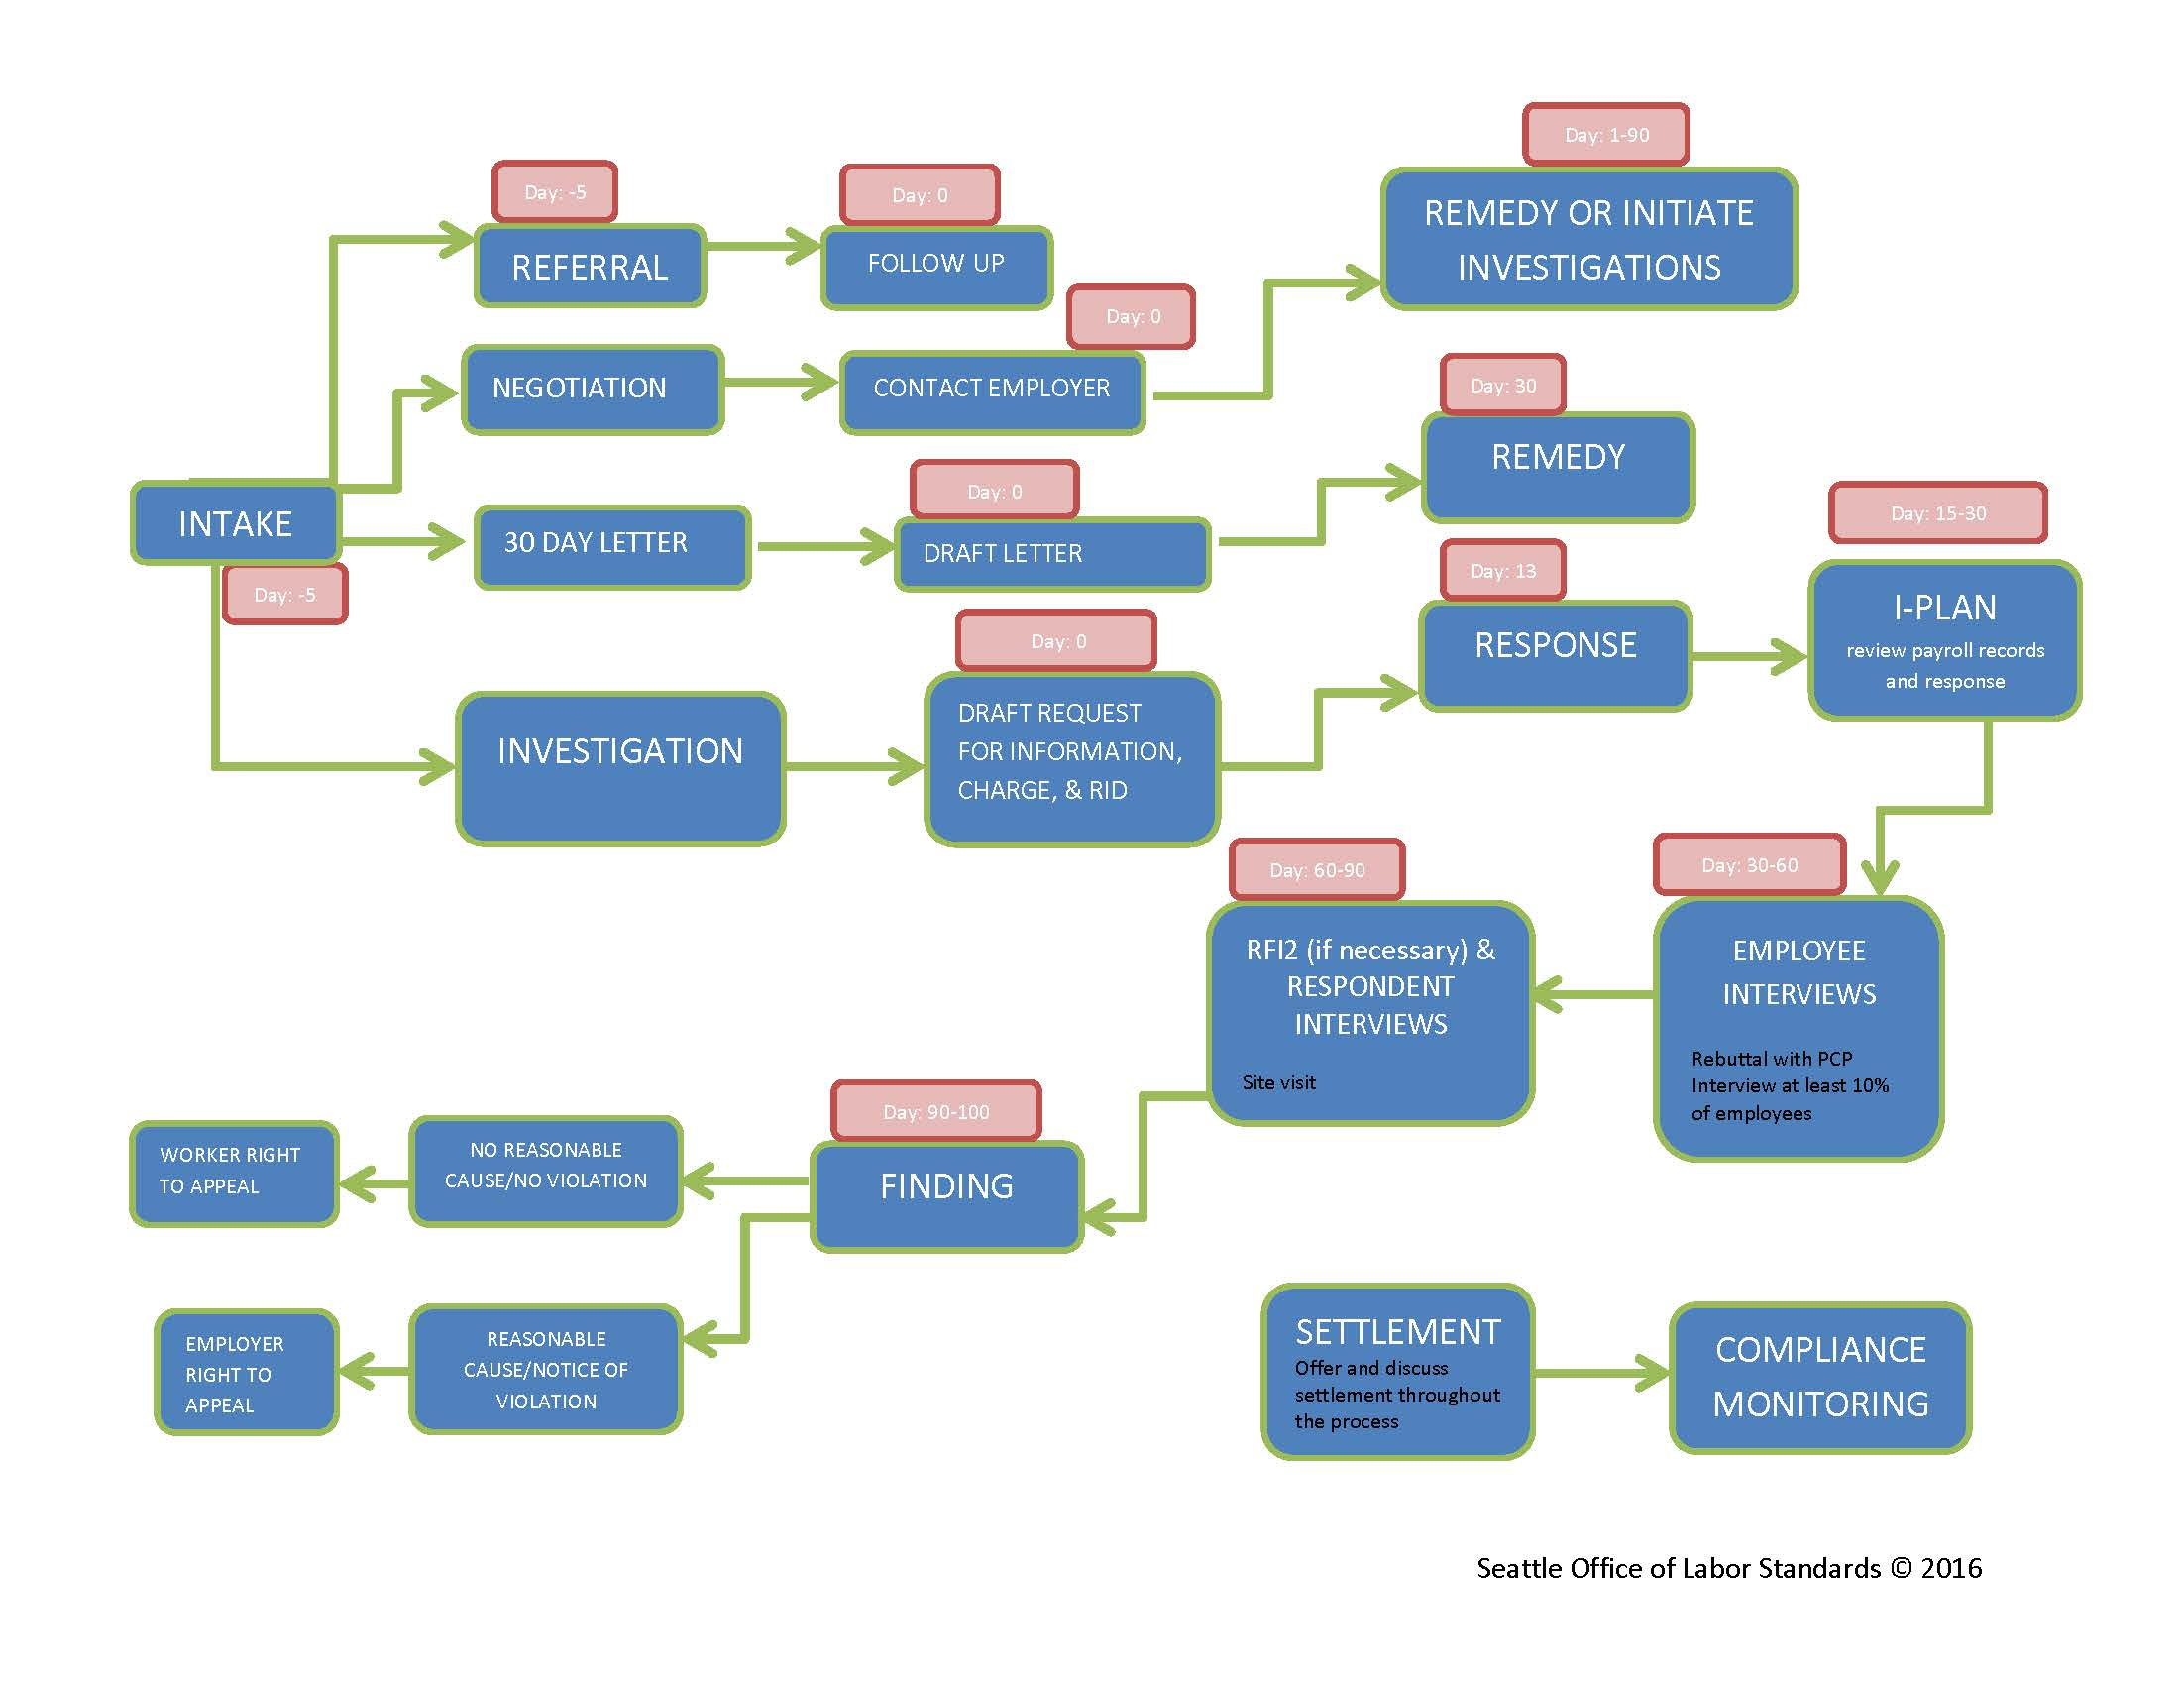

Slide 66
Violation(s) | Remedy or Penalty
First Violation | Up to 3x unpaid wages + interest
Subsequent Violations | Mandatory 3x unpaid wages + interest
First Violation | Up to $500 per aggrieved party
Second Violation | Up to $1000 per aggrieved party or 10% of unpaid wages, whichever is greater
Third Violation | Up to $5,000 per aggrieved party or 10% of unpaid wages, whichever is greater
Subsequent Violation | Up to $20,000 per aggrieved party
Chart of Fines | $500 to $1,000 fine
Retaliation | Reinstatement or up to 3x front pay; up to $5,000 to aggrieved party
Settlement & Mitigation of Penalties | Director Discretion
Notes:
(Willful) Interference - It is unlawful for any employer to willfully resist, prevent, impede or interfere with the Director in the performance of his or her duties under this Chapter. Conduct made unlawful by this section constitutes a violation and any employer who commits such a violation may be punished by a civil penalty of not less than $1,000 and not more than $5,000.

Slide 67
CHECKLIST & scenarios

Slide 68
Checklist
Good Faith Estimate - Employers provide median number hours and whether employee will work on-call shifts. Employer provide such info at time of hire, annually, and when there is a significant change.
Right to request input into work schedule - Prior to the posted work schedule, employees can identify work schedule preferences. Employers must engage in interactive process with employee & grant requests related to major life event unless there is a bona fide business reason for denying the request.
Right to rest between work shift - Employees earn 1.5x scheduled rate of pay for hours worked that are less than 10 hours between a closing and opening work shift.
Advance notice of work schedules - Employers provide 14 days advance notice of schedules. Exceptions for new and returning employees.
Notice of work schedule changes- After the posted work schedule, employee can decline an employer-requested change; and employer can grant or deny employee-requested change, unless another law requires granting the request.

Slide 69
Checklist
Pay for work schedule changes
    Additions = Additional hour of pay at scheduled rate.
    Subtractions = Half the length of work shift that was cancelled or the remaining hours of a work shift that was shortened.
    Exceptions for employee-requested changes, mass communications, etc.
Access to hours for existing employees
    Hiring protocol = Before hiring new employees (including temps), employers must offer addt’l hours of work to existing employees. Employers must post notice of addt’l hours for three days and allow existing employees two days to consider job offers.
    Exceptions for receipt of written declination from employees, use of access to hours list, and diversity hire programs.
Record keeping - Three years.
Notice and posting – Workplace poster and certain translations.
Waiver - Collective bargaining agreement can waive requirements. Employees must ratify an alternative scheduling structure that meets policy goals.

Slide 70
ScenarioS - bona fide business reasons
  Which of the following situations could be bona fide business reasons?
      Employee asks to not work on Friday and Saturday nights, but those shifts are the busiest nights of the week; it’s all hands on deck.
      Employee asks to work only morning and early afternoon shifts but those shifts are already covered by Fred and Angela who have seniority under the collective bargaining agreement.
      Employee asks not to work on August 5, but the employer can’t provide a firm answer for a date so far in the future.
      Employee asks not to work on Thursday morning, but the schedule is already posted; the employer will have to find a replacement employee and possibly pay premium pay for a schedule change.
      Employee asks to be scheduled for morning shifts, but the employer thinks that it will cost too much to add another employee to the morning schedule.
      Employee asks to start working on Friday evenings, but the manager does not think that the employee is qualified to work on a busy night.
      Employee asks to not work on a scheduled shift on June 21, but the manager can’t think of anyone who could work that shift.

Slide 71
Scenarios - major life events
  Which of the following situations are related to major life events?
      Employee asks to not work on Friday and Saturday nights because she regularly works at an upscale restaurant on those days.
      Employee asks to work only morning and early afternoon shifts because that is when his children are in school.
      Employee asks not to work on August 5 because she is celebrating her 15th annual family reunion.
      Employee asks not to work on Thursday morning because she needs to take her partner to a doctor appointment on that day.
      Employee asks to be scheduled for morning shifts for the next month because his car broke down; he’ll need to start taking the bus and it is most reliable in the mornings.
      Employee asks to not work on a particular, Sunday evening next month because there is a special concert happening that night.
      Employee asks to not work on a scheduled shift on June 21 because he has a last minute, parent/teacher conference.

Slide 72
Scenario - Right to request
  Example – Josie asks her manager if she can only work on Tuesdays and Thursdays for a college class. A week later, the manager says that she will think about it and asks for verifying information. Josie provides a handwritten note that she is taking classes at Central College on Mondays and Wednesdays. She also states that she wants to study on Fridays. The manager is perplexed: Tuesdays don’t appear available because Devin has been working those days, by request, for 4 years. Thursdays might be available, but it would be a fair amount of work to make modify the schedules. Friday is the busiest day of the week and the manager really needs Josie to work that day. The manager is tries hard to find a solution and schedules a meeting Josie 4 weeks after her request.
  Is there a major life event? What is it?
  Is the manager required to grant part or all of Josie’s request?
  Is there a bona fide business reason for denying part of all of Josie’s request?
  Is the manager’s response timely?

Slide 73
Scenarios - compensation for work schedule changes
  Which of the following situations requires additional pay for work schedule changes after the schedule is posted?
  Employee calls out sick. Manager calls all employees on the roster to find replacement coverage. Maria picks-up the shift.
  Business is slow. Manager asks currently-working employees if anyone wants to go home early, Jose accepts the offer and leaves 90 minutes early.
  Business is booming. Manager sends a mass text to all employees with notice of additional hours. Erica accepts two shifts.
  Business is uncertain. Manager adds an “open shift” on the posted schedule and asks employees to sign-up if they are interested.
  Weather is wretched and gloomy. Manager of an outdoor café sends all employees home, but stays herself to staff the business solo.
  A tree fell on the store during the windstorm. The store is closed for a week and all shifts are cancelled.

Slide 74
206-684-4500
seattle.gov/laborstandards laborstandards@seattle.gov

