Slide 1
Secure Scheduling Ordinance Office of Labor Standards

Slide 2
Thank you for joining our
Secure Scheduling Webinar.
Before we begin, please mute
your microphone!

Slide 3
Seattle Labor Standards
Minimum Wage
Wage Theft
Paid Sick and Safe Time
Fair Chance Employment
Secure Scheduling
Hotel Employees Health and Safety Initiative
Domestic Workers Ordinance
Commuter Benefits Ordinance

Slide 4
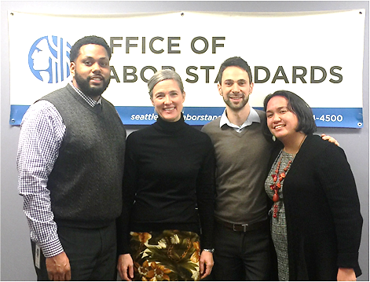
Ask us!
206-256-5297
Employers
Business.laborstandards@seattle.gov
Workers
Workers.laborstandards@seattle.gov

Slide 5
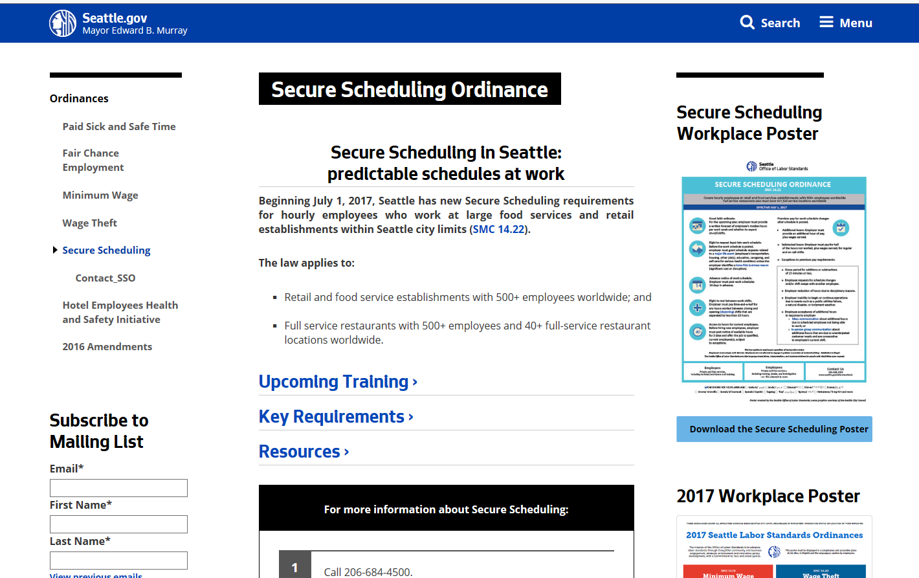
ON-LINE RESOURCES
http://www.seattle.gov/laborstandards/ordinances/secure-scheduling

Slide 6
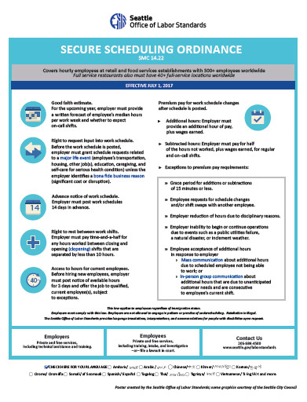
ON-LINE RESOURCES
http://www.seattle.gov/laborstandards/ordinances/secure-scheduling
Links to Ordinance
Links to Administrative Rules
Power point presentations
Templates
Workplace Poster
Translations
Questions & Answers

Slide 7
HOURLY EMPLOYEES

Slide 8
Large Food Services & Retail
Type of Business
Retail = 2012 or 2017 NAICS code 441 through 453998
Food Service = 2012 or 2017 NAICS code 722
Size of Business
500+ employees worldwide
Full Service Restaurants = 40+ restaurant locations

Slide 9
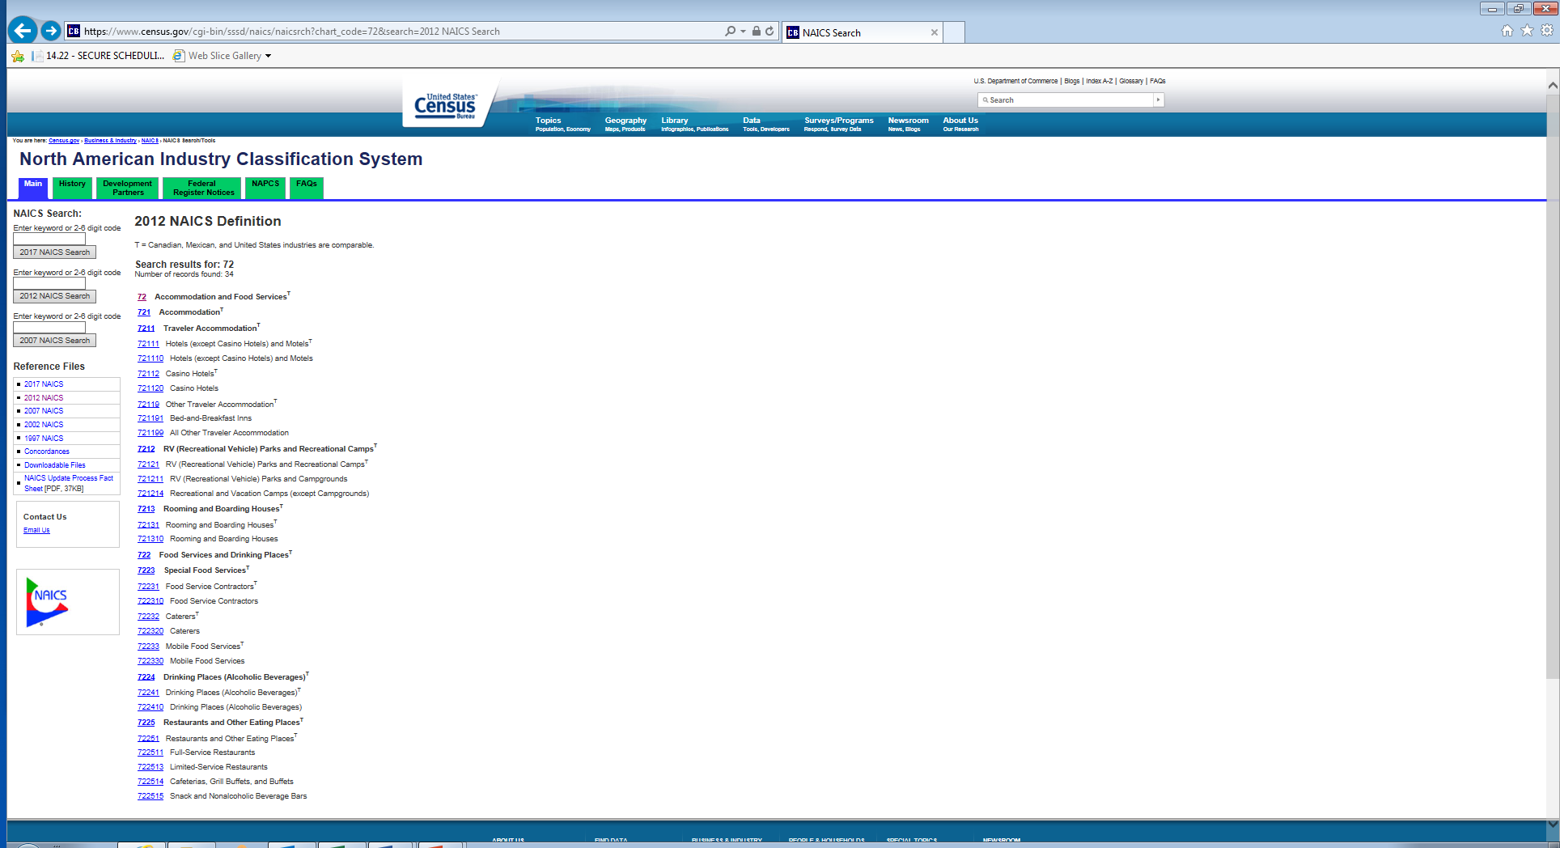
NAICS Code
https://www.census.gov/eos/www/naics/
North American Industry Classification System

Slide 10
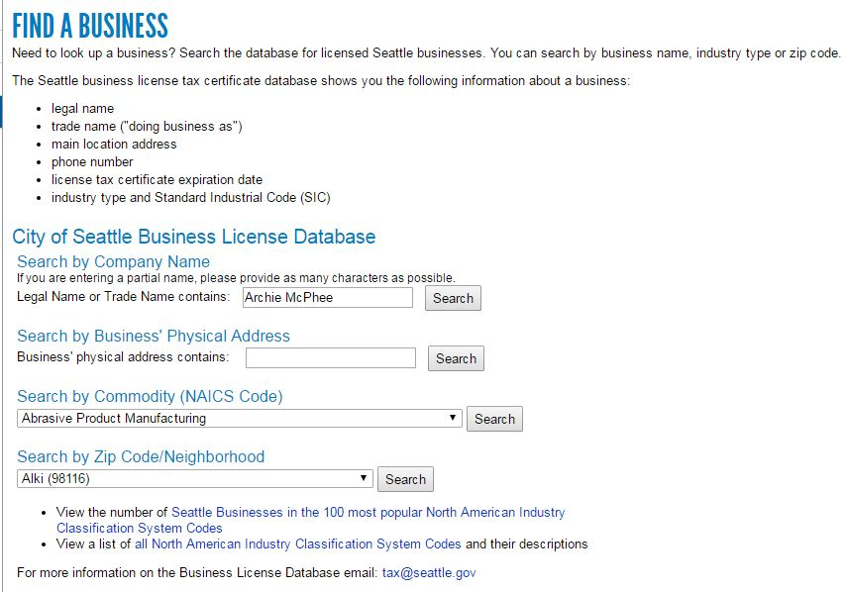
NAICS Code--Seattle Business license
https://www.seattle.gov/licenses/find-a-business

Slide 11
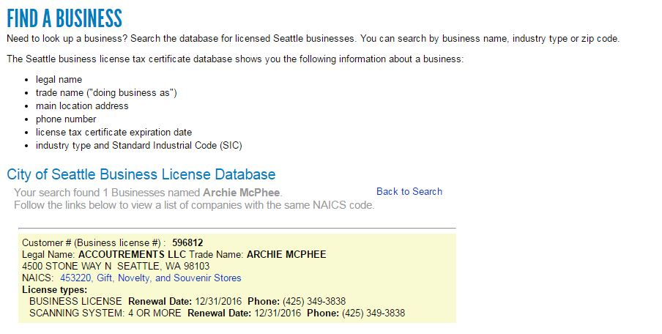
NAICS Code--Seattle Business license
https://www.seattle.gov/licenses/find-a-business

Slide 12
Scheduling Requirements
Advance notice of schedule
Pay for schedule changes
Good faith estimate of work schedule
Right to request input into work schedule
Right to rest between work shifts
Access to hours for current employees

Slide 13
Advance notice of work schedule
Employer provides work schedule
14 days in advance.

Slide 14
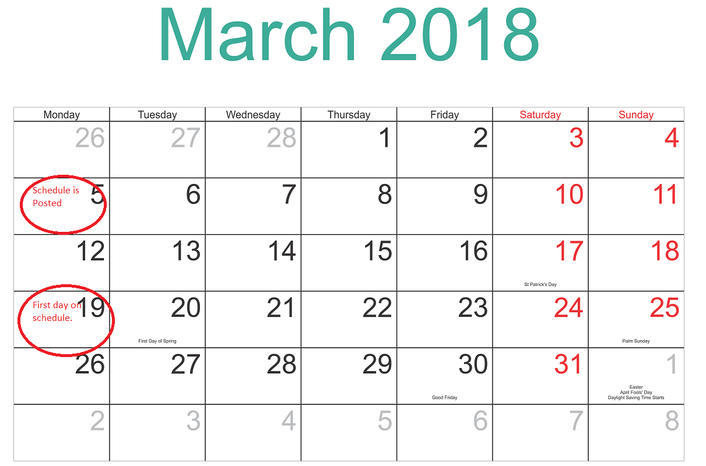
Advance notice of work schedule

Slide 15
EXCEPTIONS  Advance notice of schedule
Exceptions for “new and returning employees”
Employees with a work schedule change.
New employees at time of hire.
Transfers, promotions, and new job classifications.
Employees who are jointly employed and starting a new assignment (e.g. employees provided by a staffing agency, contractor, subcontractor); and
Returning employees from a leave of absence.

Slide 16
Pay For Schedule Changes
Employer provides additional pay for employer-requested schedule changes (with some exceptions).

Slide 17
Pay For Schedule Changes
Additional pay (i.e. “premium pay”) in addition to payment for hours worked.
Adding hours = Payment for one hour at the scheduled rate.
Pro-rated payment allowed for schedule changes that are less than one hour.
Employee right to decline.
Subtracting hours (including on-call shifts) = Payment for half the hours not worked.
Grace period = 15 minutes.

Slide 18
Exceptions  Pay For Schedule Changes
Employer DOES NOT provide additional pay for certain schedule changes.

Slide 19
Exceptions  Pay For Schedule Changes
Employee-requested changes*
Shift swaps
Access to hours
Discipline*
Operations cannot begin or continue
Mass communication*
In-person group communication
* Record-keeping requirement

Slide 20
Exceptions  Pay For Schedule Changes
“Mass communication”
Employer-initiated, written message sent to two or more employees about availability of additional hours due to a scheduled employee not being able to work.
Required information
The message is a mass communication;
Accepting the offer of additional hours is voluntary and the employee has the right to decline such hours; and
Accepting such hours does not require the employer to provide additional pay for work schedule changes.

Slide 21
Exceptions  Pay For Schedule Changes
“In-person group communication”
Employer-initiated, discussion with two or more employees about availability of additional hours due to unanticipated customer needs. Hours must be consecutive to current shift.
Required information
Accepting the offer of additional hours is voluntary and the employee has the right to decline such hours; and
Accepting such hours does not require the employer to provide additional pay for work schedule changes.

Slide 22
Good Faith Estimate
Employer provides written estimate of median hours and on-call shifts.

Slide 23
Good Faith Estimate
Employer provides written information.
Median hours per work schedule over one year period (divided into quarters);
On-call shifts.
New employees. Provide GFE at time of hire.
Existing employees.
Revise GFE once every year;
Revise GFE when an employee provides notice of a “significant change” (30% change over a quarter period) between median hours in GFE and advance work schedule.
Translations required. Provide GFE in English and primary language of the employee.

Slide 24
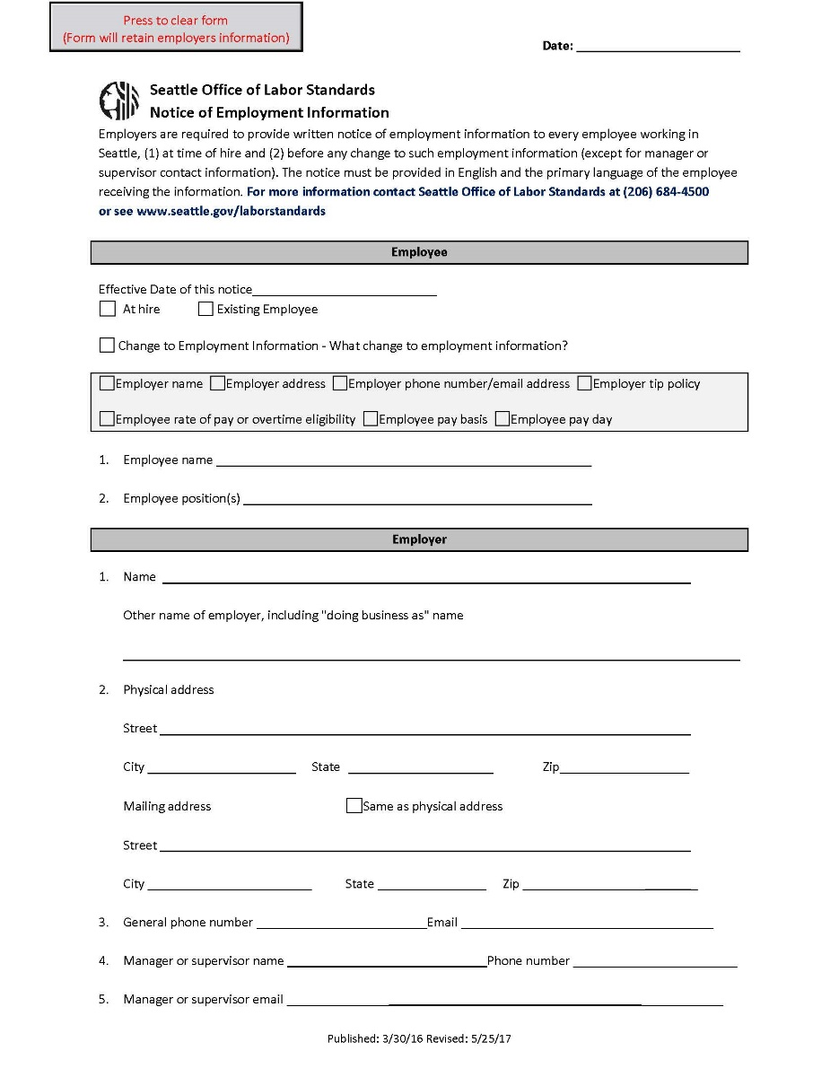
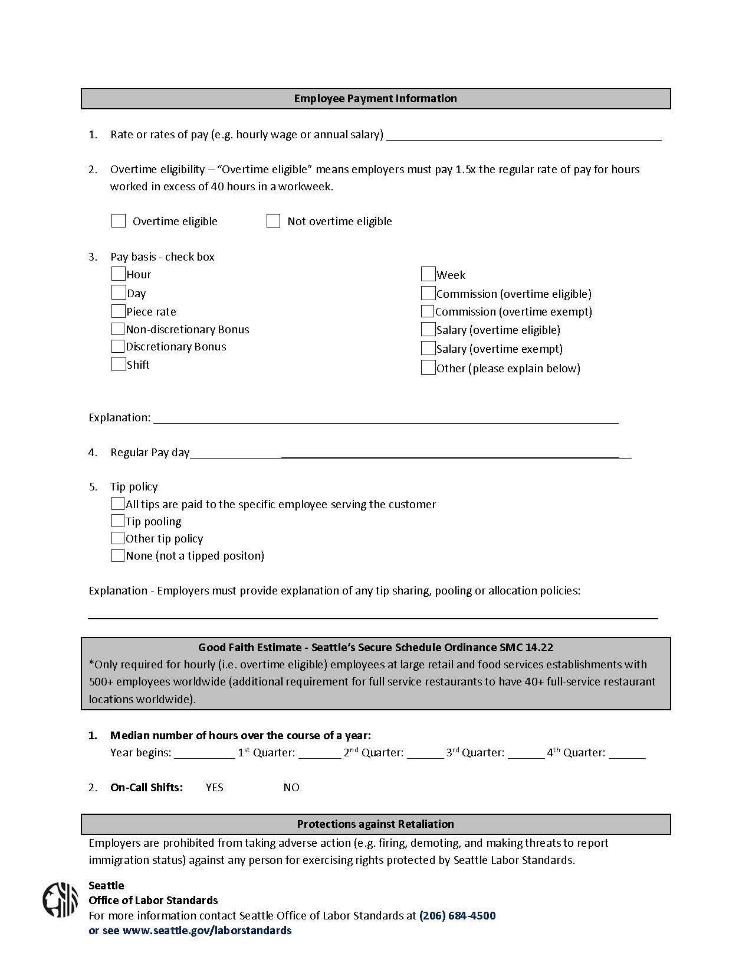
Good Faith Estimate
http://www.seattle.gov/laborstandards/ordinances/secure-scheduling

Slide 25
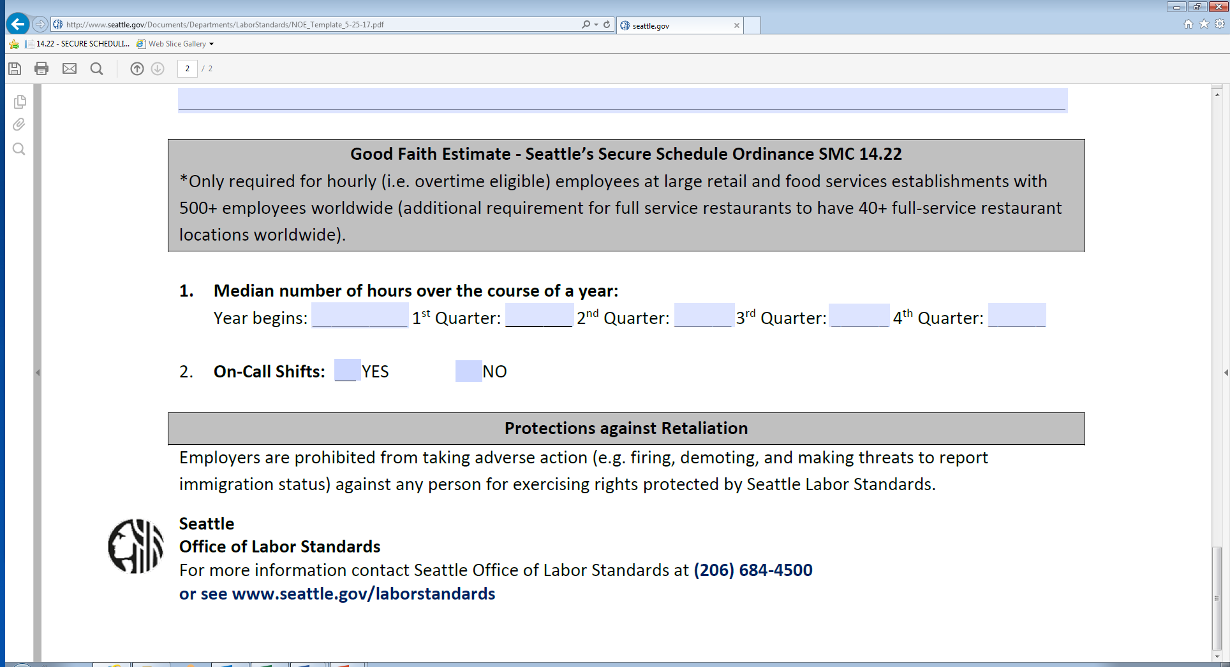
Good Faith Estimate
http://www.seattle.gov/laborstandards/ordinances/secure-scheduling

Slide 26
Right To Request
Employee can request schedule preferences prior to posted
work schedule.

Slide 27
Right To Request
Employee can request specific times and locations of work.
Employer must complete “interactive process” within 3 weeks.
Employer has increased obligations for requests due to “major life events.”
Grant such requests unless there is a bona fide business reason for denial.
Provide a written response (e.g. written schedule for grants).
Employer can ask for “verifying information” of major life event.
Inform employee of ability to redact private information.
Accept written statement from employee or other documents described in SS rules.

Slide 28
Major Life Event
Important, serious or significant event related to employee's access to the workplace due to:
Changes in employee's transportation.
Changes in employee’s housing.
Employee's own serious health condition.
Employee's responsibilities as a caregiver.
Employee's enrollment in a career-related educational or training program.
Employee's other job or jobs.

Slide 29
Bona Fide Business Reason
Significant & identifiable burden of additional costs.
✶ Significant & identifiable detrimental effect on ability to meet organizational demands
A work schedule change that requires an employer to pay additional compensation under a law or written policy (e.g. holiday pay).
An action causing employer to violate a bona fide collective bargaining agreement or a seniority system in a written policy;
An action causing the employer to displace one or more employee(s) from an existing work schedule arrangement.

Slide 30
Right To Rest
Employer provides additional pay for “clopenings” separated by less than 10 hours.

Slide 31
Right To Rest
“Clopening”  Employee works closing and opening work shifts.
Employee request or consent
Employer can only schedule clopenings separated by less than 10 hours upon employee request or consent.
Additional pay (i.e. “premium pay”)
Employer must pay 1.5x scheduled rate of pay for hours worked that are less than ten hours apart.
Exception
Additional pay does not apply to “split shifts.”

Slide 32
Access To hours
Before hiring new employees
(including temporary employees)
employers must offer additional hours of work to current employees.

Slide 33
Access To hours
3 + 2 Days = Notice + Offer
Notice  Three days
Employer posts written information about additional hours in noticeable place at worksite for all employees on the payroll
Offer  Two Days
Employer offers additional hours to qualified, current employee(s) and allows two days to consider offer.

Slide 34
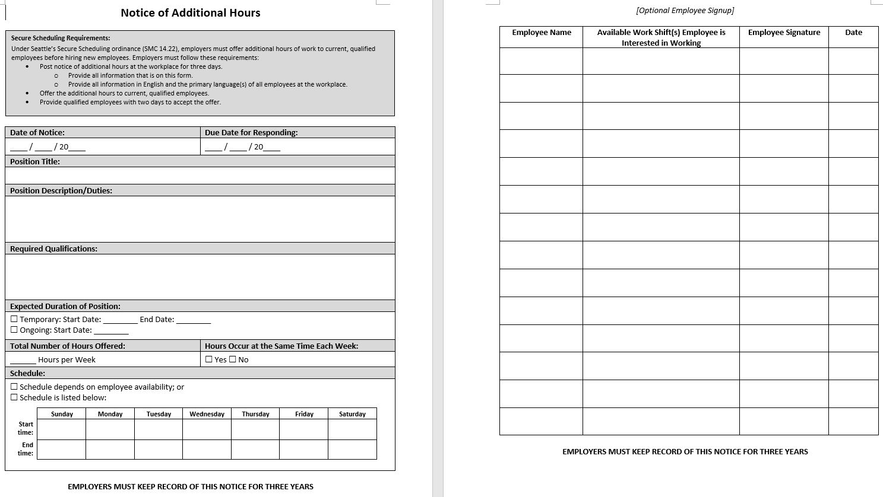
Access To hours

Slide 35
Exceptions  Access To Hours
Employer can immediately
hire new employees in certain situations.

Slide 36
Exceptions  Access To Hours
Written declination from all current employees
Written declination from employees on “Access to Hours List(s)”
Written list of employees who receive notice of additional hours available for work.
Employees are automatically on the list.
Employees can ask to be added or removed at time of hire or during employment.
Employer must make list available for viewing to employees upon request.

Slide 37
Exceptions  Access To Hours
Diversity hiring programs
Hours of work that the employer has designated for hiring programs (e.g. diversity, supported employment, young adult programs);
Affiliated with a government entity or external non-profit organization;
Approved by Labor Standards Advisory Commission; and
Confirmed by OLS.

Slide 38
OTHER REQUIREMENTS
Record keeping
Poster & translations
Protections against retaliation
Waiver in CBA
Employees who are jointly employed

Slide 39
Record Keeping – 3 years
Good faith estimates
Right to request – Employer’s grant or denial of employee’s request for schedule preferences related to major life event.
Advance notice of work schedules
Pay for work schedule changes - Payroll records showing additional pay provided to each employee.
Exceptions to pay for work schedule changes
Mass communications.
Documentation of employee-requested changes.
Documentation of employee discipline.
Access to hours - Notices for additional hours of work.
Exceptions to access to hours
Written confirmation from employees – Confirmation from all employees, or employees on the access to hours list, that they are not interested in accepting additional hours of work.
Access to hours list(s) - Records of employees who have opted out of receiving written notice of additional hours of work.

Slide 40
Scheduling Poster
http://www.seattle.gov/laborstandards/ordinances/secure-scheduling
Display SS workplace poster
English and employee’s primary language(s)
Download from OLS website
Pick-up from OLS
Pick-up from Seattle Customer Service Centers

Slide 41
Translations
Employers must translate the following documents
Good faith estimate
Advance notice of work schedule
Notice for access to hours
Workplace poster
OLS will translate documents and post on website
Employers are not required to provide translations until OLS posts the appropriate documents

Slide 42
Retaliation
Protections from retaliation
Employers shall not interfere with any employee right protected by ordinance.
Employees have the right to decline any hours not on the posted schedule.
Discipline permitted for certain situations
Abuse of employer’s requirements for employee-requested work schedule changes and/or preferences PRIOR to posted work schedule; and
Failure to comply with, or abuse of, employer’s requirements for employee-requested work schedule changes AFTER the posted work schedule.

Slide 43
Waiver
Waiver allowed in CBA
Express waiver - Waiver must be expressly stated in a collective bargaining agreement; and
Alternative scheduling structure - Employees must ratify an alternative scheduling structure that meets public policy goals of ordinance

Slide 44
Joint Employees
Special requirements for joint employees:
Temporary services provider
Staffing agency
Contractor
Subcontractor
Other employer(s)

Slide 45
Joint Employees
Joint liability - Joint employers are individually and jointly responsible for compliance.
Good faith estimate - Employers provide a good faith estimate when such employees start each distinct assignment.
Advance notice of work schedule - Employers may immediately place such employees on posted work schedules without providing 14 days of advance notice.
Pay for work schedule changes - Employers provide additional pay for each work schedule change after such employee has started a distinct assignment.
Access to hours - Employers are not required to provide notice of additional hours of work to such employees if they are not on the employer’s payroll.

Slide 46
Scenarios  Pay For Work Schedule Changes
Which of the following situations requires additional pay for work schedule changes after the schedule is posted?
Employee calls out sick. Manager calls all employees on the roster to find replacement coverage. Maria picks-up the shift.
Business is slow. Manager asks currently-working employees if anyone wants to go home early, Jose accepts the offer and leaves 90 minutes early.
Business is booming. Manager sends a mass text to all employees with notice of additional hours. Erica accepts two shifts.

Slide 47
Scenarios  Pay For Work Schedule Changes
Which of the following situations requires additional pay for work schedule changes after the schedule is posted?
Business is uncertain. Manager adds an “open shift” on the posted schedule and asks employees to sign-up if they are interested.
Weather is wretched and gloomy. Manager of an outdoor café sends all employees home, but stays herself to staff the business solo.
A tree fell on the store during the windstorm. The store is closed for a week and all shifts are cancelled.

Slide 48
Thank you!

Slide 49
Ask us!
206-256-5297
Employers
Business.laborstandards@seattle.gov
Workers
Workers.laborstandards@seattle.gov

