Slide 1
Land Use 101: The Design Process
Housing Affordability and Livability Agenda
Notes:
Hi, my name is Lisa Rutzick and I am the program manager of the City’s Design Review program. This presentation is an overview of the design and permitting process with a focus on Design Review.

Slide 2
The design process
Before building a new project in Seattle, a developer must secure a Master Use Permit (MUP) from the City.
The MUP includes:
Zoning Review
Design Review
Environmental Review
Other (depending on the project)
Community
City Permit Review &
Design Review Boards
Development
Team
Notes:
Before building a new project in Seattle a developer must secure a Master Use Permit - an overarching land use permit from the City. The Master Use Permit or “MUP” includes several reviews: a zoning review, design review, environmental review, and other reviews depending on the project. Members of the community, the developer, and City Planners and Design Review Boards all play important roles in the design process. Developers propose and design the project, community members provide input, and the Board and city reviews and gives approval for the project before it can be built.

Slide 3
The design process
What is Design Review?
The review of most private new development of commercial, multifamily and mixed-use buildings by citizen Design Review Boards (or City staff) for compliance with citywide and neighborhood design guidelines.
Notes:
Design review is the review of most private new development of commercial, multi-family and mixed use buildings by citizen Design Review Boards (or city staff), for compliance with citywide and neighborhood design guidelines. Only projects that meet thresholds for a certain size are required to have design review. But most largescale mixed use projects you would see in a neighborhood business district, and most development in an urban village or urban center would be required to have design review. Single family homes are not required to have design review. Citywide Design Guidelines lay out design principles that apply to the city as a whole. In addition, 21 neighborhoods have neighborhood-specific design guidelines that lay out design priorities that are unique to local areas.

Slide 4
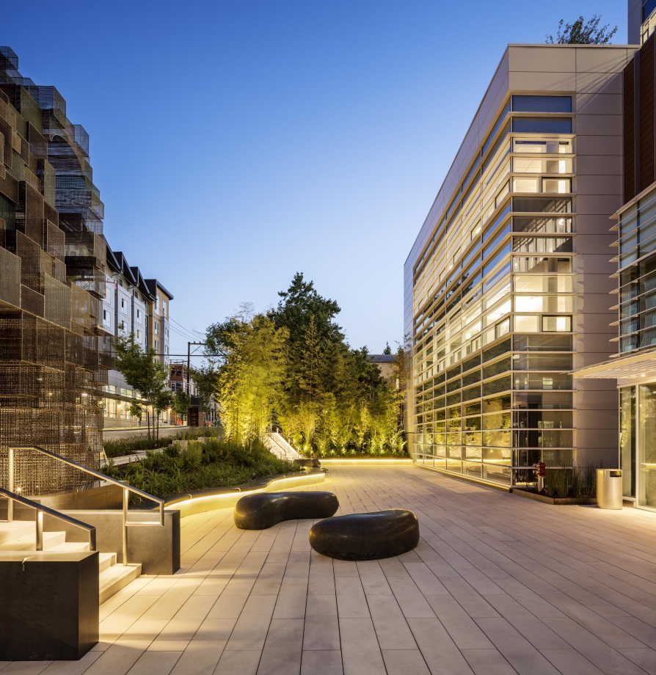
Design Review overview
Purpose
Encourage better design to ensure new development enhances the city and fits into neighborhoods
Provides flexibility in application of development standards
Improve communication and mutual understanding among developers, neighborhoods, and the City
History
In place since 1994
Reviewed over 1,500 built projects in Seattle
Reviews over 100 projects a year
Notes:
The purpose of design review is to: (read 3 slide statements). Design Review has been in place since 1994, has reviewed over 1,500 built projects, and reviews over 100 projects per year.

Slide 5
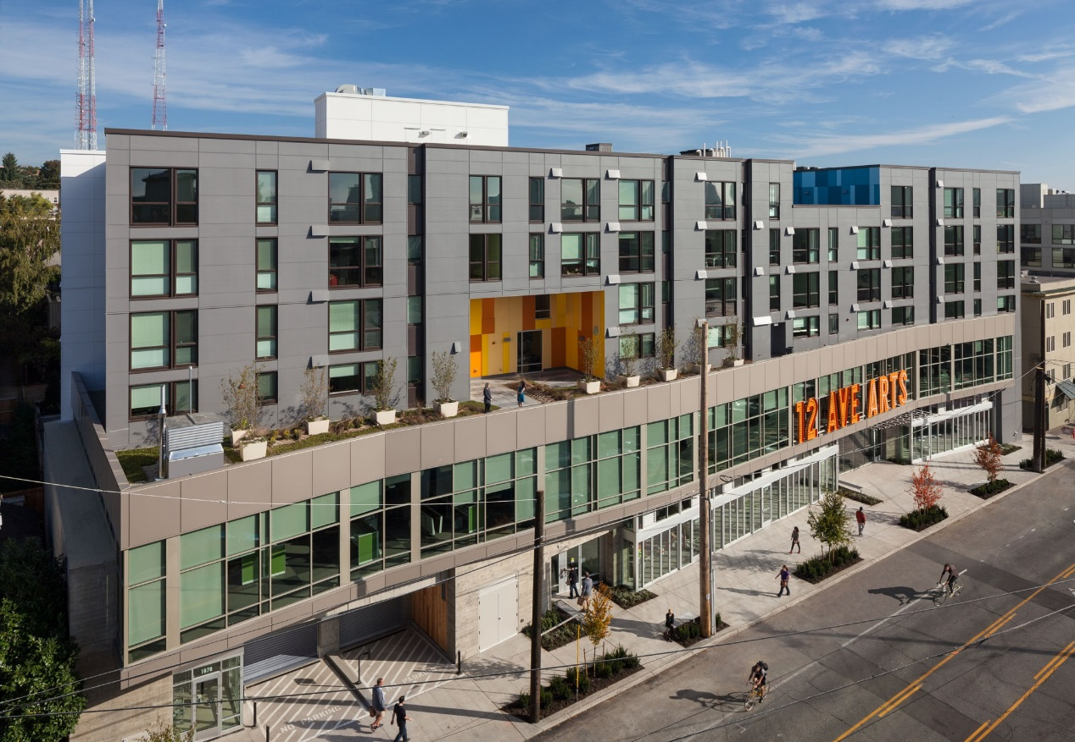
Design Review scope
Design Review addresses project design:
Exterior appearance and materials
Arrangement of a building on a site
Relationship of project to its surroundings and unique location
Notes:
It’s important to consider the scope of what design review addresses. Design review can affect the exterior appearance of a building’s design and it’s materials and colors. Design review can affect how a building is arranged on a site – which is referred to as “massing”. And Design Review can affect how a site relates to it’s surroundings and it’s unique location. An example of that would be placement of a building’s entrance to put a front door facing a public street or important corner. Design review does not affect the basic amount of development that can be placed on a site – which is prescribed by the zoning. Design review also can not affect the amount of parking a building must provide or the types of transportation improvements that must be made along with the new building. Those elements are addressed in environmental review, which we’ll touch on in a minute.

Slide 6
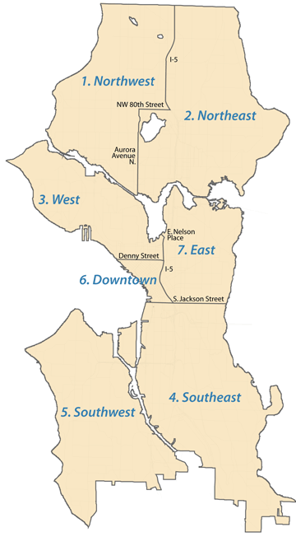
Design Review structure
City is divided into 7 Boards
Each Board has 5 members representing the following interests:
community
design
development
residential
business
Board members are volunteers and are appointed by the Mayor and Council for two-year terms that can be extended by two years
Notes:
For Design Review purposes the city is divided into 7 district boards. Each board has 5 members including 1 at large citywide community member, 1 design professional, 1 development representative, 1 district resident, and 1 business representative. All board members are volunteers and are appointed by the Mayor and Council for a 2 year term. Design review board meetings are public meetings held in the evening at a location in the district.

Slide 7
Other reviews
Environmental Review is addressed through the State Environmental Protection Act (SEPA) review process.
Topics considered in SEPA review include:
Natural areas like steep slopes or wetlands
Wildlife habitat
Transportation or parking
Historic resources
SEPA review includes a 14-day public comment period
SEPA review determines whether a project is likely to have a significant adverse impact on the environment
Notes:
Environmental aspects of a project are evaluated in a State Environmental Policy Act or SEPA review. The SEPA review addresses topics such as (read slide). Comments form the community on these topics should be submitted to the city’s project planner during a 14 day comment period, and are not a good fit for comment in the Design Review process. Based on the SEPA review the City determines if the project is likely to have a significant adverse impact on the environment, and if so, the developer would be required to prepare an environmental impact statement or EIS. An EIS is a more in depth analysis of environmental conditions, and it may identify mitigation measures for the project.

Slide 8
Process overview
Design Review*
Early Design Guidance (EDG) Phase
Master Use Permit Application (MUP)
Recommendation (REC) Phase
Publish
Decision
Building Permit
Identify design guidelines of highest priority, give early feedback
Includes discretionary reviews (DR, SEPA, etc.) as well as zoning
Evaluate how design has responded to EDG
SDCI Director’s Decision
Public notice
Design packet posted online
Public meeting with DR Board
Public notice
Comment period for SEPA
Public notice
Design packet posted online
Public meeting with DR Board
Public notice
2-week appeal period
Appeals go to Hearing Examiner
* For Board Design Review process. There are other forms of Design Review mostly for some smaller projects that are reviewed by City Staff.
Notes:
This graphic summarizes the permit process with a focus on Design Review. There are two phases to Design Review – the Early Design Guidance phase (EDG) and the Recommendation phase, the green boxes on this slide. Both phases have a public meeting, and a chance for public comment. Before the public meeting for each phase the developer submits a design review packet with images and renderings of it’s proposed design. Community members can view the packets online. After the EDG phase and before the Recommendation phase the developer applies for the Master Use Permit. The MUP application contains the SEPA analysis. Public notice is provided for each of these steps including a mailing to parties of record for the project. After a project receives a design review recommendation the city publishes a MUP decision, and the project can proceed to pursue a building permit.

Slide 9
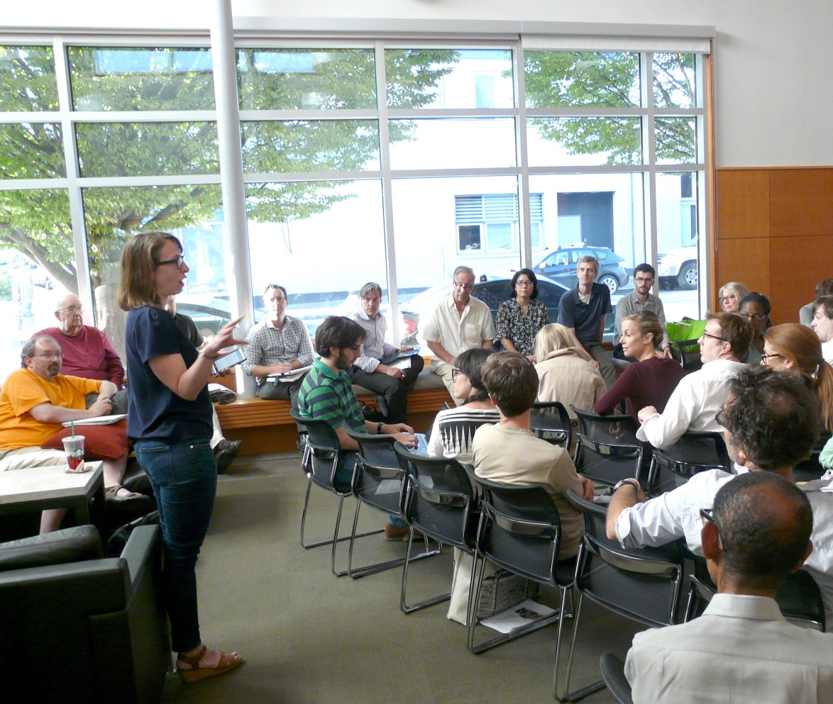
Process overview
Public comments in the Design Review process
Boards consider public comment in project review
Provide comment at the EDG or Recommendation meeting, or submit written comments to the planner
Focus on design elements
Refer to the design guidelines
Community member provides public comment at a Design Review Board meeting.
Notes:
Public comments are an important part of Design Review. The board considers public comment before it approves a project design. You can provide your public comment at the EDG or the Recommendation meeting, or with an e-mail or letter to the city’s planner. The most effective design review comments focus on the project’s design elements, not the amount of development allowed by zoning, or the environmental impacts. For a design review comment to have the most impact it should reference an approved citywide or neighborhood design guideline.

Slide 10
Early Design Guidance (EDG)
Early Design Guidance Phase
Analysis of the site and its context
Exploration of massing
Draft / schematic designs
Identifies any requested departures
Notes:
The Early Design Guidance phase is the first step in Design Review. It includes an analysis of the site and it’s surroundings, and provides options for the massing of the building. The project design should be draft or schematic at this time. The design review board acts to approve a project to advance to the recommendation phase, and an EDG report is prepared.

Slide 11
Design Recommendation
Design Recommendation Phase
Materials and architectural detailing
Landscaping design
Responsiveness to previous guidance at EDG
Notes:
The Recommendation addresses the details of the proposed building. This includes materials landscaping design and other features. The recommendation phase design must demonstrate responsiveness to the EDG report. The design review board must vote to approve the design review recommendation for the project to receive a MUP.

Slide 12
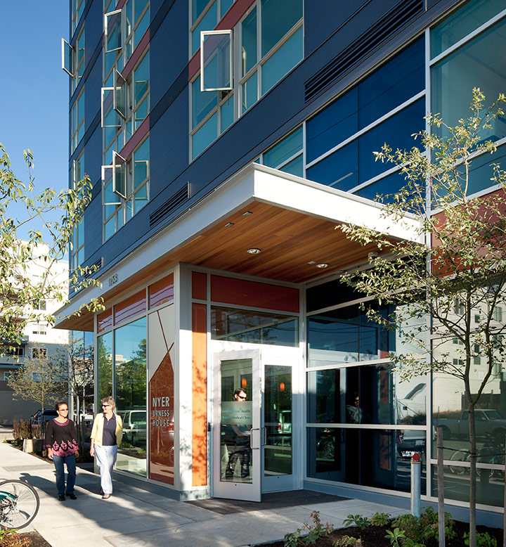
Design Review Departures
What is a departure?
A Design Review Board can grant flexibility to “depart” from a zoning code standard
The design must improve the project’s ability to meet a design guideline
Zoning standards from which departures are not allowed are:
Height limit
Allowed FAR
Notes:
Earlier I mentioned that a goal of design review is to provide flexibility in the application of development standards. This is done through the approval of Design Review departures. A Design Review board can grant flexibility for a developer to depart from a rigid zoning code standard only if the developer demonstrates how the proposed design would better meet the intent of an adopted design guideline. There are a few zoning code standards that can’t be departed from included the height limit and the allowed FAR. Departures are an important tool to encourage innovative and flexible design solutions that reflect site conditions.

Slide 13
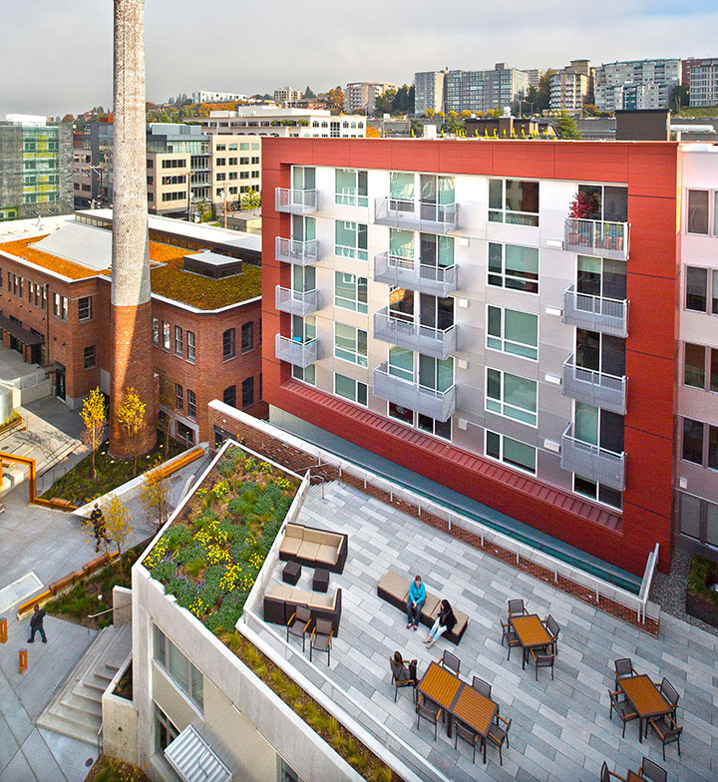
Design Review
Summary
Your chance to weigh in on the design of new development
Improves design quality and compatibility
Creates dialogue
Provides flexibility
Notes:
In summary, design review is an good way for you to weigh in on the design of new development in your neighoborhood. Design review has a track record of improving the design quality and compatibility of new development with an existing neighborhood. The program encourages a dialogue between the developer, city staff, and the community. And the program provides flexible design solutions. I hope to see you will consider participating in the Design Review process for a project in your neighborhood. Thank you.

Slide 14
Thank you
Notes:
Earlier I mentioned that a goal of design review is to provide flexibility in the application of development standards. This is done through the approval of Design Review departures. A Design Review board can grant flexibility for a developer to depart from a rigid zoning code standard only if the developer demonstrates how the proposed design would better meet the intent of an adopted design guideline. There are a few zoning code standards that can’t be departed from included the height limit and the allowed FAR. Departures are an important tool to encourage innovative and flexible design solutions that reflect site conditions.

