Slide 1
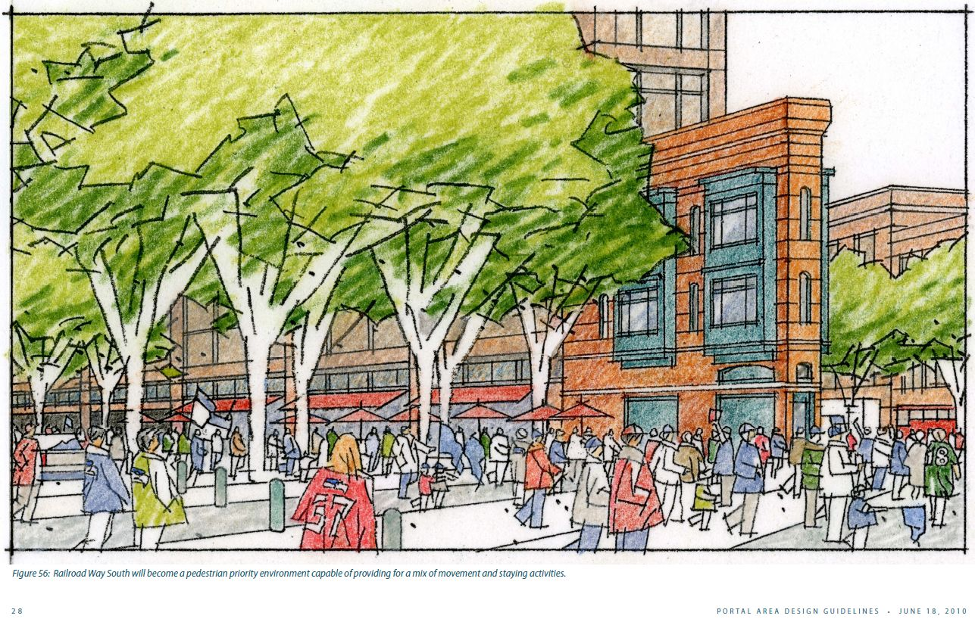
Seattle Design Commission
Railroad Way – April 4, 2013

Slide 2
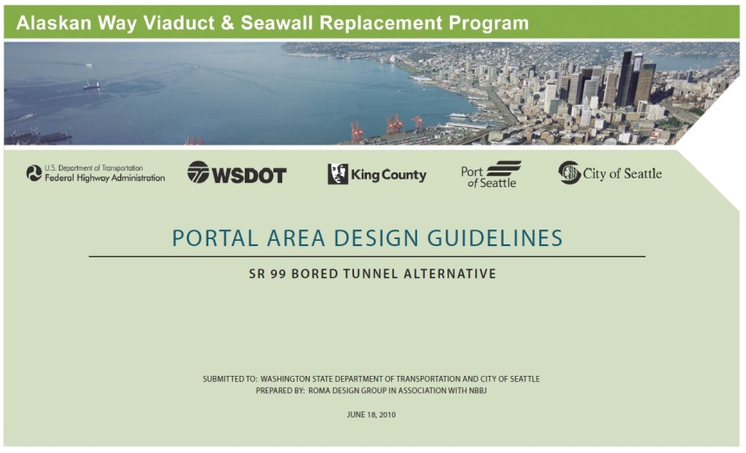
Design Development of Railroad Way
Urban Design Guidelines
WSDOT, SDOT, ROMA Design and NBBJ developed design guidelines in 2009 and 2010 with the Seattle Design Commission
Provide a framework and a unified vision to guide implementation over multiple project design and construction contracts.
Included goals, objectives and
guiding principles.
Responded to City of Seattle
initiatives and neighborhood
planning efforts.

Slide 3
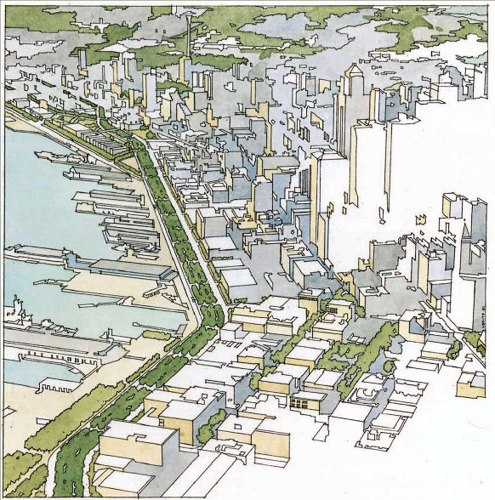
Design Development of Railroad Way
Urban Design Goals
Provide for the safety and comfort of pedestrians, bicyclists, transit, freight and
other vehicles.
Reinforce the sense of place and
give structure and orientation to
the urban experience.
Contribute positively to the
fabric of the city and the
unique qualities of adjacent
neighborhoods.
Contribute to the sustainability
of the urban environment.

Slide 4
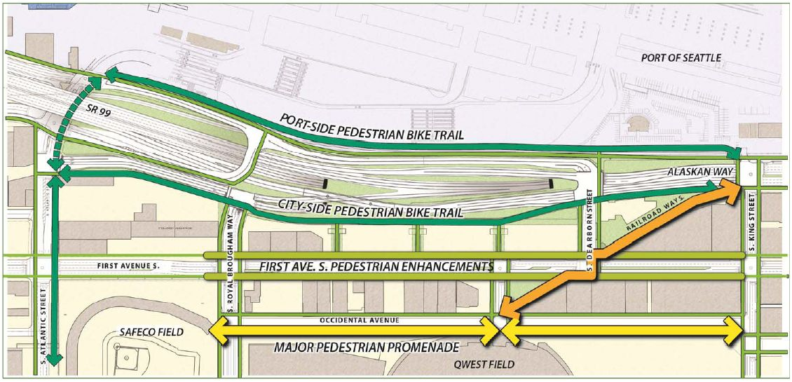
Design Development of Railroad Way
Opportunity for Connectivity
Improved bicycle and pedestrian access and connection to the waterfront along Railroad Way.

Slide 5
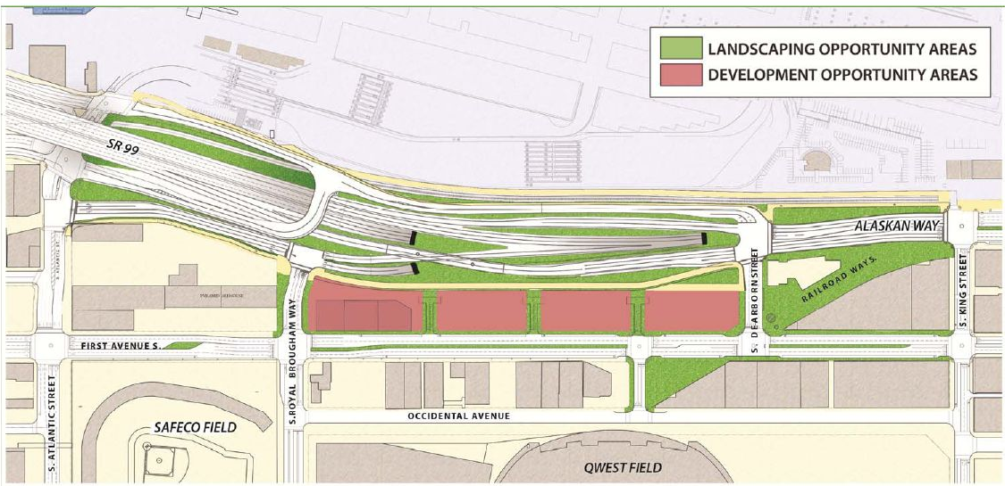
Design Development of Railroad Way
Opportunity for Landscape and Future Development
South Portal Area, Railroad Way and the WOSCA site

Slide 6
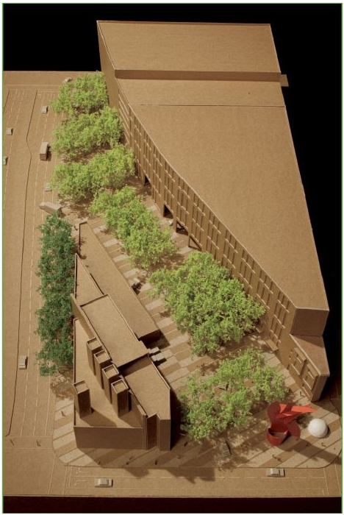
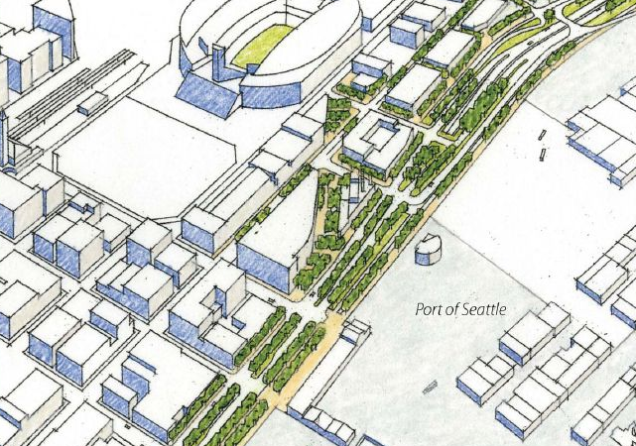
Design Development of Railroad Way
WSDOT and Railroad Way Urban Design
The Urban Design Guidelines and early ROMA
Design efforts recognized the importance of
Railroad Way as a connection to the waterfront.
However, during the WSDOT’s
South Portal Landscape Design
approval process, the Seattle
Design Commission requested
the urban design of Railroad
Way be re-evaluated in the
context of the Central
Waterfront design effort.

Slide 7
Design Development of Railroad Way
WSDOT and Railroad Way Urban Design
Railroad Way is still part of WSDOT’s South Access project, but the Waterfront Seattle team has been contracted to perform the re-evaluation of the urban design and develop the contract plans for WSDOT South Access project.
Railroad Way Design & Construction Schedule
  90% WSDOT submittal May 2013
  100% WSDOT submittal in September 2013
  Contract Advertisement in January 2014
  Construction of Railroad Way anticipated in mid 2016

Slide 8
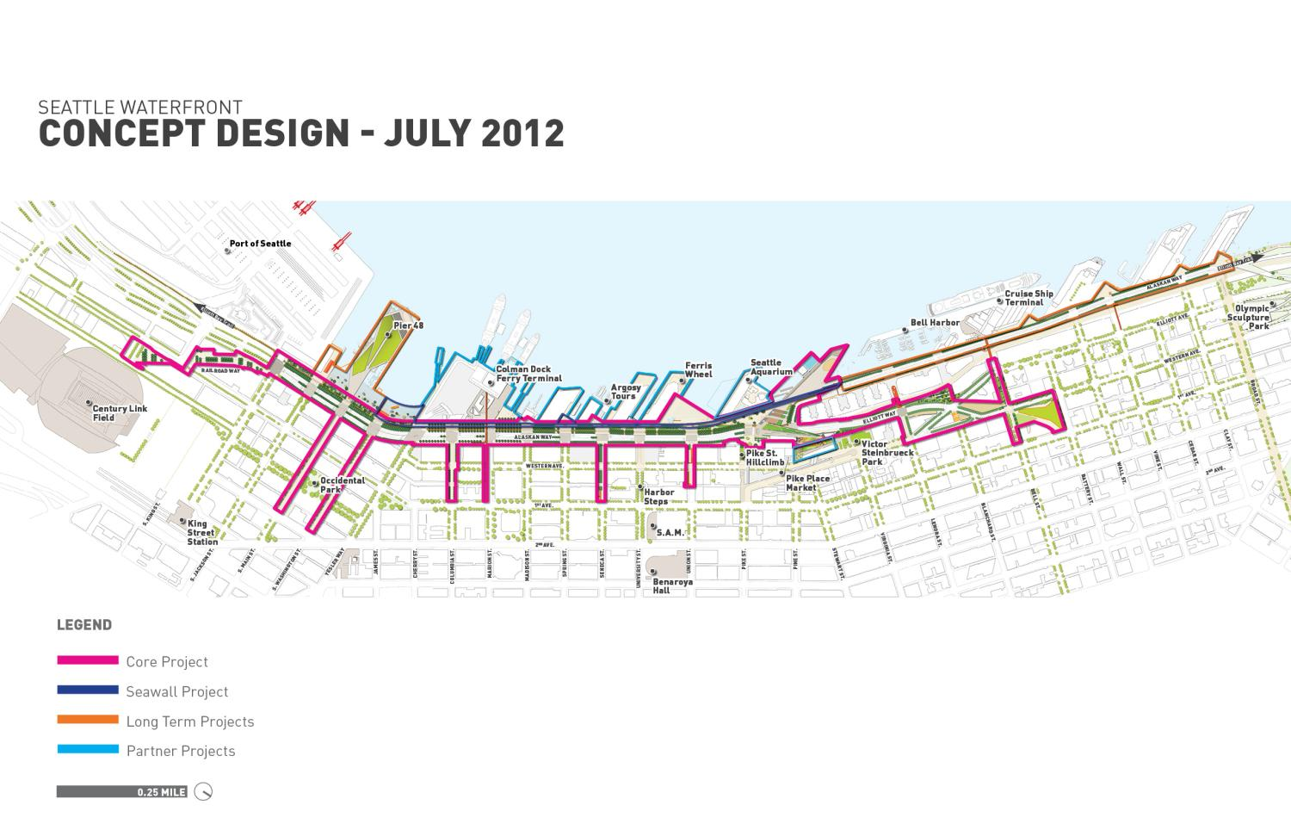

Slide 9
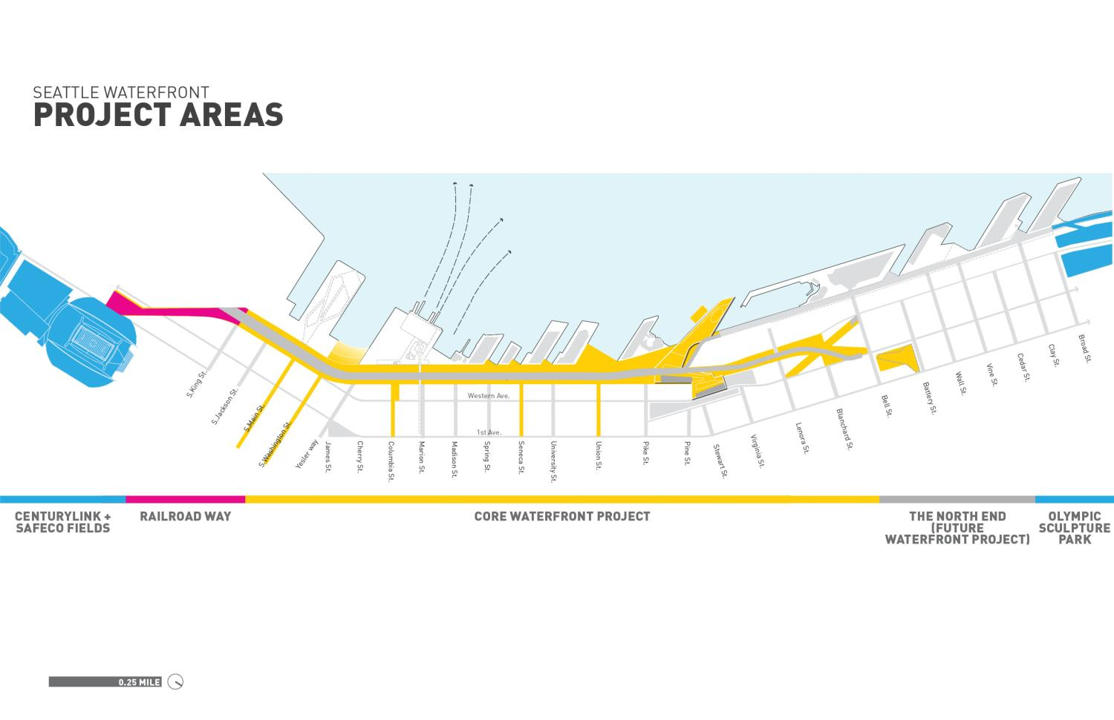

Slide 10
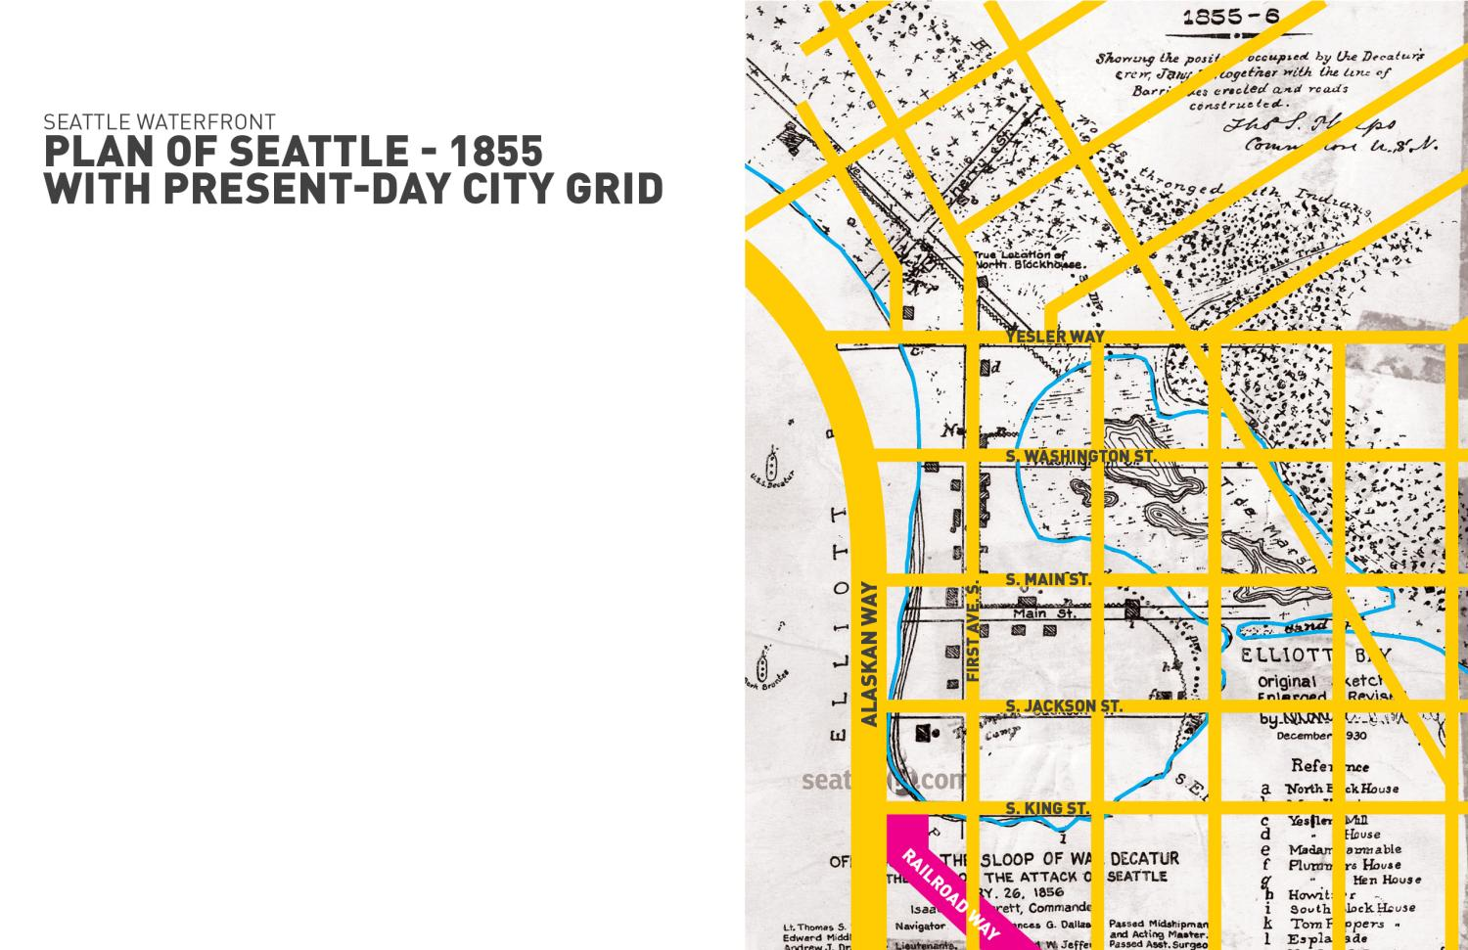

Slide 11
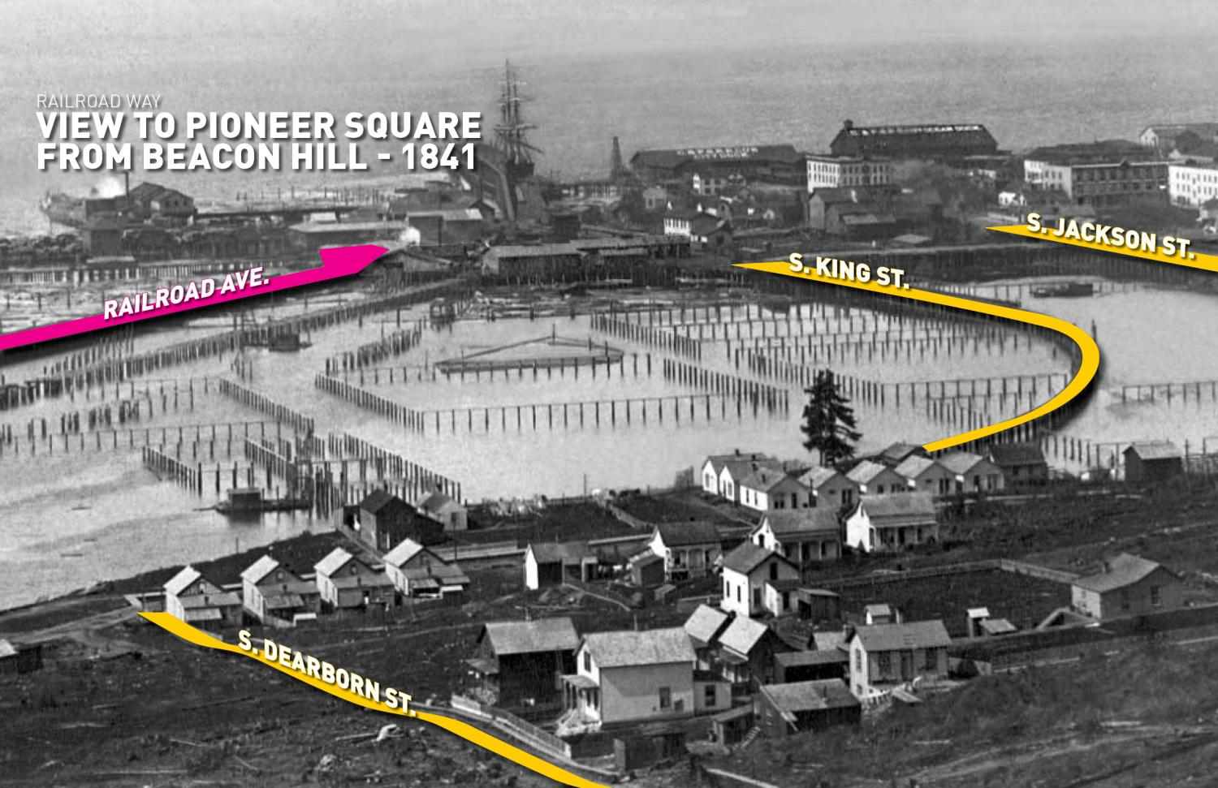

Slide 12
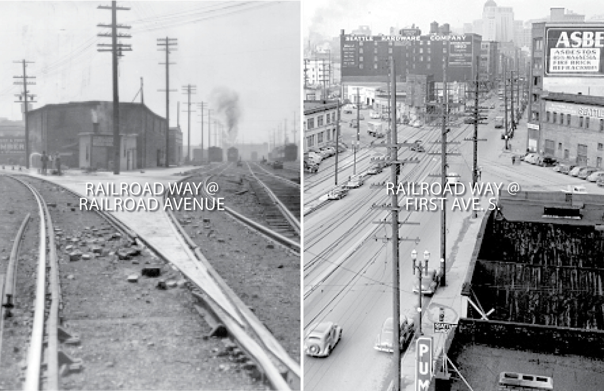

Slide 13
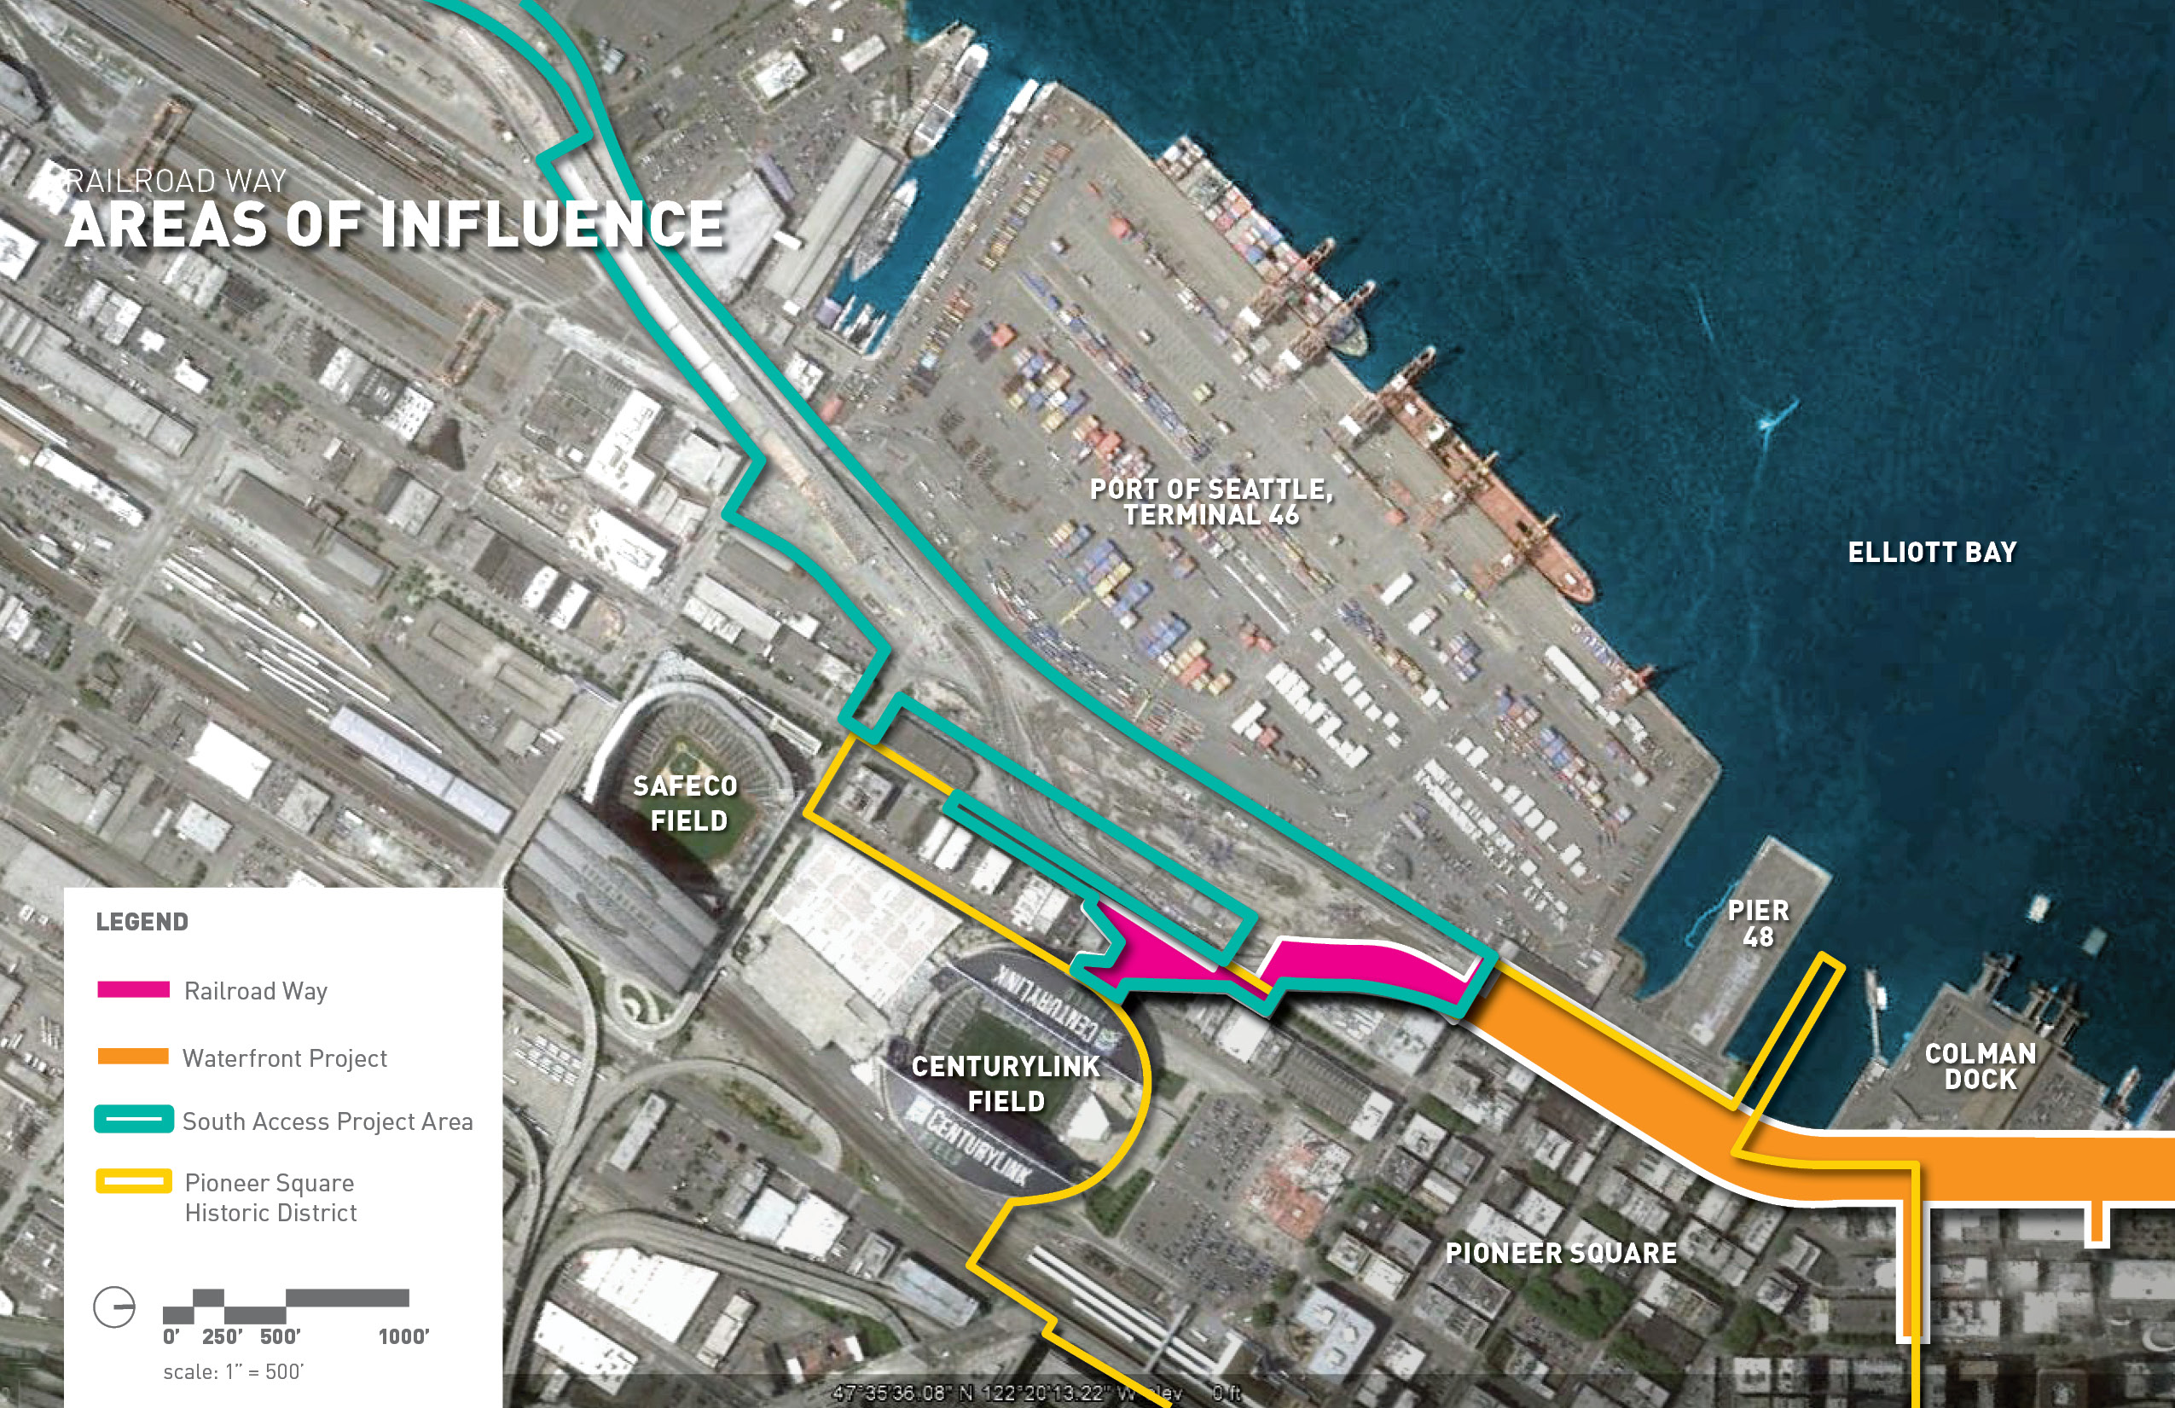

Slide 14
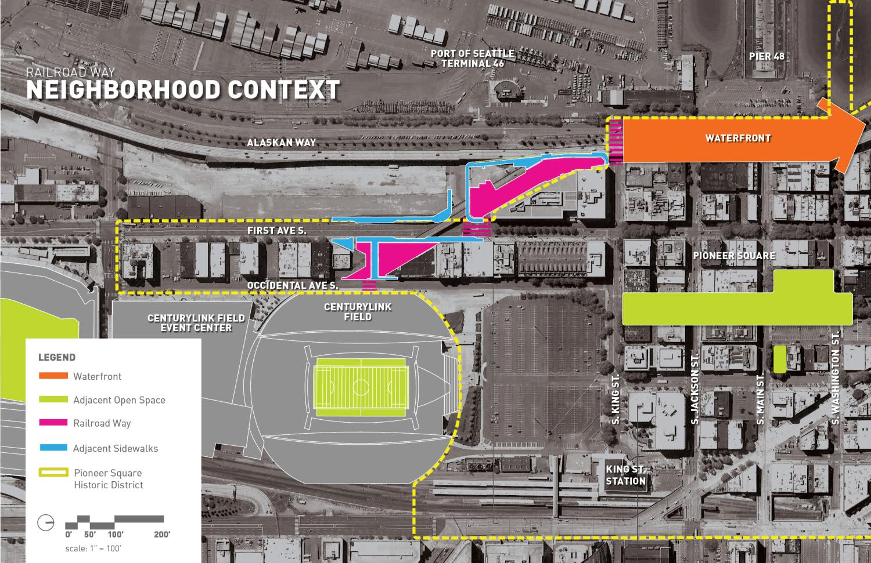

Slide 15
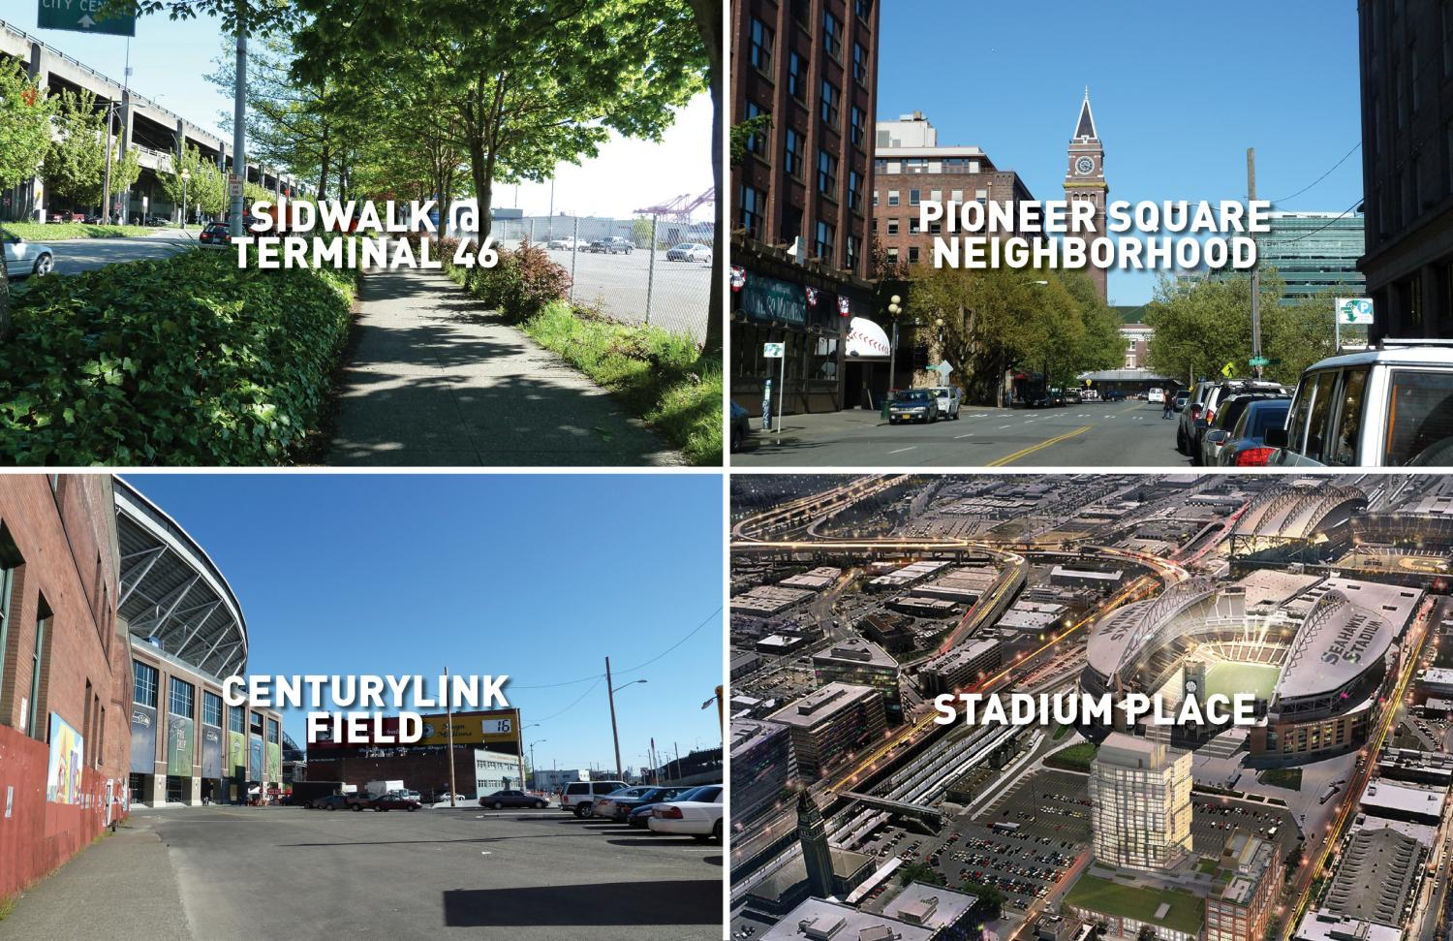

Slide 16
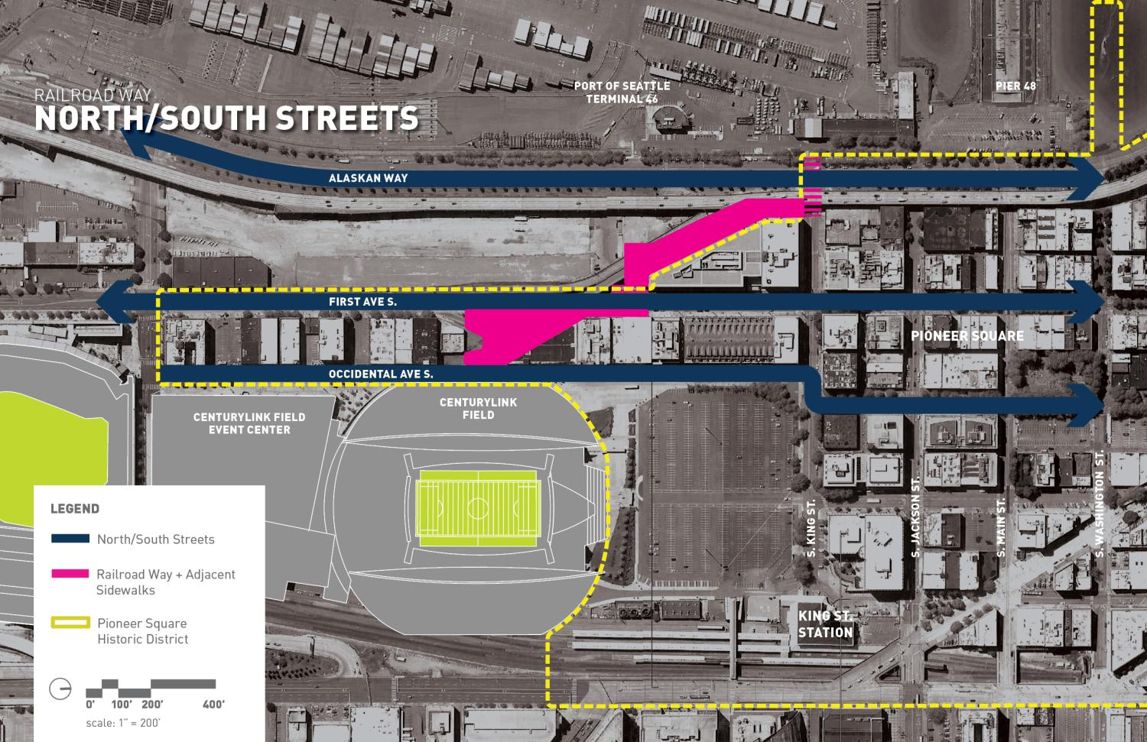

Slide 17
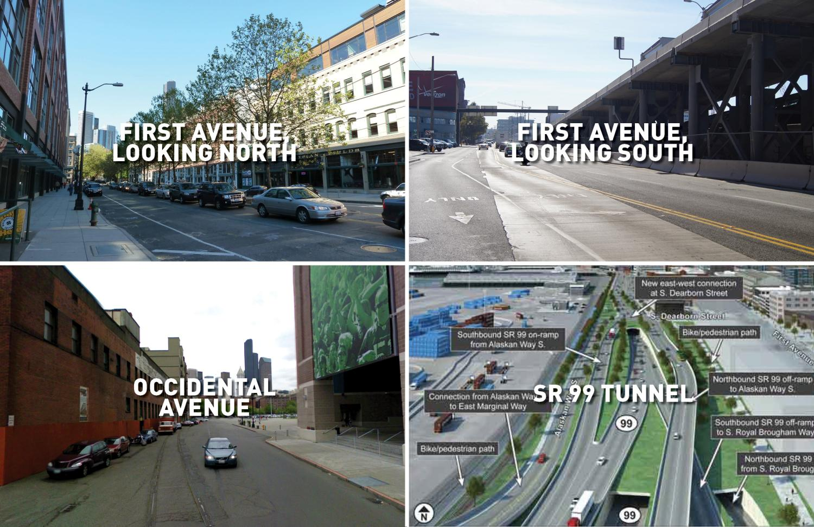

Slide 18
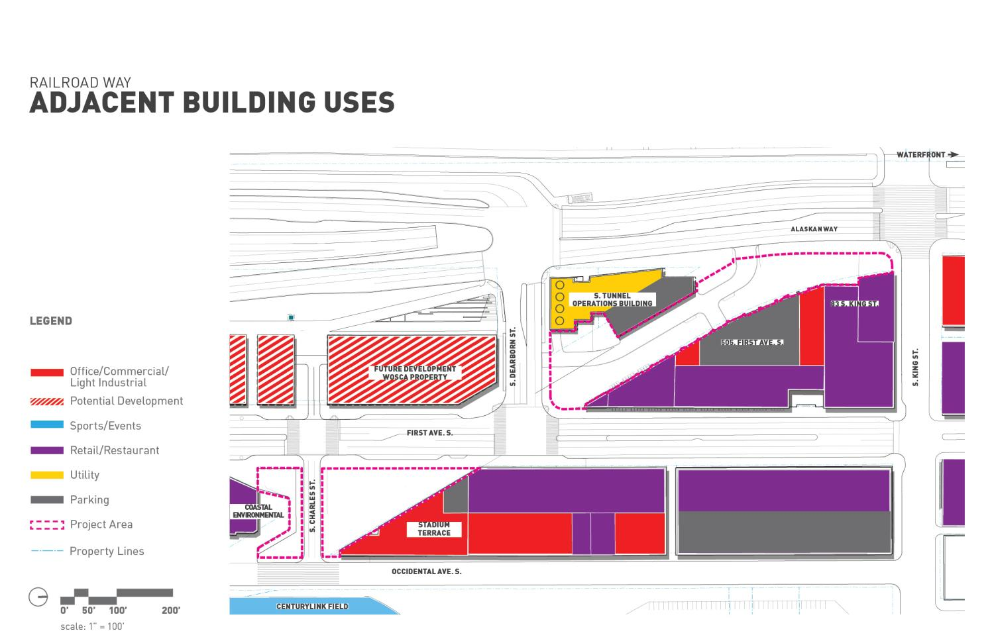

Slide 19
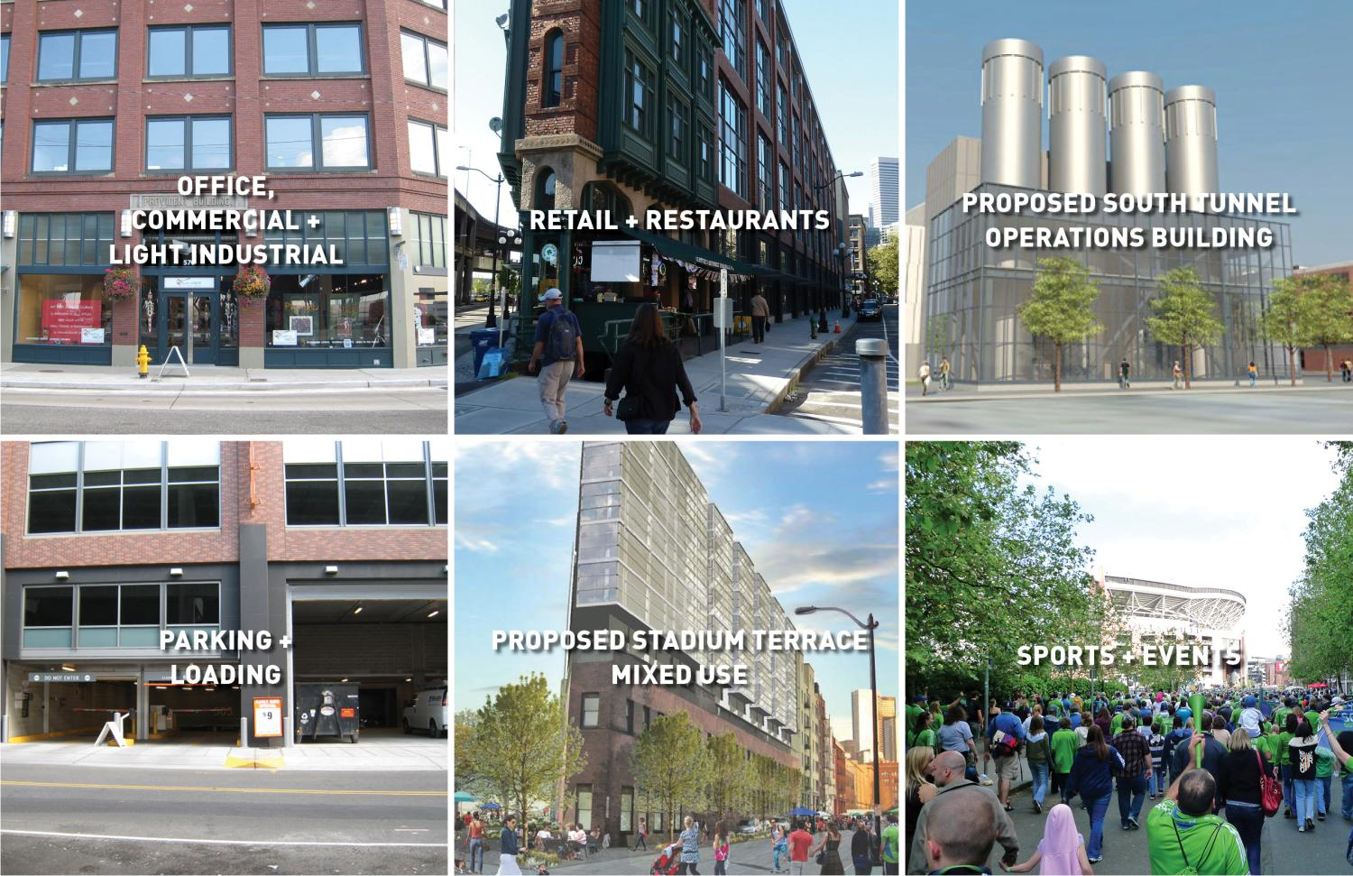

Slide 20
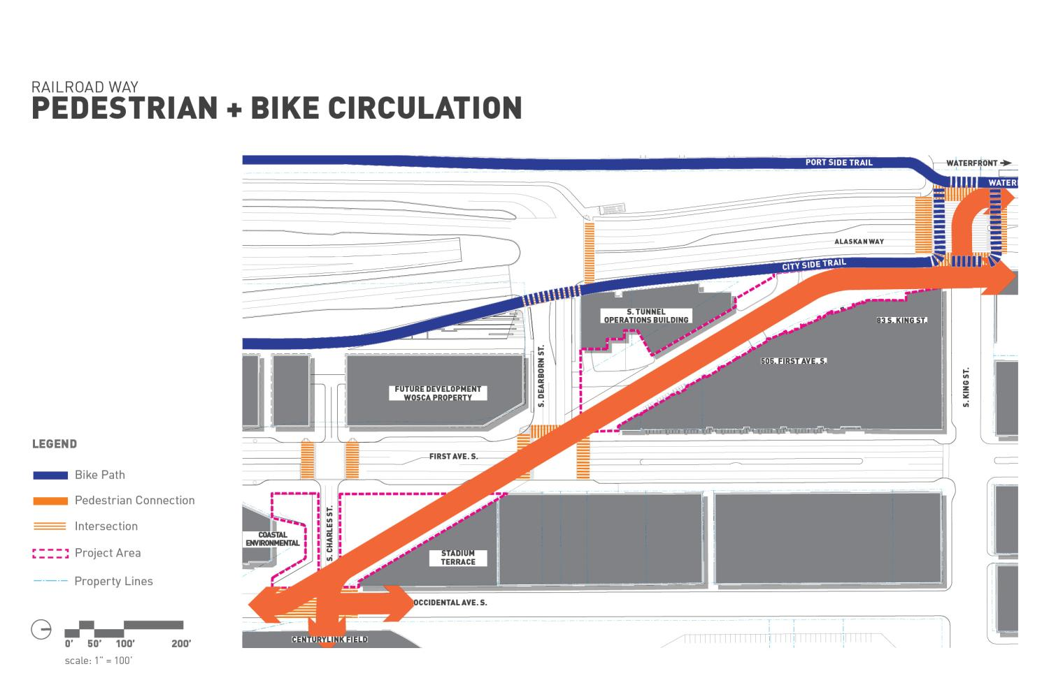

Slide 21
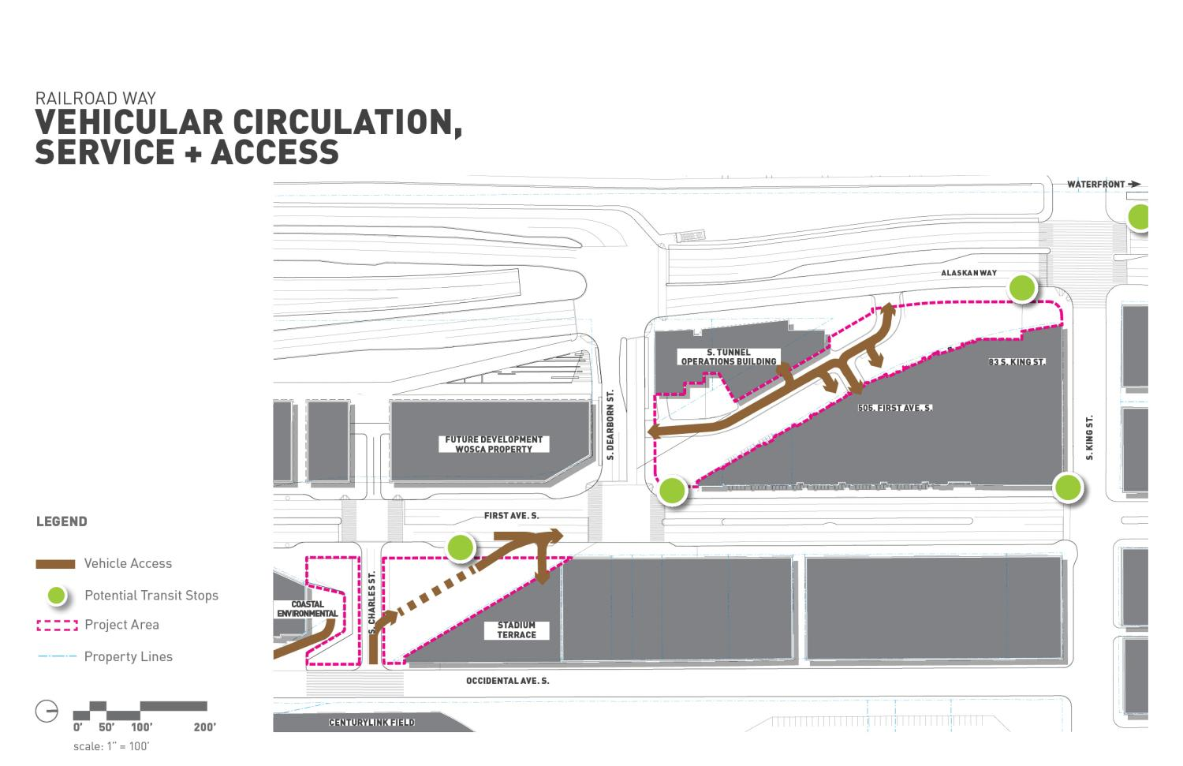

Slide 22
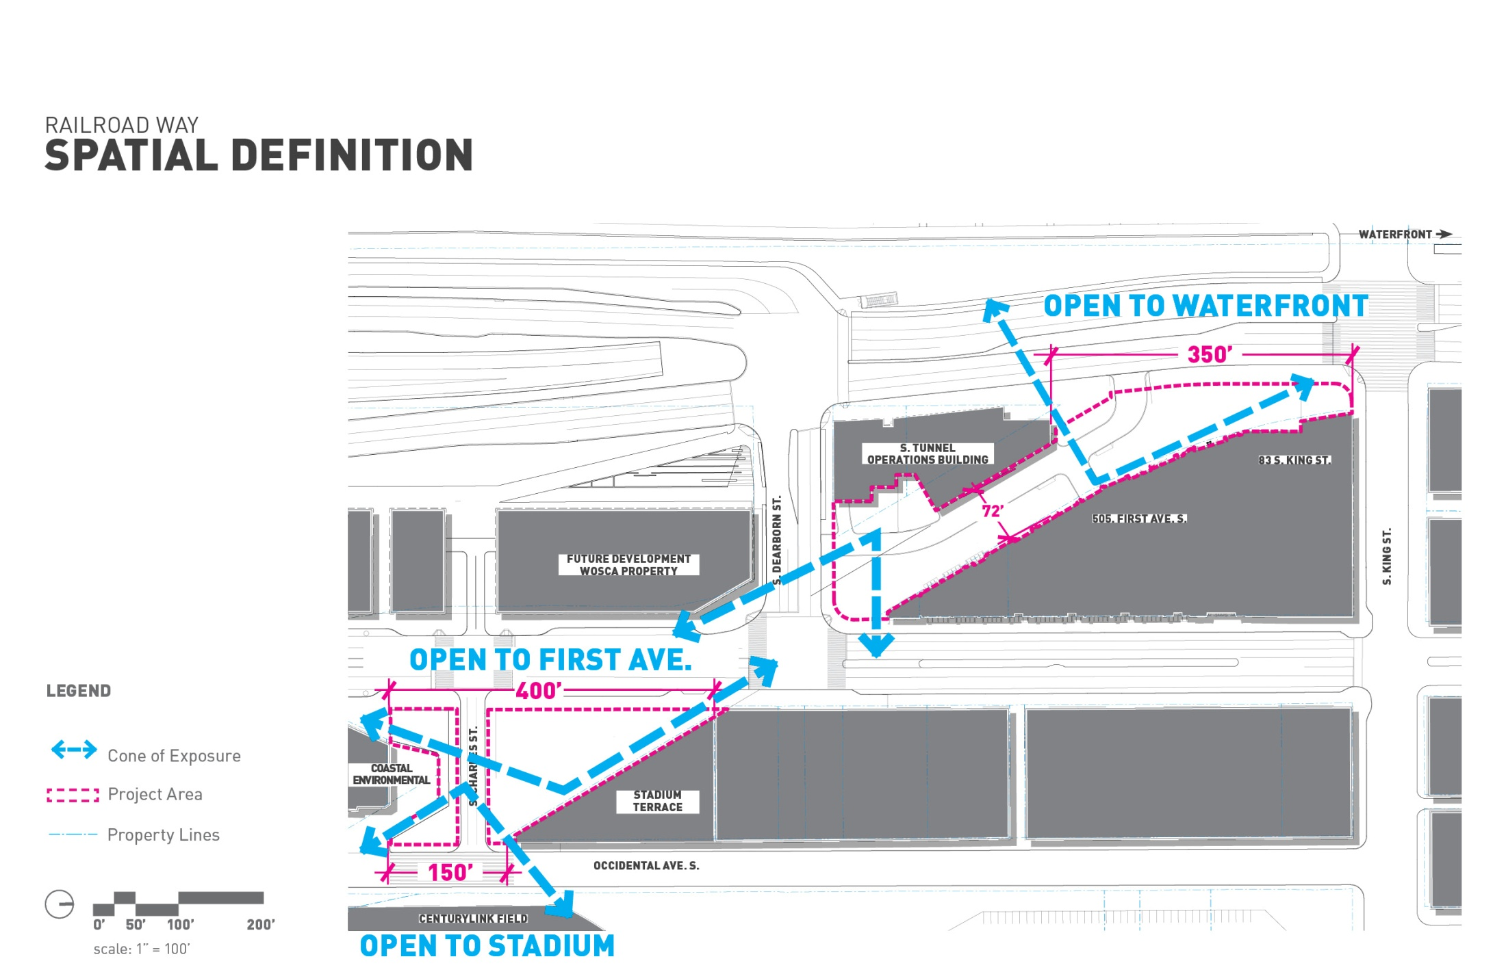

Slide 23
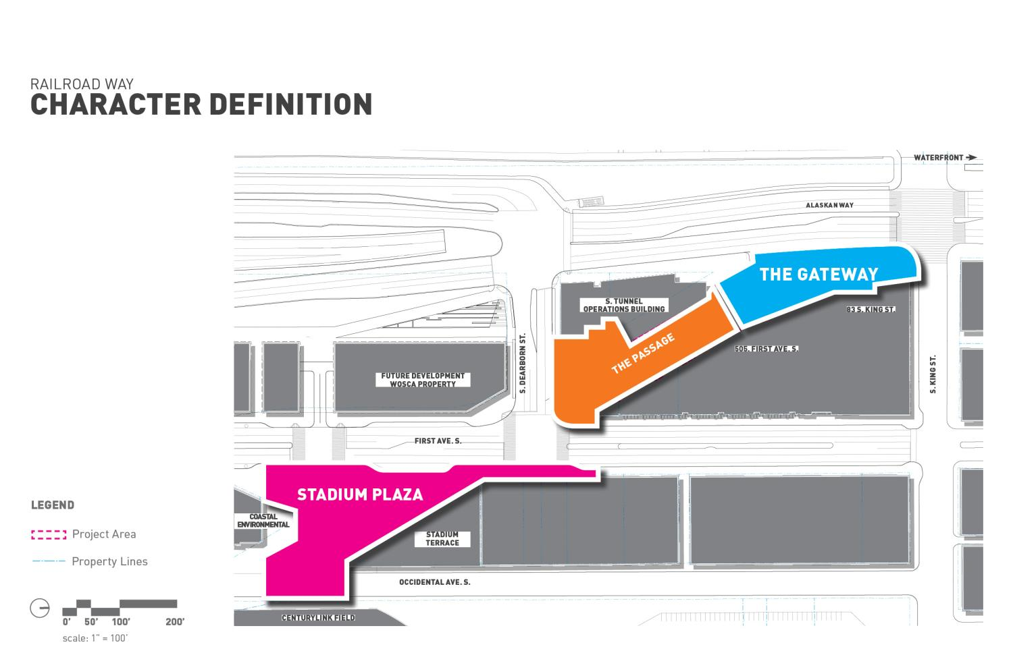

Slide 24
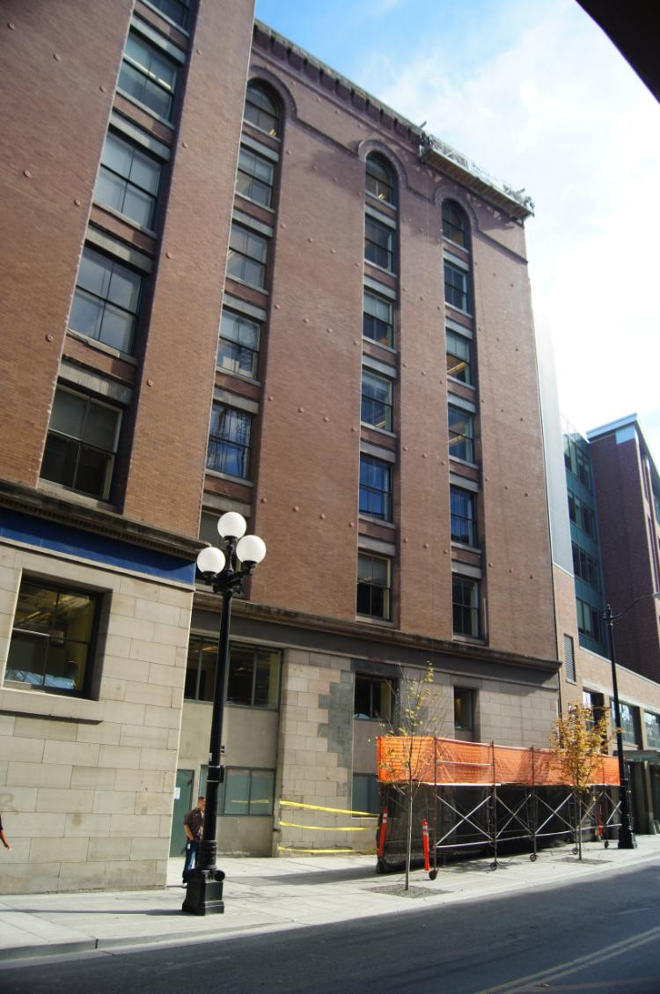
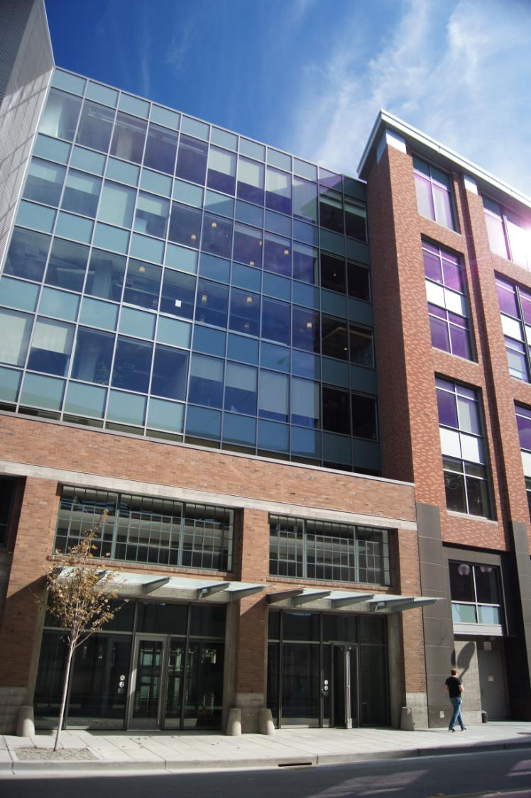

Slide 25
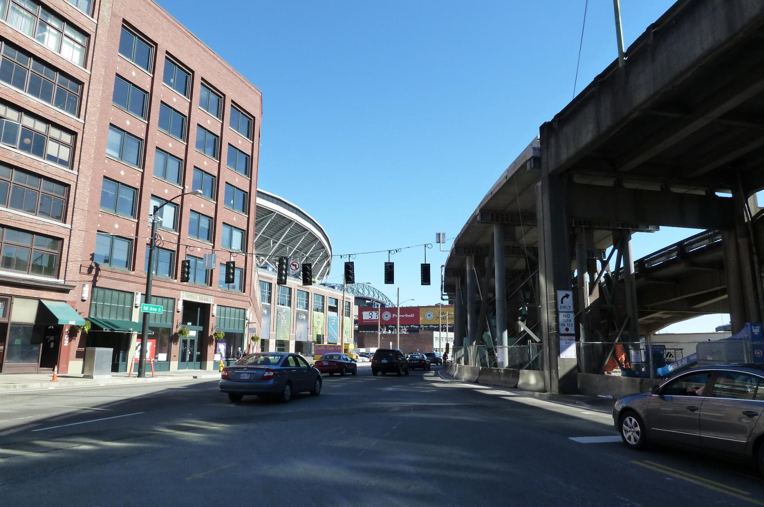

Slide 26
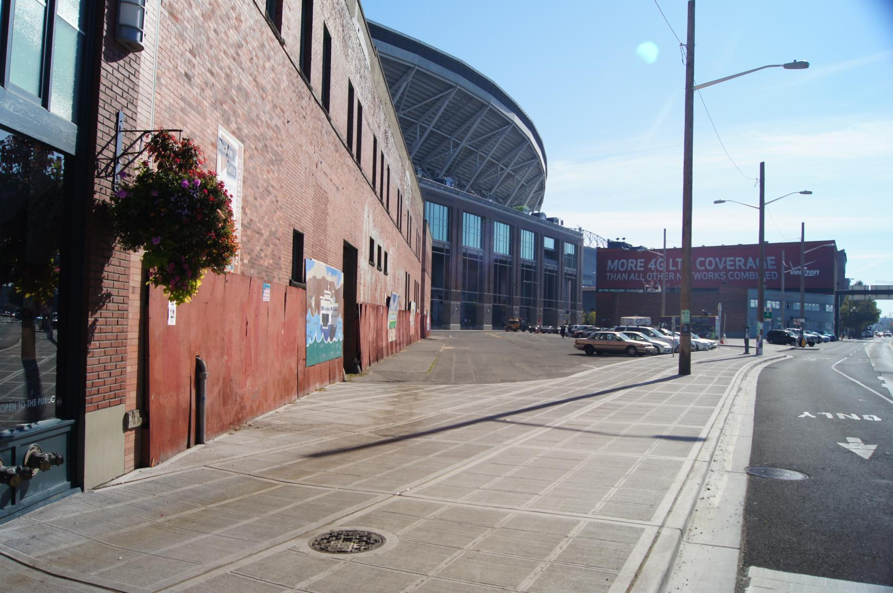

Slide 27
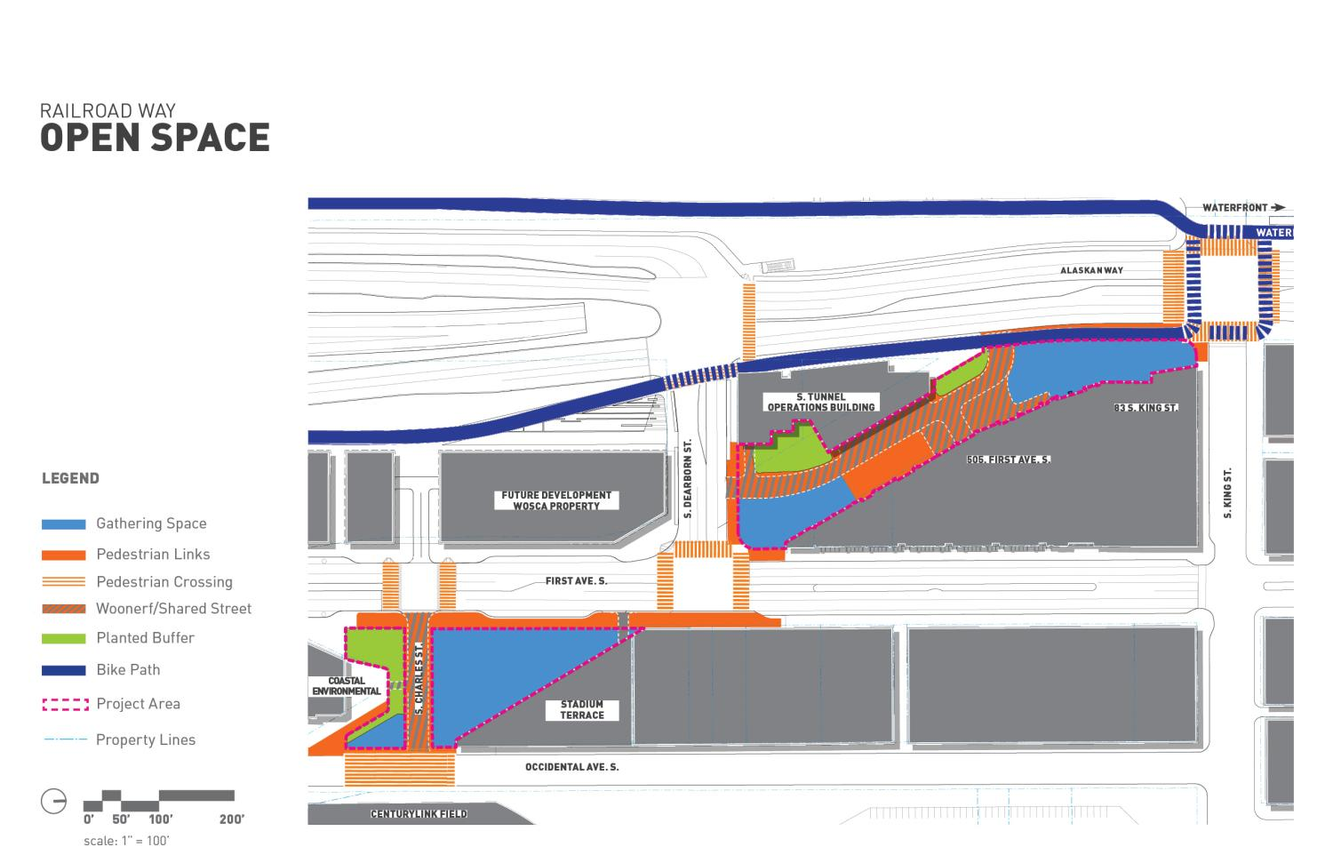

Slide 28
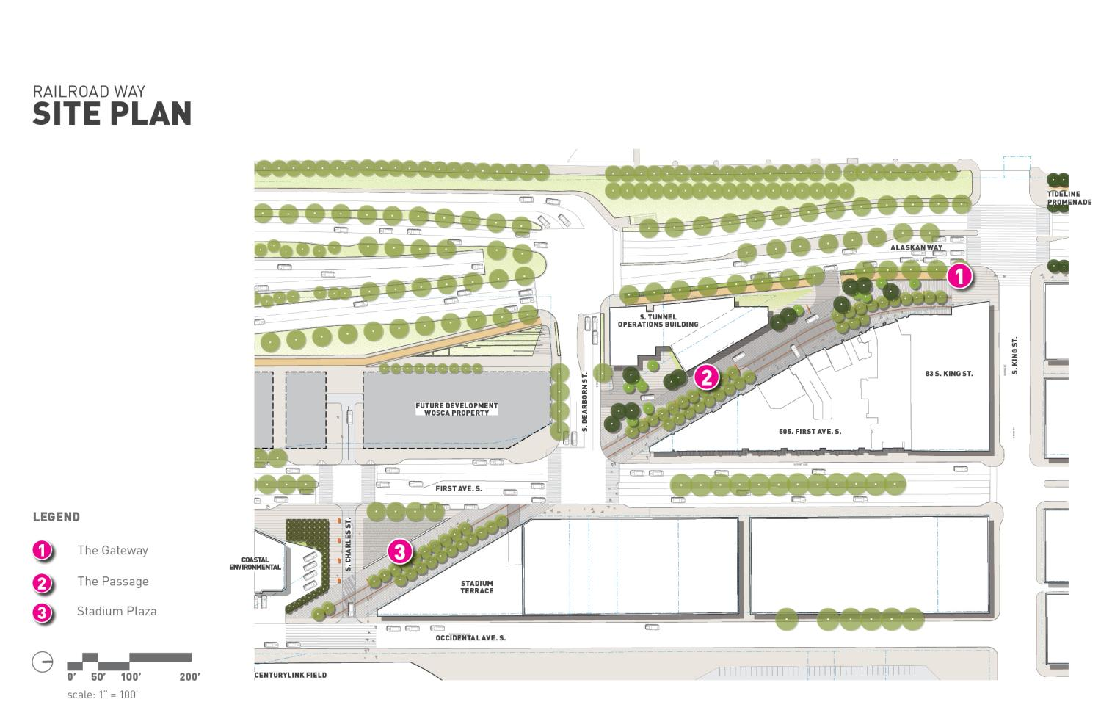

Slide 29
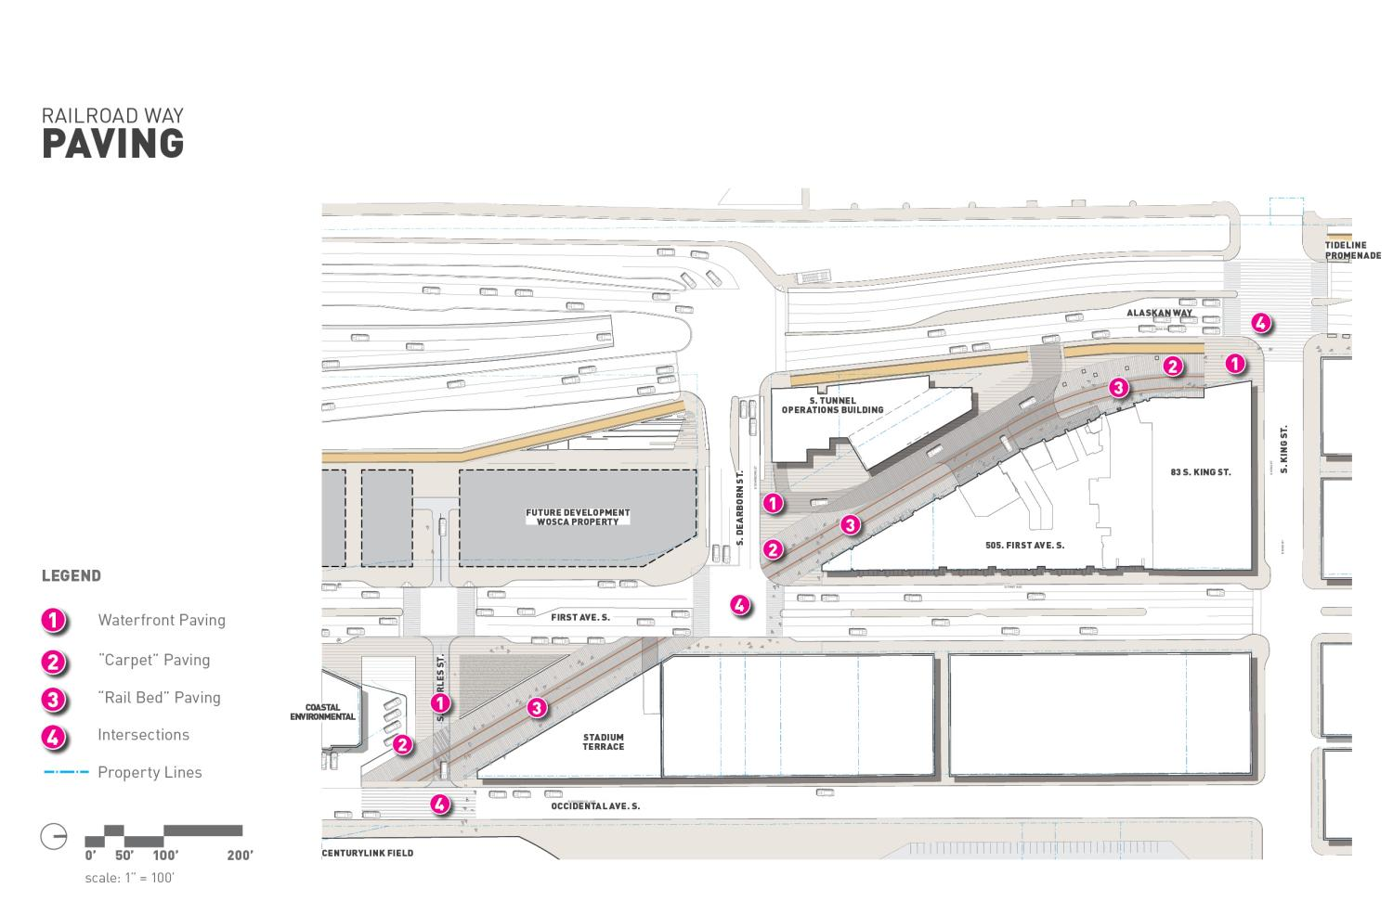

Slide 30
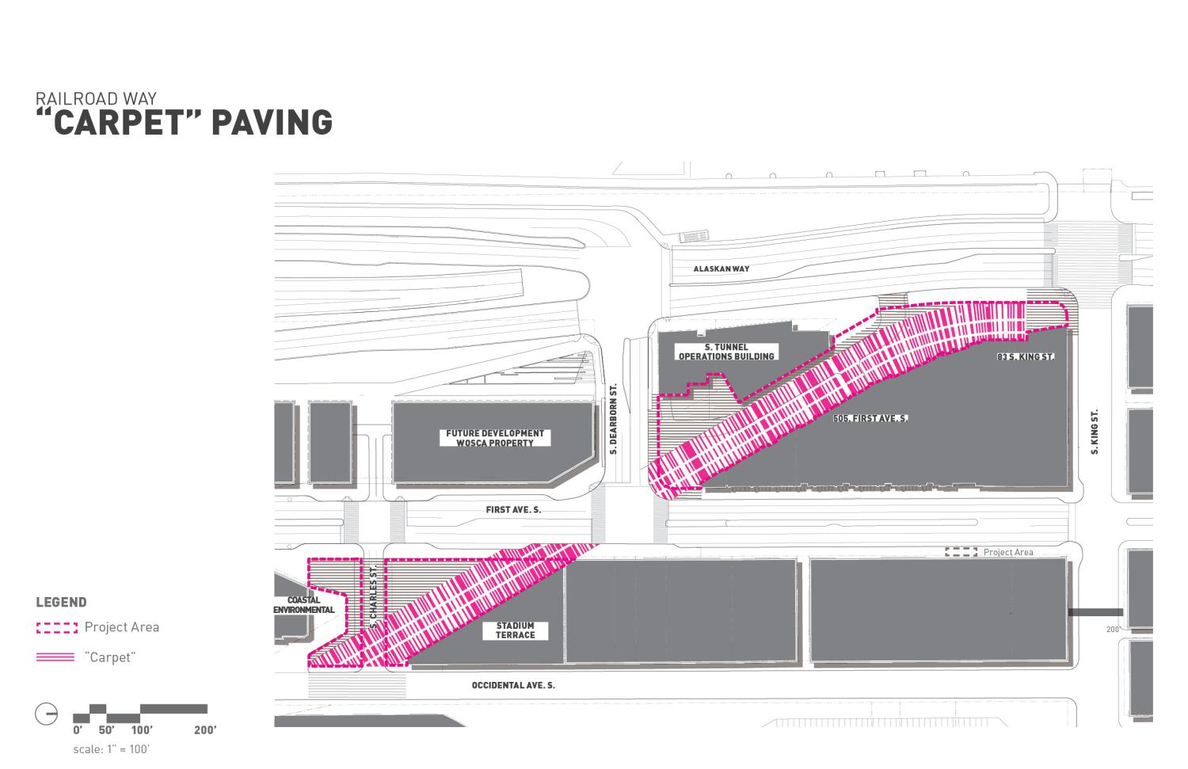

Slide 31
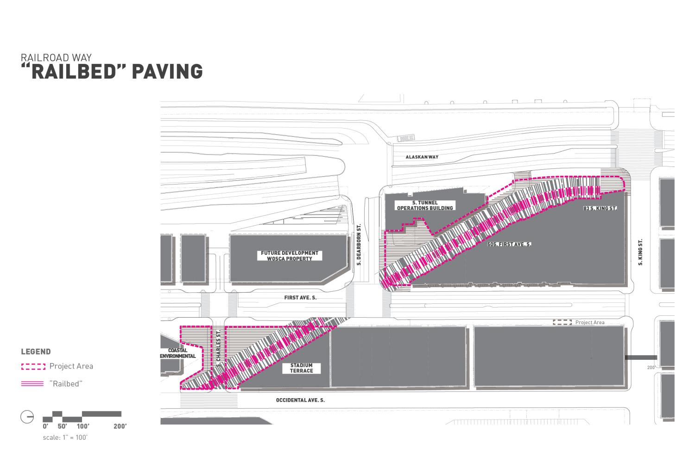

Slide 32
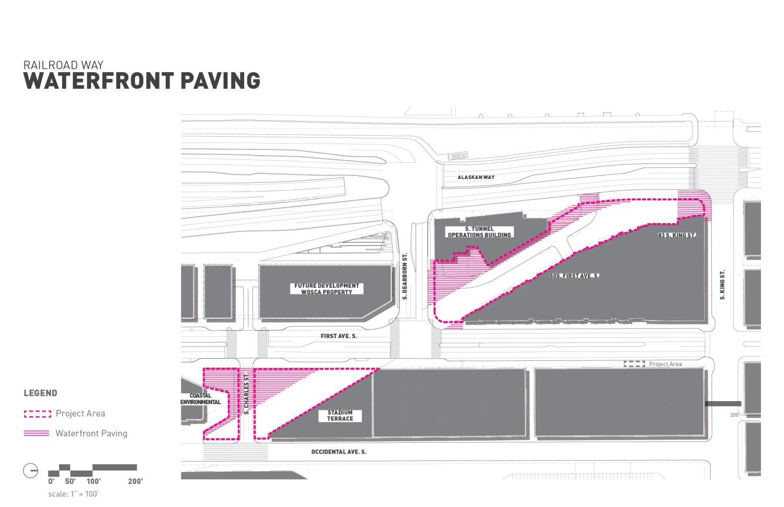

Slide 33
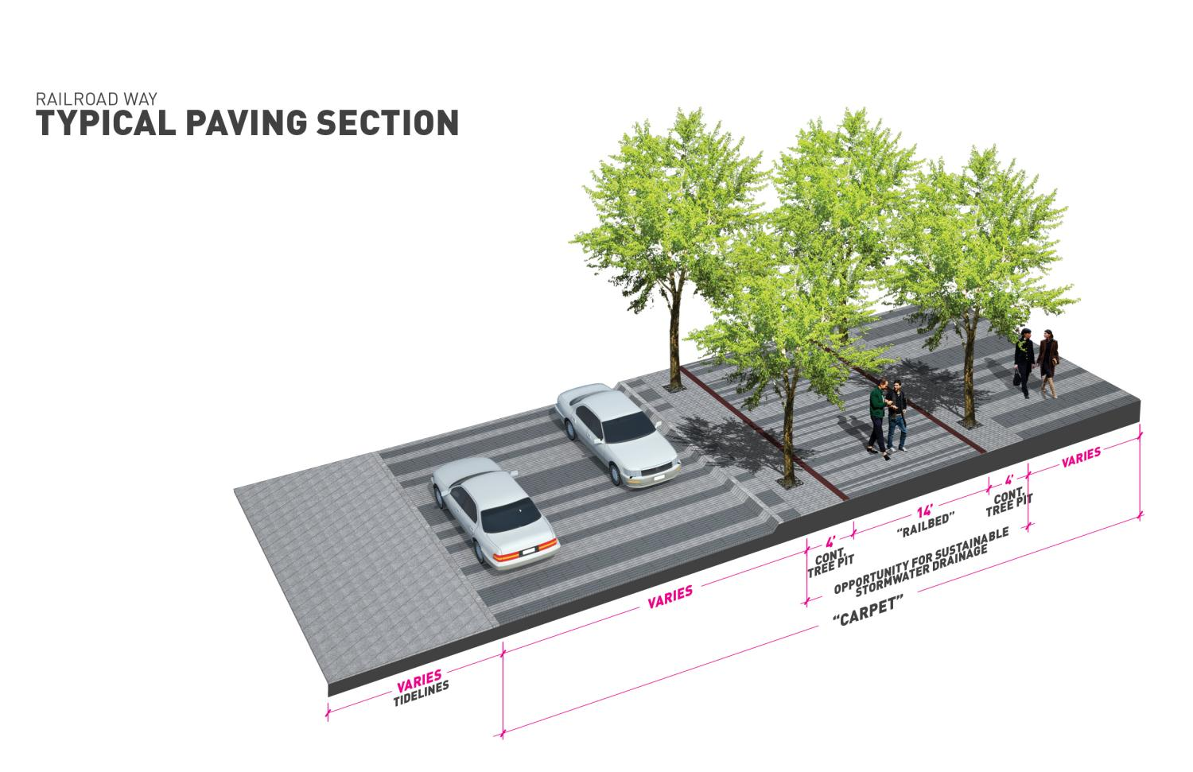

Slide 34
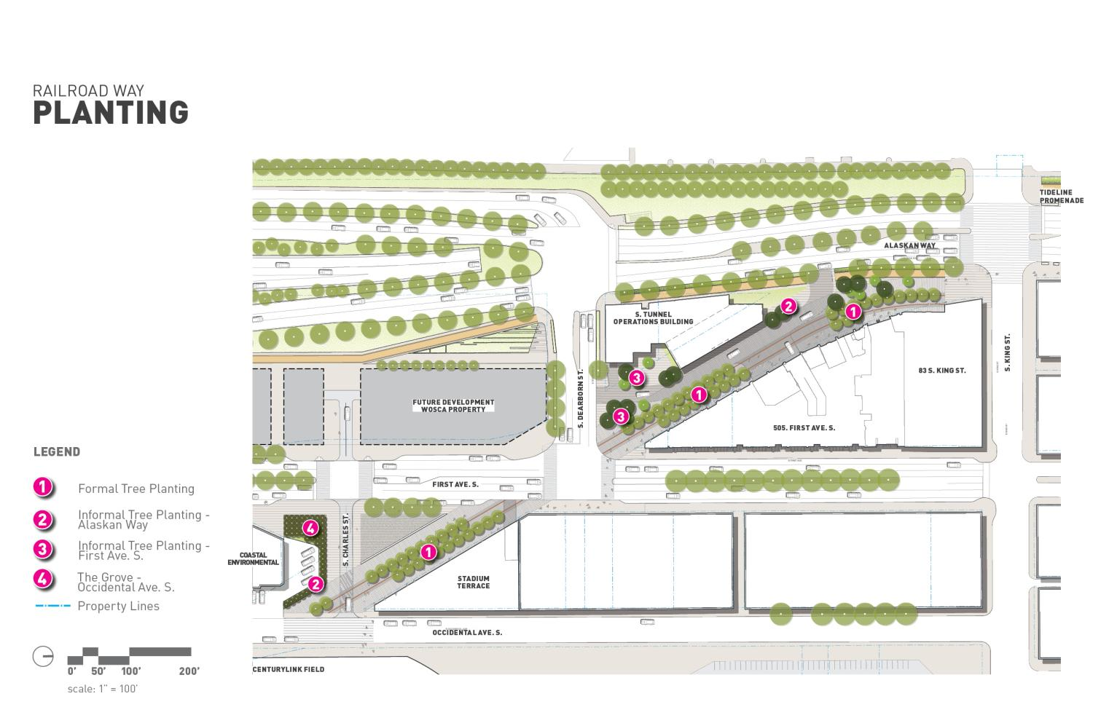

Slide 35
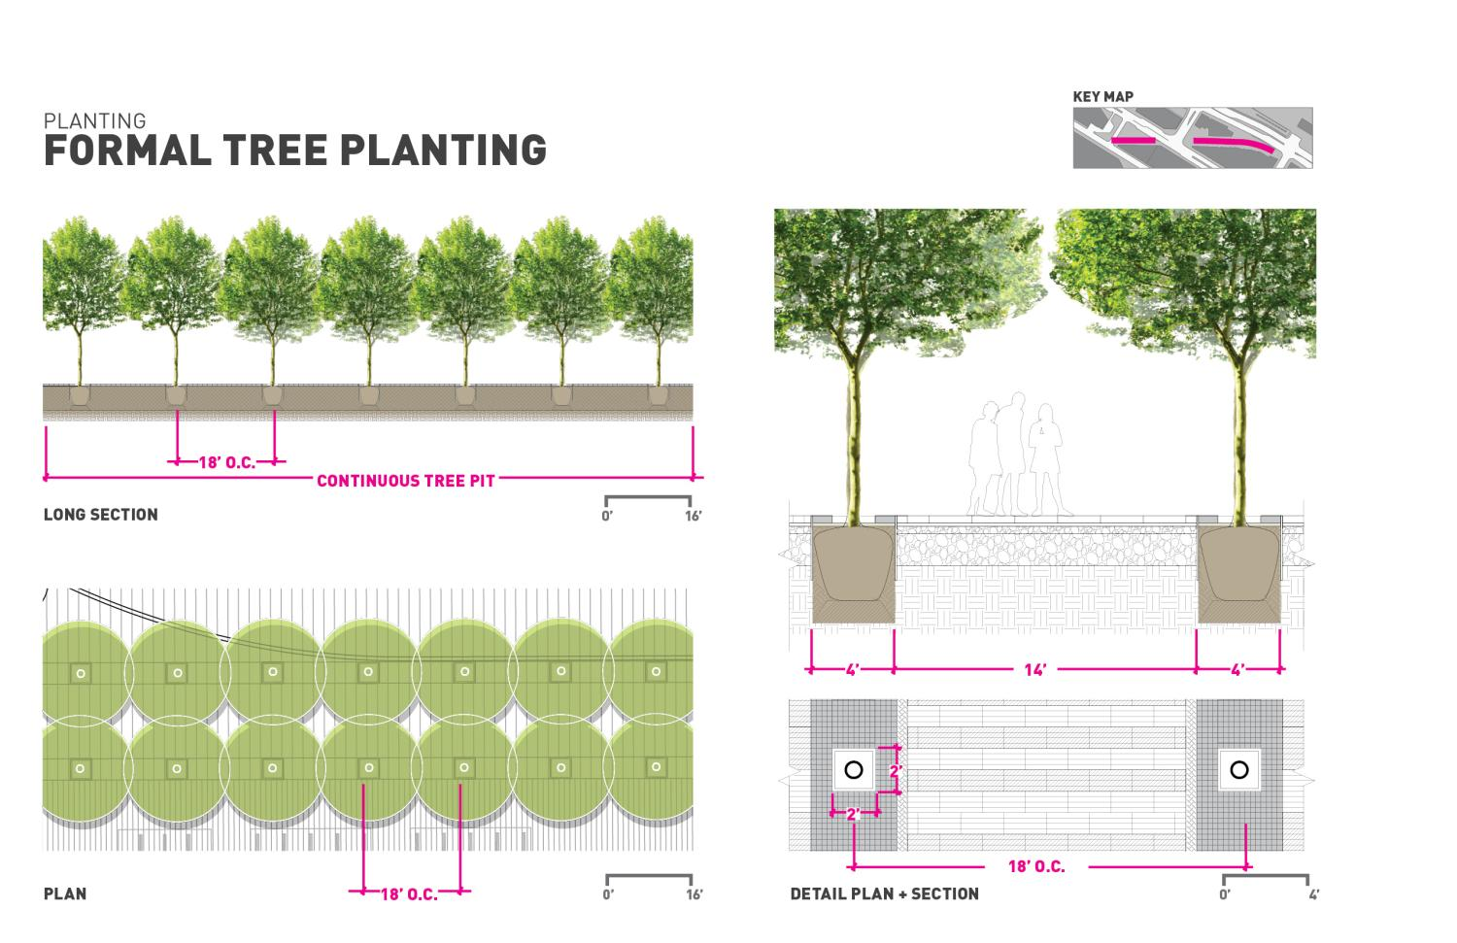

Slide 36
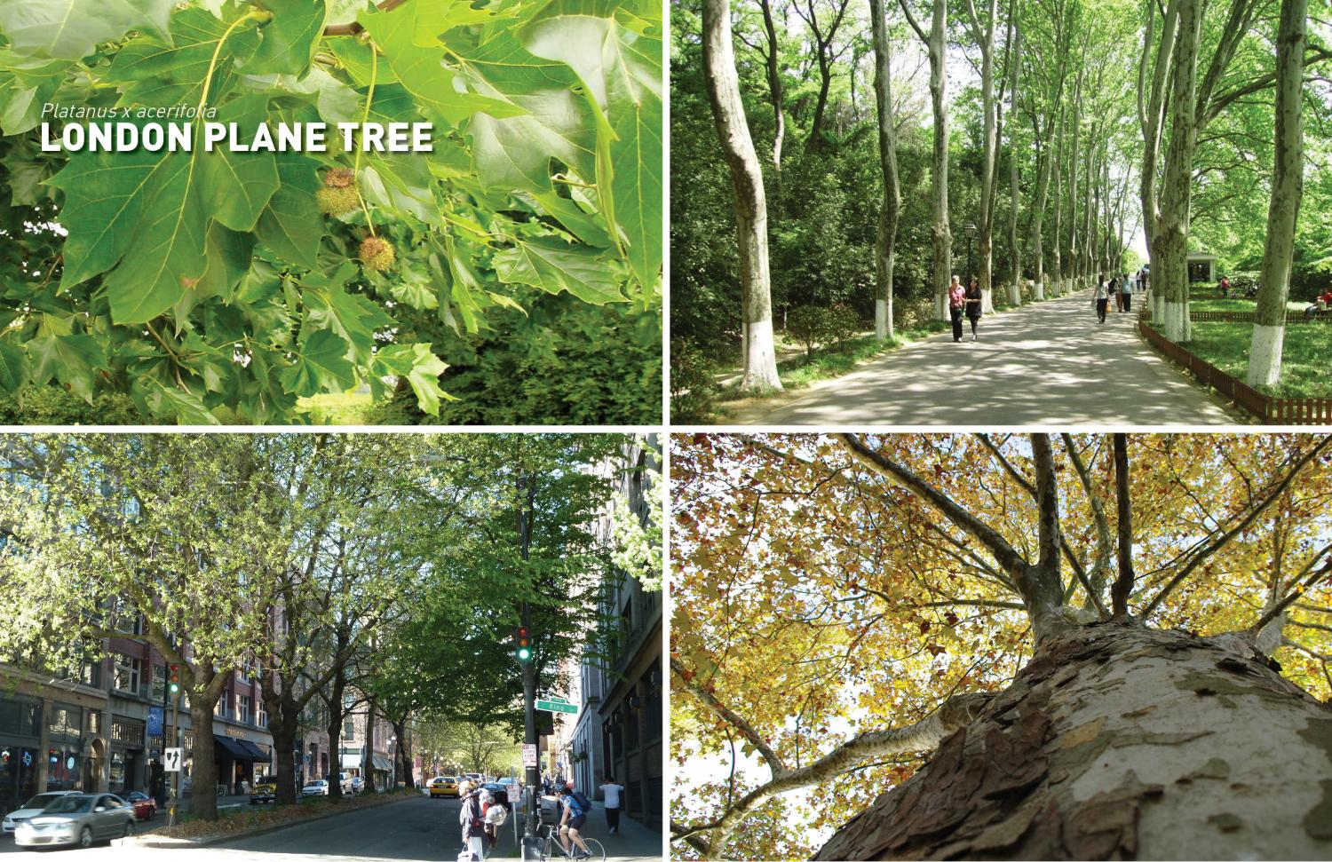

Slide 37
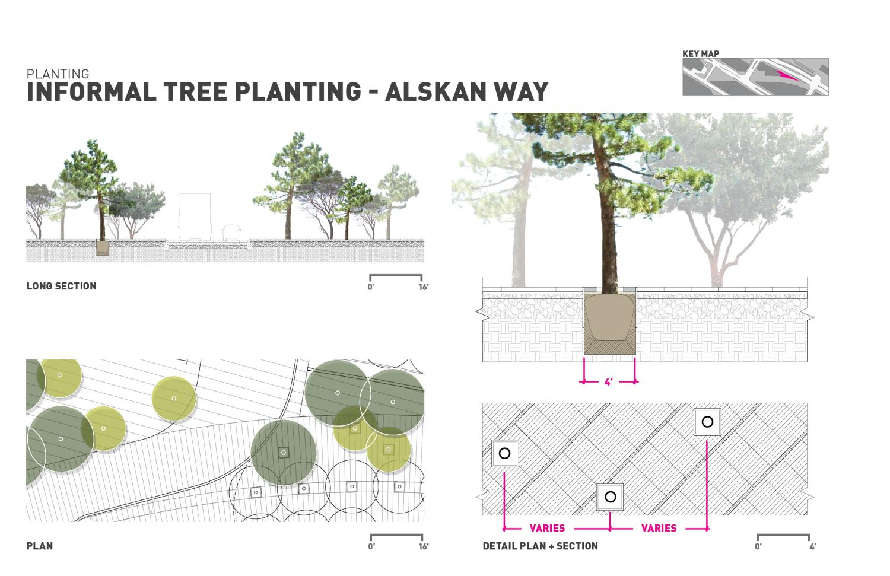

Slide 38
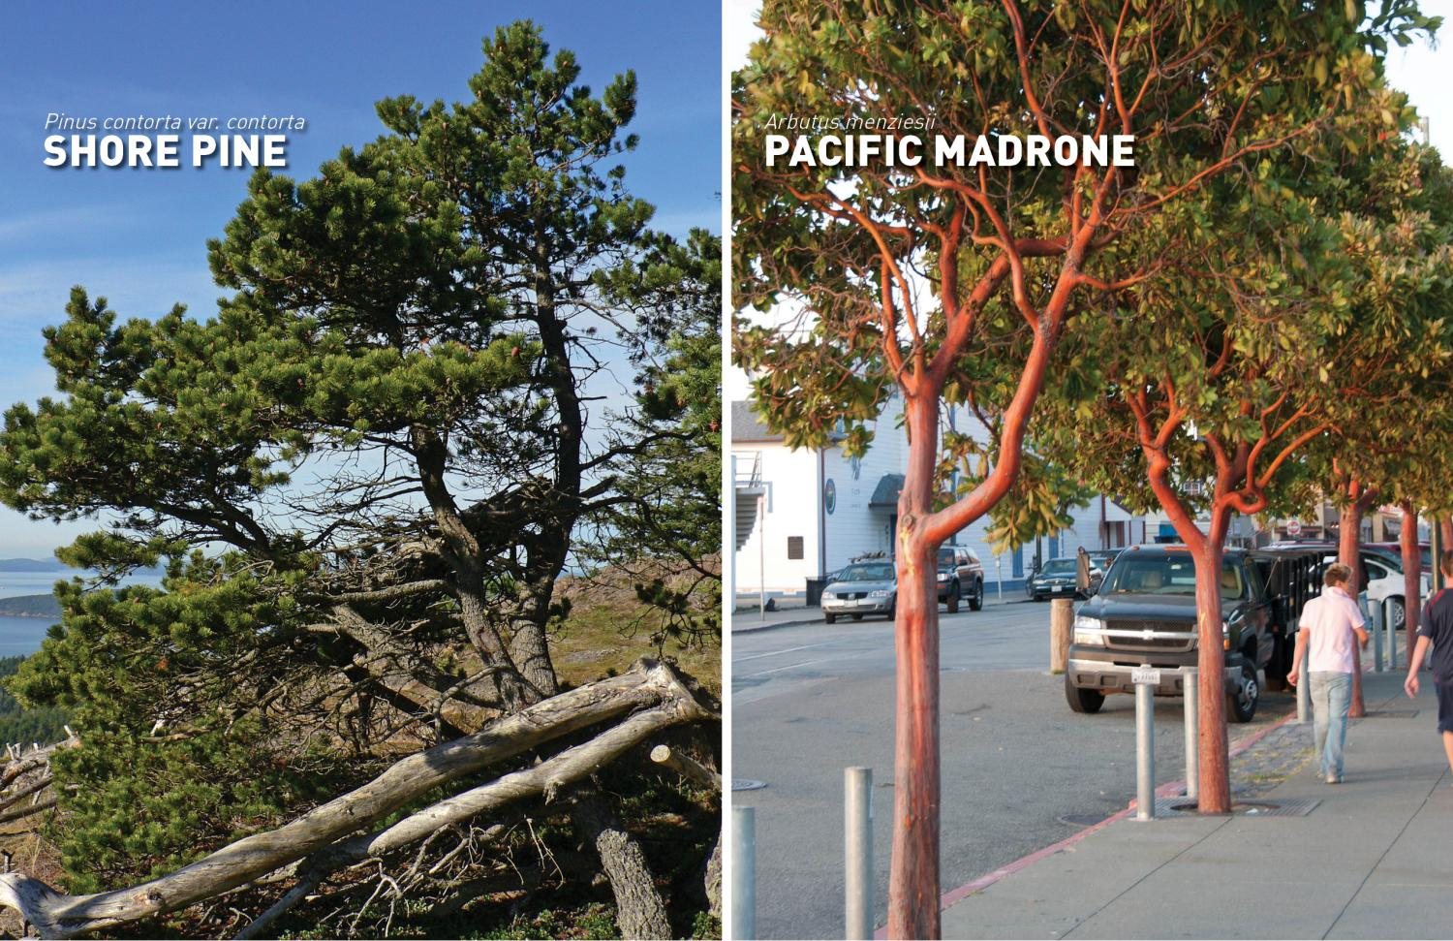

Slide 39
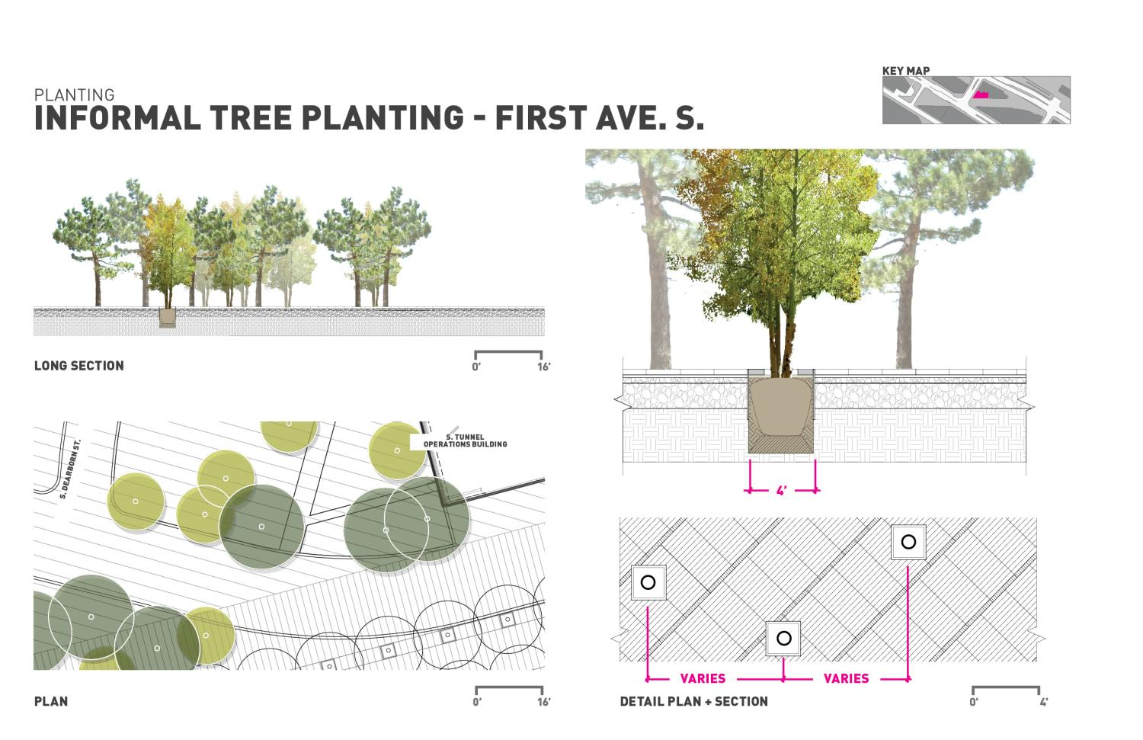

Slide 40
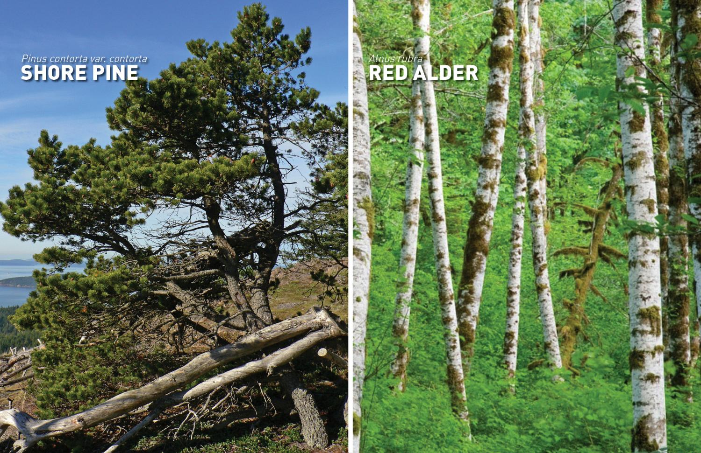

Slide 41
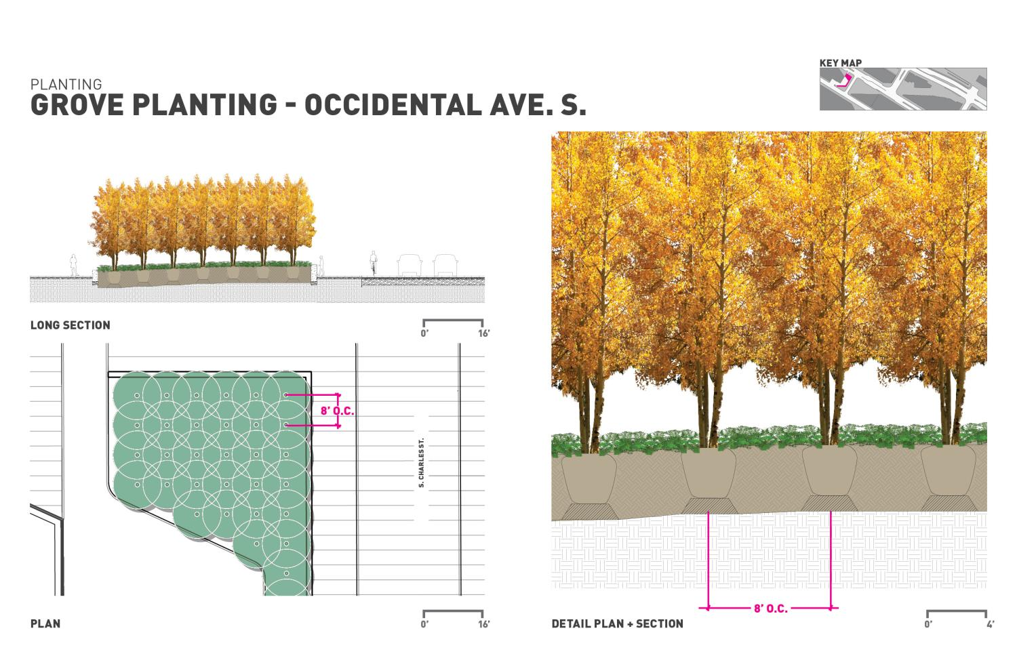

Slide 42
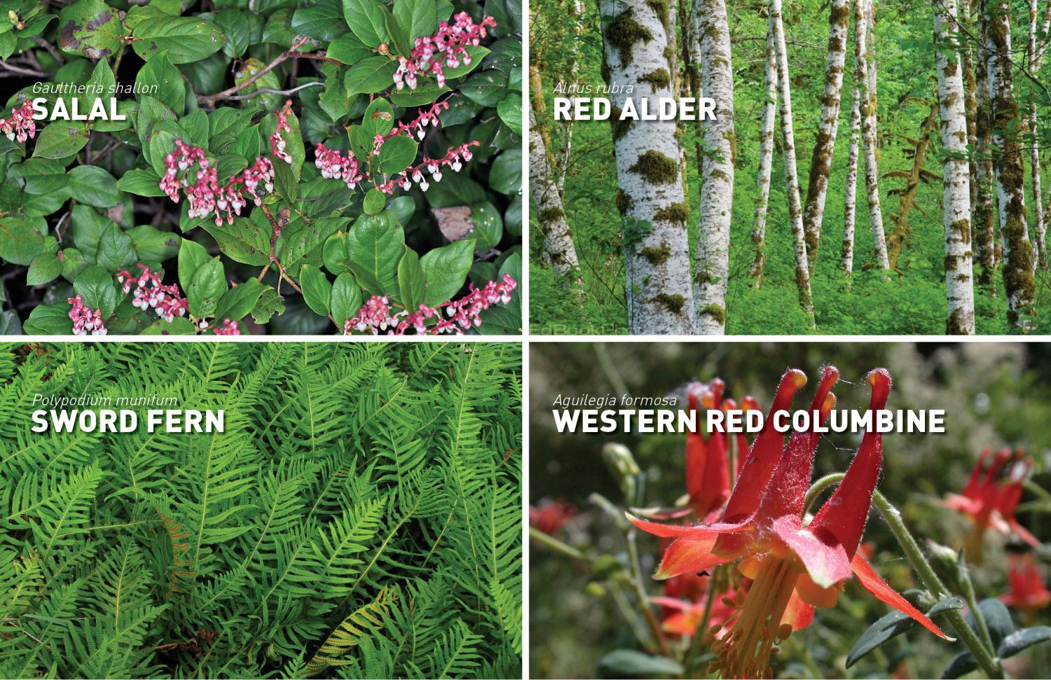

Slide 43
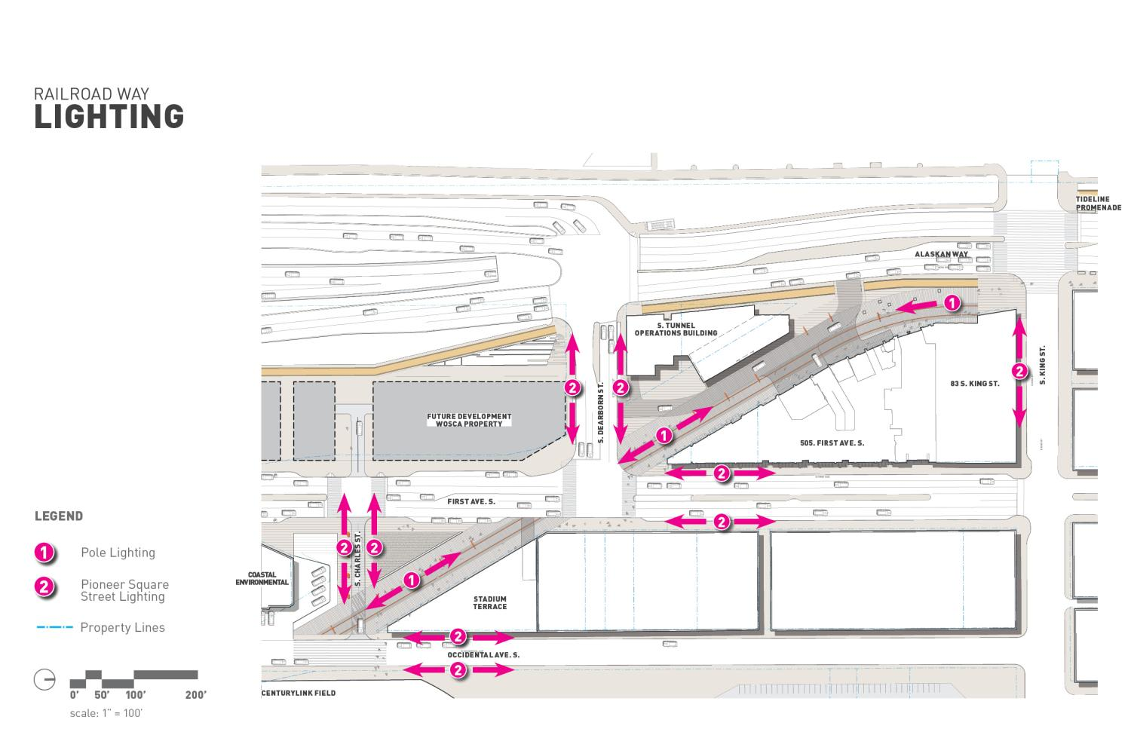

Slide 44
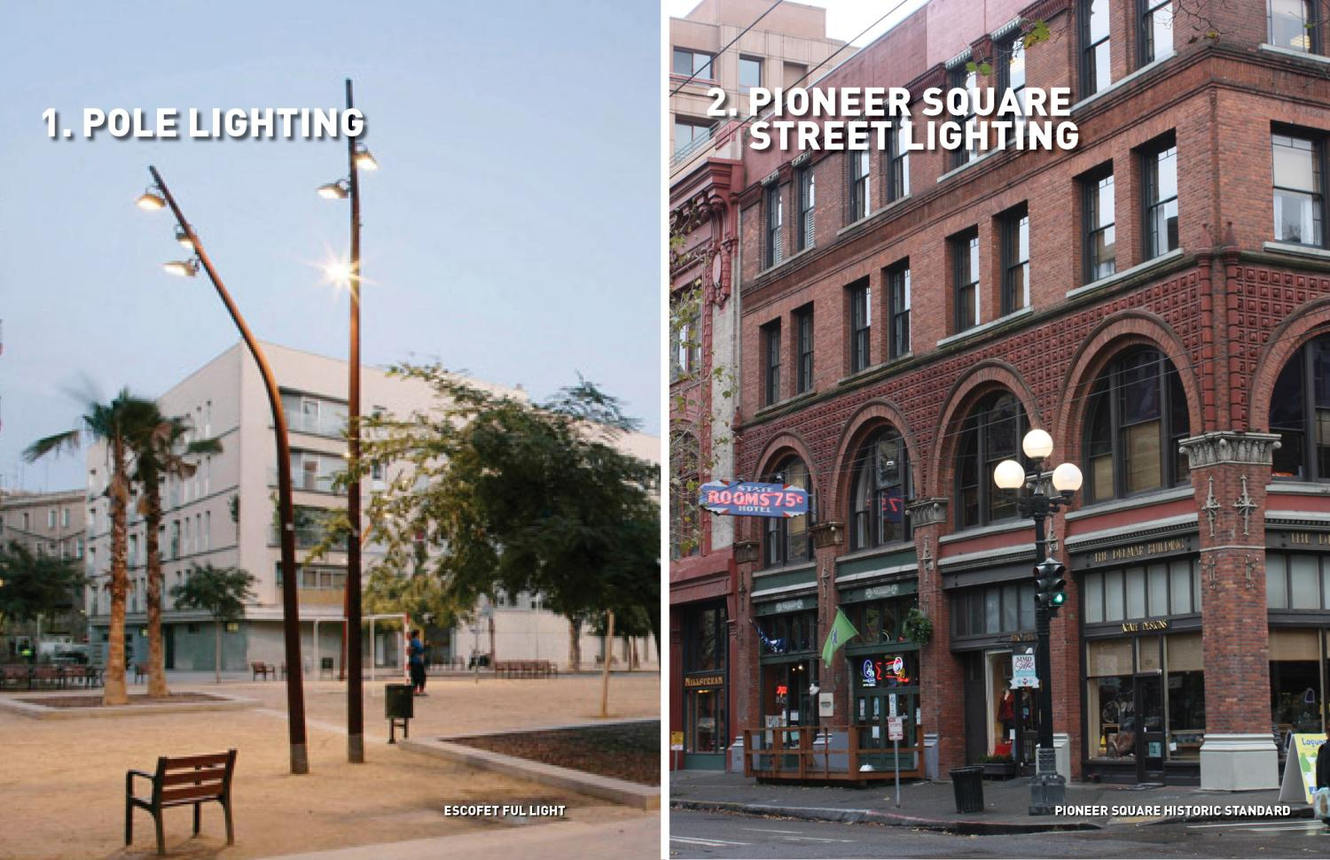

Slide 45
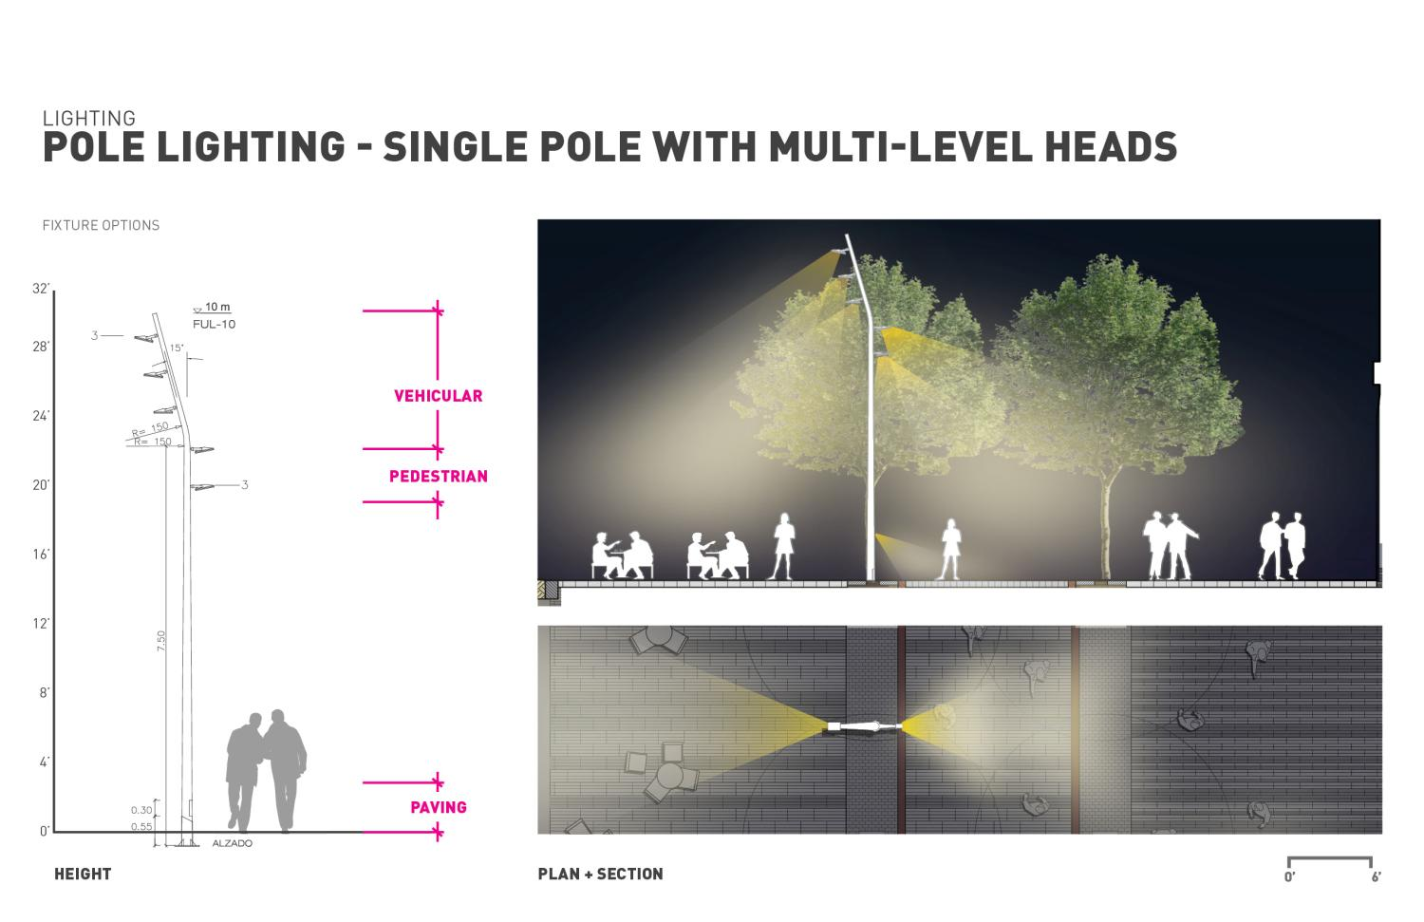

Slide 46
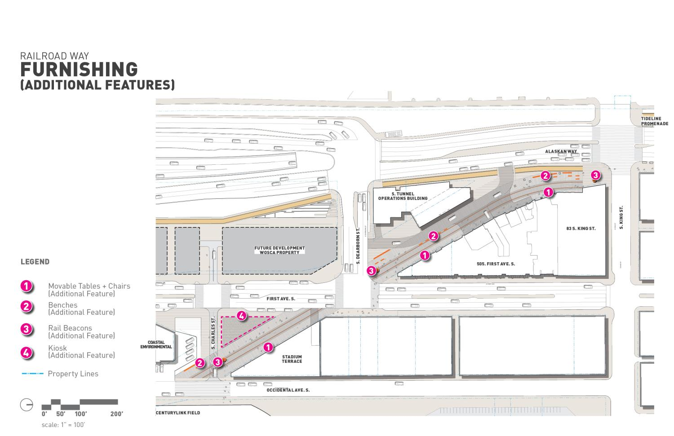

Slide 47
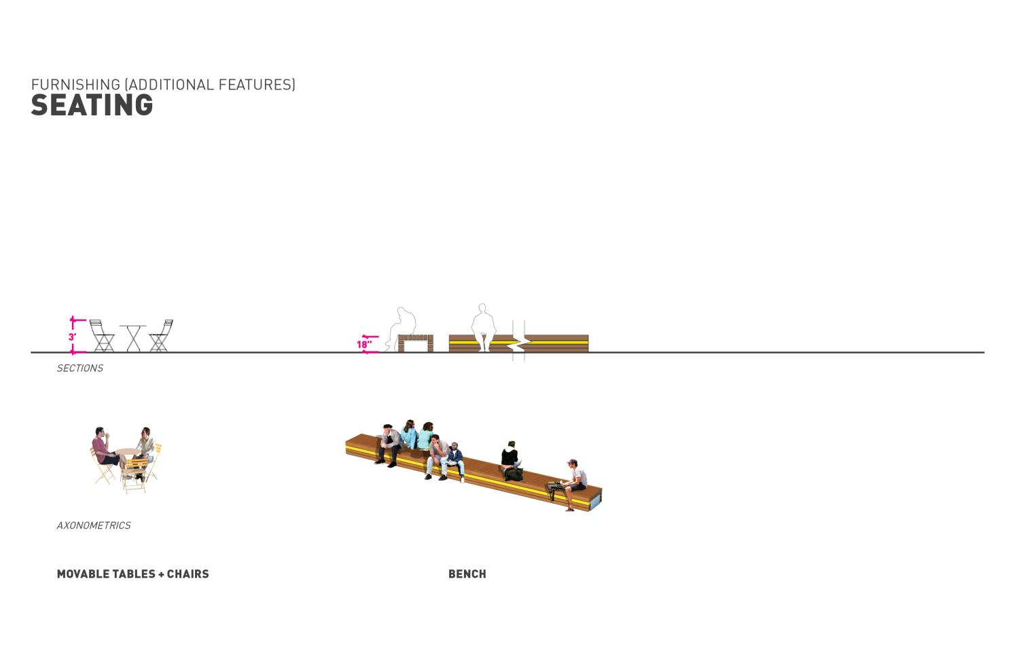

Slide 48
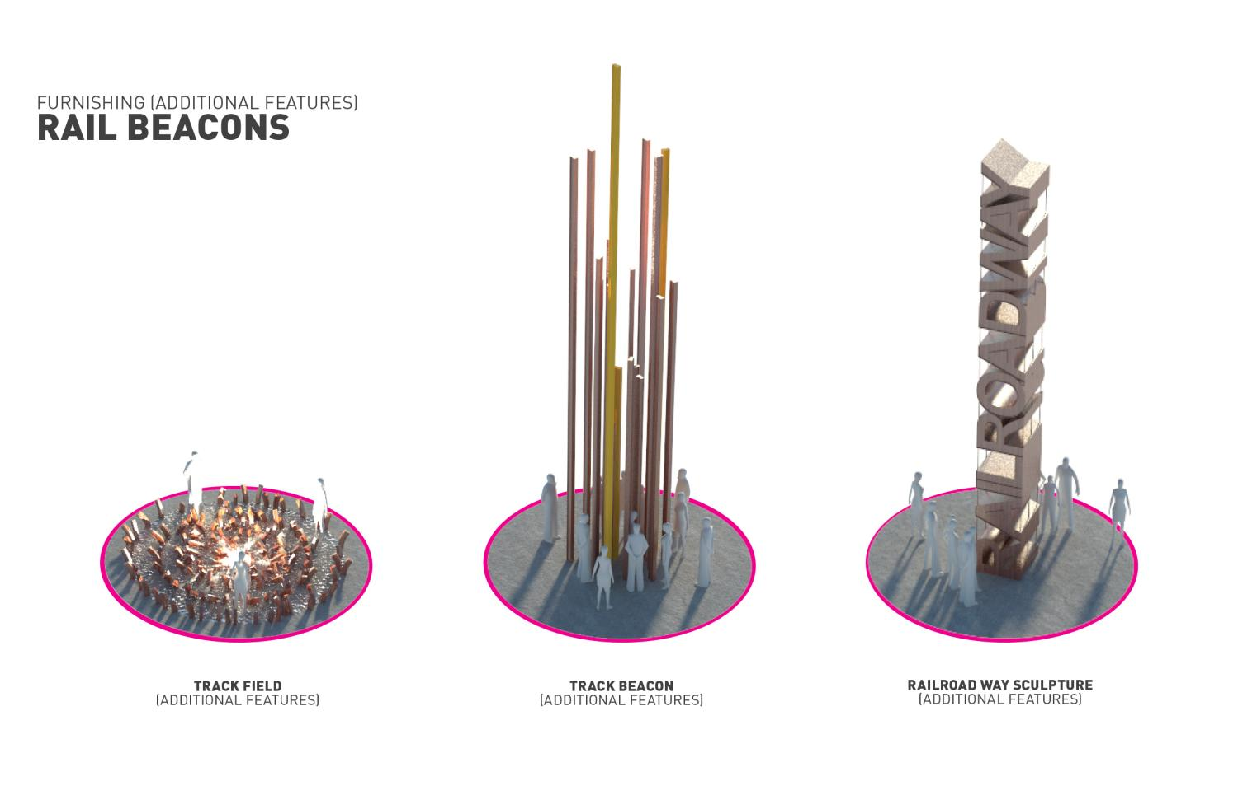

Slide 49
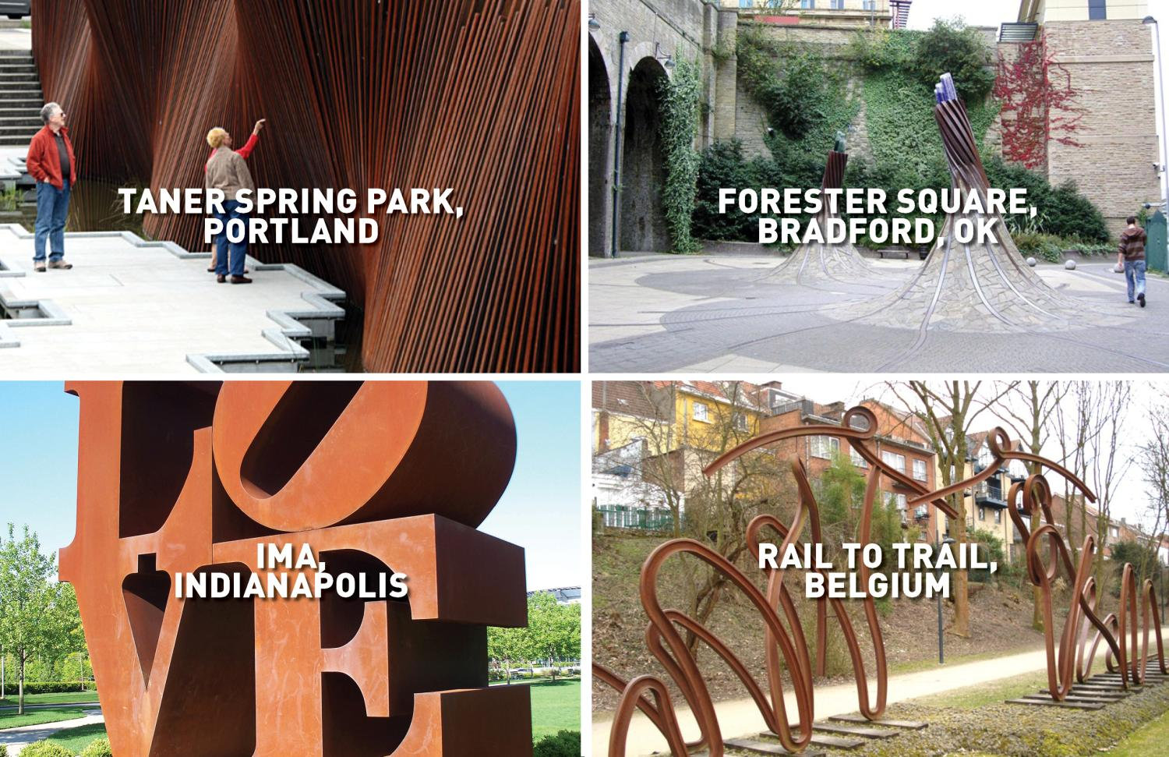

Slide 51


Slide 52


Slide 53


Slide 54


Slide 55


Slide 56


Slide 57


Slide 58


Slide 59


Slide 60


Slide 61


Slide 62


Slide 63


Slide 64


Slide 65


Slide 66


Slide 67


Slide 68


Slide 69


Slide 70


Slide 71


Slide 72


Slide 73


Slide 76


Slide 77


