Slide 2


Slide 3
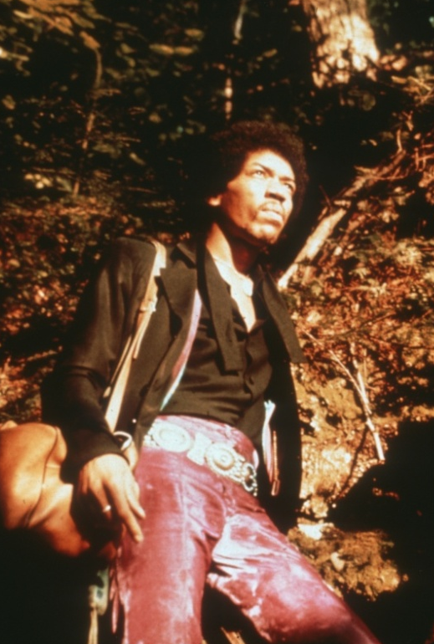
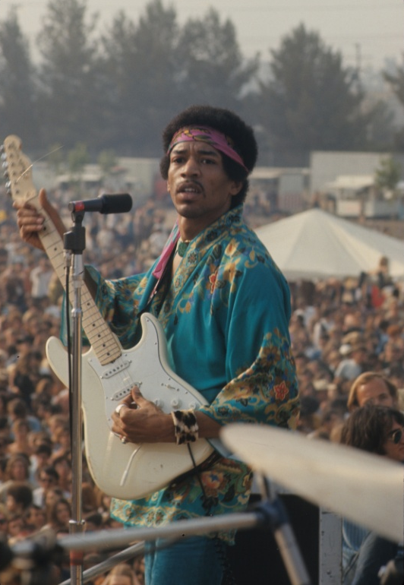
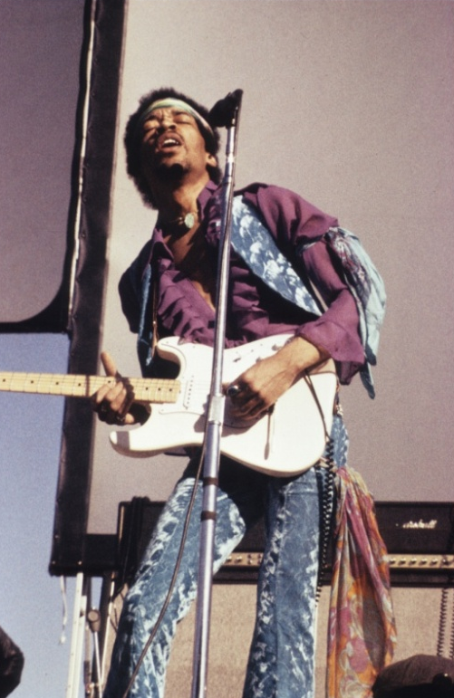

Slide 4
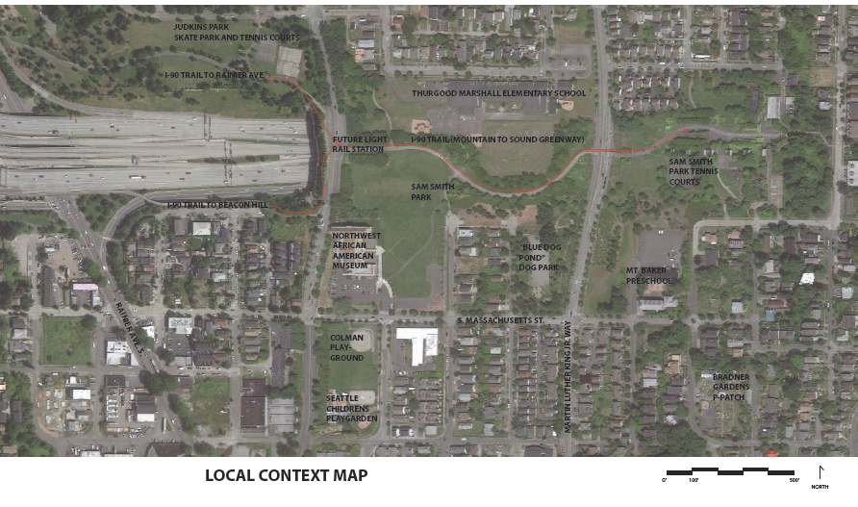
JIMI HENDRIX PARK
23RD AVE S.

Slide 5
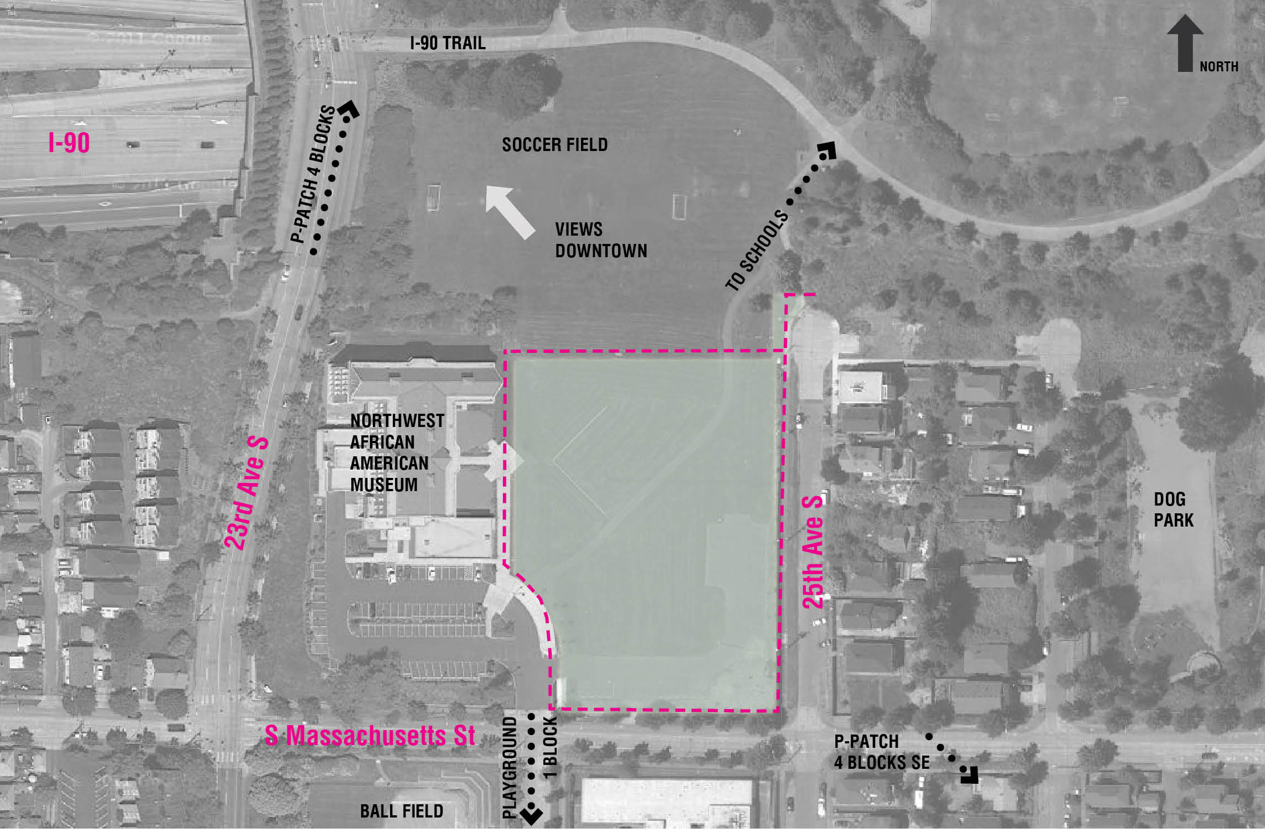

Slide 6
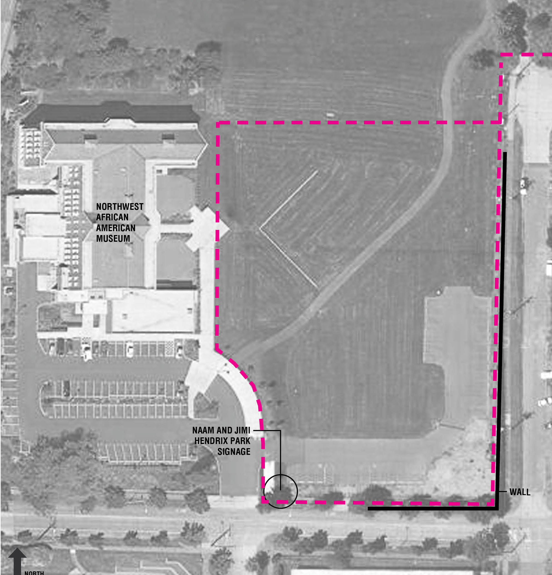

Slide 7
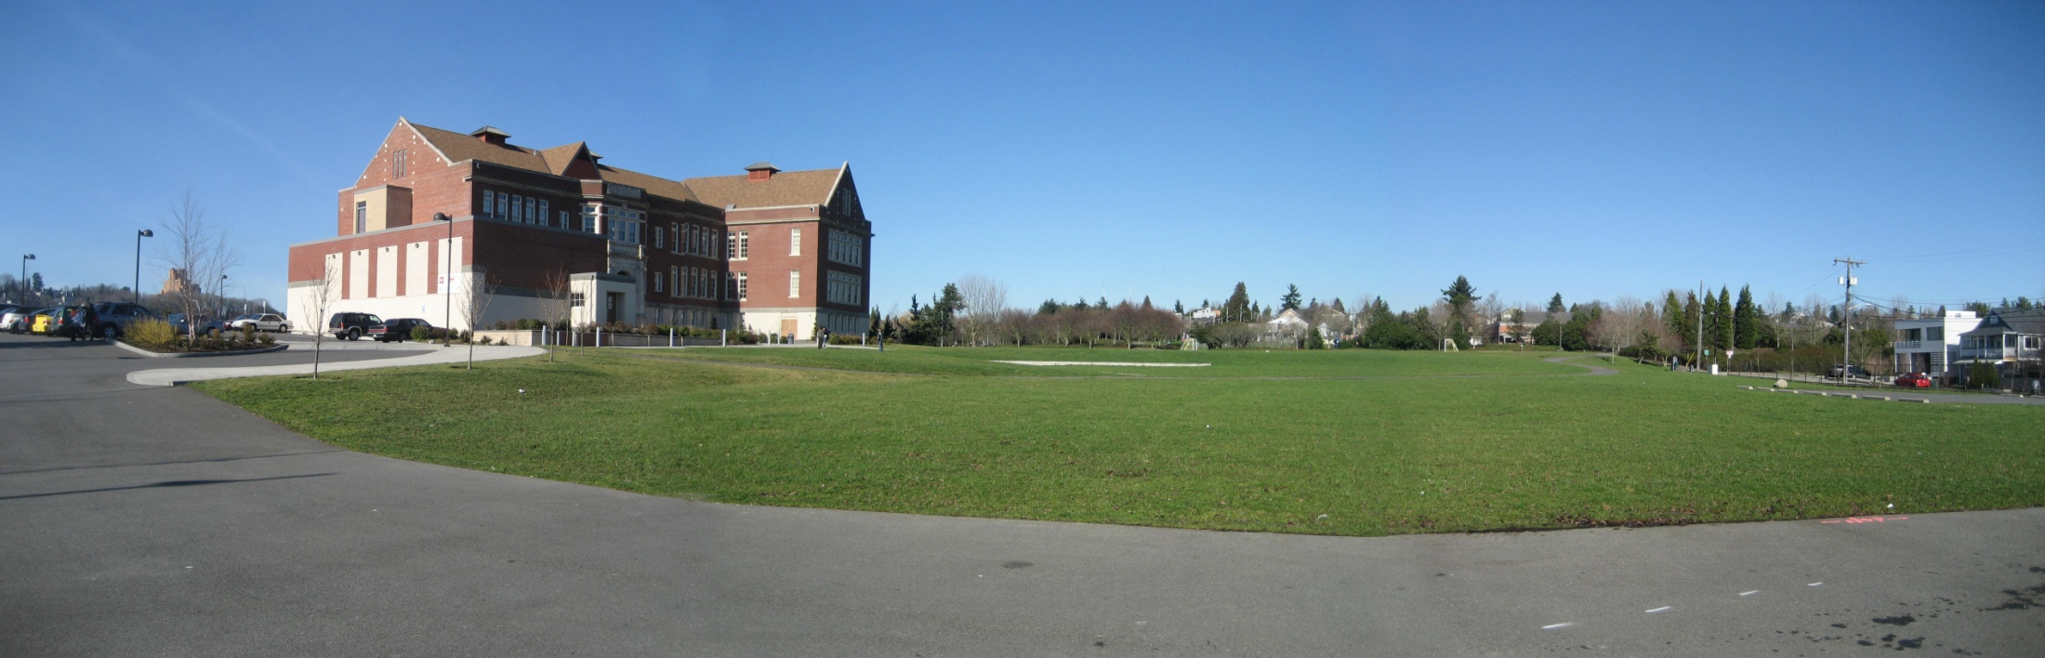
VIEW OF PARK FROM SOUTH (EXISTING PARKING LOT)

Slide 8
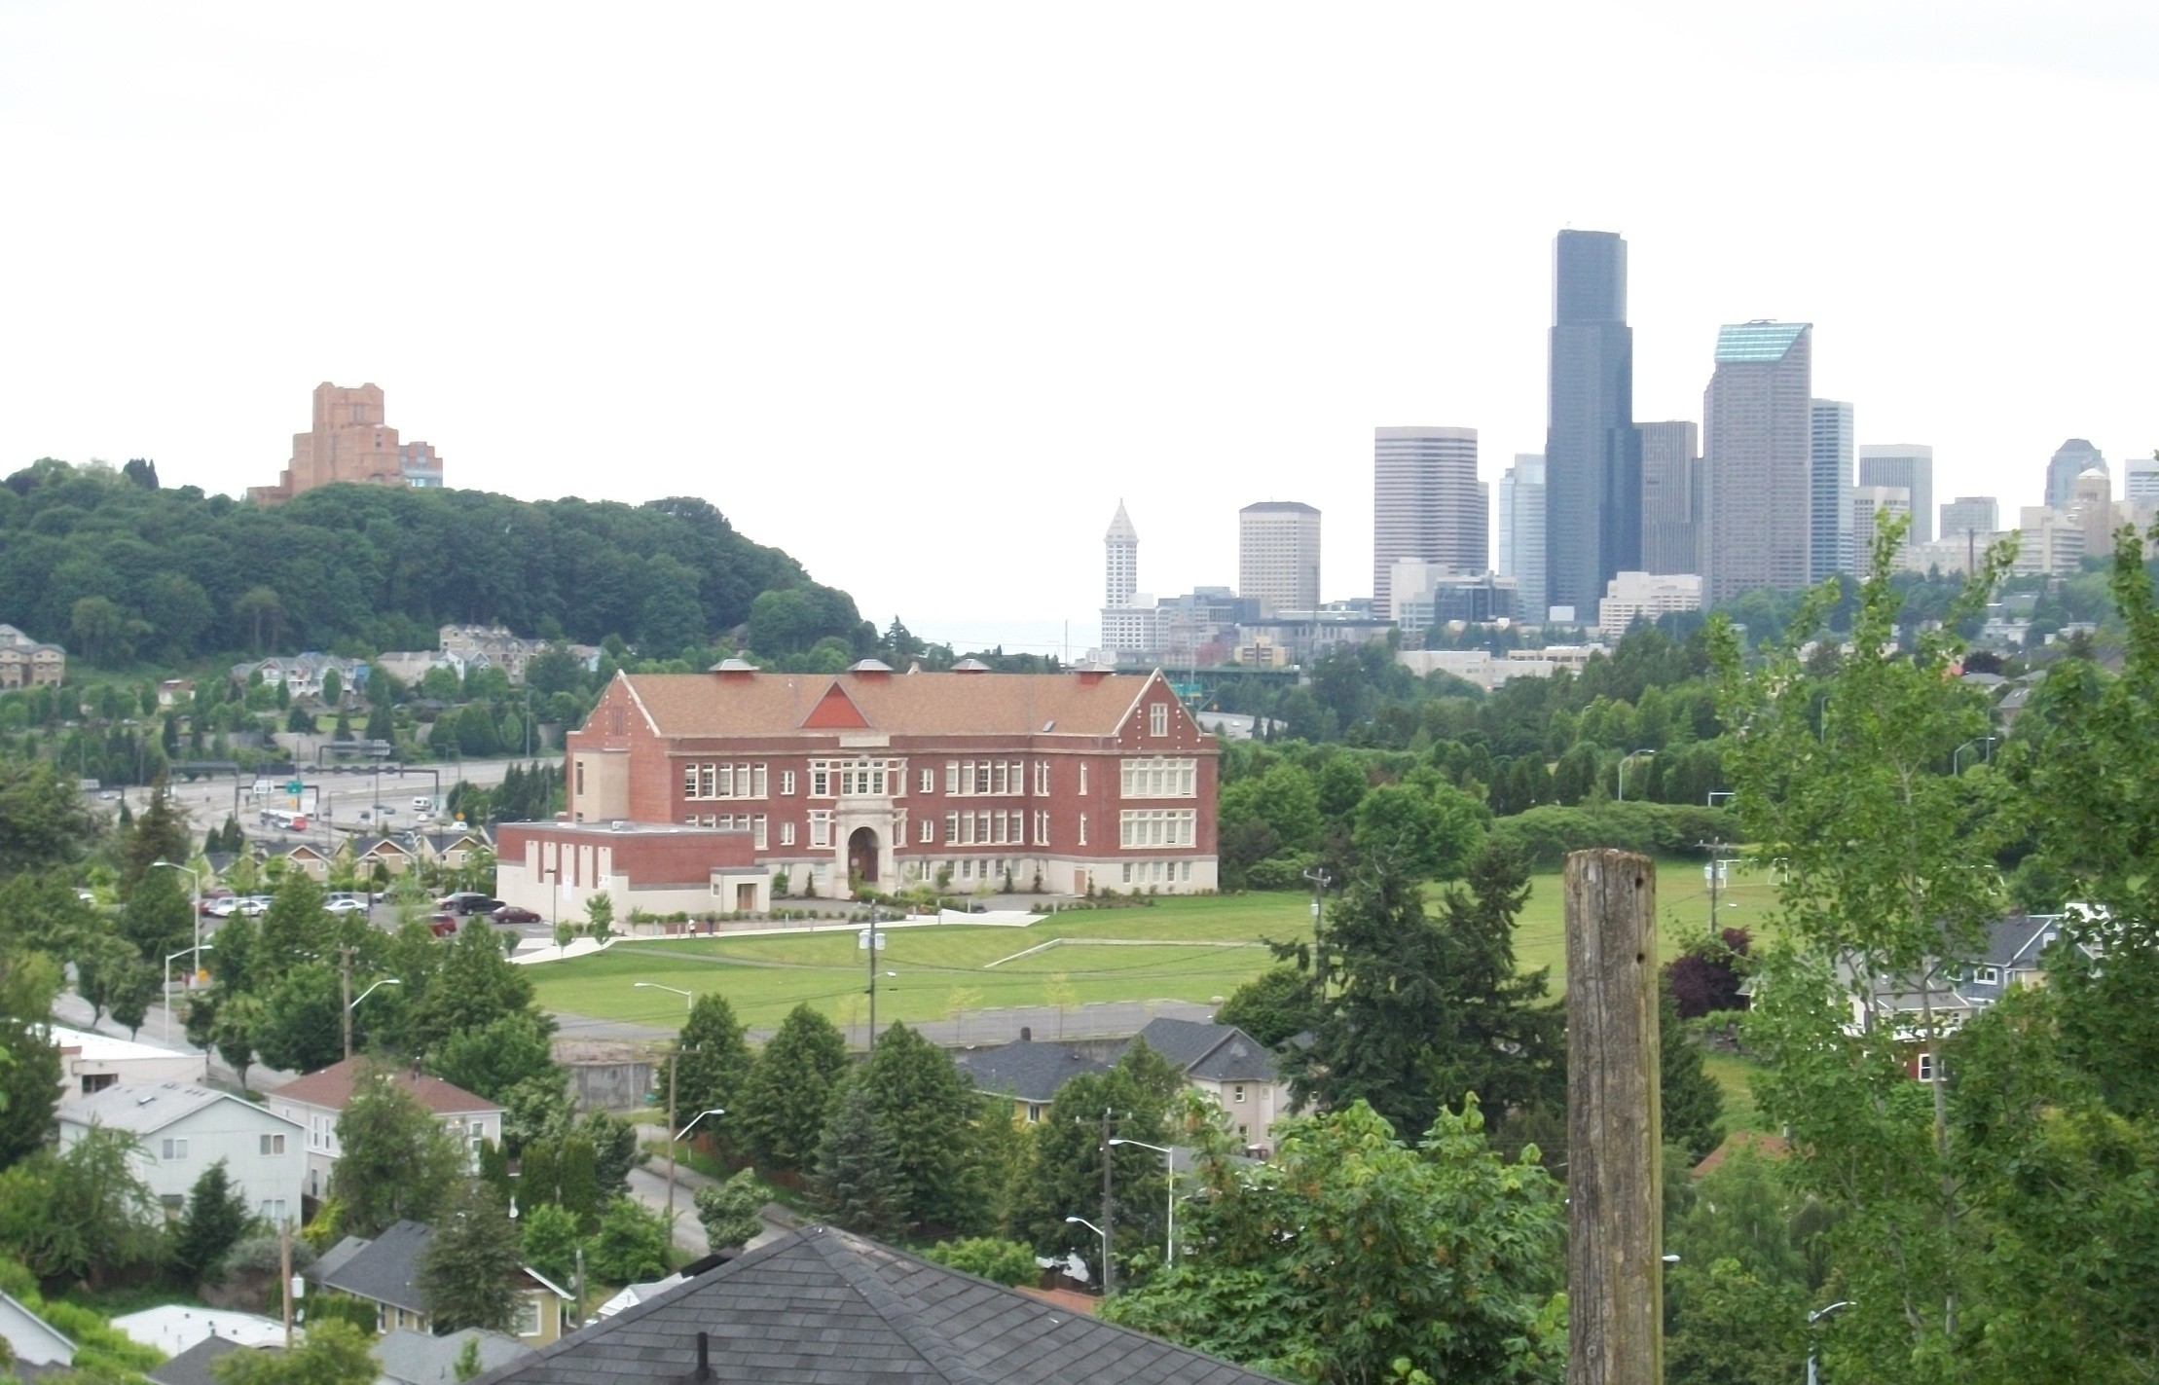
VIEW OF PARK FROM SOUTHEAST (MT. BAKER NEIGHBORHOOD)

Slide 9
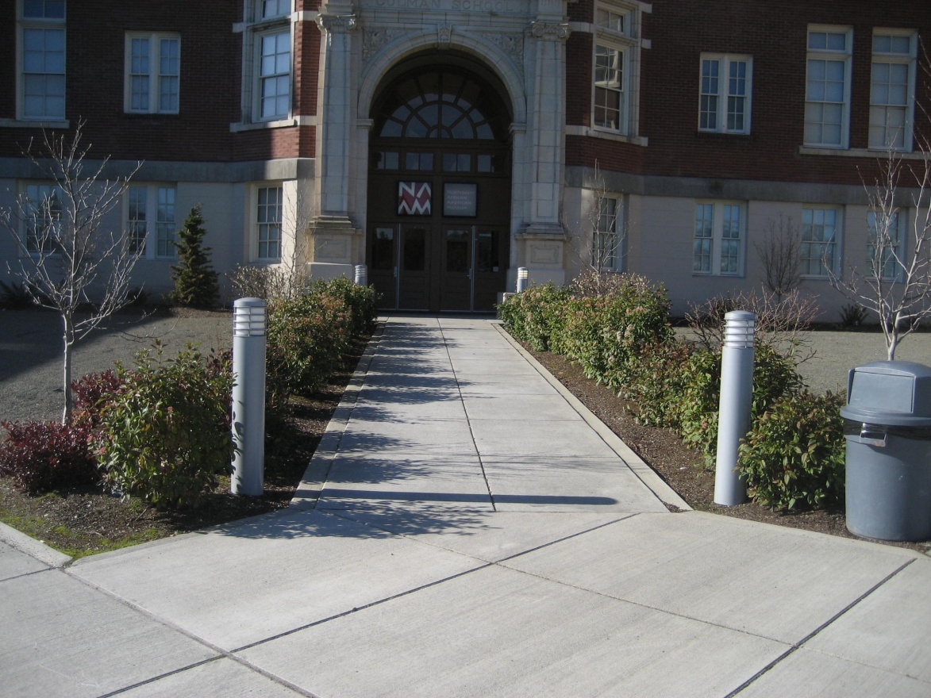
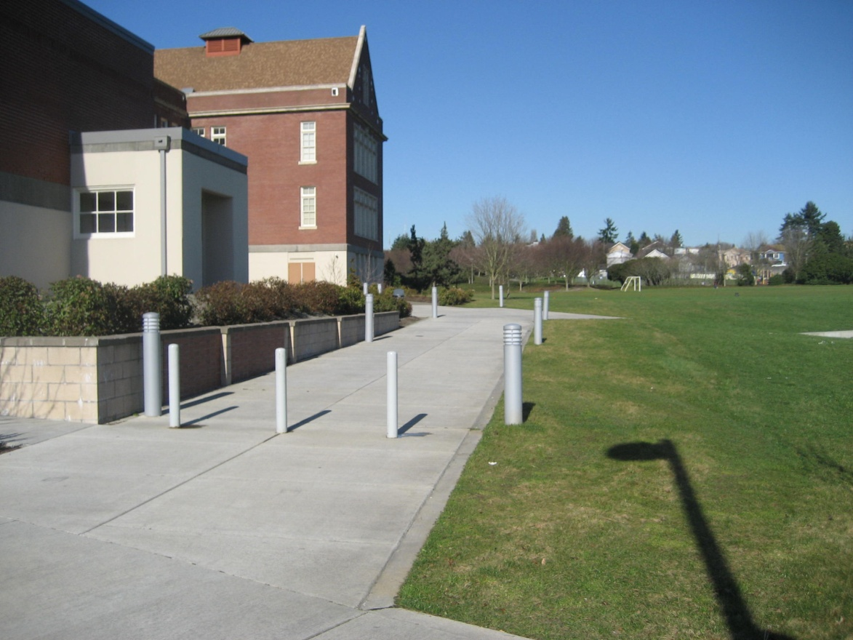
NORTHWEST AFRICAN AMERICAN MUSEUM ENTRANCE

Slide 10
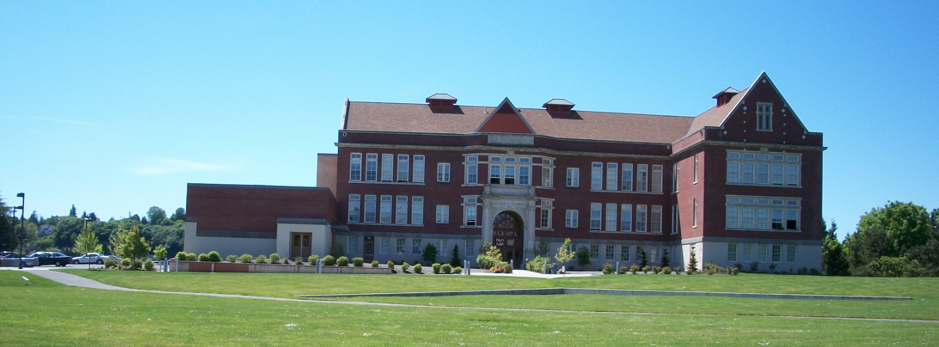
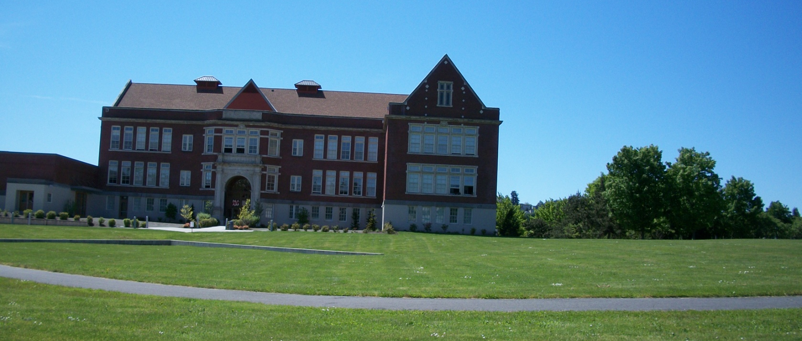

Slide 11
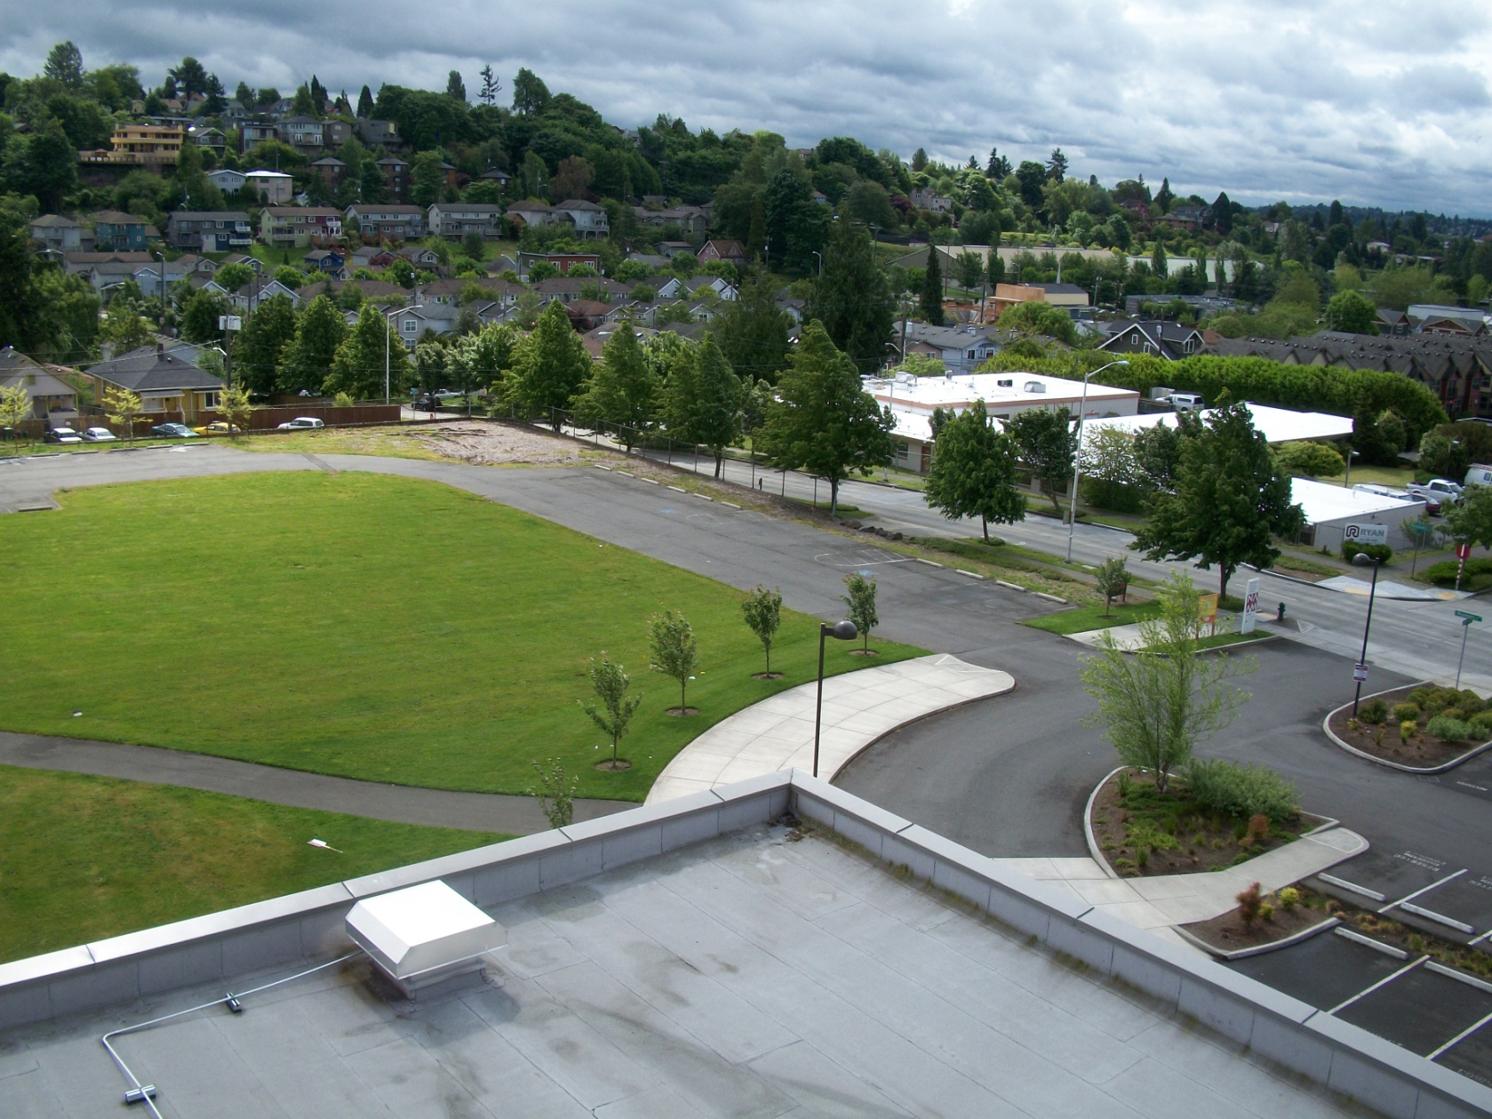
VIEW TO SOUTHEAST FROM NAAM ROOF

Slide 12
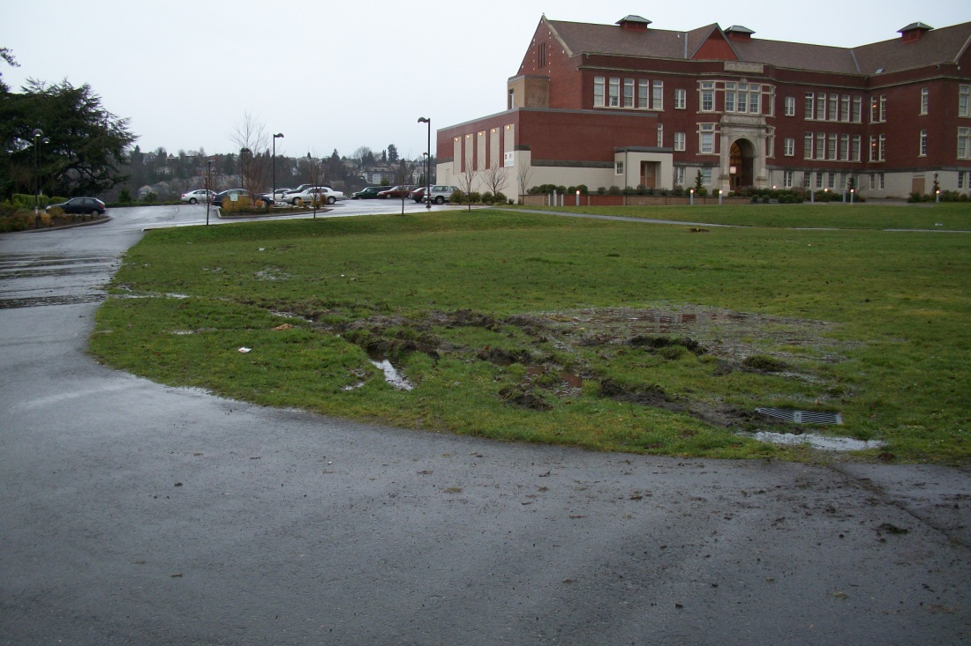
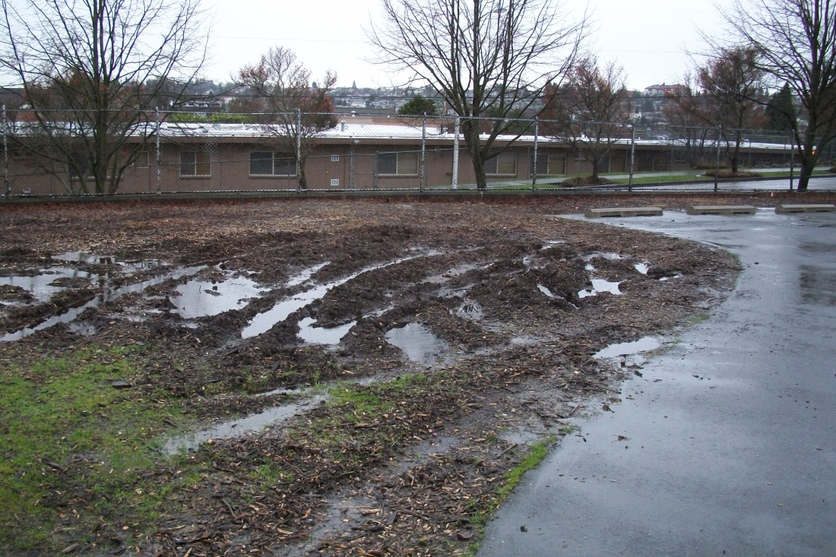
POOR DRAINAGE AT CENTER AND SOUTHEAST

Slide 13
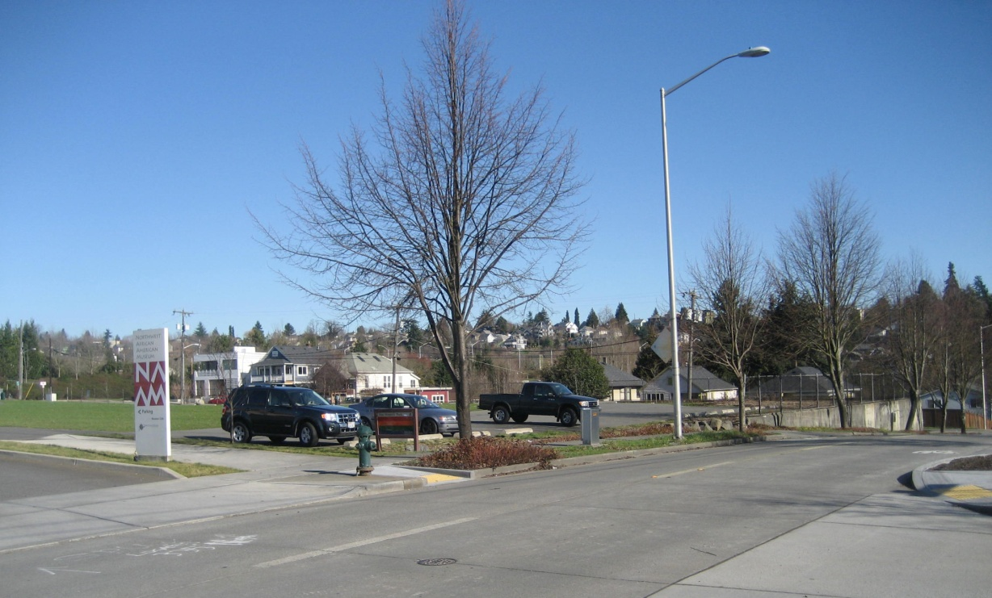
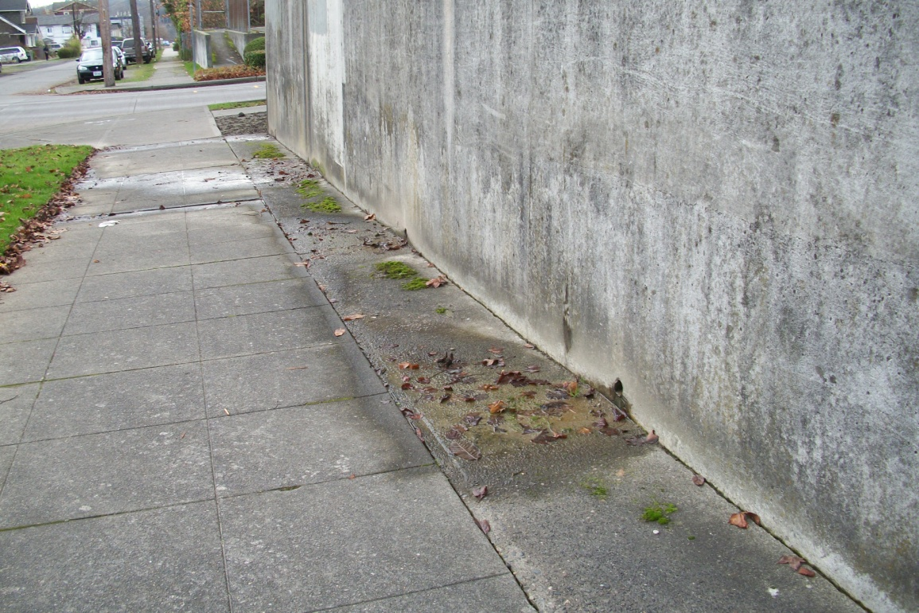
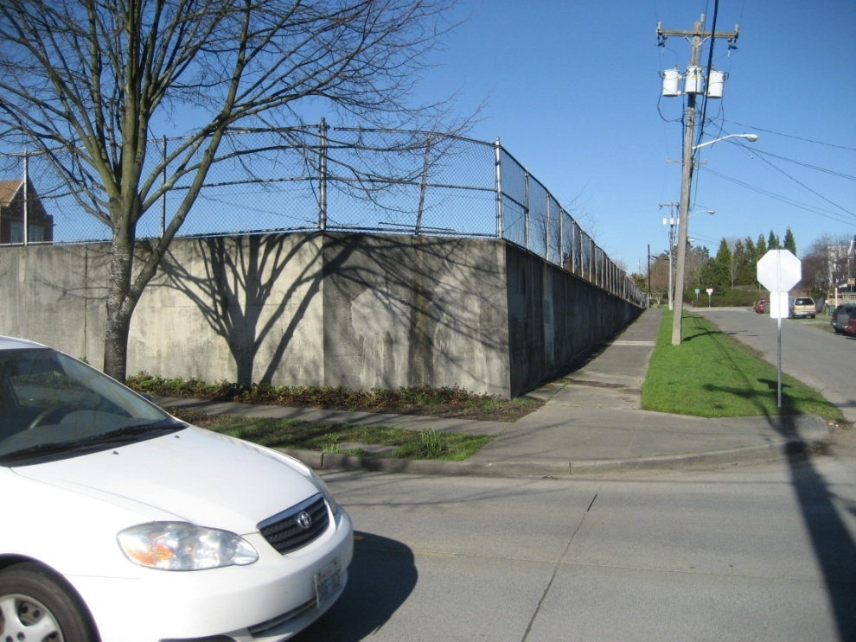
RETAINING WALL INHIBITS ACCESS FROM SOUTHEAST

Slide 14
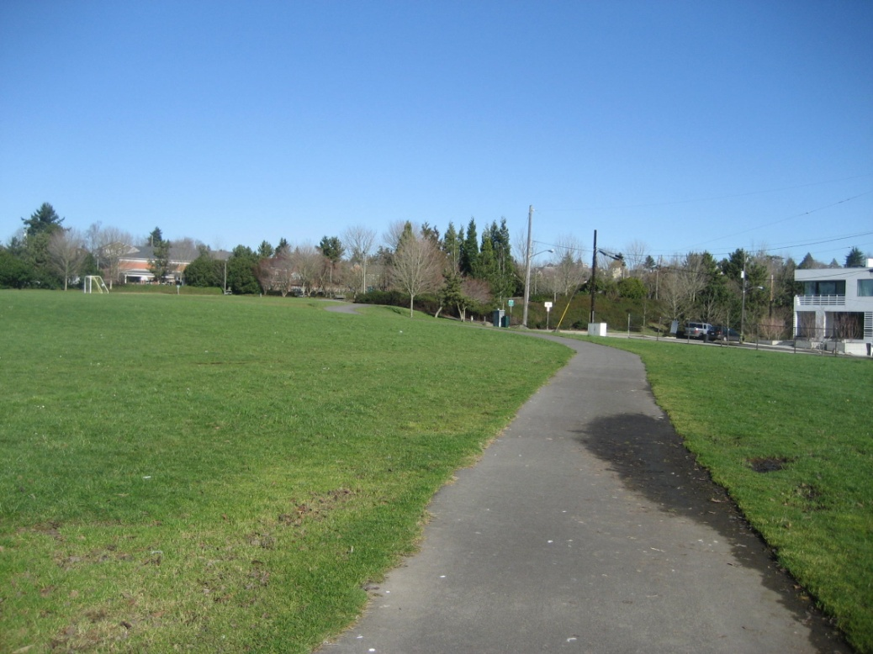
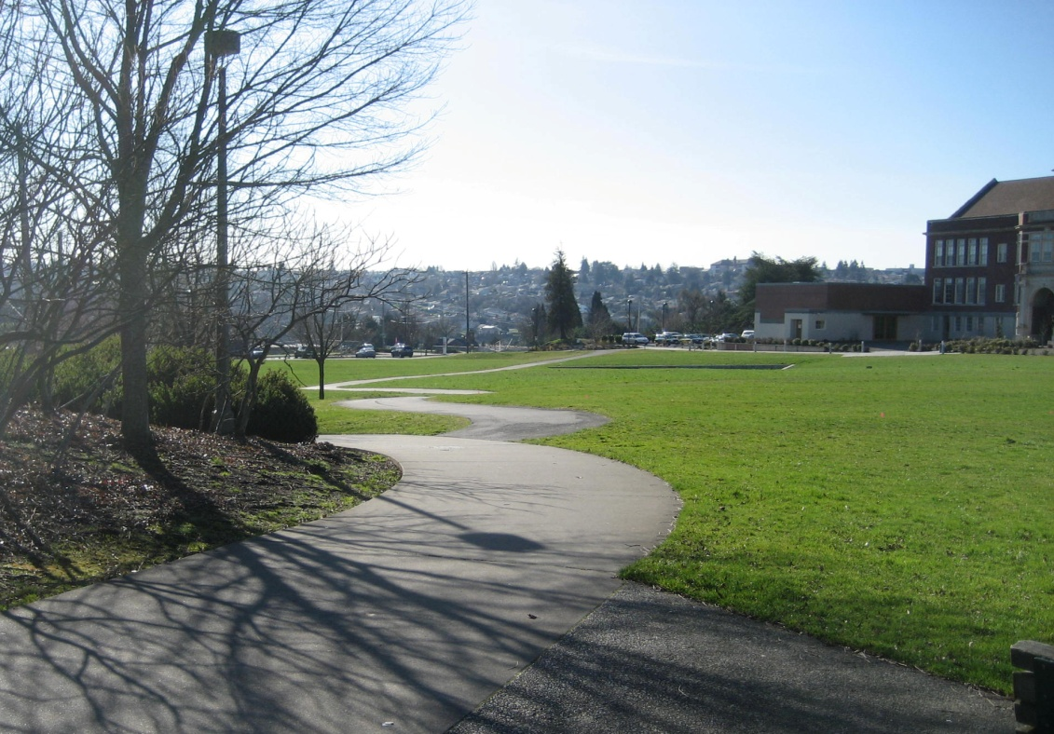
PATH LOOKING NORTHEAST TO I-90 TRAIL
PATH LOOKING SOUTHWEST

Slide 15
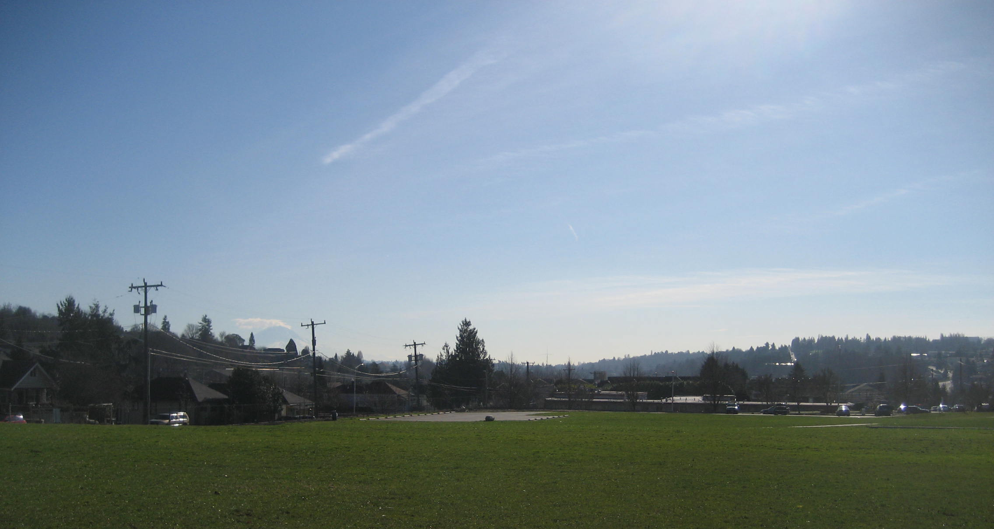
VIEW TO MOUNT RAINIER

Slide 16
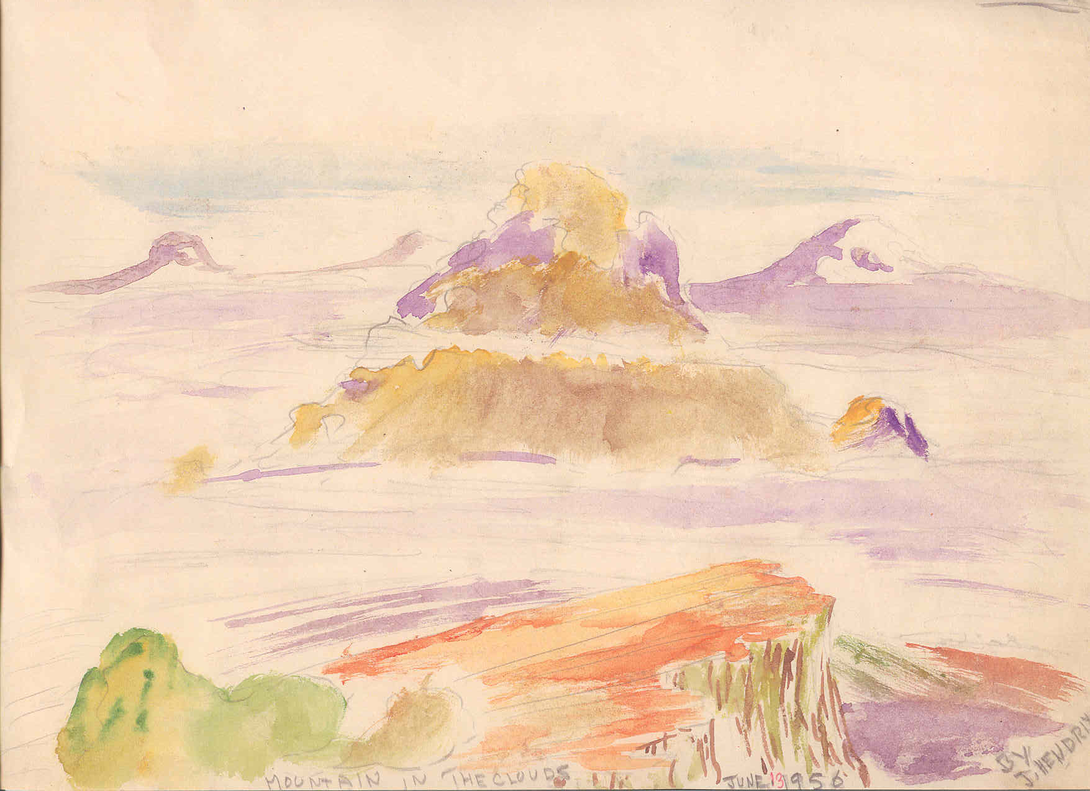

Slide 17
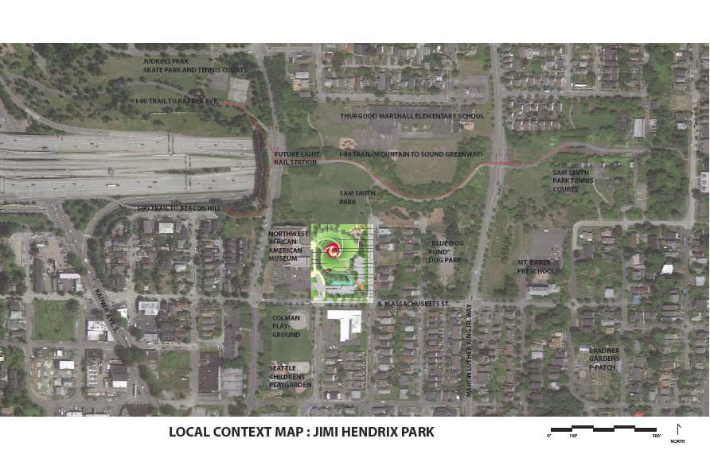

Slide 18
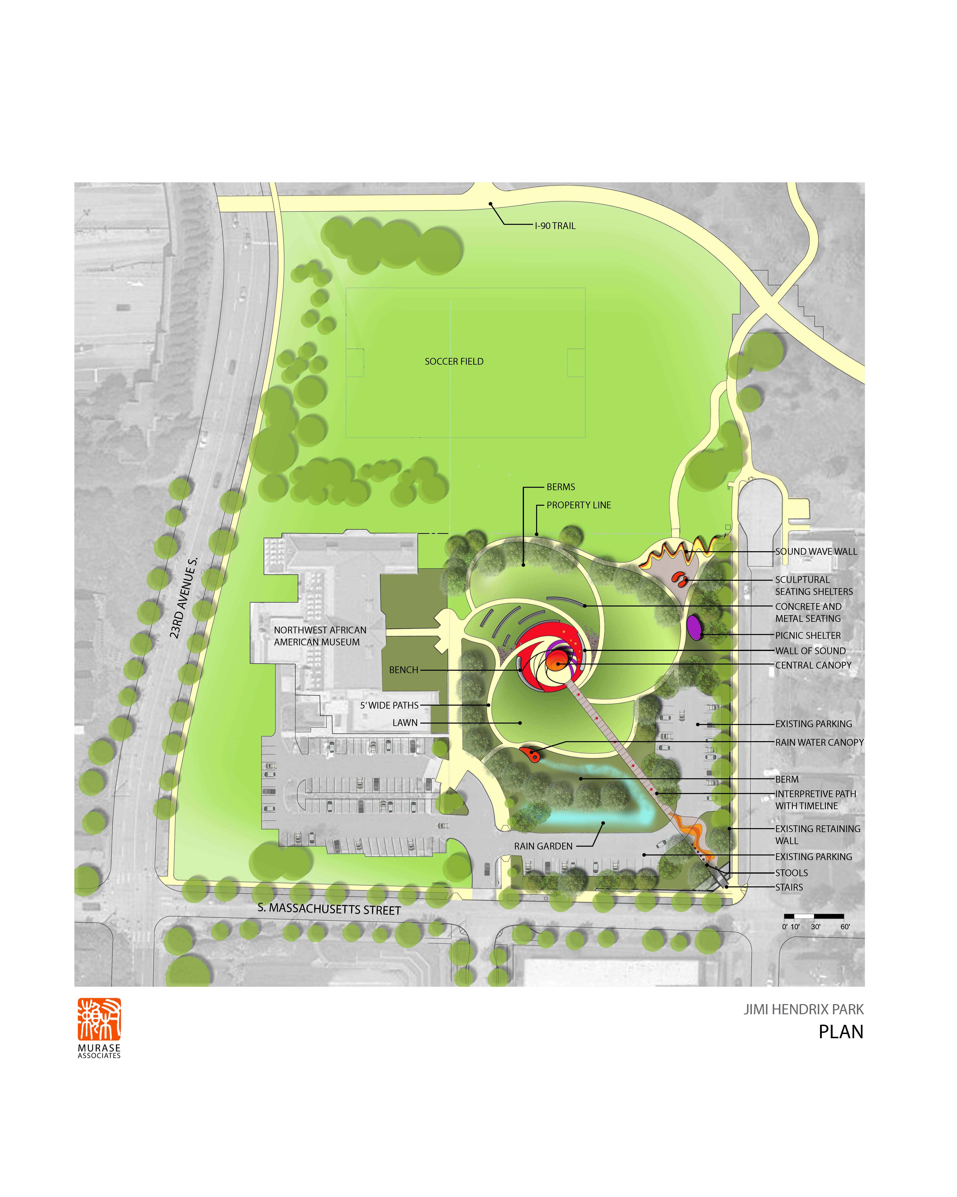
JIMI HENDRIX PARK

Slide 19
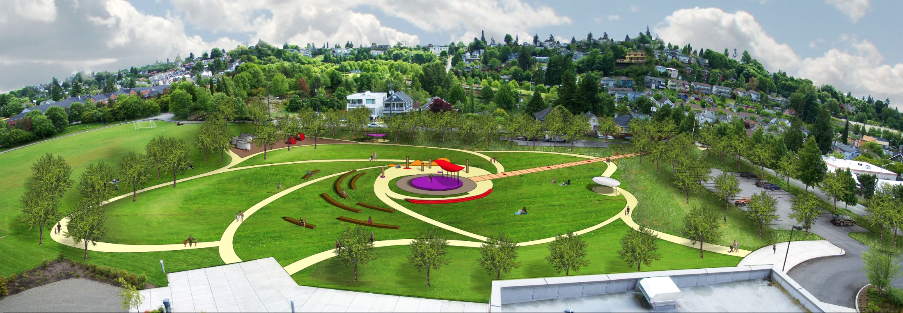

Slide 20
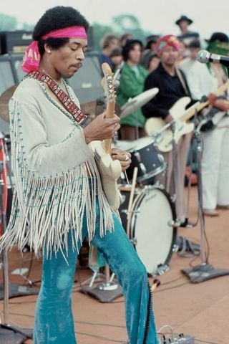
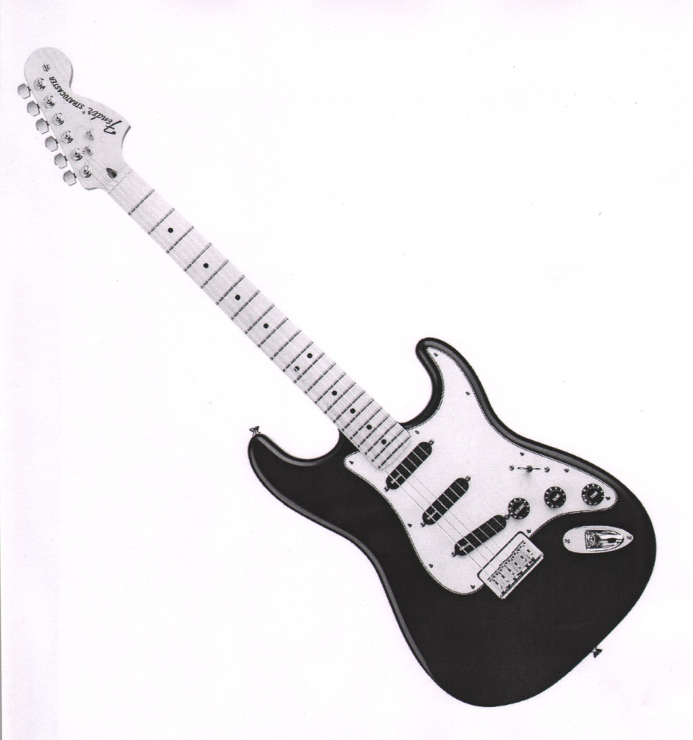
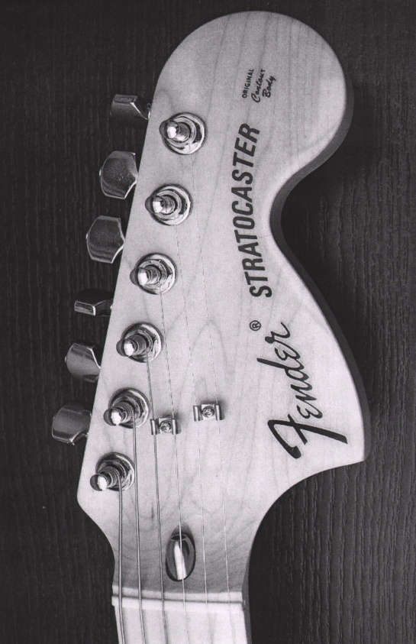
THE GUITAR

Slide 21
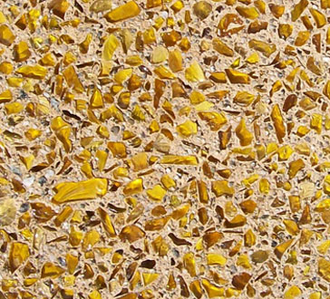
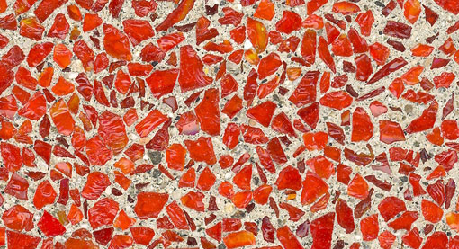

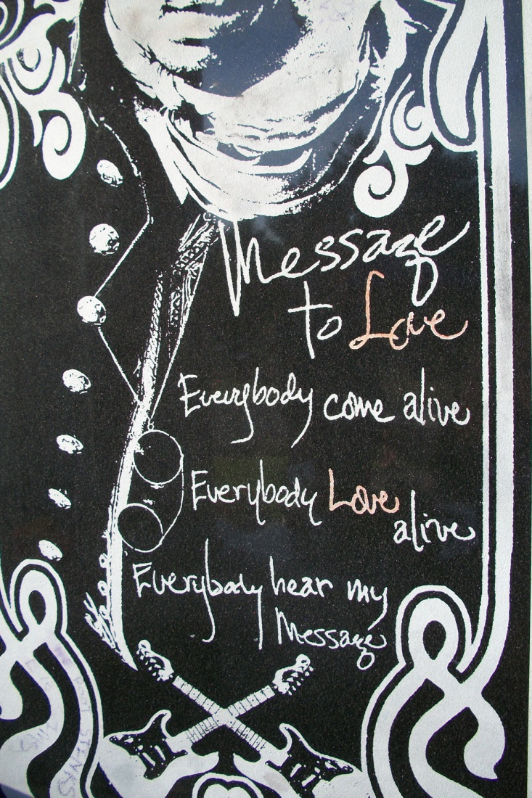
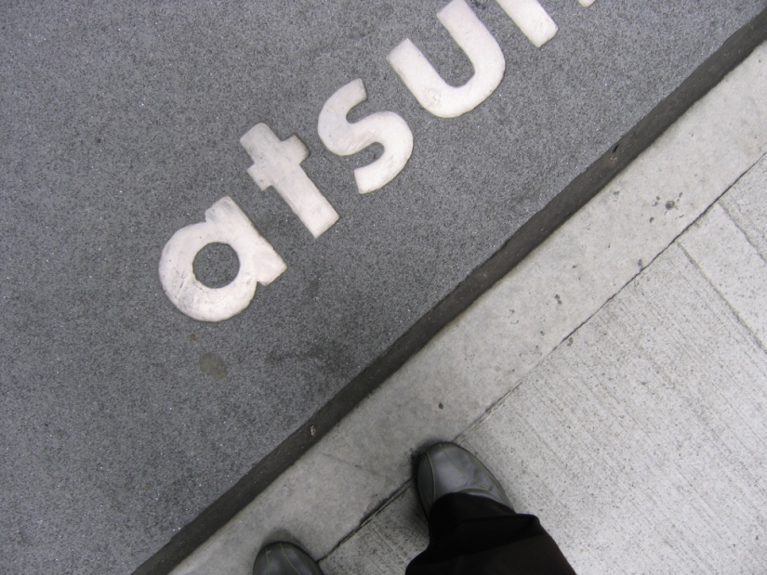
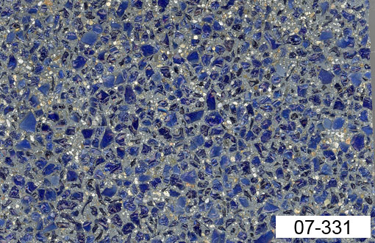
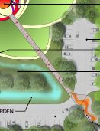
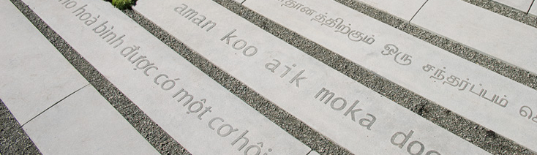
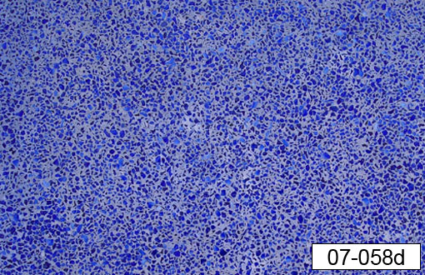
TEXT IMBEDDED IN STEM OF GUITAR TIMELINE PATH

Slide 22
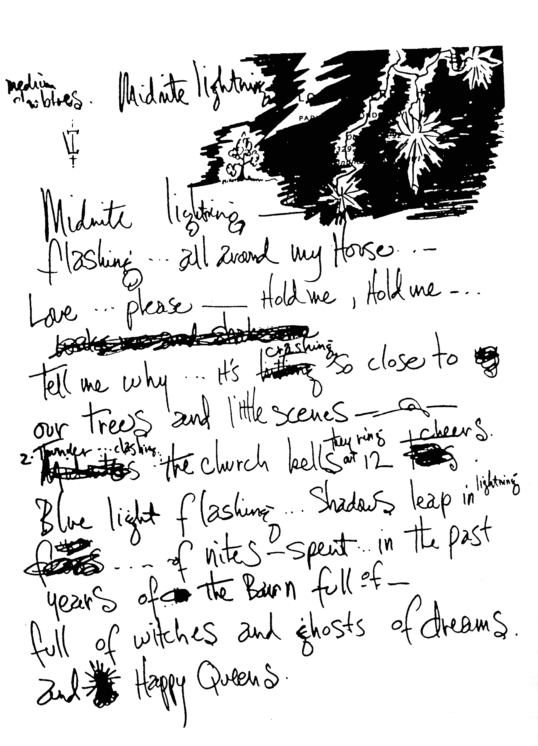
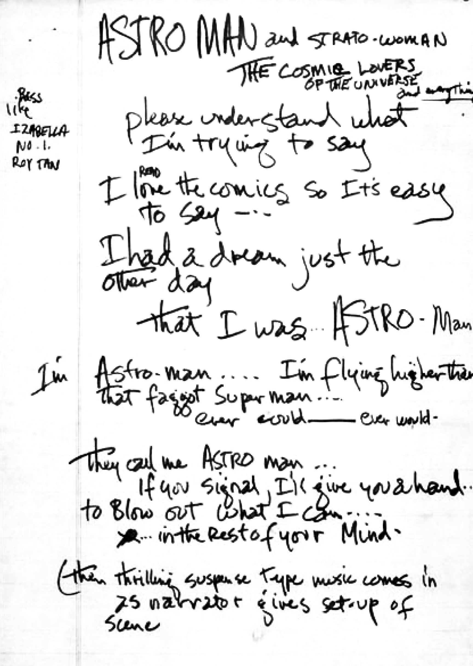

Slide 23
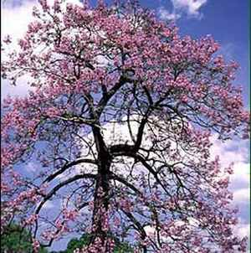
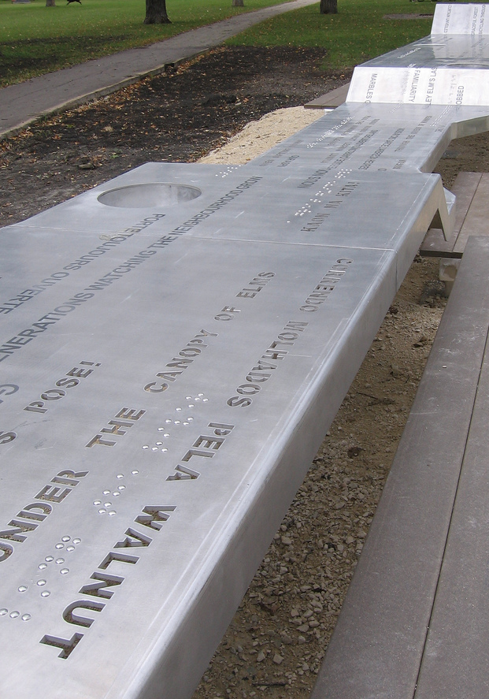
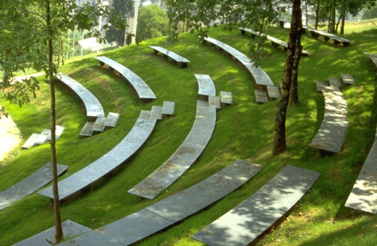
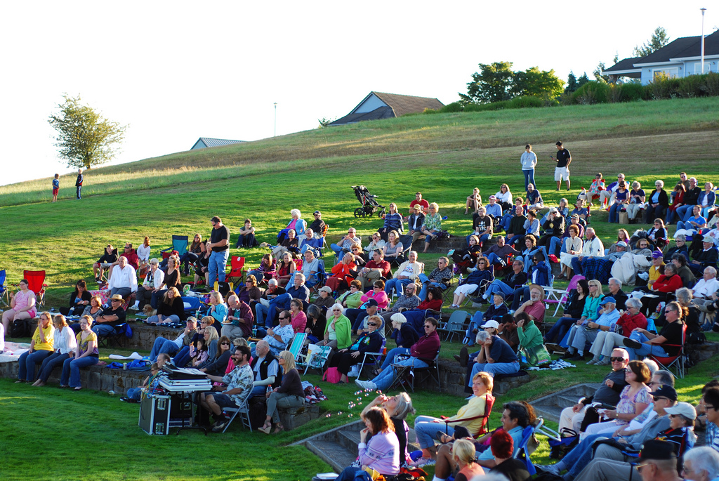

Slide 24
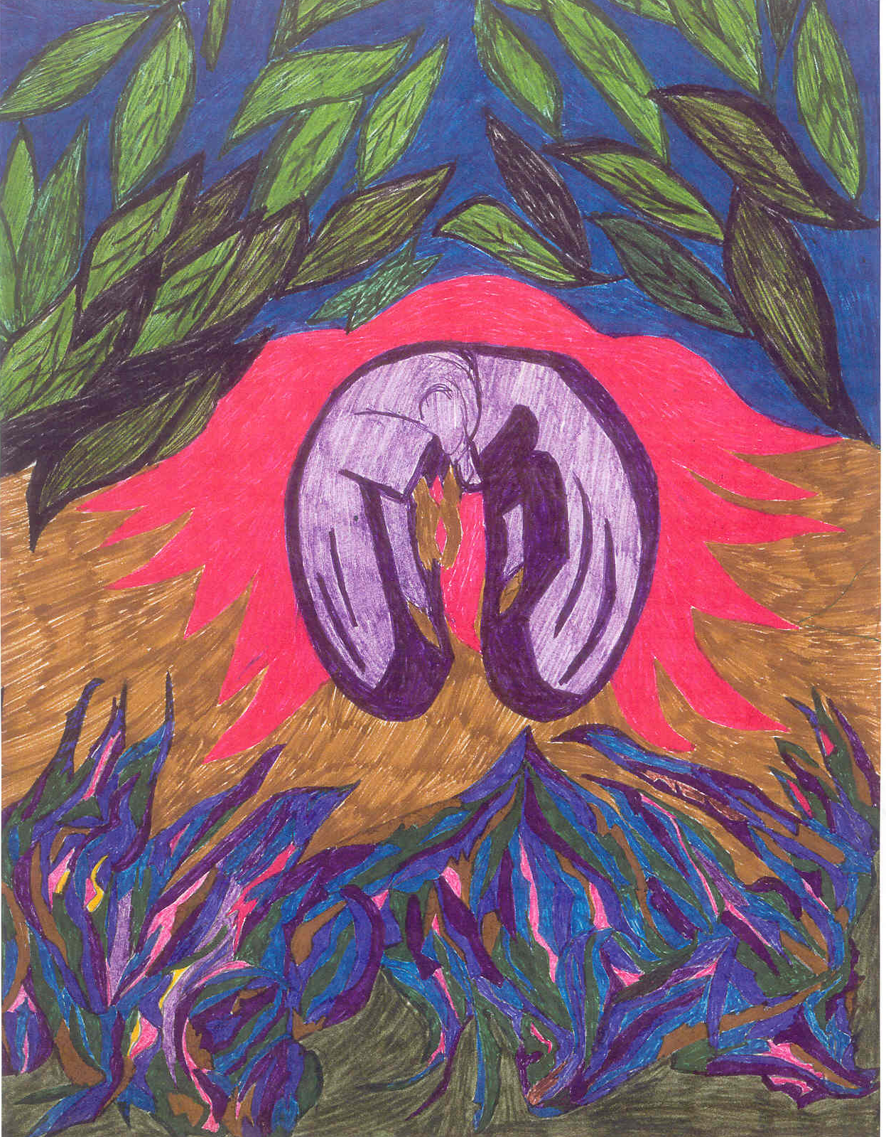

Slide 25
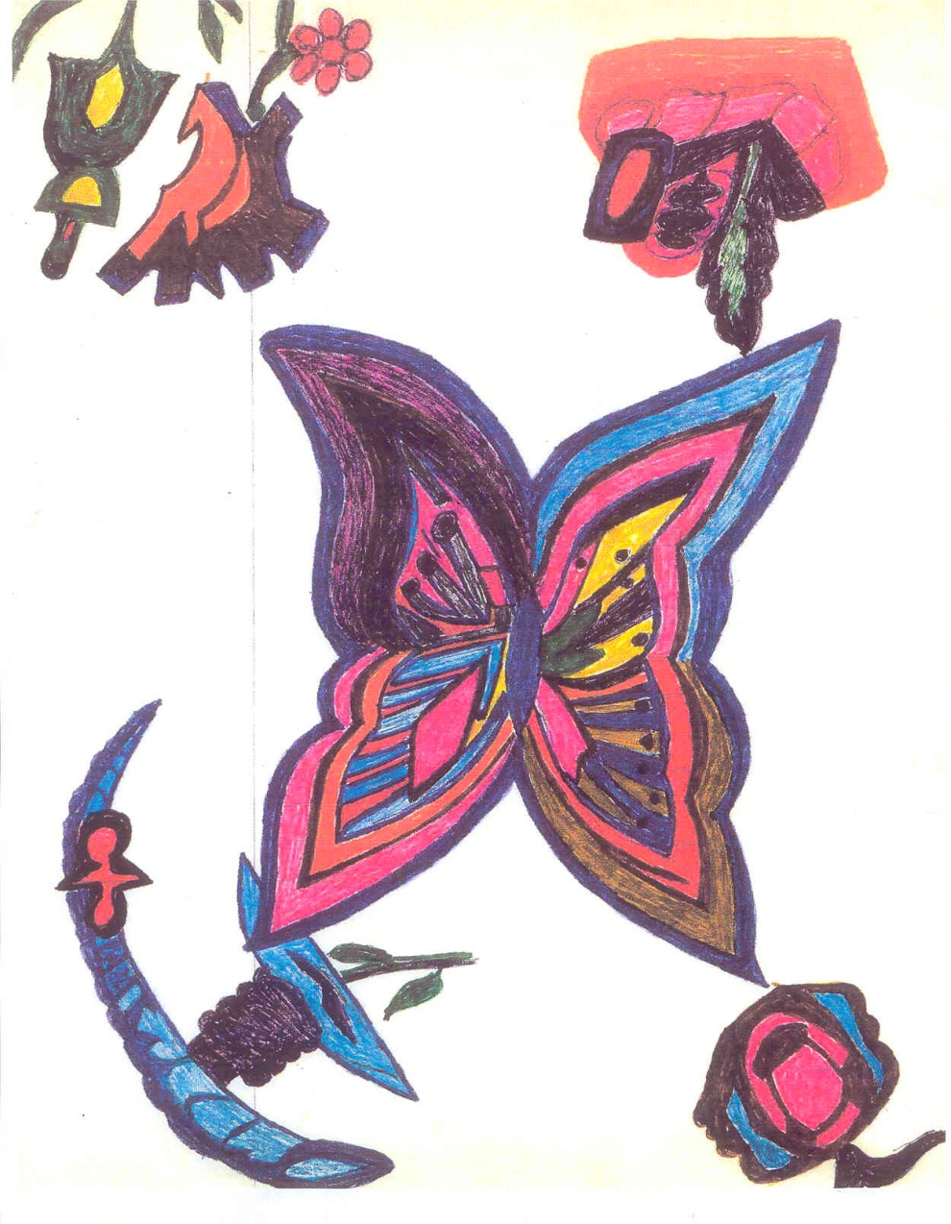
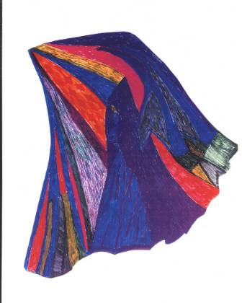

Slide 26
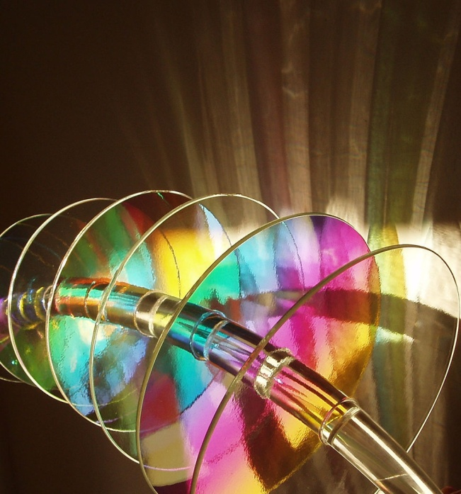
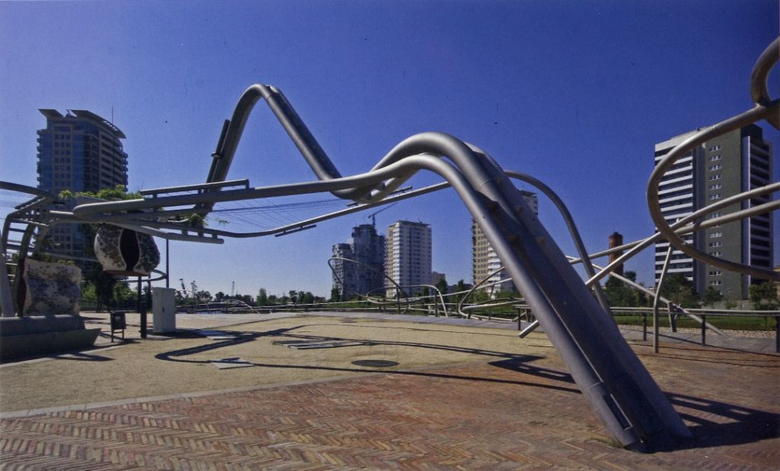
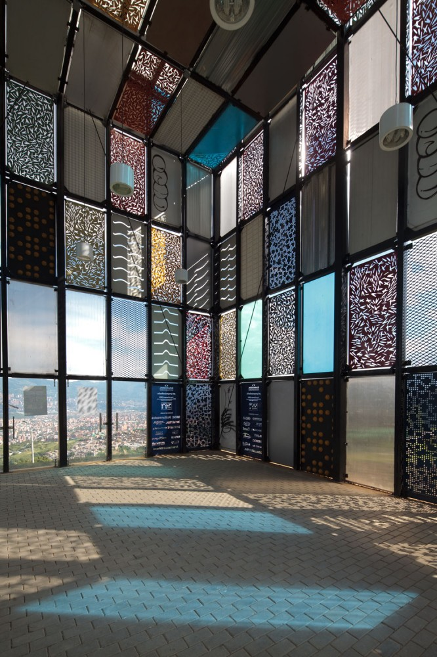
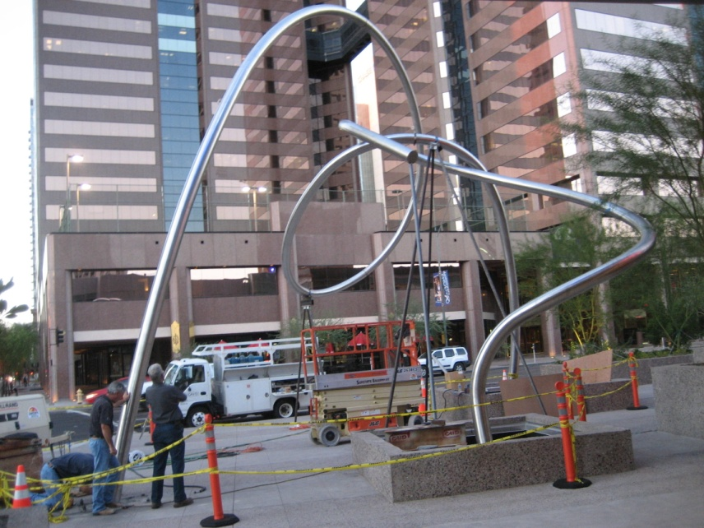
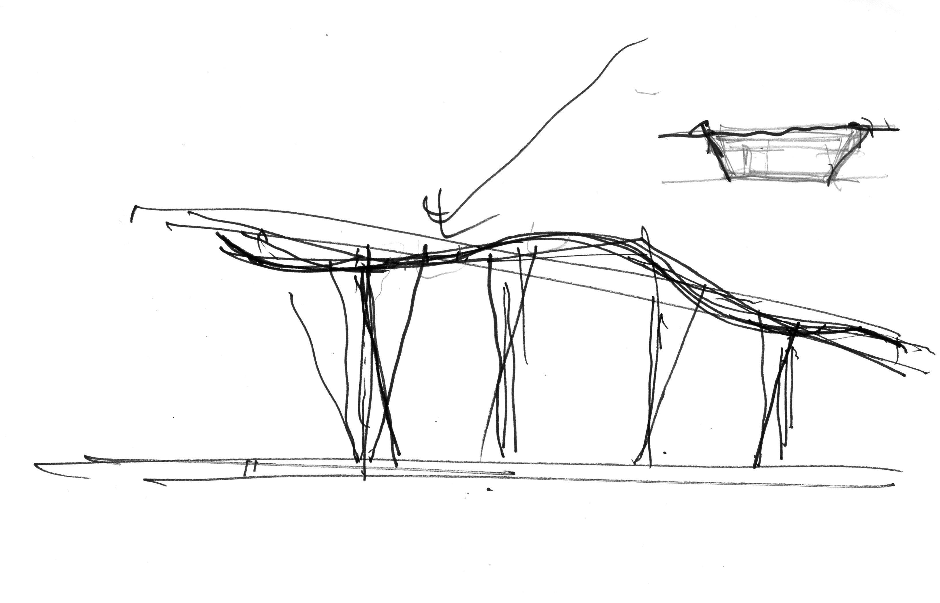



CENTRAL CANOPY

Slide 27



Slide 28


SHADOW WAVE WALL

Slide 29

SHADOW WAVE WALL

Slide 31

GRADING PLAN

Slide 32


Slide 33

PROVIEW SUBMITTAL

Slide 34

PROVIEW SUBMITTAL

Slide 35

PROVIEW SUBMITTAL

Slide 36

PROVIEW SUBMITTAL

Slide 37

PROVIEW SUBMITTAL

Slide 38

PROVIEW SUBMITTAL

Slide 39

PROVIEW SUBMITTAL

Slide 40

PROVIEW SUBMITTAL

Slide 41

PROVIEW SUBMITTAL

Slide 42

PROVIEW SUBMITTAL

Slide 43

PROVIEW SUBMITTAL

