Slide 1
Street Use Hourly Rate and Fee Updates
External Workshop
SDOT Street Use
Melody Berry
Notes:
Welcome to the SDOT Street Use Utility workshop

Slide 2
Our vision, mission, and core values
Vision: Seattle is a thriving equitable community powered by dependable transportation
Mission: to deliver a transportation system that provides safe and affordable access to places and opportunities
Committed to 6 core values:
Equity
Safety
Mobility
Sustainability
Livability
Excellence

Slide 3
Street Use Hourly Rate and Fee Updates
Other updates
Hourly rate and permit fee updates
Use fees – how they work
New Total Days in ROW field overview and how to use it
New and updated help articles
Virtual coaching
How to get help
Open Q&A

Slide 4
Webinar rules of conduct
Please only use the Q&A Chat to ask questions during the presentation
Any questions not answered in the Q&A Chat can be asked again in the open Q&A session at the end of the webinar
If you would like to be unmuted to ask a question, please request that in the Q&A Chat

Slide 5
Updates – Off-hour Inspection Requests
For off-hour Inspection requests:
Email the following information to DOT_StUse_OffHours_Inspection@seattle.gov a minimum of 3-business days in advance:
Permit/record number
Address/location
Hours of work
Dates of work
And (if applicable) stated confirmation of Hub coordination approval.

Slide 6
Updates – New Required Document & Conditions Tab
Street Use uses conditions in Accela for the following reasons:
Request new or revised documents
Request additional information via a document
Inform when an activity has been applied to the record (e.g., Withdraw request etc.)
To clarify confusion on what a condition is and how it relates to a required document, we have added a new page to our records titled Required Documents & Conditions

Slide 7
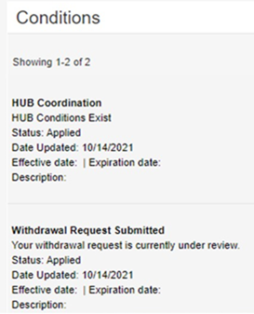
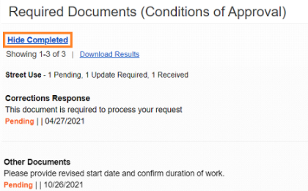
Updates – New Required Document & Conditions Tab
This page is split between Required Documents that requires a document of the same name to be uploaded:
And applied Conditions that is informational only:
Information on this change can be found in the How to Respond to Corrections help article.

Slide 8
Updates – New Hub Coordination Condition Coming Soon!
Work in Construction Hub areas must have schedules coordinated by the Hub Coordinator. For initial issuances of a permit, the Hub Coordinator reviews the times and dates during the review process
For some record types, schedule changes in Hub areas after the initial issuance is done directly with the Hub Coordinator
The Hub Coordinator now has a way to capture schedule changes after issuance on the record. You eventually will see this information in the HUB Coordination condition in the new Required Documents & Conditions page on the record

Slide 9
Background – Types of Street Use Fees
Permit Fees
Recovery: Administrative, some review time and overhead
Hourly Rate
Recovery: Review or inspection time and overhead
Use and Occupation Fees
Issuance, amendment and renewal fees
Review and inspection rates
Non-transportation uses of the right-of-way charged by the square footage
Discretionary: Used to encourage shorter and more efficient use of the public right-of-way

Slide 10
Hourly Rate and Permit Fees Update Goals
Goals:
Ensure full cost recovery to maintain service levels and reduce reliance on use fees
Align updates with policy goals to support businesses, homeowners, affordable housing, and improved livable communities

Slide 11
Summary of Proposed Changes
Issuance Fees
For construction and utility permits, update to full or partial full cost recovery
Hourly Rate
Update with 2019 – 2021 AWI
Use and Occupancy Fees
No change
For public activation and maintenance permits, update with 2019 – 2021 AWI
Keep free permits free (e.g., gardening, signs, block party etc.)

Slide 12
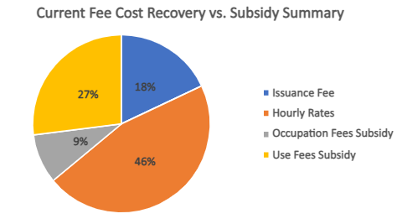
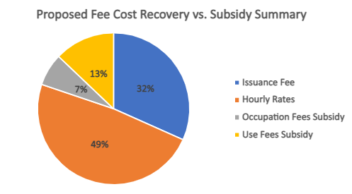
Current vs. Proposed Recovery Summary
We have not kept pace with cost increases over the past several years
This has led to subsidizing hourly rates and issuance fees with use and occupation fees
Use and occupation fees are intended to be used for transportation improvements that benefit those communities that have been impacted by construction

Slide 13
Hourly Rate Update
Current Hourly Rate | Proposed Hourly Rate​ | Difference
$278.00 ​ | $305.00 ​ | $27.00

Slide 14
Permit Fee Updates
Permit Type(s) | Current Fee | Proposed Fee | Difference
ROW Maintenance | $155.00 | $178.00 | $23.00
ROW Construction, Heavy Crane, & Minor Utility | $324.00 | $640.00 | $316.00
Public Activation & Vending | $181.00 | $275.00 | $94.00
Private Encroachment | $232.00 | $362.00 | $130.00
Renewal for Private Encroachments | $176.00 | $275.00 | $99.00
Street Vacations | $6,500.00 | $10,130.00 | $3,630.00
Long-term Encroachments (e.g., Skybridges, tunnels) | $232.00 | $362.00 | $130.00
Utility Major | $4,865.00 | $7,580.00 | $2,715.00
Street Improvement Lite | $4,865.00 | $2,900.00 | $(1,965.00)
Street Improvement | $4,865.00 | $7,580.00 | $2,715.00
Date Change, Extension, or Revision Amendment | $165.00 | $255.00 | $90.00
Block Party, Signs, Safe-streets, Gardening, Public Amenities | $0 | $0 | n/a

Slide 15
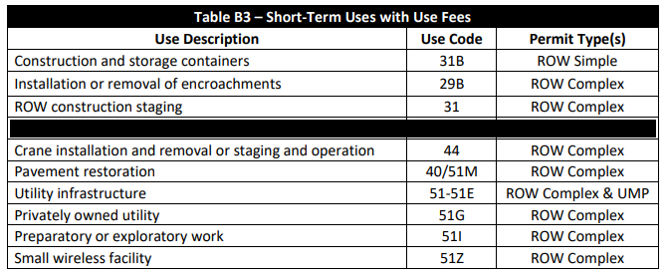
When use fees are applied
Non-transportation use types that incur use fees are shown below in the Table B3 from the Street Use Fee Schedule
Use types that incur use fees are only on the following record types:
ROW Construction
Heavy Crane
Minor Utility
Utility Major

Slide 16
How use fees are calculated
The following variables influence use fees:
Type of street (arterial vs. non-arterial)
Location (Urban zones, residential etc.)
Type of mobility impact (sidewalk, travel lane, alley etc.)
Type of closure (closed, intermittent, reduced width etc.)
Time in right-of-way (current use code table uses Duration + Work Days, but will be changing to Total Days in ROW)
Duration of time in right-of-way (escalation rate = Rate Start Date)

Slide 17
How use fees are calculated – Mobility & Closure types in Accela
Mobility Type | Definition | Closure Type Options
Sidewalk Impact | Dedicated pedestrian zone including asphalt pathways | None Intermittent Closure Reduced Width Closed Rerouted
Bike Lane Impact | Dedicated striped and/or barricaded 24/7 bike lanes | None Intermittent Closure Closed Rerouted
GP Lane(s) Impact | General purpose travel lanes | None Reduced Width Intermittent Closure Some Lanes Closed All Lanes Closed
Transit Lane Impact | Dedicated striped 24/7 bus and other transit lanes | None Intermittent Closure Closed Rerouted
Parking Lane Impact | Dedicated paid or unpaid parking lanes | None Closed
Other ROW Impact | Any area not specifically listed (e.g., planting strip, gravel shoulder etc.) | Yes No

Slide 18
How use fees are calculated – Closure Types
Closure Type | Definition | Use Fees? | Additional Modal Priority Factor?
None | There is no impact to the chosen streetscape type and thus the public can use it as normal. | N | N
Intermittent Closure | Short-term (less than 5 mins) closures 3 times or less an hour to stop the traveling public using a flagger or UPO | N | N
Reduced Width (Equivalent to Impacted) | For sidewalks: partial sidewalk closure with at least a 4’ pedestrian pathway per ADA (or 8’ in Urban Centers) For GP lanes: reduced width travel lane while maintaining vehicular traffic per the Traffic Control Manual or as approved by Transportation Ops | Y | Y for sidewalks
Closed (Equivalent to Blocked) | Completely closed to the traveling public | Y | Y for sidewalks, transit lanes, and bike lanes
Rerouted | The traveling public has been routed to a different part of the streetscape on the same frontage. | N | N
All Lanes Closed | All general-purpose travel lanes on a frontage (one direction of travel for a 2-way road) are closed. | Y | N
Some Lanes Closed | Some general-purpose travel lanes on a frontage (one direction of travel for a 2-way road) are closed, but one or more lanes is still open for travel. | Y | N
Yes | There are impacts to an area not specifically listed under Other ROW (e.g., planting strip, gravel shoulder, filler etc.) | Y | N
No | There are no impacts to an area not specifically listed under Other ROW (e.g., planting strip, gravel shoulder, filler etc.) | N | N

Slide 19
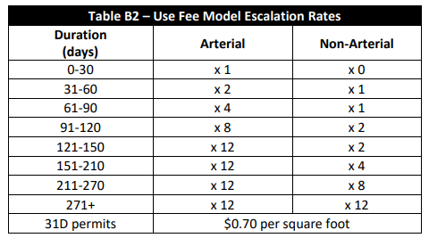
How use fees are calculated – Time in right-of-way
Use fees escalate with time and the rate of escalation varies by street type
The escalation rate is captured by the Rate Start Date (RSD) in Accela
If a project clears a frontage for a period, the RSD will continue from where it left (it does not reset)
The RSD for the first 30 days on non-arterial streets is 0, which means no use fees incur
The higher the RSD, the higher the use fees
Each street type maxes out at an RSD of 271

Slide 20
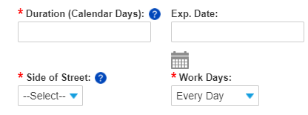
How use fees are calculated – Time in right-of-way
The 2019 use fee methodology replaced the old 10-day increment of tracking time in right-of-way to every day
Currently, we track time in right-of-way with Duration + Work Days
BUT this does not allow projects to easily track work that only impacts the right-of-way for partial weekdays, AND we are not meeting the intent of the use fee methodology
The new way to calculate time in right-of-way will be with the new field Total Days in ROW

Slide 21
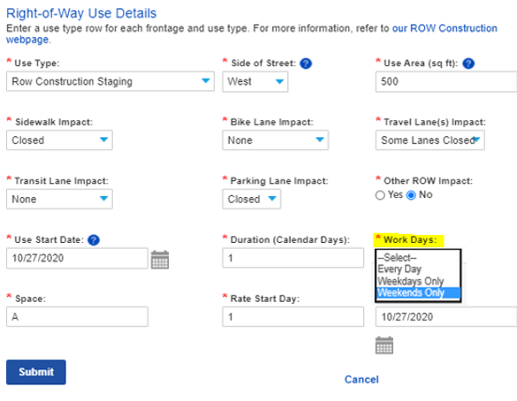
Upcoming Total Days in the ROW option to track uses
With our R2 Accela launch in Nov 2020, we added options to track uses with Work Days options
However, these options didn’t give an option for less than 5-days a week

Slide 22
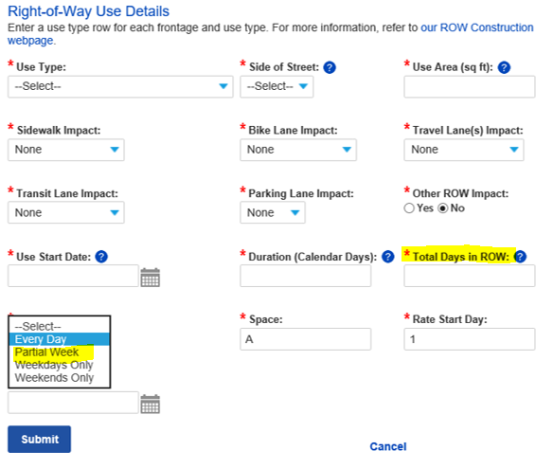
Upcoming Total Days in the ROW option to track uses
Beginning November 18th, you will have the ability to let us know how many total days you are working in the right-of-way
News Total Days in ROW field is how many days you will be in the right-of-way
Used to calculate use fees
Not required for SIP or ROW Maintenance records
New Partial Week option under Work Days
Informational only, no impact on use fees
Duration is the overall project timeline and will be used to calculate the Use Expiration Date

Slide 23
Total Days in ROW Conversion on Existing Records
Use Fees Calculated with Total Days in ROW
Primary
Review
Issuance
Application
Screening
Issuance
Inspection
Closeout
Review
Evaluation
Prep
Secondary
Review
Secondary
Review
Use Fees Calculated with Duration + Work Days

Slide 24
Total Days in ROW Conversion on Existing Records
For existing records that are not at the Issuance step, a one-time script will calculate the Total Days in ROW using Duration and Work Days
Examples:
Exceptions
Issued, Withdrawn, Void and Canceled Amendments
Closed Records
Duration | Workdays | Calculation | Days in ROW
56 | All Days | 56 x 1 | 56
56 | Weekdays Only | 56 x (5/7) | 40
56 | Weekends Only | 56 x (2/7) | 16

Slide 25
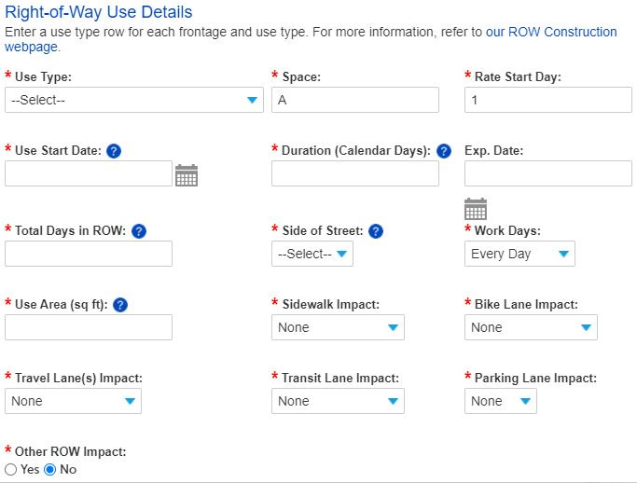
Duration vs. Total Days in ROW
?
Duration: Enter the total number of calendar days needed to complete work in the right-of-way (e.g., if work starts on Monday and ends two weeks later on Thursday, the Duration is 11). This is used to calculate the Use Exp. Date.
Total Days in ROW: Enter the actual number of days you will be using the right-of-way (e.g., if you are using the right-of-way Monday thru Thursday for two weeks, the Total Days in ROW is 8). This number cannot exceed the duration. This is used to calculate use fees.
?

Slide 26
Duration vs. Total Days in ROW
Utility Permits
Duration calculates Use Exp & Permit Exp Dates
Construction Permits
Duration calculates Use Exp Date
Total Days in ROW calculates use fees
Duration = Total Days in ROW
Total Days in ROW calculates use fees
Duration = Project timeline
Can be greater than Total Days in ROW
Total Days in ROW = Working days in ROW
Different approach for utility vs. non-utility permits

Slide 27
Utility Permit Duration vs. Total Days in ROW Rules
The 6-month permit expiration rules do not change with the new Total Days in ROW field
Initial issuance:
The Use Expiration = Use Start Date + Duration
The Permit Expiration = Latest Use Expiration Date + 6-months
Amendment issuance before the Latest Use Expiration Date:
The Use Expiration = Use Start Date + Duration
The Permit Expiration = Latest Use Expiration Date + 6-months

Slide 28
Utility Permit Duration vs. Total Days in ROW Rules
How use fees are calculated are changing with the new Total Days in ROW field
The Duration must match the Total Days in ROW
If the number of days is unknown (10, 12, or 23 etc.):
Choose the highest possible number of days to avoid costly and timely extension amendments

Slide 29
Utility Permit Duration vs. Total Days in ROW Rules
Duration – Enter the total number of days needed to complete work in the right-of-way (e.g., if work starts on a Monday and ends two weeks later on a Thursday, the Duration is 11).
This is used to calculate the Use Exp. and Permit Exp. Dates
The Duration must equal Total Days in ROW
Total Days in ROW – Enter the total number of days that you will be using the right-of-way.
This is used to calculate use fees
This number must equal Duration
This number must be greater than zero

Slide 30
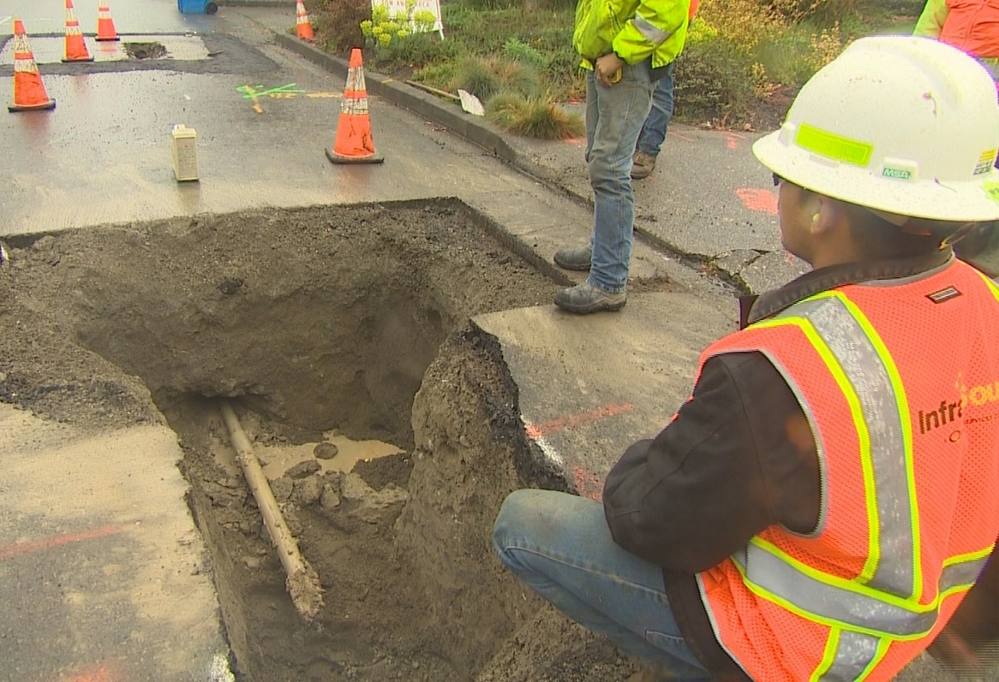
Utility Permit Duration vs. Total Days in ROW Rules - Examples
Example 1: Gas line installation
Project timeline is 4 months
Project requires intermittent street closures for a total of 18 days for installation and restoration phases
Right-of-way is clear outside construction days
Duration = 18 days
Total Days in ROW = 18 days
Use Expiration Date = Start Date + Duration (18 days)
Permit Expiration Date = Latest Start Date + 6 months
Notes:
Job Start reschedules must be 2 business days in advance

Slide 31
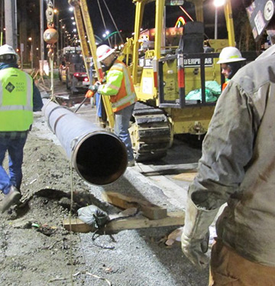
Utility Permit Duration vs. Total Days in ROW Rules - Examples
Example 2: Gas main line installation
Project timeline is 10 months
Project requires street closures for a total of 46 days for installation and restoration phases
Right-of-way is clear outside construction days
Duration = 46 days
Total Days in ROW = 46 days
Use Expiration Date = Start Date + Duration (46 days)
Permit Expiration Date = Latest Start Date + 6 months
Notes:
Job Start reschedules must be 2 business days in advance

Slide 32
Utility Permit Extension Amendment Rules
Scenario 1: Work is taking place after the Permit Exp. Date
Existing Use Line:
Initial Total Days in ROW = 6 days
Initial Duration = 6 days
Use Expiration Date = Initial Start Date + Duration (6 days)
Permit Expiration Date = Latest Use Start Date + 6 months
Extended Use Line:
Additional Total Days in ROW = 8 days
New Duration = 8 days
New RSD = 7
New Use Expiration Date = New Start Date + Duration (8 days)
New Permit Expiration Date = Latest Use Start Date + 6 months
Requires an Extension Amendment
Duration = Days in ROW
Notes:
Job Start reschedules must be 2 business days in advance

Slide 33
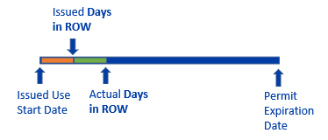
Utility Permit Revision Amendment Rules
Scenario 2: Work is extending beyond issued Days in ROW date within the original Permit Exp. Date
Existing Use Line:
Space = A
Initial Total Days in ROW = 22 days
Initial Duration = 22 days
Use Expiration Date = Initial Start Date + Duration (22 days)
Permit Expiration Date = Latest Use Start Date + 6 months
New Use Line:
Space = B
Initial Duration = 22 if the Start Dates are the same
Additional Total Days in ROW = 15 days
RSD will need to be manually updated based on when the impacts began
Use Expiration Date = Same as Initial Issuance if the Start Dates are the same
Permit Expiration Date = Same as Initial Issuance if the Start Dates are the same
An Extension Amendment forces a new Start Date after the Use Expiration Date
To add more days within an existing timeframe, an additional use line will need to be added through a Revision Amendment
Notes:
Job Start reschedules must be 2 business days in advance

Slide 34
Construction Permit Duration vs. Total Days in ROW Rules
The Total Days in ROW should be actual days they will be in the right-of-way
If the number of days is unknown (1, 2, or 3 etc.):
Choose the highest possible number of days to avoid costly and timely extension amendments
The Duration is capturing project timeline independent of number of days you’ll be in the right-of-way
Having a longer Duration does not allow the project to be in the right-of-way beyond the number of Total Days in ROW

Slide 35
Construction Permit Duration vs. Total Days in ROW Rules
Duration – Enter the total number of calendar days needed to complete work in the right-of-way (e.g., if work starts on a Monday and ends two weeks later on a Thursday, the Duration is 11).
This is used to calculate the Use Exp. Date.
The Duration can be greater than Total Days in ROW
Total Days in ROW – Enter the actual number of days that you will be using the right-of-way (e.g., if you are using the right-of-way Monday through Thursday for two weeks, the Total Days in ROW is 8).
This is used to calculate use fees
This number cannot exceed Duration
This number must be greater than zero

Slide 36
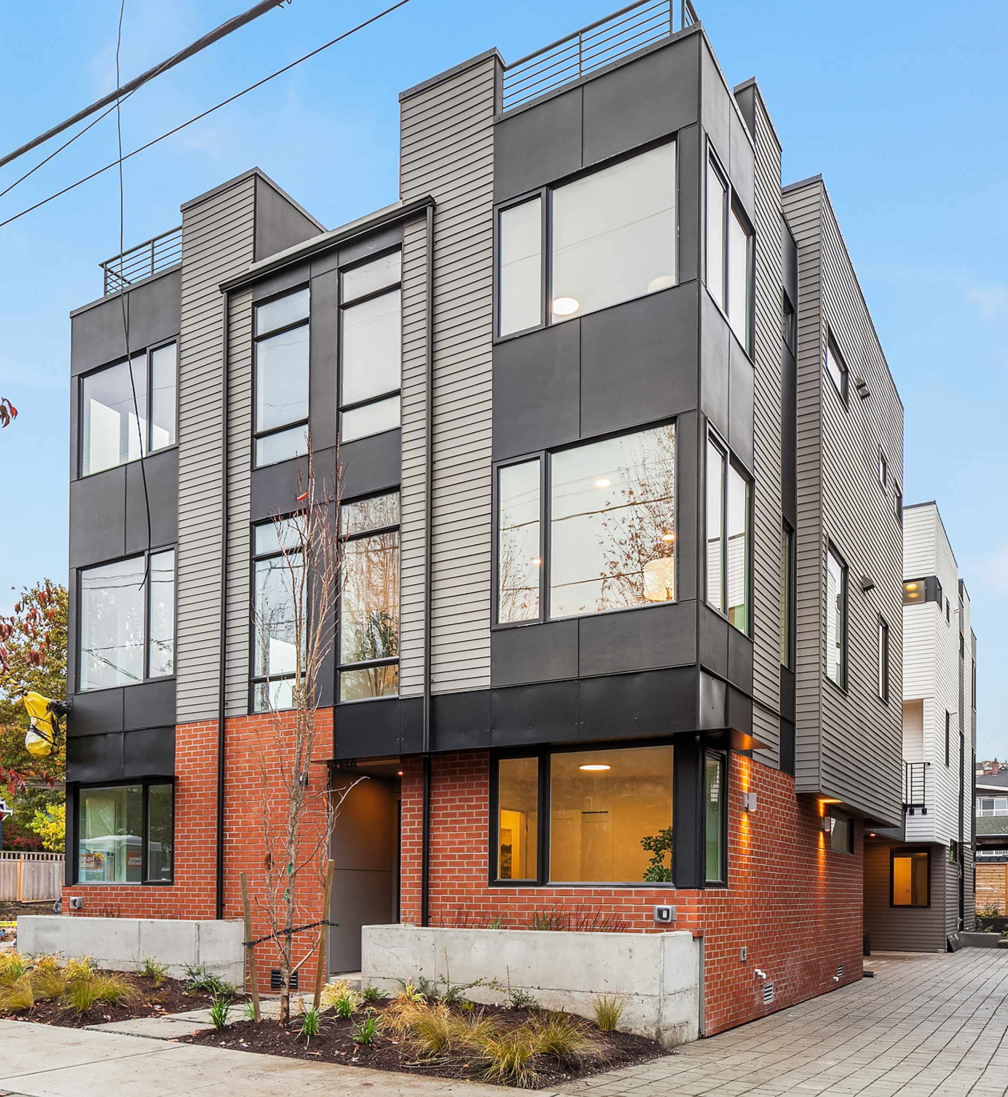
Construction Permit Rules - Examples
Example 1: Townhouse project on a non-arterial street
Project timeline is 6 months
Project requires intermittent material deliveries 2-3 days a week
Right-of-way is clear outside delivery days
Duration = 185 days (26 weeks)
Total Days in ROW = 78 days (3x26 weeks)
Use Expiration Date = Start Date + Duration (185 days)
Notes:
Job Start reschedules must be 2 business days in advance

Slide 37
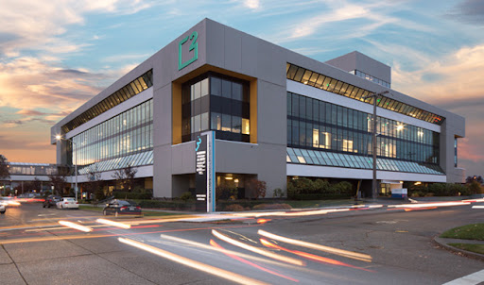
Construction Permit Rules - Examples
Example 2: Office Building in an Urban Village
Project timeline is 18 months
Project requires a sidewalk and parking lane closure 7 days a week
Peds are rerouted to the parking lane on the weekends
Sidewalk Closed Use Line:
Duration = 556 days (79 weeks)
Total Days in ROW = 556 days
Use Expiration Date = Start Date + Duration (556 days)
Parking Lane Closed Use Line:
Duration = 556 days (79 weeks)
Total Days in ROW = 395 days (5*79 weeks)
Use Expiration Date = Start Date + Duration (556 days)
Parking Lane Rerouted Use Line:
Duration = 556 days (79 weeks)
Total Days in ROW = 158 days (2*79 weeks)
Use Expiration Date = Start Date + Duration (556 days)
Notes:
Job Start reschedules must be 2 business days in advance

Slide 38
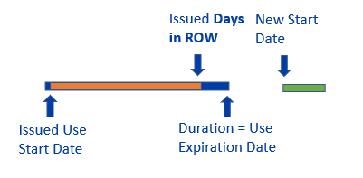
Construction Permit Extension Amendment Rules
Scenario 1: Work is taking place after the Use Exp. Date
Existing Use Line:
Initial Total Days in ROW = 62 days
Initial Duration = 78 days
Initial Use Expiration Date = Initial Start Date + Duration (78 days)
Extended Use Line:
Additional Total Days in ROW = 18 days
New Duration = 20 days
New RSD = 63
New Use Expiration Date = New Start Date + Duration (20 days)
Notes:
Job Start reschedules must be 2 business days in advance

Slide 39
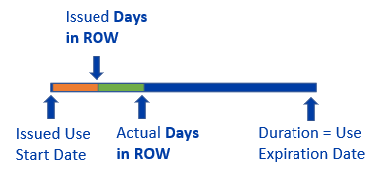
Construction Permit Revision Amendment Rules
Scenario 2: Work is extending beyond issued Days in ROW date within the original Use Exp. Date
Existing Use Line:
Space = A
Initial Total Days in ROW = 20 days
Initial Duration = 78 days
Use Expiration Date = Initial Start Date + Duration (78 days)
New Use Line:
Space = B
Duration = 78 if the Start Dates are the same
Additional Total Days in ROW = 15 days
RSD will need to be manually updated based on when the impacts began
Use Expiration Date = Same as Initial Issuance if the Start Dates are the same
An Extension Amendment forces a new Start Date after the Use Expiration Date
To add more days within an existing timeframe, an additional use line will need to be added through a Revision Amendment
Notes:
Job Start reschedules must be 2 business days in advance

Slide 40
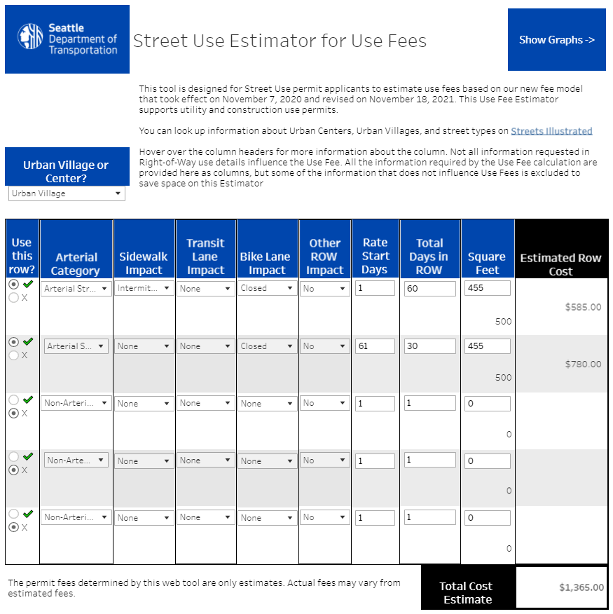
Updated Use Fee Calculator

Slide 41
Update Schedule
Update Description | Date of Implementation
Total Days in ROW method of tracking working days and calculating use fees | November 18th, 2021
New Hourly Rate and Permit Fees | January 1st, 2022

Slide 42
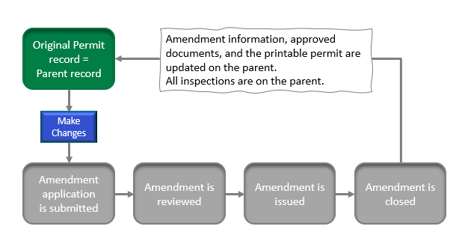
New help articles!
What Happens After an Amendment is Issued
Defines what an Amendment is and what the general process is
Describes the relationship between the Initial (aka Parent) and an Amendment (aka Child) record
This information has also been provided on our existing Amendment help articles:
Date Change Amendment
Extension Amendment
Revision Amendment (Construction, Utility, and Street Improvement permits)
Revision Amendment (Public Space Management permits)

Slide 43
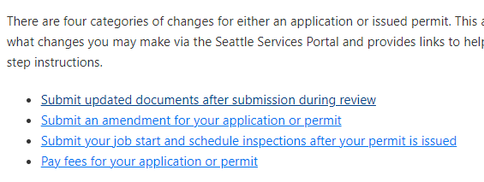
New help articles!
What Changes Can I Make on My Street Use Application or Permit
This help article provides guidance on how to do the following in the Seattle Services Portal:
Submit updated documents after the application has been submitted
Submit an amendment request
Submit a job start notification and schedule inspections after the initial inspection has been passed
Pay fees on your application or permit

Slide 44
Virtual coaching
Virtual 1x1 coaching is now available during the below hours:
10:30am-noon
1-3pm
Virtual coaching is available by the below methods:
Virtual meeting using Webex
Phone meeting
To request virtual coaching:
Email SDOTPermits@seattle.gov or
Call the Street Use phone line at 206-684-5253

Slide 45
How to get help on our websites
Our websites have been updated to walk you through the process
You can also find a link to the Seattle Services Portal on the right panel of every website
http://www.seattle.gov/transportation/permits-and-services/permits
Access to the Portal can be found on the right panel of every webpage
To stay informed on Street Use updates, you can sign-up to receive our monthly newsletter

Slide 46
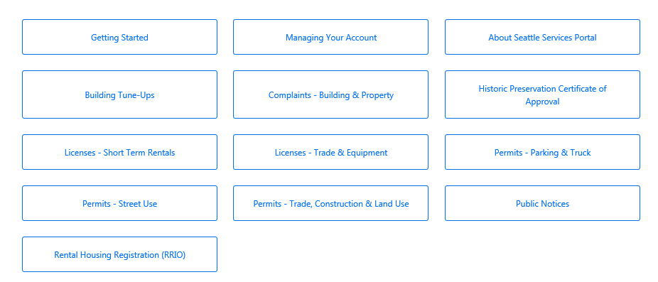
How to get help on the SSP Help Center
You can find many help articles on how to navigate the Seattle Services Portal from the Help Center
Get familiar with these three sections:
Getting Started
Managing Your Account
Permits - Street Use
2
Notes:
When a user needs help, they can access the Help Center articles by clicking on Help.
The banner is available throughout the portal, and Help can be accessed at any time simply by clicking on the Help button.

Slide 47
How to get help if you can’t find the answer
Email dot_su_ssportal_questions@seattle.gov for:
General Seattle Service Portal navigation
Contact cleanup or fix needs
Help on responding to Corrections, uploading documents, scheduling inspections etc.
If you think an error has occurred in the Seattle Services Portal
Email dot_permits@seattle.gov for:
General inquiries and coaching
Contact changes for permits or amendments in process
Application changes for unassigned records
Fee disputes
Email SeattleServices_ITHelp@seattle.gov for Seattle Services Portal account issues

Slide 48
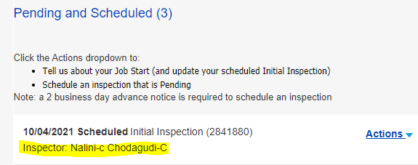
How to get help
Where to find the assigned reviewer on the Status tab
Email the assigned reviewer for:
Application changes for permits or amendments in process
Corrections required response clarification on
Permit status inquiries outside the posted permit timelines
Email the assigned inspector for:
Job start changes after the Initial Inspection has passed
Inspection questions including notification, inspection results etc.
Scheduling an on-site meeting
Where to find the assigned inspector on the Inspections tab

Slide 49
Open Q&A

Slide 50
Questions?
Melody.Berry@seattle.gov
www.seattle.gov/transportation

