Slide 1
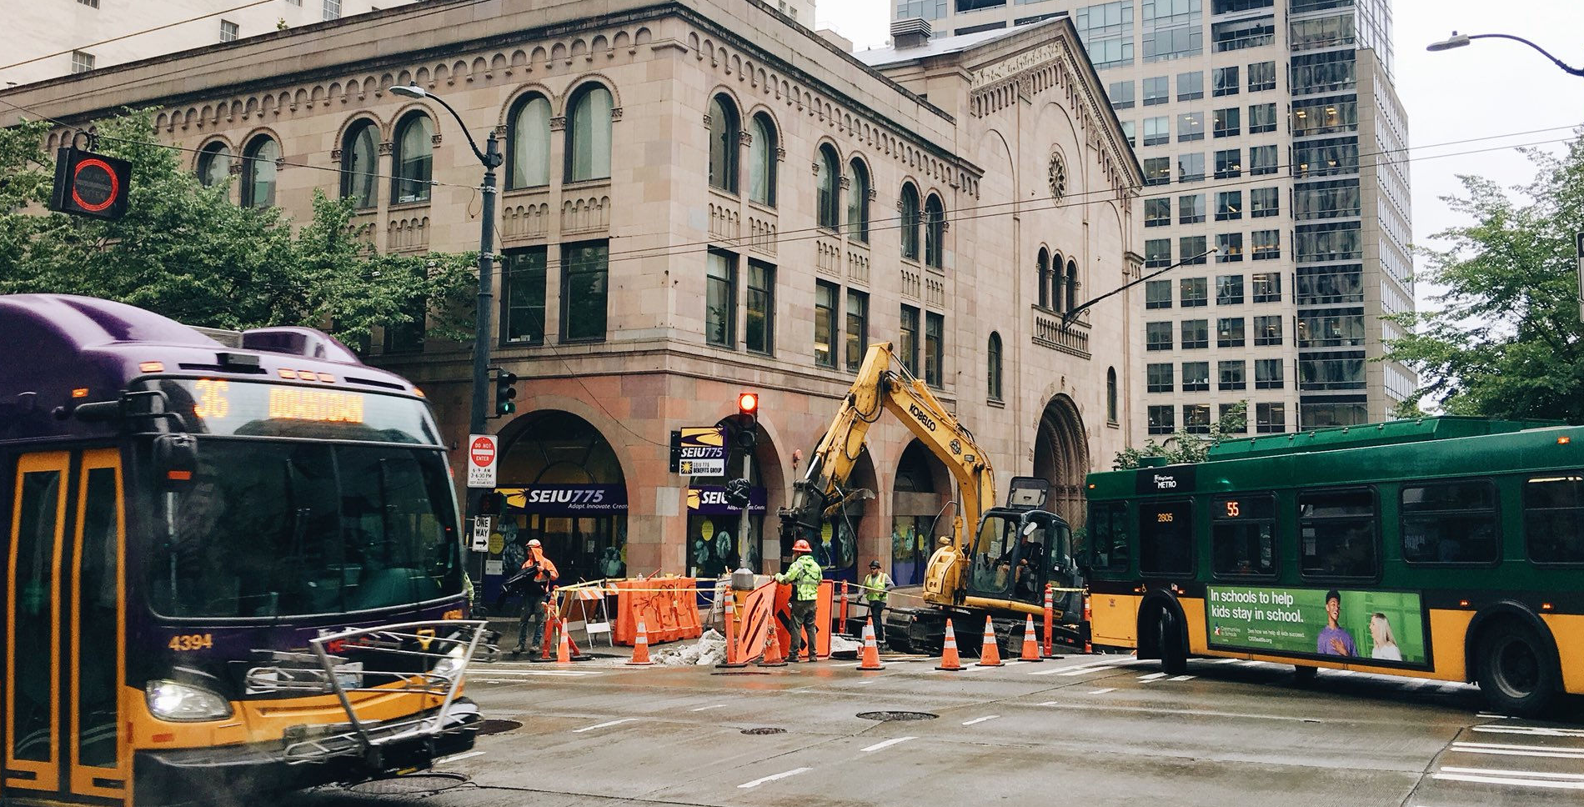
Street Use Inspection Notification and Types in Accela
External Workshop
SDOT Street Use
Chris Luedke and Daniel Conn

Slide 2
Our vision, mission, and core values
Vision: Seattle is a thriving equitable community powered by dependable transportation
Mission: to deliver a transportation system that provides safe and affordable access to places and opportunities
Committed to 6 core values:
Equity
Safety
Mobility
Sustainability
Livability
Excellence

Slide 3
Workshop overview
Accela launch overview
Permit types coming in November
Inspection types
Inspection notifications
How to schedule an inspection through the Seattle Services Portal via an inspection notification
How to schedule an inspection that isn’t available to schedule through the Seattle Services Portal
How to find the status of an inspection

Slide 4
Accela launch overview
Accela is a new permit system that will replace Hansen 7
Accela meets the following city, department, and division goals:
Improved consistent, predictable, and transparent permitting and inspections
Improved online user experience
Integrate systems for users across departments

Slide 5
Accela launch overview
SDOT’s last implementation into Accela will be November 7th, 2020
Traffic, Public Space Management, and Annual Vehicle permits are already in Accela
Come November, the remainder of Street Use permits will be in Accela

Slide 6
Permit types - what’s coming in November
ROWM Permits
ROW Construction (today’s Construction Use)
ROW Maintenance (new)
Heavy Crane (new)
Minor Utility
Major Permits
Utility Major
Street Improvement
Final Plat

Slide 7
Inspection types
Core
Initial
Interim
Ad Hoc
Site
Curb Ramp
Offline
Off Hours
Interim-Amend
Final
Acceptance or Bond Release
Mark Out
Restoration
Pre-Con Meeting
SDOT Asset
Utility
Notes:
We’ve grouped our inspections into three categories: Core, Ad Hoc and Other. We’ll spend a little bit of time on each.

Slide 8
Core inspection type definitions
Core Inspection Type | Definition
Initial | First inspection on a new permit. There is only one Initial Inspection on a permit.
Interim | Subsequent inspection(s) during a project, based on a current defined cadence.
Interim-Amend | Indicates a permit amendment with a scope of work change has been issued.
Reinspection | Inspection required after a code violation was found.
Final | Indicates project has completed, the right-of-way is clear.
Acceptance and Bond Release | Indicates the restoration has been accepted. These are scheduled per the required timelines in the ROWORR.

Slide 9
Ad hoc inspection type definitions
Ad-hoc Inspection Type | Definition
Site | Non-cadence inspection. Request may indicate a follow up or other non-cadence event requiring inspection.
Curb Ramp | Inspection to confirm new curb ramps meet ADA requirements.
Mark Out | Inspection to request SDOT to mark-out restoration limits.
Restoration | Inspection to ensure restoration meets current requirements.

Slide 10
Offline inspection type definitions
Offline Inspection Type | Definition
Off Hours | Any inspection performed outside of normal business hours (e.g. nights and weekends).
SDOT Asset | Inspection when an outside SDOT division needs to accept an asset (e.g. tree, signal infrastructure etc.).
Utility | Inspection when a public utility needs to accept the backfill or installation of an asset.
Pre-Con Meeting | Formal meeting (through Permit Reviewer) and/or on-site walk through required for most Major permits before construction begins. May be requested for others through Inspector.

Slide 11
Inspection results
Result Name | Definition
Completed | Inspection performed and no violation found
Waived | Did not go to site or is not required
Failed – Violation Found | Code violation found, requires a reinspection
Not Ready | Visited site, but contractor was not ready for the scheduled inspection
Final Completed | Indicates the Final inspection can be set to Completed
Final Completed – No Acceptance | Indicates the Final inspection is completed, and an Acceptance or Bond Release inspection is not required

Slide 12
Inspections by permit type
 | ROW Construction | Minor Utility | Heavy Crane | ROW Maintenance | SIP | UMP
Initial | X | X | X | X | X | X
Interim - Amend | X | X | - | - | X | X
Interim | X | X | - | - | X | X
Site | X | X | X | X | X | X
Reinspection | X | X | X | X | X | X
Restoration | X | X | - | X | X | X
Curb Ramp | - | - | - | - | X | X
Off Hours | X | X | X | X | X | X
Mark Out | X | X | - | X | X | X
Pre-Con Meeting | X | X | X | X | X | X
Final | X | X | X | X | X | X
SDOT Asset | X | X | - | - | X | X
Utility | X | X | - | - | X | X
Acceptance | X | X | - | X | - | X
Bond Release | - | - | - | - | X | X

Slide 13
Inspection notifications
Inspection notifications enable you to schedule an inspection either through the Seattle Services Portal or through an email to Street Use’s inspection group.
Notification | Inspection Triggered | Through Portal or Street Use
Job Start | Initial | Portal
Site | Site | Portal
Restoration | Restoration | Portal
Curb Ramp | Curb Ramp | Portal
Mark Out | Mark Out | Portal
Off-Hours | Off-hours | Street Use
Pre-Con Meeting | Pro-Con Meeting | Street Use

Slide 14
Notifications by permit type
 | ROW Construction | Minor Utility | Heavy Crane | ROW Maintenance | SIP | UMP
Job Start | X | X | X | X | X | X
Site | X | X | X | X | X | X
Restoration | X | X | - | X | X | X
Curb Ramp | - | - | - | - | X | X
Mark Out | X | X | - | X | X | X
Off Hours | X | X | X | X | X | X
Pre-Con Meeting | X | X | X | X | X | X

Slide 15
Action dependencies
At Permit Issuance
Add Job Start notification
Schedule Job Start
Schedules Initial inspection
On Initial Result
Add Site, Curb Ramp, Mark Out, Restoration notifications
Waive Job Start if still pending
Initial inspection scheduled 5 bus days after start date
Final inspection scheduled one business day after end date*
Not all inspections and notifications populate at one time.
Inspections and notifications are populated based on an action.
*Final inspections for utility permits get scheduled one business day after the 6- month expiration date.
Notes:
For non-Utility:
The record’s expiration date is set to the latest use expiration date in the use table
For utility (UMP & Minor)
Get the earliest use start date and latest use expiration dates on the use table
Add 6 months to the earliest use start date
If the latest use expiration date is after the earliest use start date + 6 months
then set the record expiration date to the latest use expiration date
otherwise set the record expiration date to the earliest use start date + 6 months

Slide 16
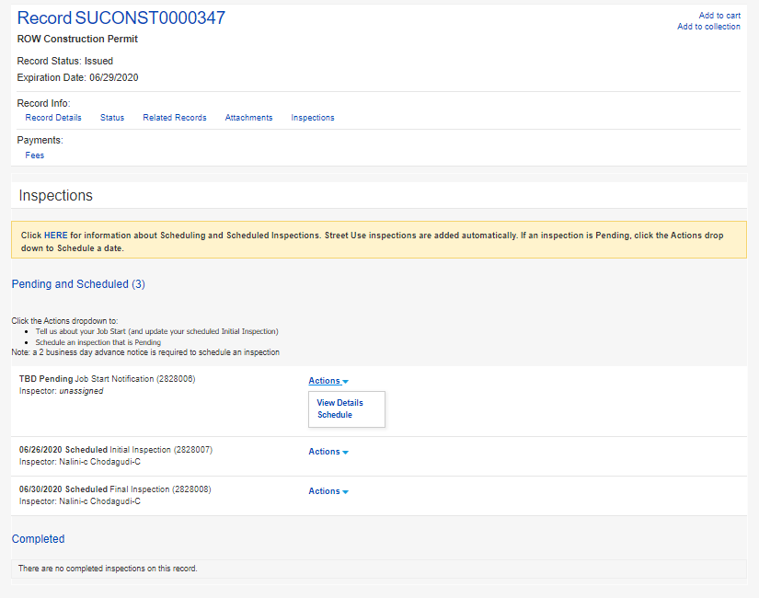
Scheduling through the Portal
In the Inspections section on the permit (aka record), select ‘Actions’ and then ‘Schedule.’
1

Slide 17
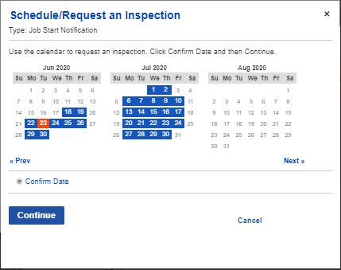
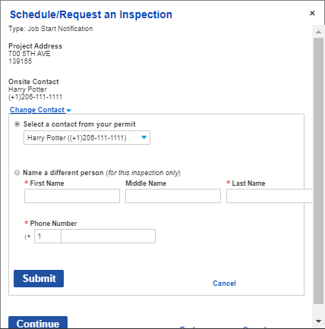
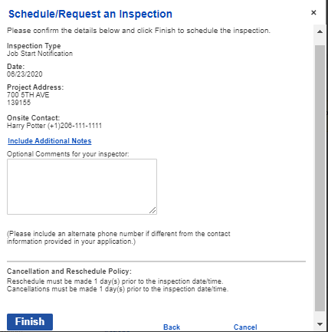
Scheduling through the Portal
2
2) Select date on the calendar in the timeframe allotted based on the issued start date and duration.
3) Verify Onsite Contact and submit.
4) Finish.
3
4

Slide 18
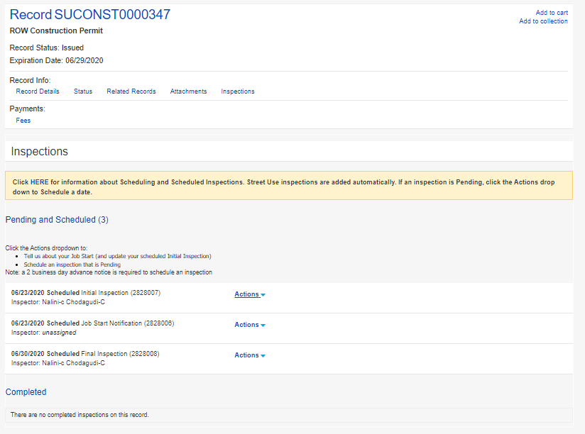
Re-scheduling through the Portal
1) In the Inspections section on the permit (aka record), select ‘Actions’ and then ‘Reschedule.’
2) Follow the previous steps 2-4.
Note: a 2-business day notice is required to schedule or reschedule an inspection
1

Slide 19
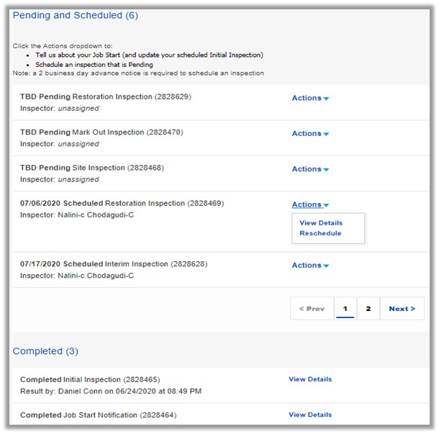
Restoration notifications
Must be scheduled by individual permit on the Portal 2-business days in advance.
Restoration notifications by email will no longer be accepted after November 7th.

Slide 20
Scheduling offline of the Portal
Pre-Con Meeting
Required on UMPs and SIPs only
For SIPs, the SIP Project Manager will schedule
For UMPs, the assigned inspector will schedule
To request a Pre-Con Meeting for non-UMP and non-SIP permits, email the assigned St Use Inspector
Off-Hours
Work outside of normal working hours, 8:00 AM - 5:00 PM Monday through Friday
3-business days in advance notice required
Email DOT_StUse_OffHours_Inspection@seattle.gov

Slide 21
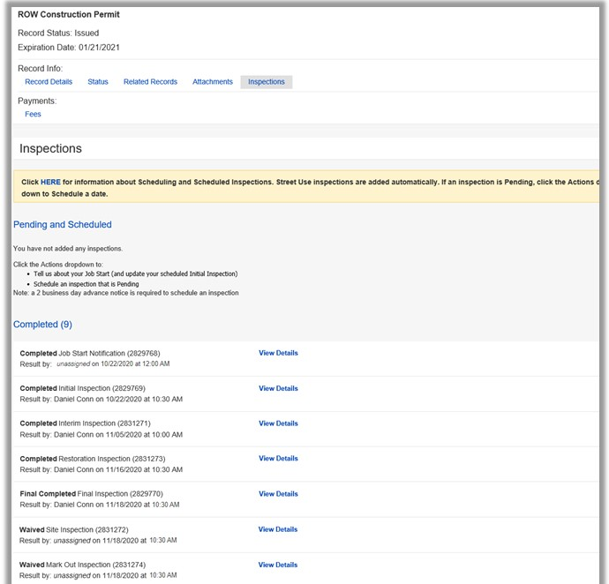
How to find the status of inspections
When on the permit, select Inspections.
All scheduled, waived and resulted inspections will be visible.

Slide 22
Upcoming events
One workshop per topic
Each workshop will be held virtually using Webex and recorded
Q&A sessions will be a 1-hour live event twice a week using Webex
Stay informed in our monthly newsletter and website
Date, Time | Topic
Oct 19th, 3-4pm | Seattle Services Portal (SSP) Overview
Oct 26th, 2-3pm | Utility Permit Overview
Oct 28th, 3-4pm | Construction Permit Overview
Oct 30th, 11:30am-12:30pm | Street Improvement Permit Overview
Week of Nov 9th | General Q&A’s Sessions
Week of Nov 16th | General Q&A’s Sessions

Slide 23
Questions?
Christopher.Luedke@seattle.gov
www.seattle.gov/transportation

