Slide 1
City of Seattle Webgrants System
Quick User Guide - Applicant
webgrants.seattle.gov
Cable Broadband Internet
Last Updated: November 1st 2014
Any questions or feedback? Please contact project manager, Derrick Hall| derrick.hall@seattle.gov

Slide 2
Table of Contents
2 Step 1 - Registration
3 Register or Sign in
4 If registering, fill in information
5 If registering, wait for confirmation
6 Step 2 - Getting Started
6 Start a new application
7 Selecting Grant
8 Applying for Grant
9 Select name for Grant
10 Fill out all forms
11 Mark all forms as complete
12 Review application
13 Submit Application
26 Step 4 – Add Additional Users
15 Follow to add additional users to grant

Slide 3
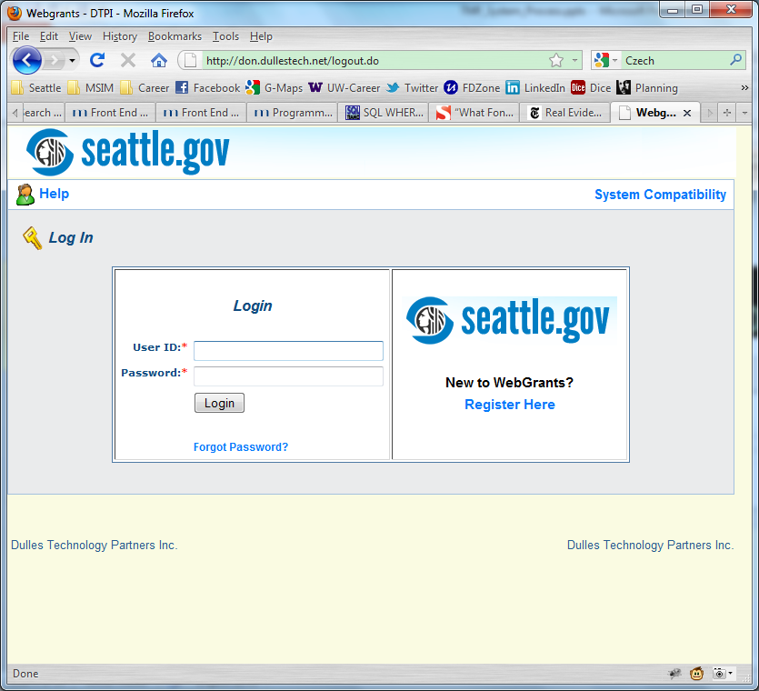
Login/Register
« Back to Table of Contents
Click Help if you encounter any issues
Click to Register
Password is case sensitive
WARNING: Password is case sensitive. If forgot your User ID, please contact Derrick Hall, derrick.hall@seattle.gov

Slide 4
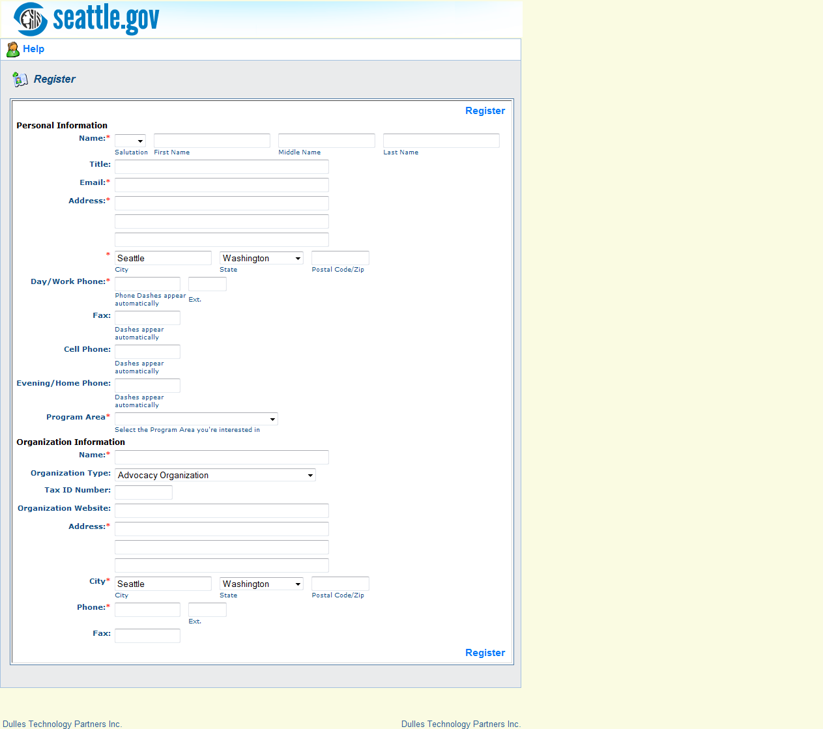
Fill Out Registration Form
« Back to Table of Contents
Fill in your
Personal Information
Organization Information

Slide 5
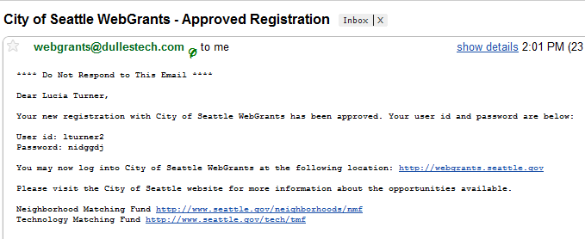
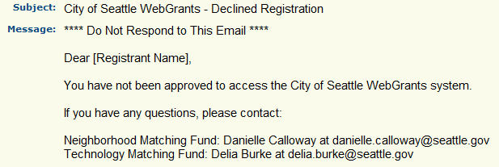
Receive Approval/Disapproval Email Notification
« Back to Table of Contents
After approval, you will receive your user ID and password.
* You can always change/reset your password in “My profile” after login

Slide 6
Getting Started
« Back to Table of Contents
After login, click Funding Opportunities to start a new application

Slide 7
Select Technology Matching Fund
« Back to Table of Contents
NOTE: Select Technology Cable Broadband Program. You can also select the funding opportunities from Department of Neighborhoods or Community Technology.

Slide 8
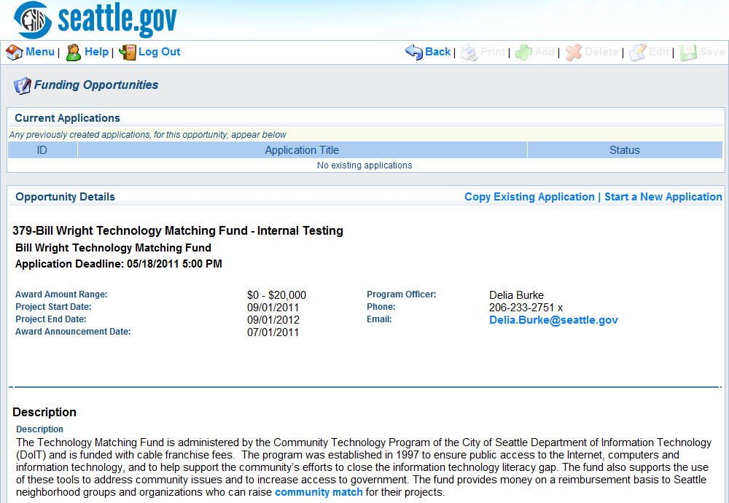
Start a New Application
« Back to Table of Contents
Click here to start a new application

Slide 9
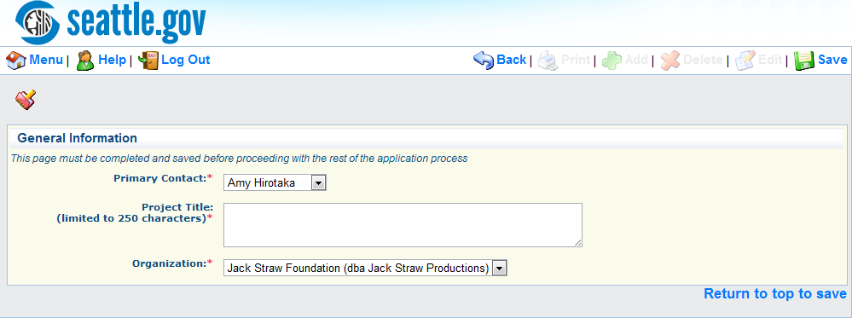
Start a New Application
« Back to Table of Contents
Click Save to complete this section
NOTE: How do I add more primary contacts? Go to My Profile and click on your
organization to add.
See more detail »

Slide 10
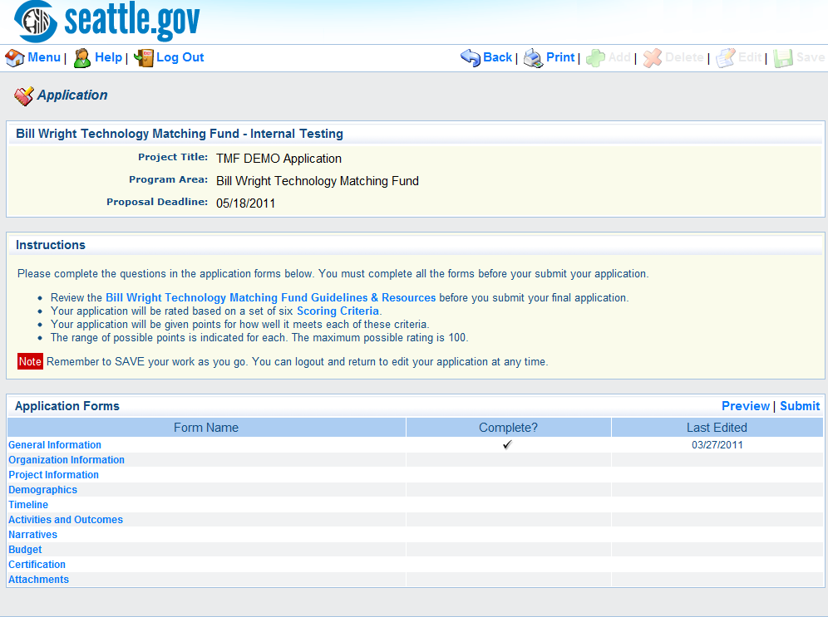
Application Forms Overview
« Back to Table of Contents
Preview and submit your application here
Once you mark a form as complete, a check mark is displayed here
All forms must be marked as complete before submission
Click each application form to fill out and mark as complete

Slide 11
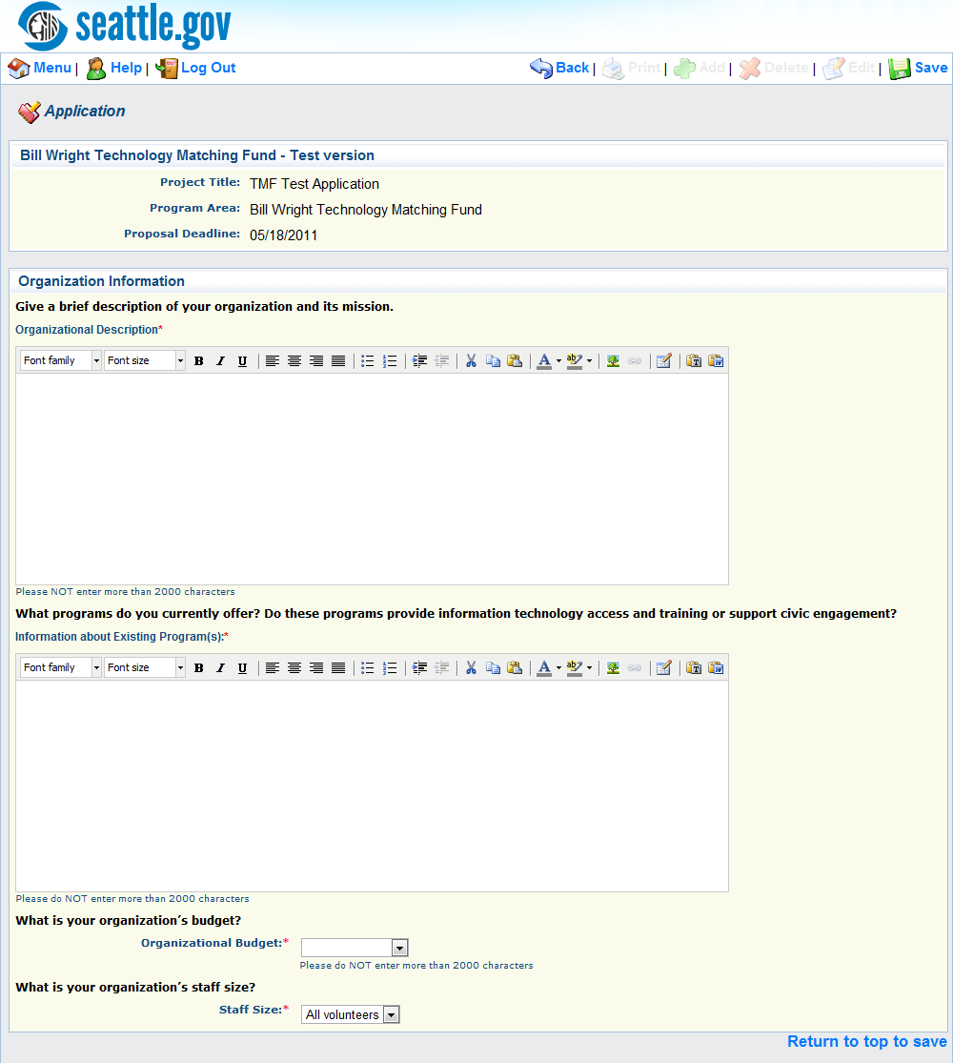
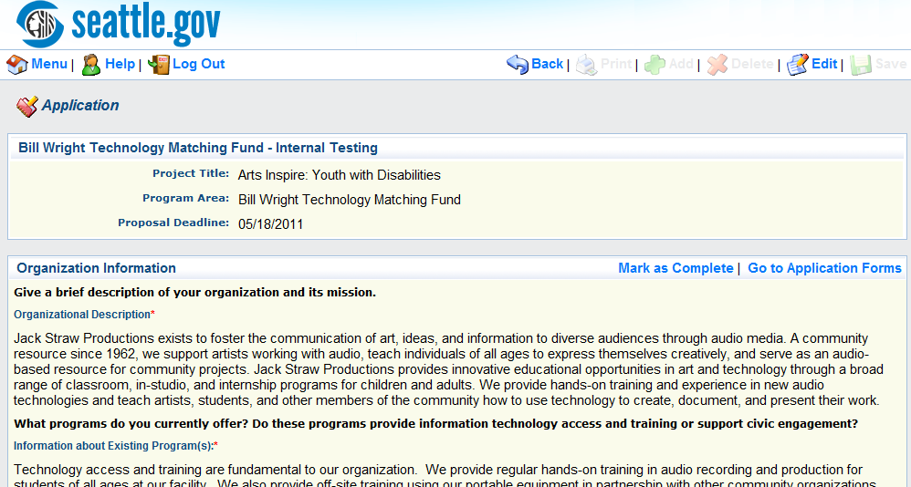
Fill Out Application Information
« Back to Table Content
Mark as complete after filling out

Slide 12
Preview Your Application
« Back to Table Content

Slide 13
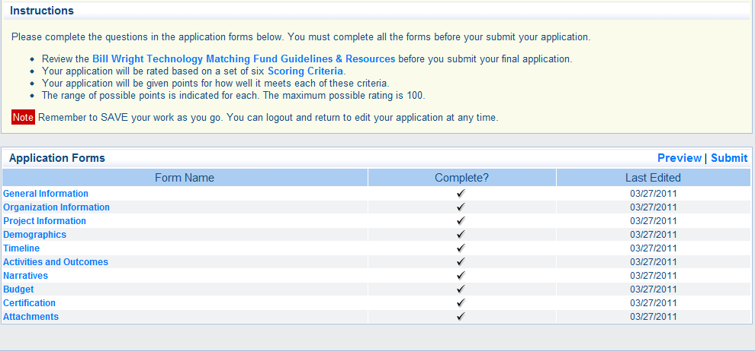
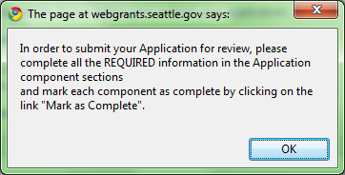
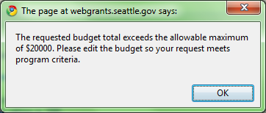
Submit Your Application
« Back to Table Content
Submit after all forms are marked as Complete
You may see some warning messages after you click Submit:

Slide 14
Successfully Submitted
« Back to Table Content
CONGRATULATIONS! Well done! Next, you will receive email notification about your application status. If you have any questions, please contact the technology matching fund project manager.

Slide 15
Add More Primary Contacts
« Back to Table of Contents
Click My Profile to add more primary contacts

Slide 16
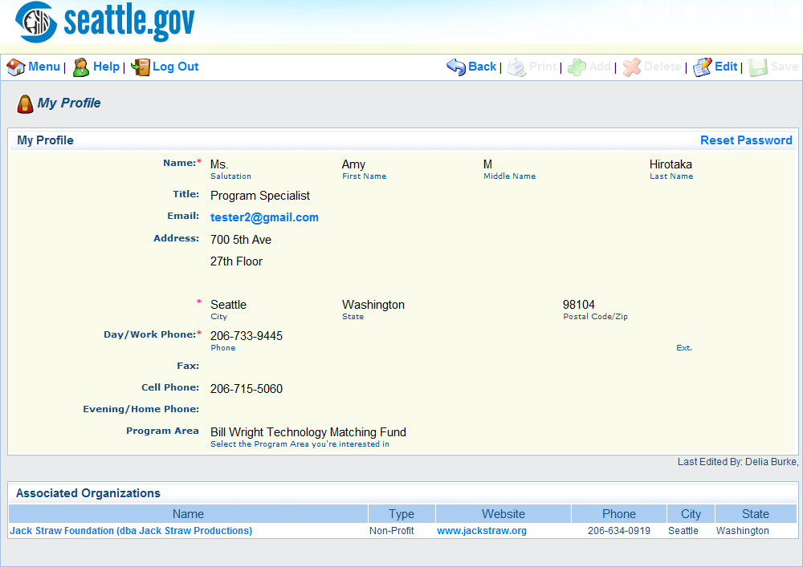
Add More Primary Contacts – My Profile
« Back to Table of Contents
Click name of associated organization

Slide 17
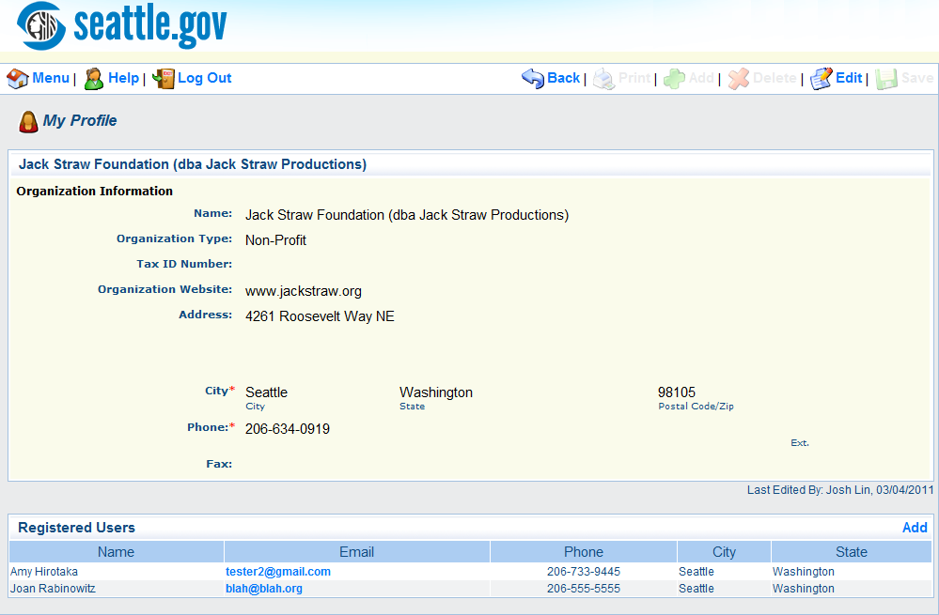
Add More Primary Contacts – Associated Organization
« Back to Table of Contents
Click Add

Slide 18
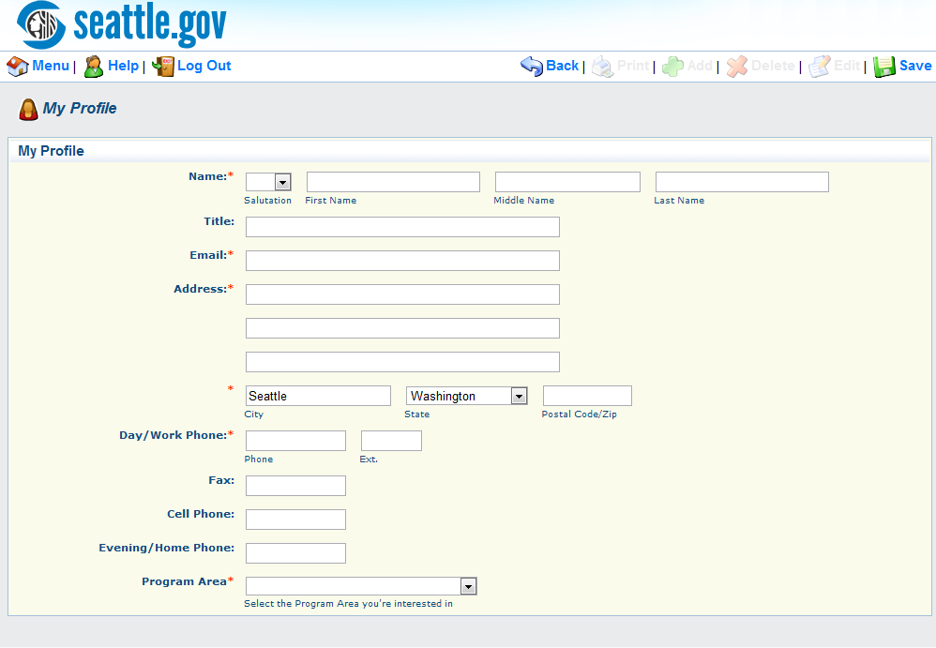
Add More Primary Contacts
« Back to Table of Contents
Fill out the form and click Save
Now you can see the name in the dropdown list when creating an application

