Slide 1
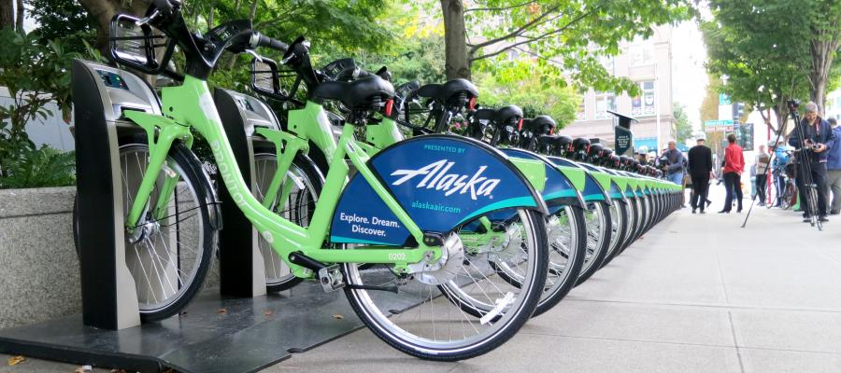

Bike Share Update
Nicole Freedman
Chief of Active Transportation
January 6, 2016

Slide 2
Our mission, vision, and core values
Mission: deliver a high-quality
transportation system for Seattle
Vision: connected people, places, and products
Committed to 5 core values to create a city that is:
Safe
Interconnected
Affordable
Vibrant
Innovative
For all
2

Slide 3
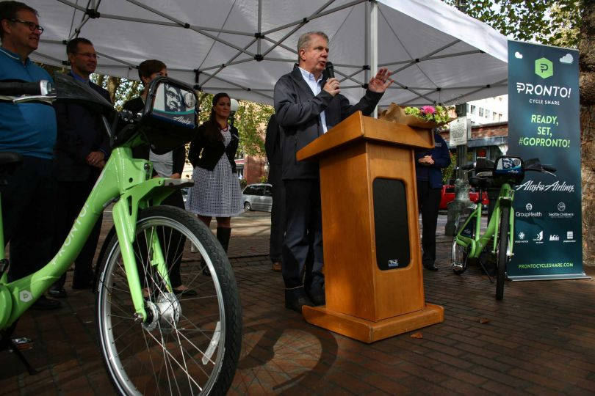
Presentation overview
About Bike Share
Vision
Status
Business Plan
3
Notes:
Let the audience know the purpose of your presentation (is it purely informational, are you seeking feedback, etc). Then walk them through what you’ll be covering.

Slide 4
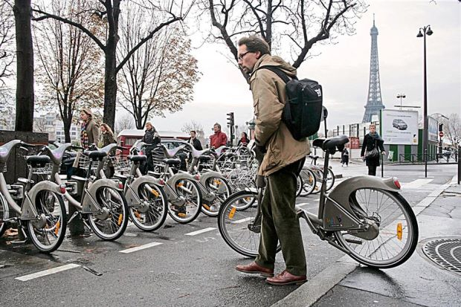
Paris
25 million trips/year
240k subscribers
6 Mil VMT
10,000 bikes,
1000 stations
Notes:
Really put on map
25 million trips/years,
240k subscribers,
6 Mil VMT,
10,000 bikes,
1000 stations.
Largest system at the time.

Slide 5
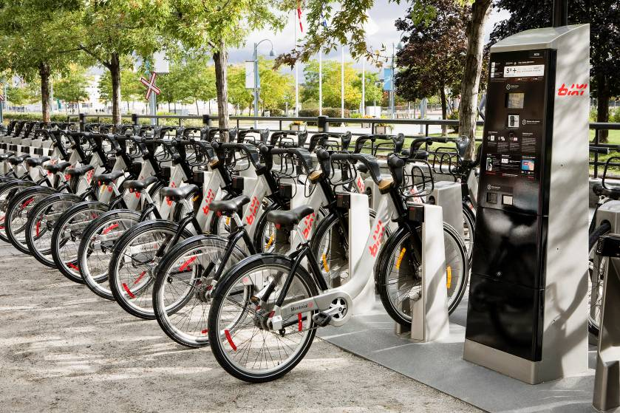
Montreal
Montreal Month 5
1 million bike trips,
3 million miles travelled,
10,000 subscribers,
86,000 occasional users
Notes:
Montreal (Month 5),
1 million bike trips,
3 million miles travelled,
10,000 subscribers,
86,000 occasional users

Slide 6
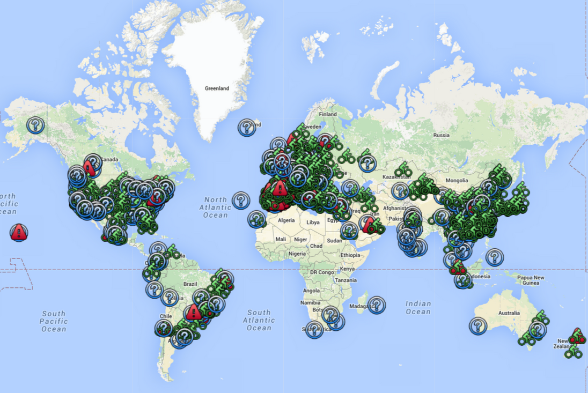
Worldwide
500 cities
5 continents
US municipalities
20 million US trips, 2015

Slide 7
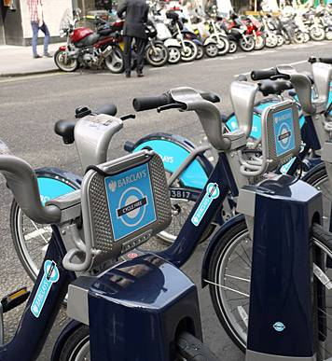
Why it Works
Convenient
Spontaneous
One Way
Inexpensive
Mainstream Design
Notes:
Convenient - 300 feet, swipe of card, no reservation
1 way,
inexpensive,
Hip & Cool - maintstream – users in suits and skirts.

Slide 8
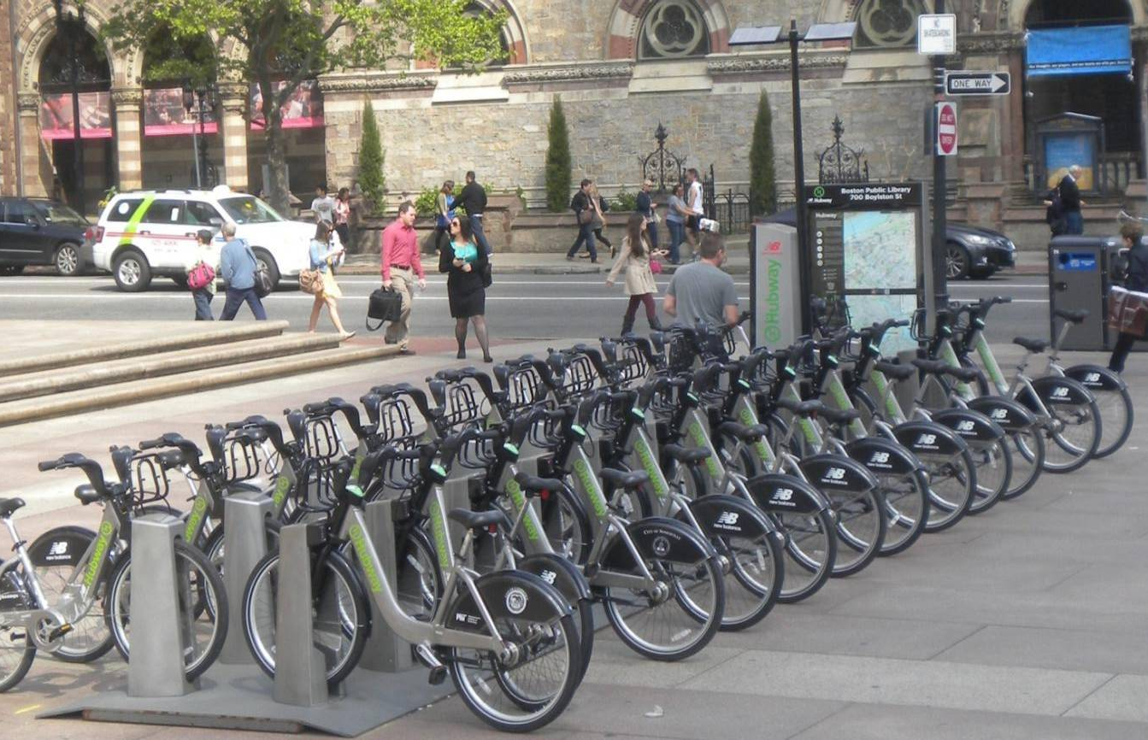
Benefits
Changes transportation behavior
Supports Local Economy
Reduces GHG
Increases Physical Activity
Notes:
VMT – 3 Mil eliminaated in US, 2015
Transportation - DC members
55% of respondents reported using a car less often;
59% used a taxi less often
64% of respondents said at least one of the bike share trips they made either started or ended at a Metrorail station;
Local Economy- Hubway $7M locally. Nearly 50% would have either shopped elsewhere or not spent the money.
Health –74 million minutes of physical activity in London and 1.4 million minutes of physical activity in Minneapolis/St. Paul, for 2012.
Equity- Most recently U.S. cities are pioneering measures to address transportation equity

Slide 9
Vision
Create a new personal mobility option that increases access to affordable transportation, promotes active and healthy living, is environmentally friendly and equitable, supports the local economy and is financially sustainable.
9
Notes:
Seattle, with its well-developed transportation infrastructure, can have not just a viable bike share system, but one of the best in the country.”

Slide 10
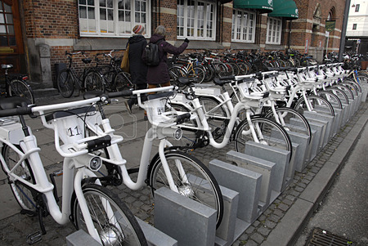
Deliverables
2017 launch
Expanded service area w/ SE Seattle
80-150 stations
Open to Gen 4.0 electric. May sell or retrofit existing
Can recover 100% of op ex from sponsors & users, 2018

Slide 11
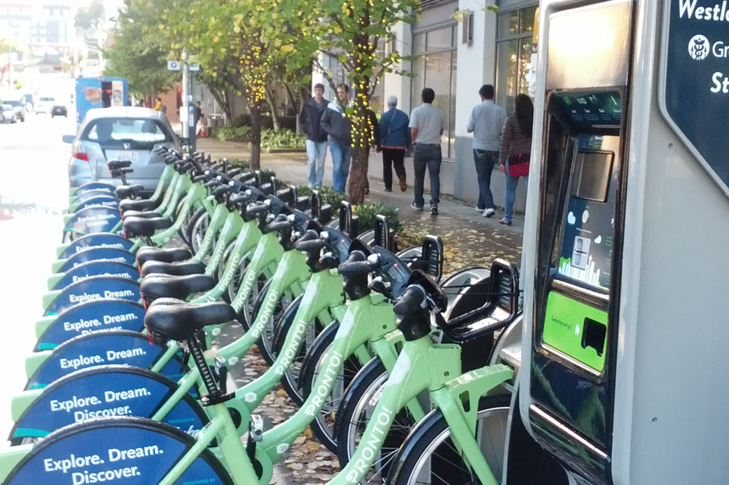
Projections
Existing (500 bikes) 2015
140,000 trips
3,000 members
$675K user revenue
Expanded (800-1200 bikes)
500,000
8,000 members
$1.4M user revenue
Ridership, Membership and Revenue Projections
 | Annual | Average Monthly
Total Trips | 500,000 | 72,531
Trips by Annual Members | 679,980 | 56,665
Trips by Casual Members | 190,392 | 15,866
Annual Memberships Sold | 8,095 | 675
Casual Memberships Sold | 86,542 | 7,212
Revenue | $1,420,886 | $118,407

Slide 12
Infrastructure & Safety
Recommendation - Seattle’s existing infrastructure can safely support bike share. Expand bike share
concurrent with implementation of the bike network
Cycling Rating of Peer Cities with Bike Share
 | Population 2010 | League of American Bicyclists Ranking | Rank By Mode Share | Launch Year | Start Size | Current Size | Fatalities
Chicago | 2,700,000 | Silver | 20 | 2013 | 75 | 476 | 0
Wash DC | 649,000 | Silver | 2 | 2010 | 49 | 339 | 0
Minneapolis | 400,000 | Gold | 4 | 2010 | 65 | 169 | 0
Boston | 644,000 | Silver | 14 | 2011 | 61 | 141 | 0
Denver | 646,000 | Silver | 13 | 2010 | 40 | 86 | 0
Seattle | 652,000 | Gold | 6 | 2014 | 50 | 54 | 0
12
Notes:
Let the audience know the purpose of your presentation (is it purely informational, are you seeking feedback, etc). Then walk them through what you’ll be covering.

Slide 13
Governance Structure
Recommendation - Consistent with peer cities, adopt a public governance model.
The City will own the bike share equipment and contract with a third party
for operations.
Public
(Government Owns &
3rd Party Operates)
Cities - Boston, Chicago, London, Los Angeles, Philadelphia, Washington DC
Pros - City controls system and oversees operator. City determines station locations, prices, SLA's. City can drive expansion to make bike share a true extension of transit. Public systems tend to be largest.
Non-Profit
(Non-Profit Owns & Operates)
Cities - Aspen, Buffalo, Boulder, Denver, Honolulu, Memphis, Minneapolis
Private
(For-Profit Owns & Operates)
Cities - NYC, Miami Beach
Cons - City responsible for some or all of finances
Pros - City not responsible for finances. Local operations can achieve lower costs.
Cons - City minimal control or input. City cannot drive expansion; systems tend to be smaller.
Pros - City not responsible for finances or management
Cons - City minimal control or input. For-profit goals not always aligned with city's.
Best for- Small and mid-sized cities and systems where local operations are feasible and cost-effective.
Best for - Larger cities invested in making bike share part of the public transportation system.
Best for - Cities with exceptional private revenue potential from sponsorship, advertisements or tourists.
13
Notes:
Let the audience know the purpose of your presentation (is it purely informational, are you seeking feedback, etc). Then walk them through what you’ll be covering.

Slide 14
Equipment
Recommendation- Issue a flexible bid open to a range of equipment options to
maximize choice. Bid responses will provide the detail required to determine the
best solution for Seattle.
Generation 3.0
Station-Based
Smart-Dock
Vendors- 8D, Bcycle, PBSC
Generation 3b
Station-Optional
Smart-Bike
Vendors - Sobi
Generation 4.0
Station-Optionsl Smart-Bikes with Pedal Assist Electric Technology
Vendors - Beweggen
Pros - Highly robust, proven equipment. Operational in US since 2010. Dominant technology of large U.S. cities. Planned upgrades to include features from newer systerms including potential electric retrofits..
Pros - Lower cost because technology in bikes. More nimble. Advanced features. Stations not required.
Cons -Less proven system. Stationless systems are less visible. Equipment not as robust. Statoinless increases rebalancing challenges. Not compatible with existing equipment.
Pros - Electric increases pool of riders and revenue potential. Advanced features.Next generation of equipment.
Cons - New technology. Early adopter challenges. Likely requires hardwiring stations. Not compatible with existing equipment.
Cons - Most expensive because technology in docks is duplicative. Lacks some newer features. Requires stations.
Cities - Birmingham
Cities - Boston, Milwaukee, Philadelphia, Chicago, Washington DC, Seattle, NYC, Denver, Minneapolis
Cities -Portland, Buffalo, Hamilton, Phoenix, Orlando, Long Beach
14
Notes:
Let the audience know the purpose of your presentation (is it purely informational, are you seeking feedback, etc). Then walk them through what you’ll be covering.

Slide 15
Operations
Recommendation- Combine operations and equipment into a single, flexible bid, open
to a range of financial models for operations.
Flat Fee
Risk/Revenue Share
Privatized Operations
Time and Management
System owner pays flat fee for operations based on size.
System owner pays actual costs of operations plus management fee.
Owner and operator share revenue and risk.
Operator takes full responsibility for operations costs.
Revenue remains with owner.
Owner retains full decision making authority.
Revenue remains with owner.
Owner has near full decision making authority.
Owner and operator share decisions.
Operator keeps majority of revenue.
Operator retains decision making authority beyond contract terms.
Operator may own and/or be responsible for equipment
15
Notes:
Let the audience know the purpose of your presentation (is it purely informational, are you seeking feedback, etc). Then walk them through what you’ll be covering.

Slide 16
System Size
Recommendation- Consistent with best practices from peer cities, invest $5M to expand
bike share to 80-150 stations. Properly capitalizing the expansion will contribute to the
financial success of the system.
 | Population | Launch Year | # Stations Initial | # Stations Current | % Growth
Chicago | 2,700,000 | 2013 | 75 | 476 | 535%
Wash DC | 649,000 | 2010 | 49 | 339 | 592%
Minneapolis | 400,000 | 2010 | 65 | 169 | 160%
Boston | 644,000 | 2011 | 61 | 141 | 131%
Denver | 646,000 | 2010 | 40 | 86 | 115%
Seattle | 652,000 | 2014 | 50 | 54 | 8%
16
Notes:
Let the audience know the purpose of your presentation (is it purely informational, are you seeking feedback, etc). Then walk them through what you’ll be covering.

Slide 17
Station Siting
Recommendation- Finalize the service area after procurement. Ensure a minimum density of six stations per square mile. Maintain the integrity of the network. Prioritize locations to meet equity, revenue, transit connectivity and operational goals.
City | Station Density (stations/sq. mile)
Washington DC | 8.9
Minneapolis | 7.7
Boston | 8.3
Denver | 8.7
Chicago | 9.4
Average | 8.7
Location Priorities
Equity
Revenue generation
Transit connectivity
Ops considerations (gap fill, rebalancing)
Network Integrity
Avoid creating “islands”
2. Avoid narrow or linear networks
3. Ensure all stations < one mile of an existing station, preferably every 300-500 yards.
17
Notes:
Let the audience know the purpose of your presentation (is it purely informational, are you seeking feedback, etc). Then walk them through what you’ll be covering.

Slide 18
Marketing
Recommendation- Implement a comprehensive marketing program emphasizing corporate memberships. Ensure a staff person is dedicated to corporate sales.
Equity
Recommendation- Locate a minimum 20% of stations in low-income neighborhoods, extending into southeast Seattle, as possible. Implement a suite of equity programs including a low-income membership program.
18
Notes:
Let the audience know the purpose of your presentation (is it purely informational, are you seeking feedback, etc). Then walk them through what you’ll be covering.

Slide 19
Financial Sustainability
City | # Bikes | User Revenue | Total Revenue (excl. grants/ public) | Ops Cost | Fare Recovery Rate | Overall Recovery Rate
Chicago | 4760 | 4,950,000 | 8,100,000 | 5,035,000 | 98% | 161%
Wash DC | 1953 | 6,192,204 | 6,825,204 | 6,741,912 | 92% | 101%
Minneapolis | 1525 | 974,997 | 2,107,297 | 1,230,000 | 79% | 171%
Boston | 844 | 1,068,339 | 2,006,339 | 1,415,000 | 76% | 142%
Denver | 700 | 636,862 | 1,073,924 | 1,248,749 | 51% | 86%
Seattle | 480 | 667,795 | 1,320,038 | 1,530,689 | 53% | 86%
Fort Worth | 345 | 192,685 | 452,897 | 428,588 | 45% | 106%
“Pronto’s biggest misstep was launching the system with insufficient capital funds thereby incurring debt payments that require diverting revenue from operations.”
Notes:
Let the audience know the purpose of your presentation (is it purely informational, are you seeking feedback, etc). Then walk them through what you’ll be covering.

Slide 20
Process & Timeline
Acquire Pronto
Oversee interim operations
Expand System
Averts system shutdown
Jan-Feb 2016
Effective
through procurement
Jan-Feb 2016
Enables expansion and ensures best outcome.
Mar-Jul 2016
Conduct procurement
Funded by $5M capital investment
Nov 2016
Launch 2017
Summer 2017
20
Notes:
Let the audience know the purpose of your presentation (is it purely informational, are you seeking feedback, etc). Then walk them through what you’ll be covering.

Slide 21





Questions?
Nicole.freedman@seattle.gov | (206) 552-4085
www.seattle.gov/transportation

