Slide 1
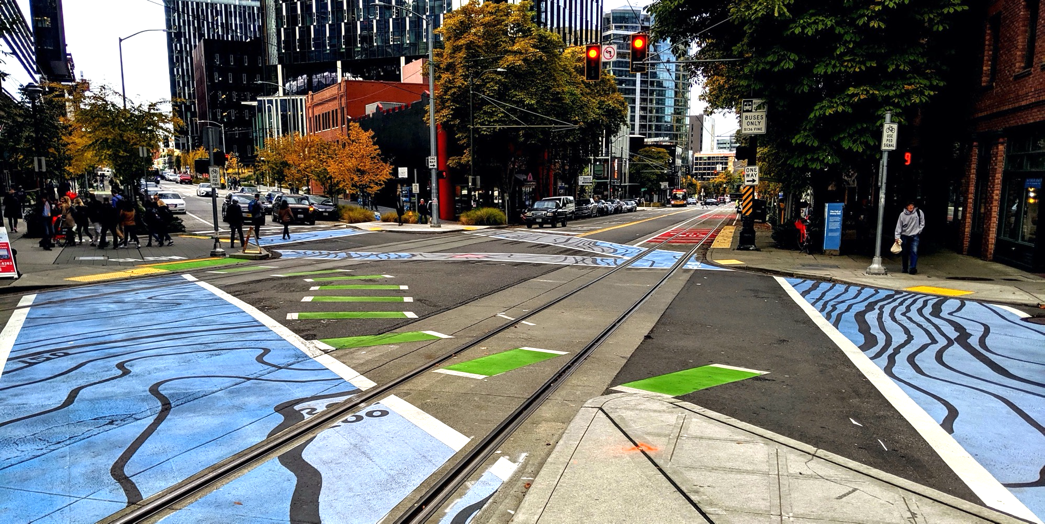
Policy & Operations Advisory Group
Policy & Operations Advisory Group
Transportation Operations and Policy & Planning Divisions

Slide 2
Meeting overview
Re-introductions
Signals Operations
Recap of Introduction to Signals Operation
Pedestrian Signal Policy – key components and opportunity to discuss
Introduction to Modal Integration
Wrap-up and next steps

Slide 3
Meeting format
We want to hear from you; we encourage you to chime in and participate
During presentations:
We will screenshare slides
Please stay on mute
If you want to chime in or have quick questions answered as we go, please use the chat function (send to "all participants" or "all panelists") or raise hand function
Please say your name before you speak
If you are having technical difficulties, please use the chat or email ellie.smith@seattle.gov

Slide 4
Re-Introductions
Name
Organization you represent
20 second question:
Name one life experience that helped shape your interest in transportation.
Notes:
N\N to develop

Slide 5
POAG roster
Board, Committee, or Commission | Members
Bike Advisory Board | Alexander Lew and Pierre Brunelle
Business Improvement Association | Mike Stewart (Ballard)
Freight Advisory Board | Warren Aakervik and Geri Poor
Pedestrian Access Advisory Committee | Dorene Cornwell and Steven Feher
Pedestrian Advisory Board | David Seater and Anna Zivarts
Planning Commission | David Goldberg and Grace Kim
Transit Advisory Board | Erin Tighe and Bryce Kolton
Transportation Equity Workgroup | Kiana Parker and Yordanos Teferi

Slide 6
Recap: Introduction to Signal Operations
Regulating the flow of people and goods in one of the nation's fastest growing cities

Slide 7
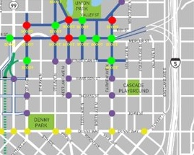
Recap: types of signal operations
Adaptive
Signals respond in real time to detected changes in traffic conditions.
Coordinated
Signals are timed with respect to other signals in a corridor or network.
Isolated
Signals operate alone and do not consider other intersections.

Slide 8
Recap: signals introduction
Types of signal phasing
Protected
Permitted
Pedestrian
Bike
Transit
Pedestrian timing
Walk and flashing don't walk
Pedestrian actuation
Push button is activated
Cycle length
Time to serve each movement at a signal

Slide 9
Recap: signal operation trade-offs
Operational Changes | Adding Phases | Increasing pedestrian crossing time | Adding pedestrian recall | Reducing cycle lengths
Vehicle and transit delay | Increase thru delay Reduce turning delay | Could increase | Increase | Increase congestion and queueing
Pedestrian & bike delay | Increased delay | Increases as a result of cycle length | Increase delay on main street. No change on side street | Reduces ped/bike wait times
Pedestrian accessibility | Reduces conflicts | Improves access | Improves expectations | Increases access
Conflicts | Reduced conflicts between vehicles and pedestrians and bikes | No change | Potential increase in red light running and jaywalking | Potential increase in collisions due to congestion

Slide 10
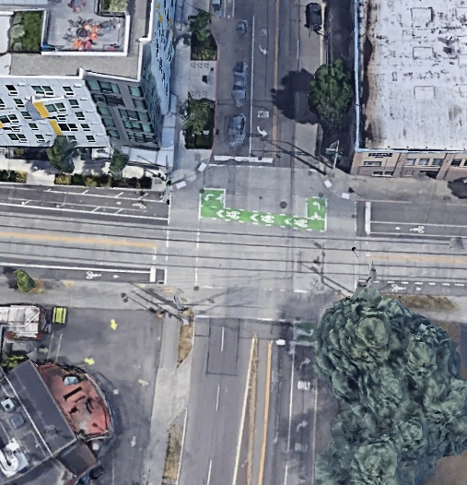
12th Ave & Yesler Way
Current conditions:
Two phases with permitted left-turns
Pedestrian recall
Bike lanes and streetcar on Yesler Way
Near an elementary school
High collision location
No space for left-turn pockets on Yesler Way
Streetcar and traffic in same lanes
Closely spaced signals

Slide 11
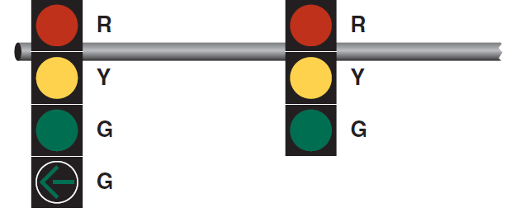
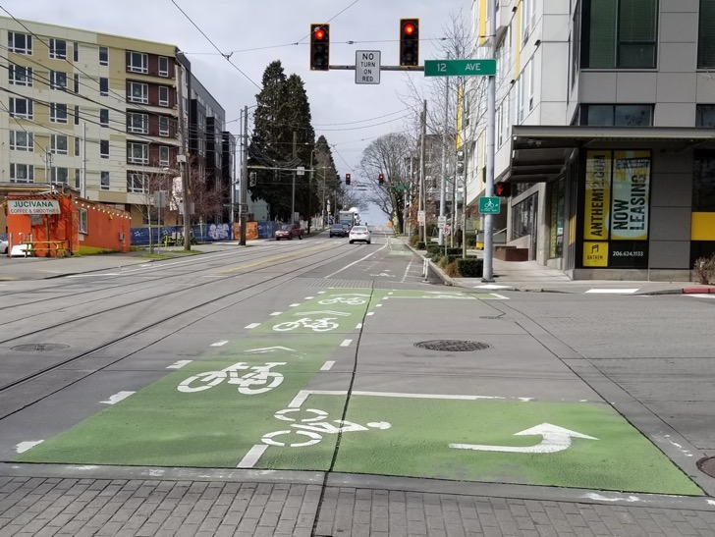
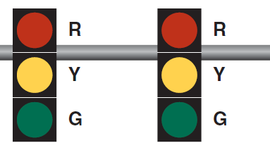
12th Ave & Yesler Way
Potential signal operation:​
1. Protect eastbound and westbound left-turns
2. Maintain permissive left-turn phase and install leading pedestrian and bike intervals
3. Restrict eastbound and westbound left-turns

Slide 12
12th Ave & Yesler Way trade-offs
Trade-offs (from existing) | Protected left-turns | Leading bike and pedestrian interval | Restrict left-turns
Transit delay | Increased ~50 sec per cycle | Slightly Increase ~5 sec per cycle | Reduced ~15 sec per cycle
Pedestrian & bike delay | Increased ~30 - 40 sec per cycle | Maintained | Maintained
Conflicts | Reduced (No EB/WB left turn conflicts) | Slightly Reduced (peds and bikes get a head start) | Reduced (No EB/WB left-turn conflicts)
Vehicle access | Maintained | Maintained | Reduced (215 WB left-turns in peak hour)

Slide 13
Traffic Signal Operations Policy Update
Purpose, policy guidance, and implementation

Slide 14
Purpose & objectives
Purpose
Develop consistent policies for signal operation city wide
Establish a unified policy on traffic signal timing and actuation
Support mobility and access while minimizing delay to pedestrians
Respond to City Council Resolution 31909
Objectives
Develop policies around improved pedestrian access
Provide direction for signal engineers and practitioners to be consistent
Implement equitably and based on data
Consistent implementation based on land use

Slide 15
Policy components
1. Define maximum cycle length
2. Increase pedestrian crossing time
3. Pedestrian actuation (push buttons)
4. Implement policy

Slide 16
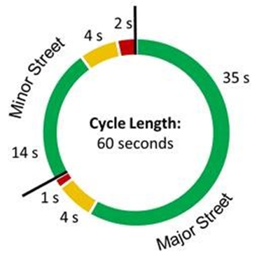
1. Maximum cycle length
Cycle length is the time required to complete one entire sequence of signal indications for all movements
Our typical cycle lengths range from 60 to 120 seconds

Slide 17
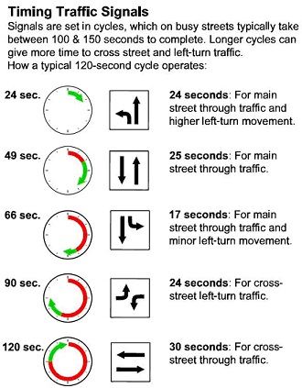
Cycle length key factors
Width of intersections and pedestrian crossing time
Number of protected movements and separate phases
Multiple phase intersections typically require long cycle lengths
Two phase intersections can usually run short cycle lengths

Slide 18
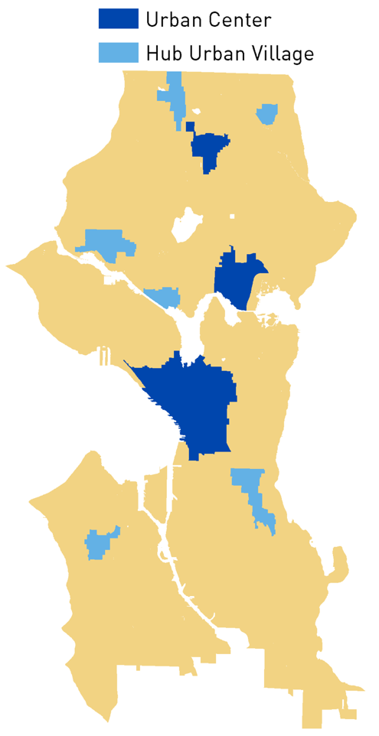
Cycle length policy
Proposed SDOT CYCLE LENGTH POLICY:
No greater than 100 seconds in urban centers
No greater than 180 seconds in manufacturing/industrial centers
In all other locations:
No greater than 120 second along minor and collector arterials
No greater than 150 seconds along principal arterials
Goal: maintain shorter cycle lengths as feasible while allowing us flexibility to respond to incidents and events that may require special timing

Slide 19
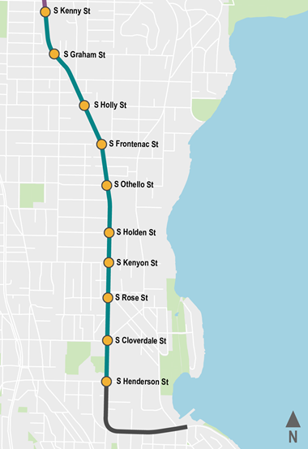
Revisiting Rainier Ave S
Rainier Ave S (S Kenny St to 52nd Ave S):
Minimum cycle length: 76 seconds
Actual cycle length: 90 and 45 seconds most of the day, 100 and 50 seconds in PM peak
6 intersections run 90 and 100
7 intersections run 45 and 50
Trade off: running a longer cycle at some intersections allows a much shorter cycle at others, reducing transit impact along Rainier.

Slide 20
Additional trade-offs and discussion
Reduced wait time for people walking and biking across the main street​
Reduced wait time for side streets and left-turns​
Potential for increased queueing for left-turns​
Potential increased delay for transit and freight along some corridors​
Potential increased delay for people walking and biking along the main street

Slide 21
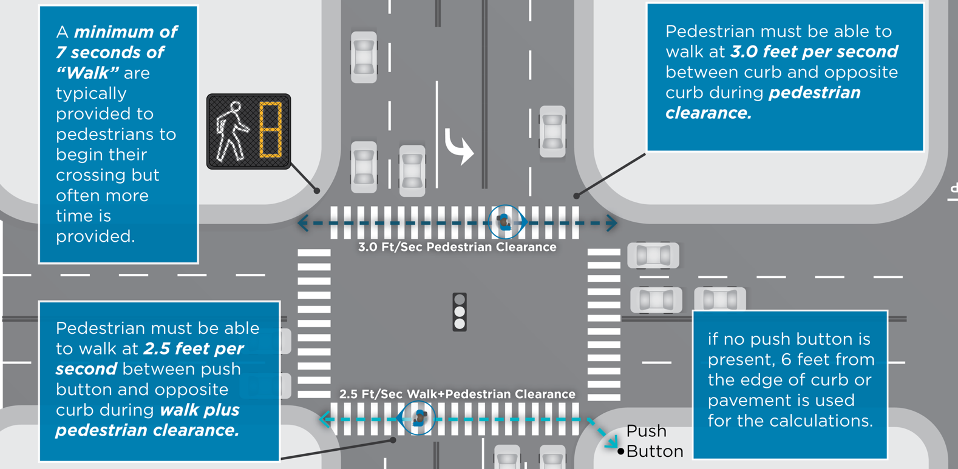
2. Pedestrian crossing time

Slide 22
Pedestrian crossing time policy
Pedestrian timing consists of:
Walk: interval a pedestrian can start crossing the street
Pedestrian Clearance: interval for a person to cross the street
SDOT PEDESTRIAN TIMING POLICY: Pedestrians will get more time to cross all streets
Walk is 7 seconds or greater (current practice)
Pedestrian Clearance calculated based on a walking speed of 3 ft/sec
MUTCD standard is 3.5 ft/sec
Walking speed of 2.5 ft/sec will be used based on community request

Slide 23
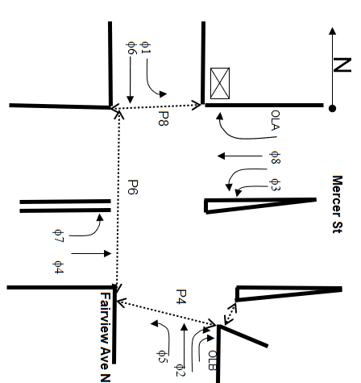
Pedestrian crossing time: example
 | Using current walking speed | Using new walking speed
Left turns | 12 seconds | 12 seconds
Fairview Ave N | 42 seconds | 51 seconds
Mercer St | 32 seconds | 38 seconds
Minimum cycle length | 98 seconds | 113 seconds
Trade-off: giving more time for pedestrians to cross the street will result in more pedestrian wait time

Slide 24
Additional trade-offs and discussion
Improved accessibility for all pedestrians
Longer cycle lengths, especially at large or complicated intersections
Less time for people to legally step off the curb to begin crossing
More time allocated to the side street
Additional delay along arterials

Slide 25
3. Pedestrian actuation
Type | Pedestrian Operation | Vehicle Operation
Total Recall (pre-timed) | All pedestrian movements automatically served | All or most vehicle movements automatically served for a set amount of time.
Partial Recall (semi-actuated) | Pedestrian movement along main street served automatically Pedestrian movement across main street requires pedestrian detection | Main street vehicle movement served automatically Side street vehicle movement requires vehicle detection
No Recall (fully actuated) | All pedestrian movements require pedestrian detection | All vehicle movements require vehicle detection
No Recall (pedestrian half‑signal) | Pedestrian movement across main street requires pedestrian detection | Main street vehicle movement served automatically Side street vehicle traffic controlled by stop sign
Pedestrian recall: walk phase comes up without pushing push button
Actuated pedestrian: push button needs to be pushed for walk phase

Slide 26
Pedestrian actuation policy
Proposed/Draft SDOT PEDESTRIAN ACTUATION POLICY:
Provide total pedestrian recall at all intersections within Urban Centers and Hub Urban Villages unless unfeasible given intersection characteristics
Excludes pedestrian only signals and phases
Use data to determine if signal should be actuated or in recall at all other location
Pedestrian recall will be provided along the main street at the majority of intersections

Slide 27
Pedestrian actuation
Signals in Urban Centers and Hub Urban Villages account for roughly 50% percent of the city's signals
As part of COVID-19 response, we have begun implementing this policy and have added recall to over 150 additional signals in these areas (about 80% of signals now have total pedestrian recall)

Slide 28
Pedestrian actuation – additional thresholds
Additional thresholds for installing pedestrian recall to be determined based on study:
Push buttons are actuated during 50% of cycles for the majority of the day
Push buttons are actuated during 75% of the cycles during the peak hours
Pedestrians volumes exceed 100 per hour for at least 4 hours a day
Adjacent to a school, pedestrian volumes exceed 50 per hour for at least 2 hours a day
Vehicle green time used for the associated vehicle phase, is within 5 seconds of the minimum needed pedestrian time

Slide 29
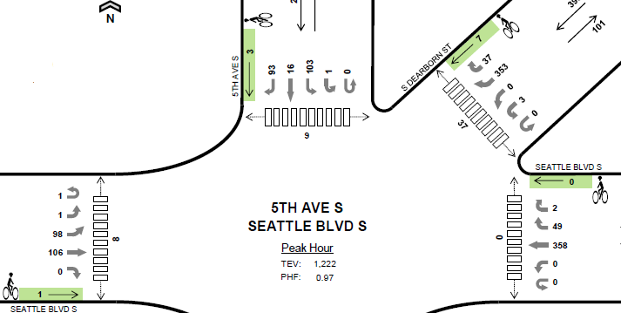
Pedestrian actuation example 5th Ave S and S Dearborn St/Seattle Blvd S
All crossings are in pedestrian recall except west crossing, with low pedestrian volumes - 8 per hour
Ped timing for
west crosswalk:
walk = 11
FDW = 27
Total = 38 seconds
There are heavy
transit volumes
in other directions

Slide 30
Additional trade-offs and discussion
Prioritized pedestrian access and mobility in Urban Center and Hub Urban villages
Provides more predictable operations for pedestrians
Potential increase in travel time for all users traveling along main street
Limits ability to run shorter cycle lengths at some intersections
Allows for flexibility and data driven installation Citywide

Slide 31
4. Policy implementation
Implement these policies when:
Install a new signal
Modify an existing signal
Re-time an existing corridor
Receive a community request

Slide 32
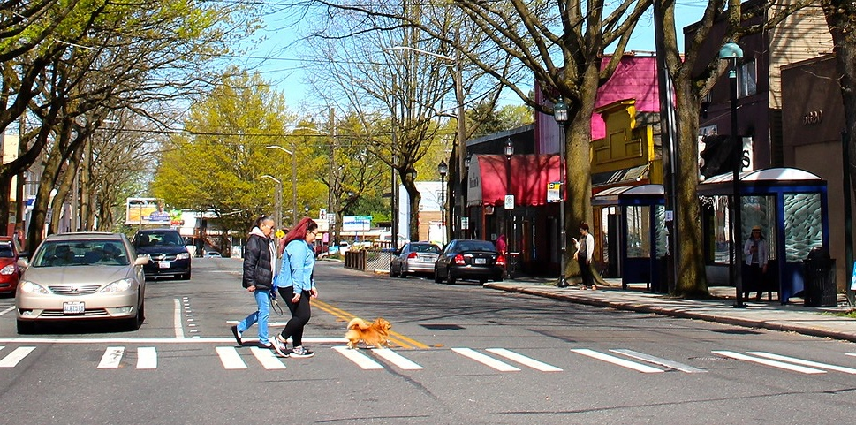
Introduction to Modal Integration

Slide 33
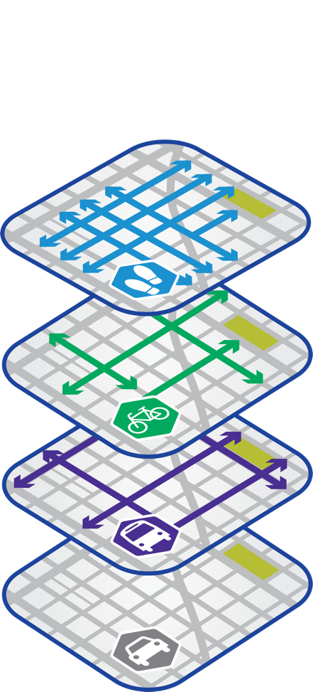
Modal integration: current policy needs
Provide policy guidance to offer clarity on competing modal priorities, particularly on constrained corridors
Establish a connection between modal priority within our modal plans and operations

Slide 34
Modal integration: present challenges
Right-of-way (ROW) allocation challenges
Layered modal plans sometimes ask streets to do too much
Missing "modes”: clarifying how autos and new mobility devices fit in our ROW
Tensions between modal priorities and other essential functions of the ROW, especially parking
Lack of transparency, especially publicly, around our ROW allocation process
Operational challenges
Lack of clarity in our operational objectives for each street
Role of vehicular level of service (LOS) in decision making

Slide 35
Existing policy framework
Policies
Comprehensive Plan
Complete Streets Ordinance
Race and Social Justice Initiative
Design standards and guidance
Streets Illustrated
Metro Route Facilities Guidelines
Plans
Modal Master Plans
Other studies including operational, subarea, corridor, street concept plans, and Bicycle-Pedestrian Safety Analysis
Processes
Project Roadmap
Complete Streets Assessment
Complete Streets Steering Committee

Slide 36
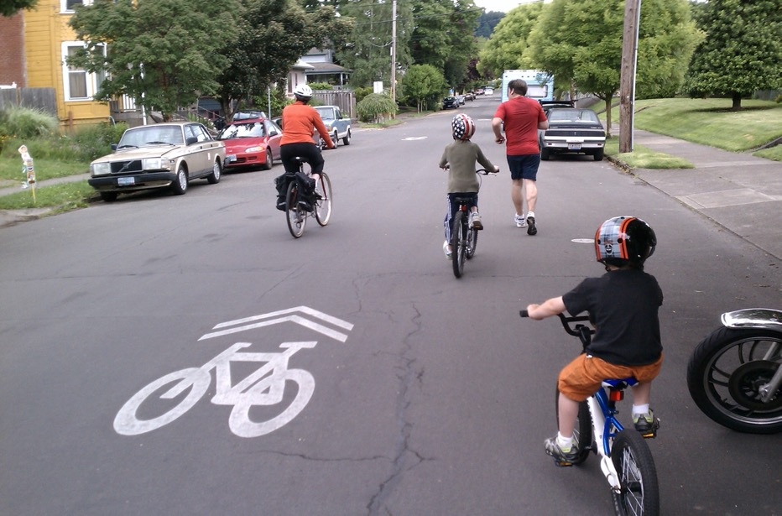
Comprehensive Plan
T 2.5 Prioritize mobility needs in the street travelway based on safety and … the modal plan networks (p. 75)
T 2.8 Not every function can fit in every street. […] Two or more streets can combine to serve as a “complete corridor,” since not every street can accommodate every need (p. 76)
T 2.9 Develop a decision-making framework to direct the planning, design, and optimization of street right-of-way (p. 77)

Slide 37
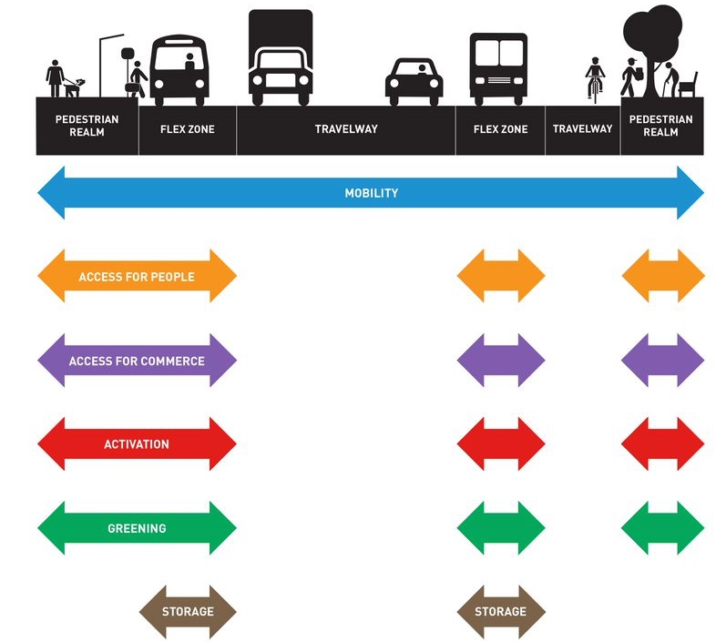
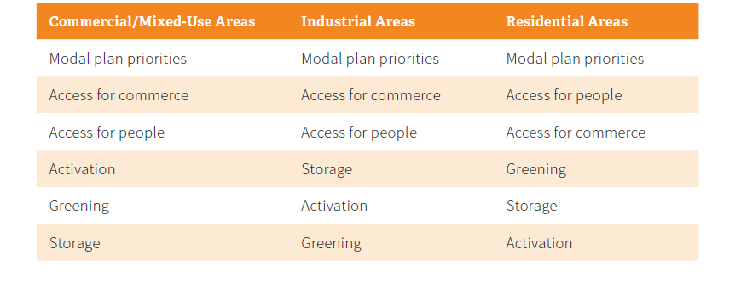
Comprehensive Plan
Establishes:
3 zones
6 essential functions
Prioritizes flex zone functions
Figure 3. Flex zone priorities by predominant area land use

Slide 38
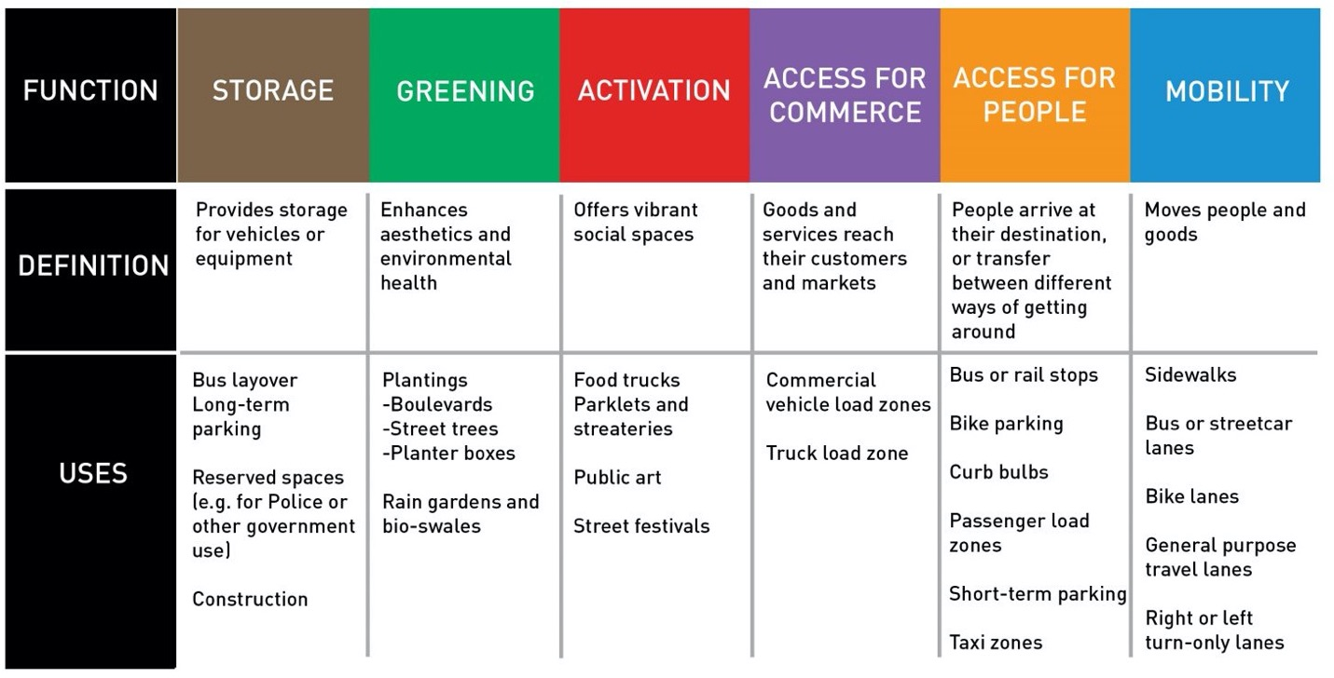
Comprehensive Plan: 6 functions of ROW

Slide 39
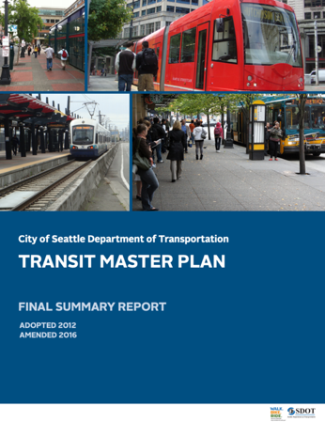
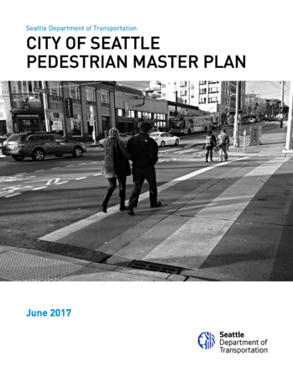
Modal Master Plans
Pedestrian (2017)
Priority investment network (PIN)
Freight (2016)
Major and minor routes
Transit (2016)
Frequent transit network (FTN)
Priority bus corridors
Principle, major, minor routes
Bicycle (2014)
Citywide network and local connectors

Slide 40
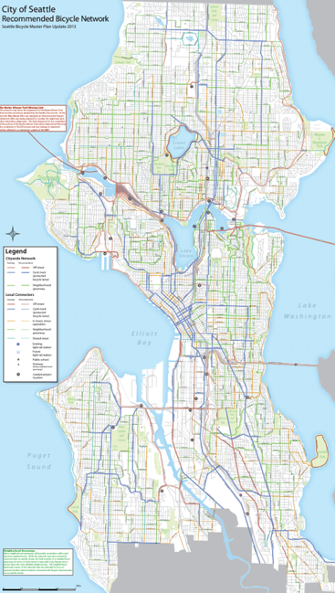
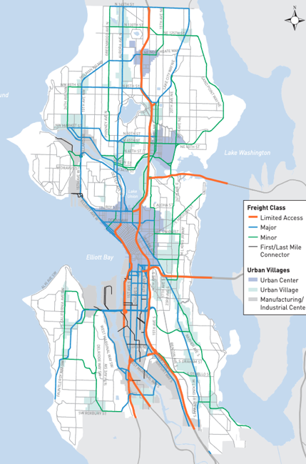
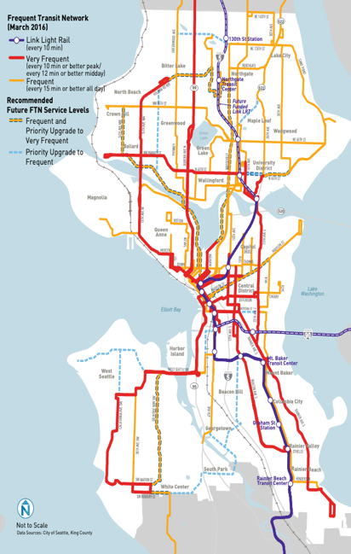
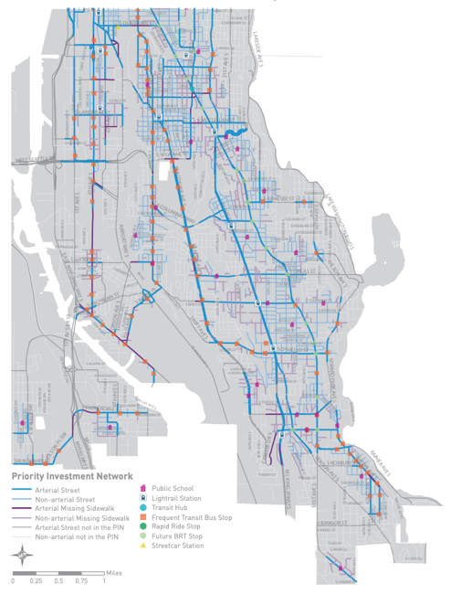
Modal Master Plans: network maps
Bicycle Network Map
Freight Network Map
Frequent Transit Network
Pedestrian Priority Investment Network

Slide 41
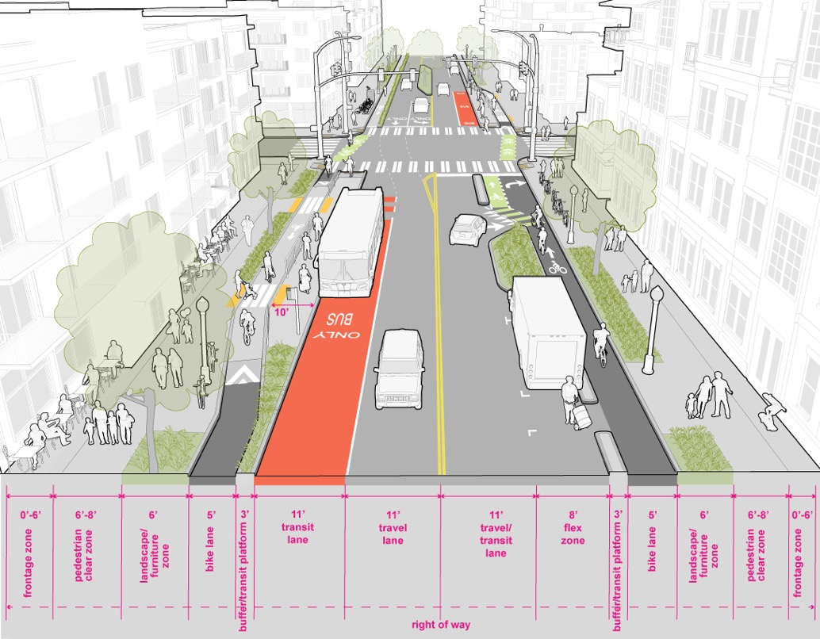
Streets Illustrated
Establishes
12 street typologies
Dimensional standards
Deviation request process
Design guidance
Existing ROW deficiencies
Pedestrian realm
Curb-to-curb
Building face-to-building face
Urban Village Main Street

Slide 42
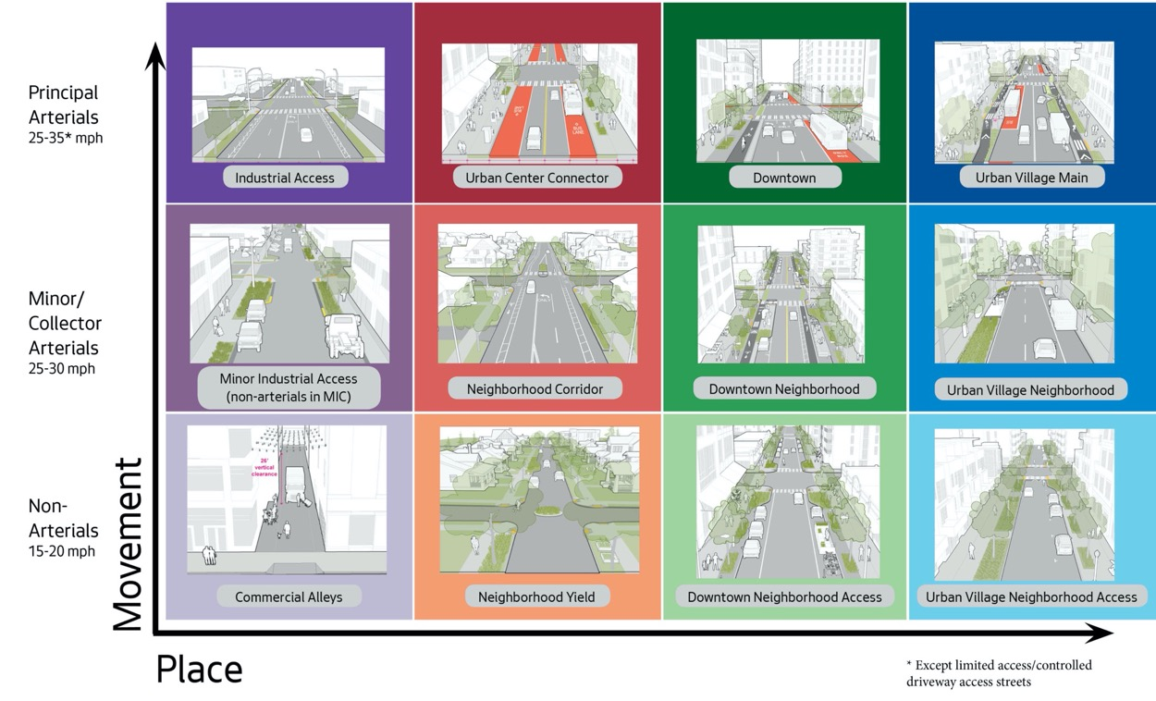
Streets Illustrated

Slide 43
Modal integration approach
Collect background information and identify problem
Analyze street geometry & networks
Develop policy guidance
Develop operational targets
Draft policies and processes
Racial Equity Toolkit process

Slide 44
Next steps
#1 – June 25
Kick-off
Introduction to signal operations
#2 – July 23
Draft Comprehensive Traffic Signal Operations Policy: presentation and discussion
Modal Integration: introduction
#3 – August 27
Draft Comprehensive Traffic Signal Operations Policy: continued discussion
Modal Integration: analysis
#4 – Sept 24
Modal Integration: draft policy options
#5 – Oct 22
Modal Integration: draft policy options and operational priority
#6 – date TBD
Modal Integration: policy recommendations and discussion
Wrap-up and reflections

Slide 45
Questions?
ellie.smith@seattle.gov | (206) 300-1690
www.seattle.gov/transportation

