Slide 1

City of Seattle
Office of Labor Standards
SEATTLE LABOR STANDARDS

Slide 2
OLS MISSION
Our mission is to advance labor standards through thoughtful community and business engagement, strategic enforcement and innovative policy development, with a commitment to race and social justice.

Slide 3
OLS History
2012 | PSST - Paid Sick and Safe Time Ordinance
2013 | FCE - Fair Chance Employment Ordinance
2014 | Mayor convened Income Inequality Advisory Committee to craft minimum wage policies
 | Mayor and City Council convened Labor Standards Advisory Group to address wage theft and to suggest ways to strengthen labor standards implementation
 | City Council passed legislation creating Office of Labor Standards as a new division within the Seattle Office for Civil Rights
April 1, 2015 | OLS birthday MW & WT - Minimum Wage and Wage Theft Ordinances
2016 | Wage Theft Prevention and Labor Standards Harmonization Ordinance
 | HEHS - Hotel Employees Health and Safety Initiative
2017 | OLS becomes an independent office SS - Secure Scheduling Ordinance

Slide 4
OLS STAFF
July 2017 - 17 Core Staff
Dylan Orr, Director
Policy Manager
Communications Manager
Finance Operations Manager
2 Business Liaisons
Community Liaison
Enforcement Supervisor
6 Investigators
Intake investigator
Paralegal
Executive Assistant
  OLS will hire 6 additional staff by the end of 2017 (Policy analyst, three investigators, admin assist, and enforcement manager)

Slide 5


OLS STAFF

Slide 6
BUSINESS QUESTIONS
Business Liaison
Business Liaison
Policy Manager
Kerem.Levitas
Karina.Bull
seattle.gov
@
seattle.gov
seattle.gov
@
@
Darius.Foster
206-386-1238
206-386-9758
206-684-4536

Slide 7
SEATTLE
LABOR STANDARDS

Slide 8
SEATTLE LABOR STANDARDS
1. MINIMUM WAGE
What is the rate of pay?
2. WAGE THEFT
Is there payment for all hours worked?
3. PAID SICK AND SAFE TIME
Is there accrual or payment of PSST for absences due to illness, preventive care or domestic violence?
4. FAIR CHANGE EMPLOYMENT
Was job or payment denied due to conviction or arrest records?

Slide 9
SEATTLE LABOR STANDARDS
5. HOTEL EMPLOYEE HEALTH & SAFETY
Did employer provide money for health insurance, panic buttons and minimum health & safety standards for hourly, non-supervisory employees at hotels?
6. SECURE SCHEDULING
Did employer provide a predictable schedule for employees at large food services and retail establishments?

Slide 10
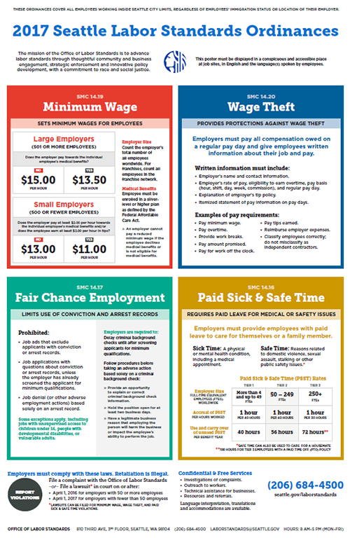
WORKPLACE POSTER (1 of 2)
(Minimum Wage, Wage Theft, Paid Sick & Safe Time, Fair Chance Employment)
Display poster at the workplace
English and primary language(s) of employee(s)
Download from OLS website https://www.seattle.gov/laborstandards/outreach/publications
Pick-up from OLS & Seattle Customer Service Centers

Slide 11
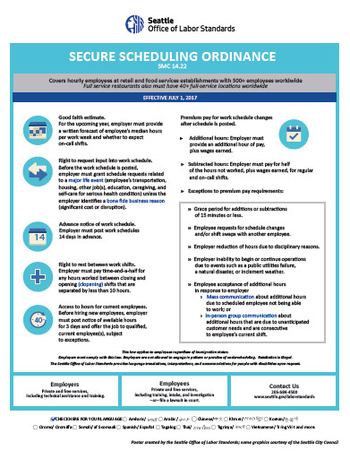
WORKPLACE POSTER (2 of 2)
(Secure Scheduling)
Applies to Retail and food service establishments with 500+ employees worldwide and full service restaurants with 500+ employees and 40+ full-service restaurant locations worldwide.
Display poster at the workplace
English and primary language(s) of employee(s)
Download from OLS website https://www.seattle.gov/laborstandards/outreach/publications
Pick-up from OLS & Seattle Customer Service Centers

Slide 12
WHAT IS THE RATE OF PAY?
MINIMUM WAGE

Slide 13
January 1, 2017
LARGE EMPLOYER
$15.00 per hour
—or—
$13.50 per hour

Slide 14
LARGE EMPLOYER
(501+ EMPLOYEES)
Year | Minimum Wage | Minimum Wage Plus payment towards medical benefits
2015 | $11.00 | $11.00
2016 | $13.00 | $12.50
2017 | $15.00 | $13.50
2018 | TBD | $15.00

Slide 15
January 1, 2017
SMALL EMPLOYER
$13.00 per hour
—or—
$11.00 per hour
  plus $2.00 tips and/or employer payment toward employee’s medical benefits

Slide 16
SMALL EMPLOYER
(500 OR FEWER EMPLOYEES)
Year | Minimum Wage | Minimum Wage Plus payment towards medical benefits
2015 | $11.00 | $10.00
2016 | $12.00 | $10.50
2017 | $13.00 | $11.00
2018 | $14.00 | $11.50
2019 | $15.00 | $12.00
2020 | TBD | $13.50
2021 | TBD | $15.00

Slide 17
IS THERE PAYMENT FOR ALL HOURS WORKED?
WAGE THEFT

Slide 18



Slide 19
WAGE THEFT ORDINANCE -BASICS
“Notice of employment information” required for
    All employees (i.e. new & existing employees)
    Change of employment
Compensation due to employees on regular pay day
Itemized paycheck information every pay day

Slide 20
NOTICE OF EMPLOYMENT INFORMATION
Employer Name
Employer address
Employer Telephone number
Employee’s rate or rates of pay
Tip policy
Pay basis = Hour, shift, day, week, commission
Established pay day
Good faith estimate of work schedule (SS ordinance)

Slide 21
PAY COMPENSATION
Minimum wage & promised wage
Tips
Service charges - Unless itemized as not payable to the employee(s) serving the customer
Overtime
Hours off the clock
Rest breaks
Paid sick and safe time
Agreements re: vacation
Last paycheck
Bonuses
Employer reimbursements
Some uniforms & equipment
*Employee vs. independent contractor

Slide 22
IS THERE ACCRUAL OR PAYMENT OF PSST?
PAID SICK & SAFE TIME

Slide 23
Business has
more than 4
full-time equivalent
employees
*full-time equivalent (FTE) – The number of hours worked for compensation that add up to one full-time employee.

Slide 24
PAID SICK TIME
PAID SAFE TIME
  Employee or family member
  Child, grandparent, parent, parent-in-law
  Spouse or domestic partner
  Physical or mental condition
  Doctor, Dental & Eye Appointments
  Employee, family & household members, roommate
  Domestic violence, sexual assault, or stalking
  Employee’s workplace or child’s school/place of care closed for critical safety issue (e.g. flu pandemic)
  Not Snow Day

Slide 25
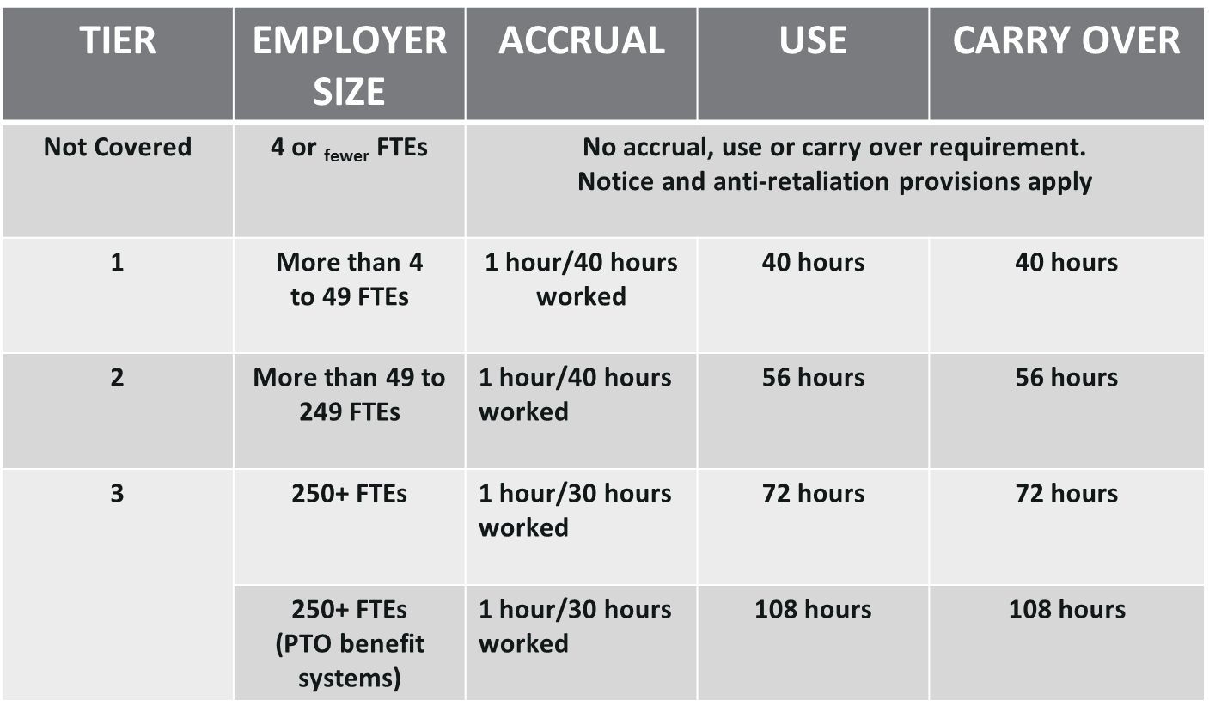
PSST ACCRUAL, USE & CARRY OVER

Slide 26
REQUIREMENTS
Joint Employer
Benefit Year
Accrual
Use and Carry Over
Vacation and PTO
Notification of Available PSST Hours
Record Keeping
Protections against Retaliation

Slide 27
REQUIREMENTS
Written PSST Policy
Waiting Period
Requesting PSST
15 increments of Use
Rate of Pay
Documentation
Suspicions of PSST Abuse
Seasonal Employee
Occasional Basis Employee
Waiver
Cash out

Slide 28
REQUIREMENTS
Joint Employers
  Both staffing agency & client can be joint employers of a temp employee
Benefit Year
  Employers must use a consistent 12 month consecutive period (e.g. calendar year, fiscal year, anniversary date, but not rolling year) for accrual, use and carry over
Accrual
  Accrual depends on employer tier size; there is no cap on accrual
Use and Carry over
  Use and carry over depend on employer tier size

Slide 29
REQUIREMENTS
Vacation and PTO
  Employers can use vacation and PTO to meet ordinance requirements, as long as the paid leave can be used in same manner as PSST
  Tier 3 employers with PTO have increased use and carry over requirements
Notification of available PSST hours
  Employers must provide notice of available PSST hours every pay period, usually on a paystub
Record Keeping – 3 years
Protections against Retaliation

Slide 30
REQUIREMENTS
Written PSST Policy
    Employers must provide employees with written PSST policy starting April 1, 2016
Waiting Period
    Employer can impose a waiting period of 180 calendar days from hire date
Requesting PSST
    Employee must provide enough information to signal need for covered absence
    “I need to use PSST” or “My child is sick”
15 minute increments of use
    If feasible by employer’s payroll system, employers must permit hourly employees to use PSST in 15 minute increments

Slide 31
OTHER REQUIREMENTS
Rate of Pay
    Employers must pay same rate of pay as employee would have earned while working the shift (exclude tips & commissions, but meet Seattle minimum wage requirements)
Documentation for PSST
    Employer can ask for documentation after employee has used PSST for more than three consecutive work days
Suspicions of PSST abuse
    Employer can ask for early documentation or deny PSST if clear instance or pattern of abuse
Seasonal employee
    Employer must reinstate unused PSST hours if employee separates from work and returns within seven months

Slide 32
OTHER REQUIREMENTS
Occasional Basis Employees
    Employees who are typically based outside of Seattle and work in Seattle on an irregular basis, must work 240 hours in a calendar year to qualify for PSST
    After meeting this threshold requirement, employee is covered by ordinance for duration of employment for employer and all previous hours worked in Seattle accrue PSST
Waiver
    Waiver is prohibited for individual employees
    Waiver is permitted for employees represented by union; waiver must be CBA
Cash out
    Cash out is not required; it is discretionary

Slide 33
WAS JOB OR PAY DENIED DUE TO CONVICTION OR ARREST RECORDS?
FAIR CHANCE EMPLOYMENT

Slide 34

  The Issue Impacts Us All
  Refusing to hire people because they have a conviction or arrest record has a significant impact on families and businesses in every community.

Slide 35



With an estimated 70 million adults in U.S. with a record, or nearly 1 in 3 adults, anyone can have a record. Some examples: Martha Stewart, George W. Bush, Bill Gates, and Sir Richard Branson (founder of Virgin Group).
www.nelp.org
SOURCE: NELP, “Advancing a Federal Fair Hiring Agenda” (2015), available at www.nelp.org

Slide 36
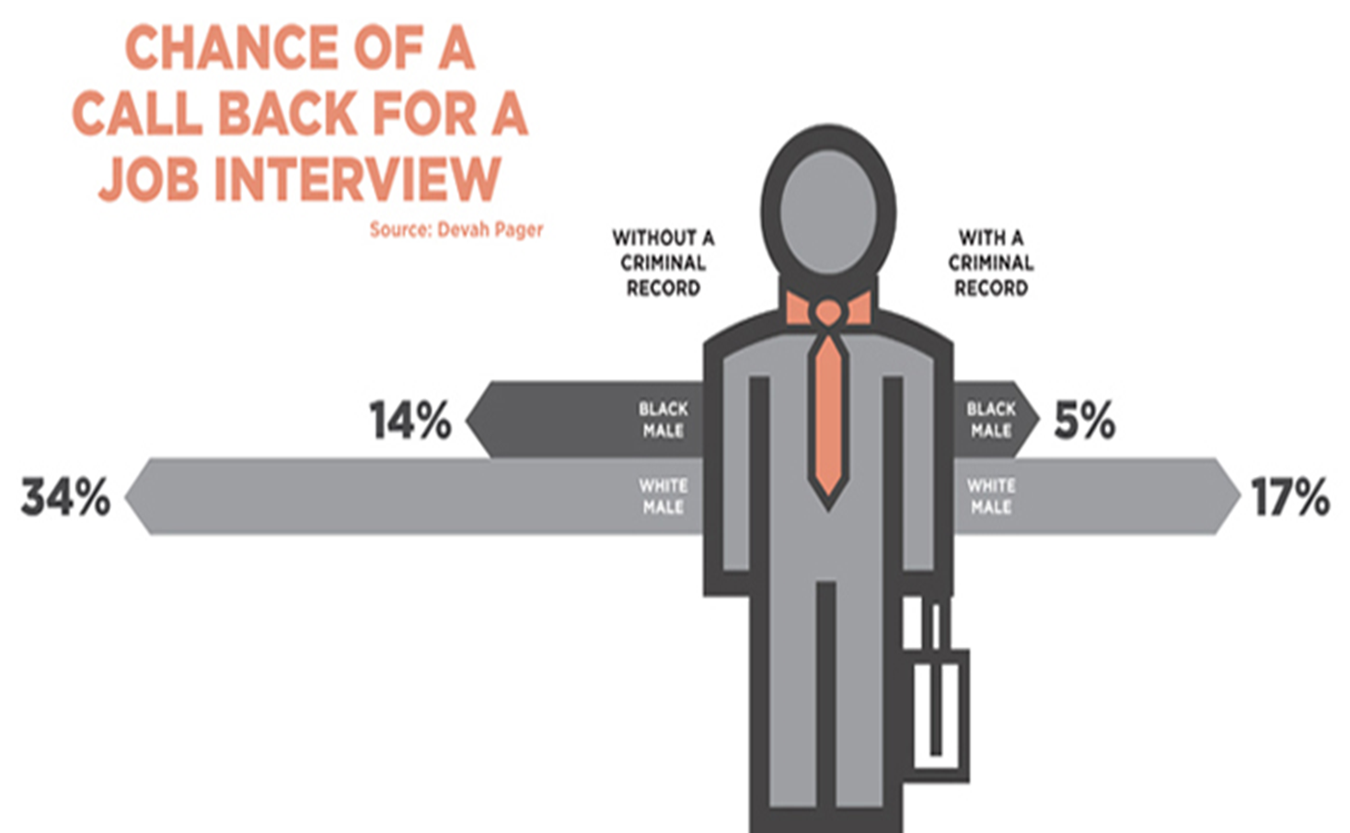

Slide 37
LIMITS ON USE OF CONVICTION & ARREST RECORDS
No job ads that prohibit conviction or arrest records
No background checks until after the employer screens applicant for minimum qualifications
    No job applications with questions about conviction and arrest records
Before denying job based solely on background check, employer must provide applicant opportunity to explain and/or correct conviction arrest records
Employer must have a “legitimate business reason” to support denial of job (6 factors)

Slide 38
JOB ADS
No exclusionary Statement in job ads
  ✗ Felons need not apply
  ✗ No criminal background
  Must have clean criminal record
  Must have clean driving record
  ? Must pass background check
  ? Must successfully clear background check

Slide 39
JOB ADS
Model Statements
  Hiring process involves background check regarding conviction and arrest records in compliance with Seattle’s Fair Chance Employment Ordinance, SMC 14.17. Applicants will be provided an opportunity to explain or correct background information and provide verifiable information of good conduct and rehabilitation.
  Job offer is contingent upon review of driving records, subject to compliance with Seattle’s Fair Chance Employment Ordinance, SMC 14.17, regarding use of conviction and arrest records in employment decisions.

Slide 40
JOB APPLICATIONS
No questions about convictions and arrests on job applications (unless the employer has already screened the applicant for minimum qualifications)

Slide 41
DELAY BACKGROUND CHECKS
  Delay background checks until after an initial screening, usually during or after the interview
    First - review applicant’s skills & experience
    Second - determine that applicant meets minimum job qualifications
    Third - ask questions about conviction and arrest records; conduct background checks.
  This process allows applicants to have a fair chance at being considered for the job

Slide 42
OPPORTUNITY TO EXPLAIN & CORRECT
Hold job open for 2 business days
Identify conviction and arrest records
Consider explanation, corrections and verifiable information of good conduct & rehabilitation
  Written or oral statement from applicant or employee, parole or probation officer, clergy member, social worker, etc.
  Certificate of rehabilitation, completion or enrollment in an educational or vocational training program, etc.

Slide 43
LEGITIMATE BUSINESS REASON
Employer believes in good faith that nature of criminal conduct
  Will have a negative impact on the employee's or applicant's fitness or ability to perform the position sought or held, or
  Will harm or cause injury to people, property, business reputation, or business assets

Slide 44
LEGITIMATE BUSINESS REASON
Seriousness of crime
Number and types of convictions or pending charges;
Time that has elapsed since conviction or pending charges, excluding periods of incarceration;
Verifiable information re: good conduct & rehab;
Specific duties and responsibilities of the position; and
Place and manner in which the position will be performed.

Slide 45
NEW LABOR STANDARD
HOTEL EMPLOYEE HEALTH & SAFETY
effective November 30, 2016

Slide 46


HOTEL EMPLOYEES
Hotels = 60+ rooms
Large hotels = 100+ rooms
Employees = Hourly, non-supervisory employees

Slide 47




REQUIREMENTS
Protection from violent assault and sexual harassment
Protection from workplace injuries
Access to medical care for low wage employees
Job security during changes of control

Slide 48
NEW LABOR STANDARD
SECURE SCHEDULING
effective July 1, 2017

Slide 49

HOURLY EMPLOYEES

Slide 50


LARGE FOOD SERVICES & RETAIL
Large food service & retail employers
Retail = 2012 NAICS code 441-453998
Food Service = 2012 NAICS code 722
500+ employees worldwide
Full Service Restaurants = additional requirement for 40+ locations worldwide.

Slide 51
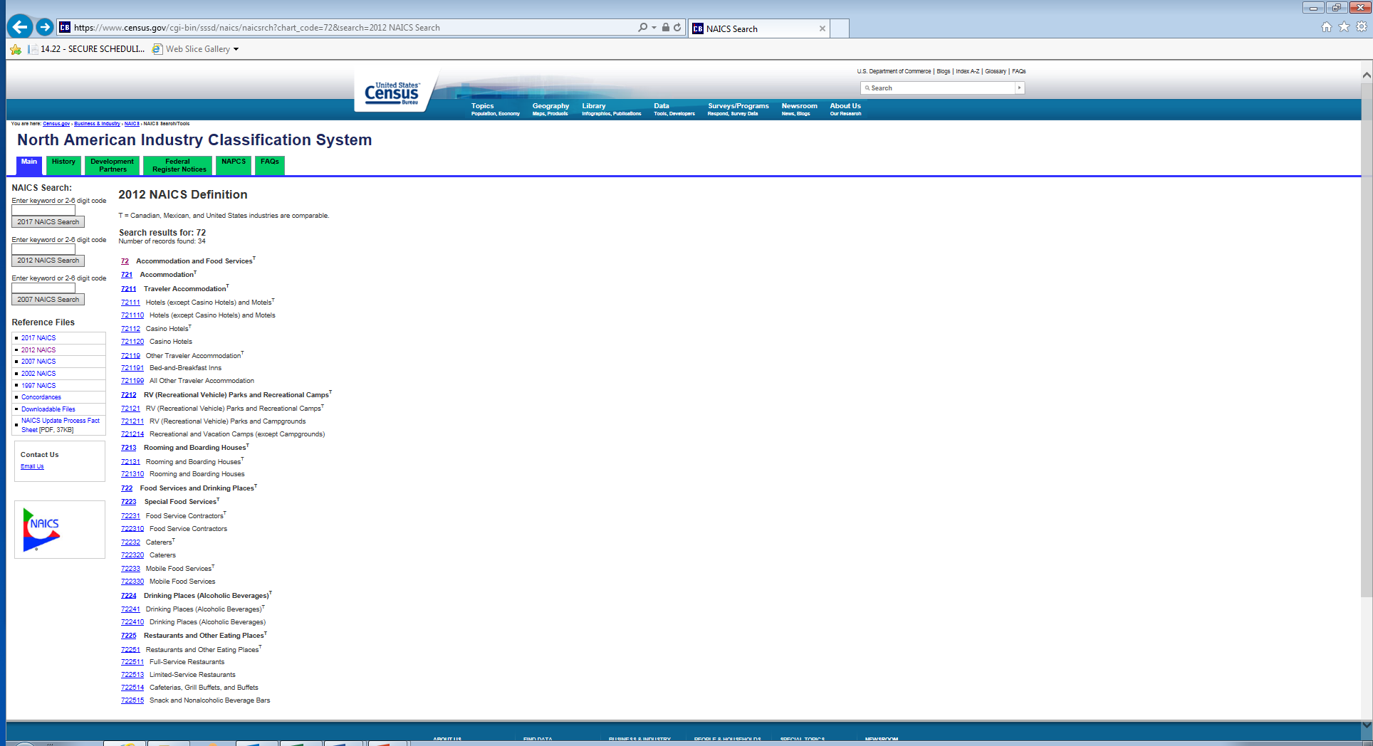
NAICS CODE
https://www.census.gov/eos/www/naics/
North American Industry Classification System

Slide 52
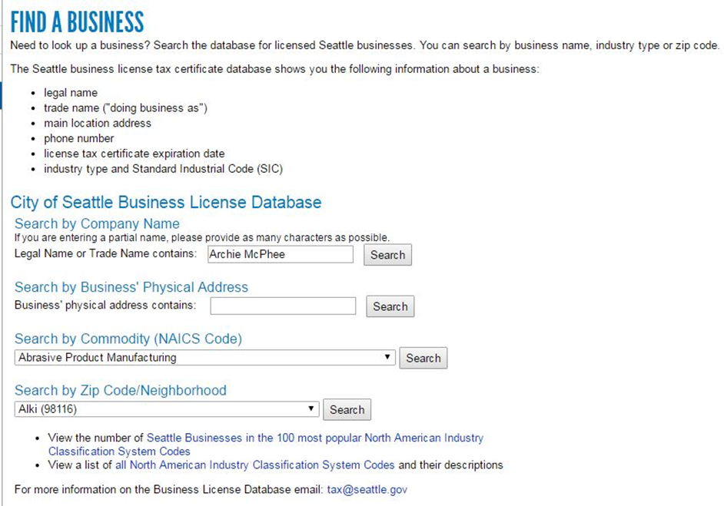

NAICS CODE
Seattle Business License
https://www.seattle.gov/licenses/find-a-business

Slide 53
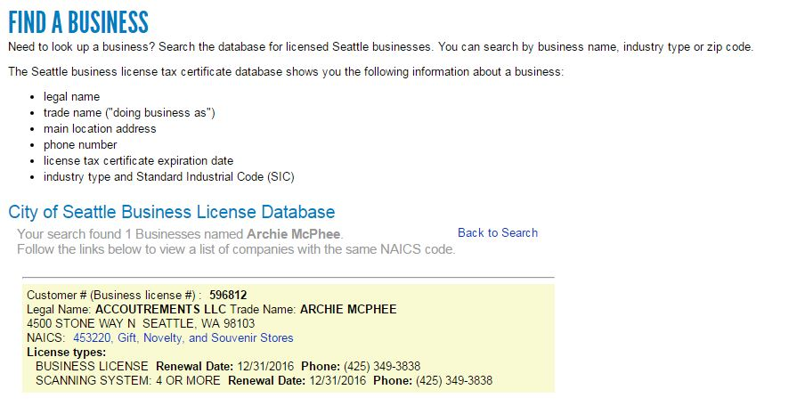

NAICS CODE
Seattle Business License
https://www.seattle.gov/licenses/find-a-business

Slide 54
REQUIREMENTS
Good faith estimate of work schedule
Right to request input into work schedule
Right to rest between work shifts
Advance notice of work schedules
Pay for work schedule changes
Access to hours
Record keeping
Notice & posting
Protections against retaliation
Waiver

Slide 55
REQUIREMENTS
Good Faith Estimate
    Median number hours and whether there will be on-call shifts
Right to request input into work schedule
    Employees have a right to request schedule preferences & modifications
Right to rest between work shifts
    Employees earn 1.5x scheduled rate of pay for hours worked that are less than 10 hours between a closing and opening work shift
Advance notice of work schedules
    14 days advance notice of schedules

Slide 56
REQUIREMENTS
Pay for work schedule changes
    Additional Hours = Employer must provide an additional hour of pay, plus pay for hours worked.
    Subtracted Hours = Employer must pay for half of the hours not worked for regular and on-call shifts, plus pay for hours worked.
Access to hours
    Employer must offer additional hours of work to current employees before hiring temps, new employees, contractors, or subcontractors
Record keeping - Three years
Notice & posting – Workplace poster requirement
Protections against retaliation - Employee can decline a work shift that is not on original schedule
Waiver permitted in collective bargaining agreement

Slide 57
ENFORCEMENT

Slide 58
PRIVATE RIGHT OF ACTION
PSST, MWO, WT, SS, HEHS (not FCE)
Remedy
  Up to 3x unpaid wages
  Up to $5,000 to aggrieved party for retaliation
  Attorney Fees and Costs

Slide 59
INVESTIGATION
Protection of Identifying Information
Company-wide Investigation (standard)
Individual Investigation (retaliation)
Complaint-based
Directed

Slide 61
PSST, MWO, WT, SS Violation(s) | Remedy or Penalty
First Violation | Up to 3x unpaid wages + interest
Subsequent Violations | Mandatory 3x unpaid wages + interest
First Violation | Up to $500 per aggrieved party
Second Violation | Up to $1000 per aggrieved party or 10% of unpaid wages, whichever is greater
Third Violation | Up to $5,000 per aggrieved party or 10% of unpaid wages, whichever is greater
Subsequent Violation | Up to $20,000 per aggrieved party
Chart of Fines | $500 to $1,000 fine
Retaliation | Reinstatement or up to 3x front pay; up to $5,000 to aggrieved party
Settlement & Mitigation of Penalties | Director Discretion
Notes:
(Willful) Interference - It is unlawful for any employer to willfully resist, prevent, impede or interfere with the Director in the performance of his or her duties under this Chapter. Conduct made unlawful by this section constitutes a violation and any employer who commits such a violation may be punished by a civil penalty of not less than $1,000 and not more than $5,000.

Slide 62
FCE Violation(s) | Remedy or Penalty
First Violation | Up to $500 per aggrieved party
Second Violation | Up to $1,000 per aggrieved party
Third Violation | Up to $5,000 per aggrieved party
Chart of Fines | $500 flat fine to $1,000 per aggrieved party
Retaliation | Reinstatement or up to 3x front pay; up to $5,000 to aggrieved party
Settlement & Mitigation of Penalties | Director Discretion
Notes:
(Willful) Interference - It is unlawful for any employer to willfully resist, prevent, impede or interfere with the Director in the performance of his or her duties under this Chapter. Conduct made unlawful by this section constitutes a violation and any employer who commits such a violation may be punished by a civil penalty of not less than $1,000 and not more than $5,000.

Slide 63
seattle.gov/laborstandards laborstandards@seattle.gov
206-684-4500

Slide 64
THANK YOU!

