Slide 1
Community Shuttles RFQ Information Session
March 9, 2017
Catherine Lester, Director | Ed Murray, Mayor | Hyeok Kim, Deputy Mayor | Kate Joncas, Deputy Mayor

Slide 2
Summary
Review timeline
Overview of Community Shuttles RFQ
Investment area and funding source
Background
HSD’s Outcomes Framework
Outcomes
Focus Population and Priority Communities
Service Delivery Framework
Agency Eligibility
Submission Process
Review and Rating Process
Appeal Process
Coordinator: Jon Morrison Winters, jon.winters@seattle.gov; 206-684-0654

Slide 3
Area Agency on Aging
13 AAAs in Washington State
Administered by the Seattle Human Services Department, Aging and Disability Services
In partnership with King County Department of Community and Human Services and Public Health of Seattle-King County
Serves all of King County

Slide 4
Timeline
Funding Opportunity Announcement Thursday, February 23
Information Session Thursday, March 9
Last Day for Questions Thursday, March 16
Application Deadline Friday, March 31, 12:00 p.m.
Review & Rating Process April 3 – May 14
Agency Notification Monday, May 15
Appeal Process May 15 – May 30
Public Announcement of Awards June 13
Contract Start Date July 1

Slide 5
Investment Area and Funding Source (pg 3)
This Community Shuttles RFQ is an open and competitive procurement process that Aging and Disability Services is using to purchase a coordinated transportation service.
Approximately $1.1 million is available through the Federal Transit Administration 5310 Enhanced Mobility of Seniors and People with Disabilities Program and match funding provided by King County Metro to sustain demand-response transportation for seniors and people with disabilities in King County for two years.
Funding awards will be made for the period of July 1, 2017 – June 30, 2019.
Continued investment after the initial contract period will be contingent on successful performance and funding availability.

Slide 6
Background
Aging and Disability Services has funded transportation services with federal and state funding for several years.
This is a new transportation service for ADS. ADS received a grant from PSRC to sustain service in areas currently served by Sound Generations/King County Metro Hyde Shuttle program that had been at risk of losing service.
This project will provide six shuttles in Seattle, with a seventh shuttle serving Seattle and/or Tukwila. Service area of seventh shuttle is being determined in consultation with King County Metro. Sub-area service boundaries are subject to change (Bids should not assume a particular sub-area within Seattle).
Service is coordinated with health/social services and other accessible transportation options in King County (see handout: Accessible Transportation Map).

Slide 7
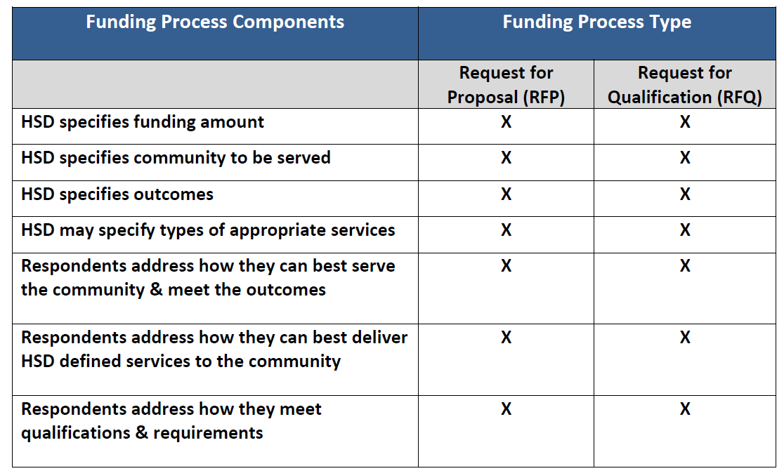
RFP vs. RFQ

Slide 8
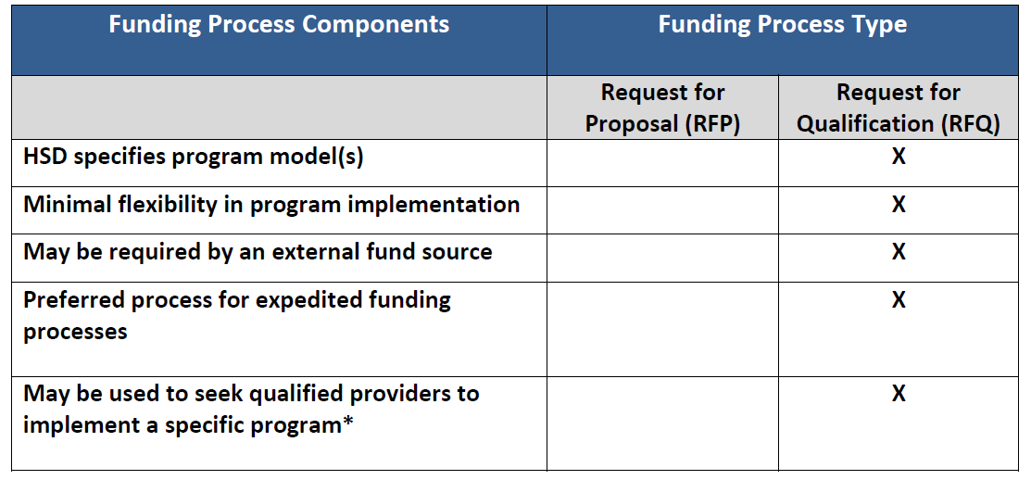
RFP vs. RFQ (cont.)

Slide 9
Results-Based Accountability Framework (pg. 5)
HSD has developed a strategy for results-based accountability and addressing disparities to ensure that the most critical human service needs are met by:
Defining the desired results for the department’s investments;
Aligning the department’s resources to the desired results; and
Evaluating the result progress to ensure return on investment.

Slide 10
Results-Based Accountability Framework (pg. 5)
HSD’s Theory of Change ensures that data informs our investments – particularly around addressing disparities – and shows the logical link between the desired results, indicators of success, racial equity goals based on disparity data, strategies for achieving the desired results, and performance measures. With this model, HSD can ensure that resources are appropriately aligned to address the most critical human service needs based on the analysis of the entire population level data.
All investments resulting from HSD’s funding opportunities will align with the Theory of Change.
Population Data
Desired Results
Strategy
Indicators
Racial Equity Goal
Performance Measure
Racial Disparity Data

Slide 11
Results-Based Accountability Framework (pg. 6)
HSD’s Theory of Change:
Population Data
Desired Results
Strategy
Indicators
Racial Equity Goal
Performance Measure
Racial Disparity Data
Data that reflects a whole population | Condition of wellbeing for an entire population | The achievement benchmark –how we know the “result” was achieved? | Data depicting socioeconomic disparities and disproportionality between ethnic/racial populations | The stretch goal for reducing and/or impacting the racial equity disparity | Activities or interventions that align to the results and indicators, and are informed by best or promising practices, cultural competency and community engagement | What gets counted, demonstration of how well a program, agency or service is doing Quantity, Quality, and Impact

Slide 12
Expected Outcomes and Indicators (pg. 12)
The desired result of HSD’s investment in Community Shuttles and other services is: all older adults experience stable health and are able to age in place.
Performance Measures include measures of QUANTITY (ridership), QUALITY (rider satisfaction), and IMPACT (rider ability to meet medical, employment, or social needs).

Slide 13
Focus Population and Priority Community (pg. 9)
Priority communities for this investment opportunity include:
Older adults (55 and over)
People with disabilities
Focus populations are identified as specific racial or ethnic groups within the priority community and with data showing the highest disparities in the investment area.
Given the best available data on racial/ethnic disparities, focus population(s) for this investment opportunity are:
Black/African Americans
Hispanic/Latinos
Proposals that clearly describe a plan to address significant needs among other populations are also encouraged.

Slide 14
Service/Program Model (pg. 9)
Community Shuttles provide a collaborative, community-based demand-response public transportation service in King County and offer affordable and accessible transportation for seniors and people with disabilities. They provide a vital link to community services for people who might otherwise remain home-bound and isolated, and play a critical role in closing transportation gaps throughout the County.

Slide 15
Criteria for Eligible Clients (pg. 9)
Eligible clients include:
individuals 55 years of age or older
individuals with a disability.
Eligibility criteria are self-identified and self-certified by the client.

Slide 16
Required Service Components (pg. 10)
1. Vehicle requirements
2. Minimum Service Standards
3. Reservations/Dispatching/Call Center Operation
4. Staff/Driver Training
5. Accessibility to Refugees, Immigrants, and LEP
6. Client Survey
7. Service must be free to the rider (donations may be accepted)
8. Service Start Date

Slide 17
Key Staffing (pg. 13)
Key staff for this service is anticipated to include:
Project manager/coordinator (part-time)
Vehicle drivers
Dispatchers/schedulers
Office support staff

Slide 18
Agency Eligibility (pg. 15)
Licensing Requirements
EIN
Tax status (open to non-profit, for-profit, and government agencies)
Experience providing demand response service and managing federal contracts
Ability to provide the specified service

Slide 19
Review and Rating Process (pg. 17)
Applications must include:
1. Cover Sheet. (Attachment 2)
2. A completed Narrative response. 15-page max length.
3. Budget Sheets (Attachments 3 and 4)
5. BOTH Federal Certifications (Attachment 7)
6. A plan to ensure that this service is accessible to immigrants, refugees and LEP.
7. If applicable, a roster of your agency’s current Board of Directors.
8. If applicable, minutes from your agency’s last three Board of Directors meetings.
9. Appropriate documentation verifying your tax/legal status.
10. Your business license(s).
11. If applicable, proof of your approved indirect rate.
Applications received by the deadline will be forwarded to the Rating Committee for their review and rating according to the rating guidelines. The Rating Committee will make funding recommendations to the HSD Director.

Slide 20
Review and Rating Process (pg. 25)
Agency Financials and Insurance information will be requested of applicants as applications are reviewed, unless we have current financial and insurance documents on file.
Agencies for which we have incomplete or no financial and/or insurance documents will be notified by the Coordinator and required to submit ALL requested documents within 4 business days from the date of written request.
Financial and Insurance documentation that may be requested are listed in Section IV. of the Application. Be sure you are prepared to provide these to the Coordinator upon request.

Slide 21
Rating Guidelines (pg. 21)
Implementation Plan 20%
Capacity and Experience 35%
Partnership and Service Coordination 10%
Cultural Competency 10%
Budget and Leveraging 25%

Slide 22
Submission Deadline
Submission deadline is 12:00 p.m. on Friday, March 31.
All applications must be received in person, by mail, or electronic submission by deadline.
No faxed or e-mailed applications will be accepted.

Slide 23
Methods of submission
Applications can be mailed or hand delivered to:
Seattle Human Services Department
Request for Qualification Response – Community Shuttles
ATTN: Jon Morrison Winters
700 Fifth Ave, Suite 5800
P.O. Box 34215
Seattle, WA 98124-4215
Applications can be submitted online at: http://web6.seattle.gov/hsd/rfi/index.aspx.

Slide 24
HSD Online Submission System
The HSD Online Submission System is a web-based program that allows applicants to upload their application for HSD Funding Opportunities (e.g. RFI, RFP, RFQ)
The system is NOT an online Application (e.g. it does not include assigned logins, ability to insert narrative responses within the system, manage your applications, etc.)
You may upload files up to a maximum of 100 MB
Acceptable file types include: .pdf .doc .docx .rtf .xls .xlsx
There are required fields to be completed as well, depending on how many files you are uploading. Ensure you allow sufficient time to complete the steps in order to submit your application by the deadline.
The system automatically sends out an e-mail confirmation to all the e-mail addresses you entered.

Slide 25
HSD Online Submission System
Review the Online Submission Assistance Page for helpful information: http://web6.seattle.gov/hsd/rfi/help.aspx.
All applicants are expected to make arrangements to ensure that applications are received by HSD by the funding opportunity application deadline. You are encouraged to submit your application early when possible. It is advisable to upload your documents several hours prior to the deadline in case you encounter an issue with your internet connectivity which impacts your ability to upload documents. If you encounter internet connectivity issues, attempting to submit your application early will allow time for you to submit a hard copy by the deadline instead.
HSD is not responsible for ensuring that applications are received by the deadline.
If you experience any issues and/or have questions about the online submission system, please contact Susan McCallister, HSD Funding Process Advisor, by phone at (206) 233-0014 or e-mail at susan.mccallister@seattle.gov.

Slide 26
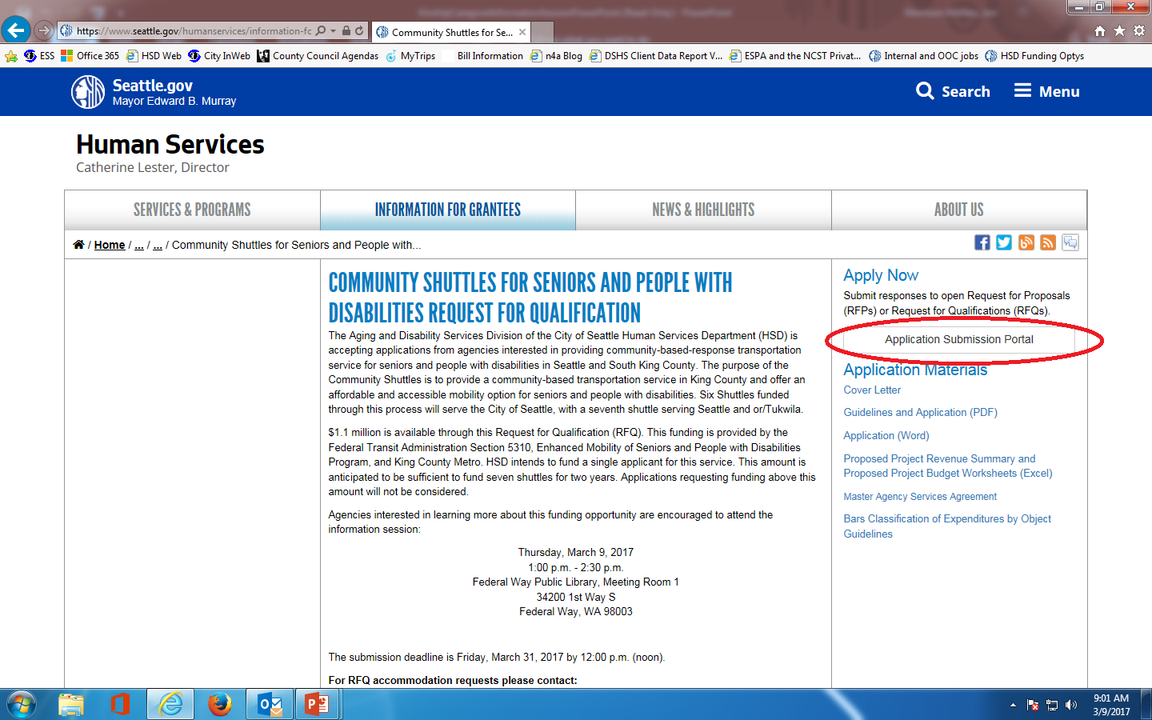
HSD Online Submission System

Slide 27
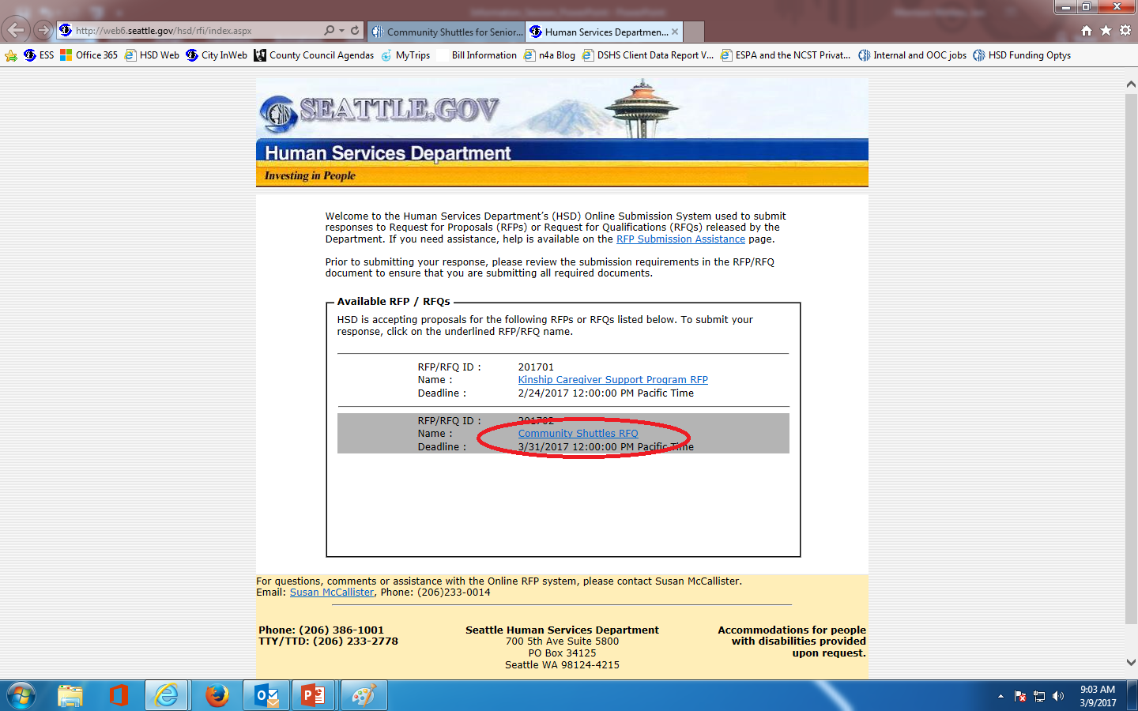
HSD Online Submission System

Slide 28
Before you respond…
Understand the focus and outcomes of the funding opportunity.
Do they match your agency’s mission and goals?
Evaluate your agency’s service capacity.
Ask questions!

Slide 29
More tips…
Follow the required format defined in the Guidelines
Be specific, detailed, and concise
Answer all questions and in the context of your proposed program(s)
Submit an accurate budget; double check your numbers. We must follow FTA and WSDOT guidelines regarding reimbursability of expenses.
Have someone else read your application before submitting
Use the application submission checklist to ensure that you have addressed all questions and requirements
Ensure enough time for application to get to HSD on time.
E-mail by the Q&A deadline if you have any questions Jon Morrison Winters at jon.winters@seattle.gov!!!

Slide 30
Post-Notice of Award Appeal Process
Applicants have the right to protest or appeal certain decisions in the award process made by HSD.
Grounds for Appeals: Only an appeal alleging an issue concerning the following subjects shall be considered:
A matter of bias, discrimination or conflict of interest.
Violation of policies or failure to adhere to guidelines or published criteria and/or procedures established in the funding opportunity.
Appeals Deadlines:
Appeals must be received within ten (10) business days from the date of written application status (award/denial).
The HSD Director will review the written appeal and may request additional oral or written information from the appellant organization. A written decision by the HSD Director will be made within ten (10) business days of the receipt of the appeal. The HSD Director’s decision is final.
No contracts resulting from the solicitation will be executed until the appeal process has closed. An appeal may not prevent HSD from issuing an interim contract for services to meet important client needs.

Slide 31
Questions and Answers
Contact info: Jon Morrison Winters 206-684-0654 jon.winters@seattle.gov
THANK YOU!
(v2.1 - 2016)

