Slide 1
Land Use 101: What is Zoning?
Housing Affordability and Livability Agenda
Notes:
Hi my name is Geoff Wentlandt. I am a strategic advisor in the City’s Office of Planning & Community Development. This presentation is on overview of some basics of what zoning is and how it works.

Slide 2
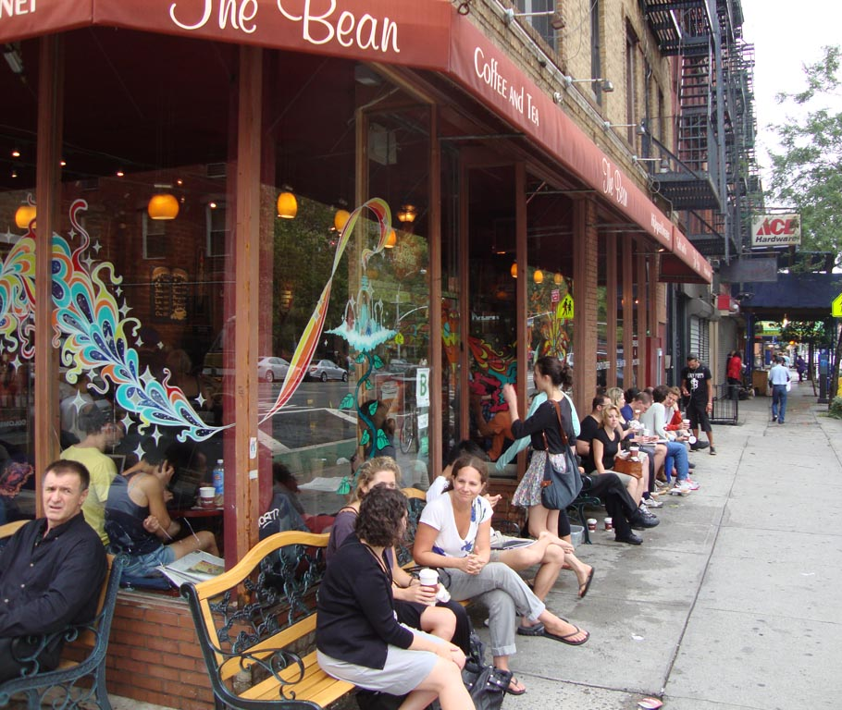
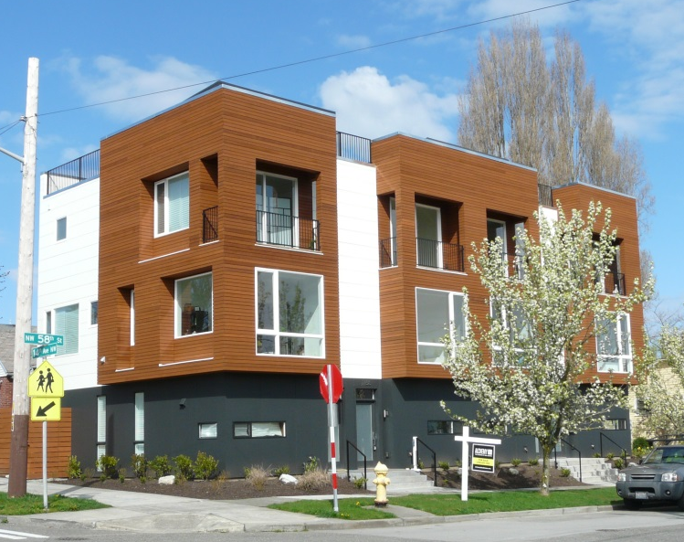
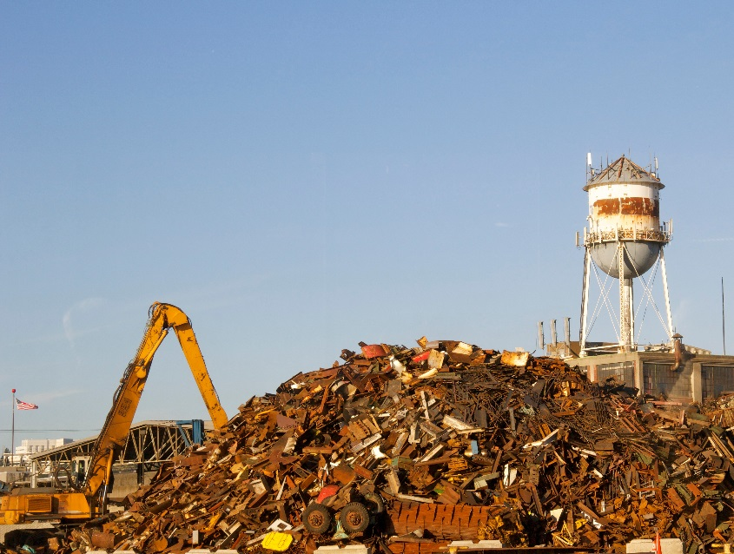
Basics of zoning
Zoning is the law that determines how land or property can be used in a city.
Regulates the activities or uses that can take place on a property
Regulates the size of buildings that can be built on a property
Promotes orderly patterns to support the public good
Commercial use
Residential use
Industrial use
Notes:
Zoning is the law of a city or county that determines how land or property can be used. [Read bullets on slide]. The first zoning ordinance in the United States was adopted by New York City in 1916. The pictures on this slide show examples of activities that would be classified as a commercial use, a residential use, and an industrial use in a zoning code. Zoning determines where certain uses can occur - to ensure land uses are compatible with each other and don’t create conflicts.

Slide 3
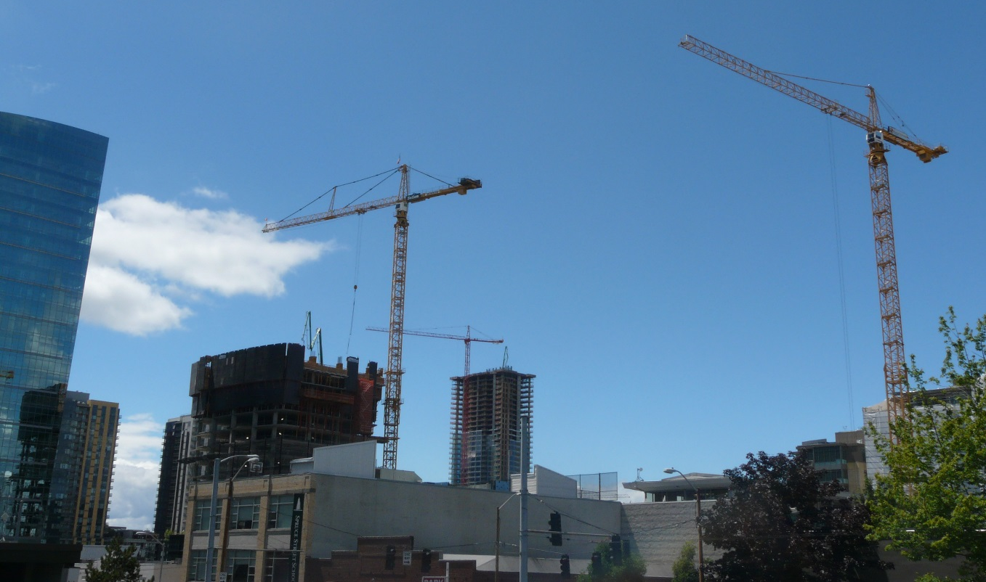
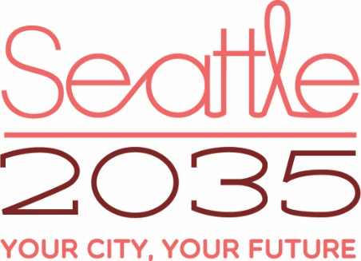
Zoning & the Comprehensive Plan
Zoning carries out the Comprehensive Plan
Must be consistent with the vision for growth established in the City’s Comprehensive Plan
Directs more growth to some areas, like urban villages
Ensures some areas remain stable or preserved for certain uses, like industrial areas
Zoning regulates growth as it happens with new construction.
Sets the vision, goals, and policies about growth.
Notes:
In Washington State, according to a law called the Growth Management Act, a city’s zoning must be consistent with, and implement a City’s Comprehensive Plan. The zoning has to provide enough room to accommodate the amount of growth that is expected. Zoning is the tool that directs more growth to certain areas. In Seattle areas expected to receive more growth are urban villages and urban centers, so the zoning usually allows for taller or denser buildings in those areas. In other places zoning restricts certain types of development, so the area remains preserved for certain uses. An example of that in Seattle is industrial zoning, where largescale office buildings or residential uses are not allowed so that industry can continue to operate effectively.

Slide 4
The zoning map
The zoning map gives a zone designation to each property.
Single Family Zoning
(SF)
Neighborhood Commercial Zoning (NC)
Lowrise Multifamily Zoning (LR)
Notes:
Every location or property in the city is given a zoning designation on the city’s zoning map. In this example (which is a simplified version of the actual zoning map) the areas in yellow have Single Family zoning which allows single family homes; the areas in orange have Neighborhood Commercial zoning which allows a mix of retail stores, offices, and housing; and the areas in brown have lowrise multi-family zoning which allow only residential uses in formats such as apartments and rowhouses. So, if you owned the property inside the red circle on this map the zoning of your property would be lowrise multi-family. One other thing to note on this map is that the thick black line represents the urban village boundary. In general areas inside the urban village contain more neighborhood commercial and multifamily zoning while the areas outside of the urban village boundary are zoned primarily single family. Although there are some single family areas within urban villages today.

Slide 5
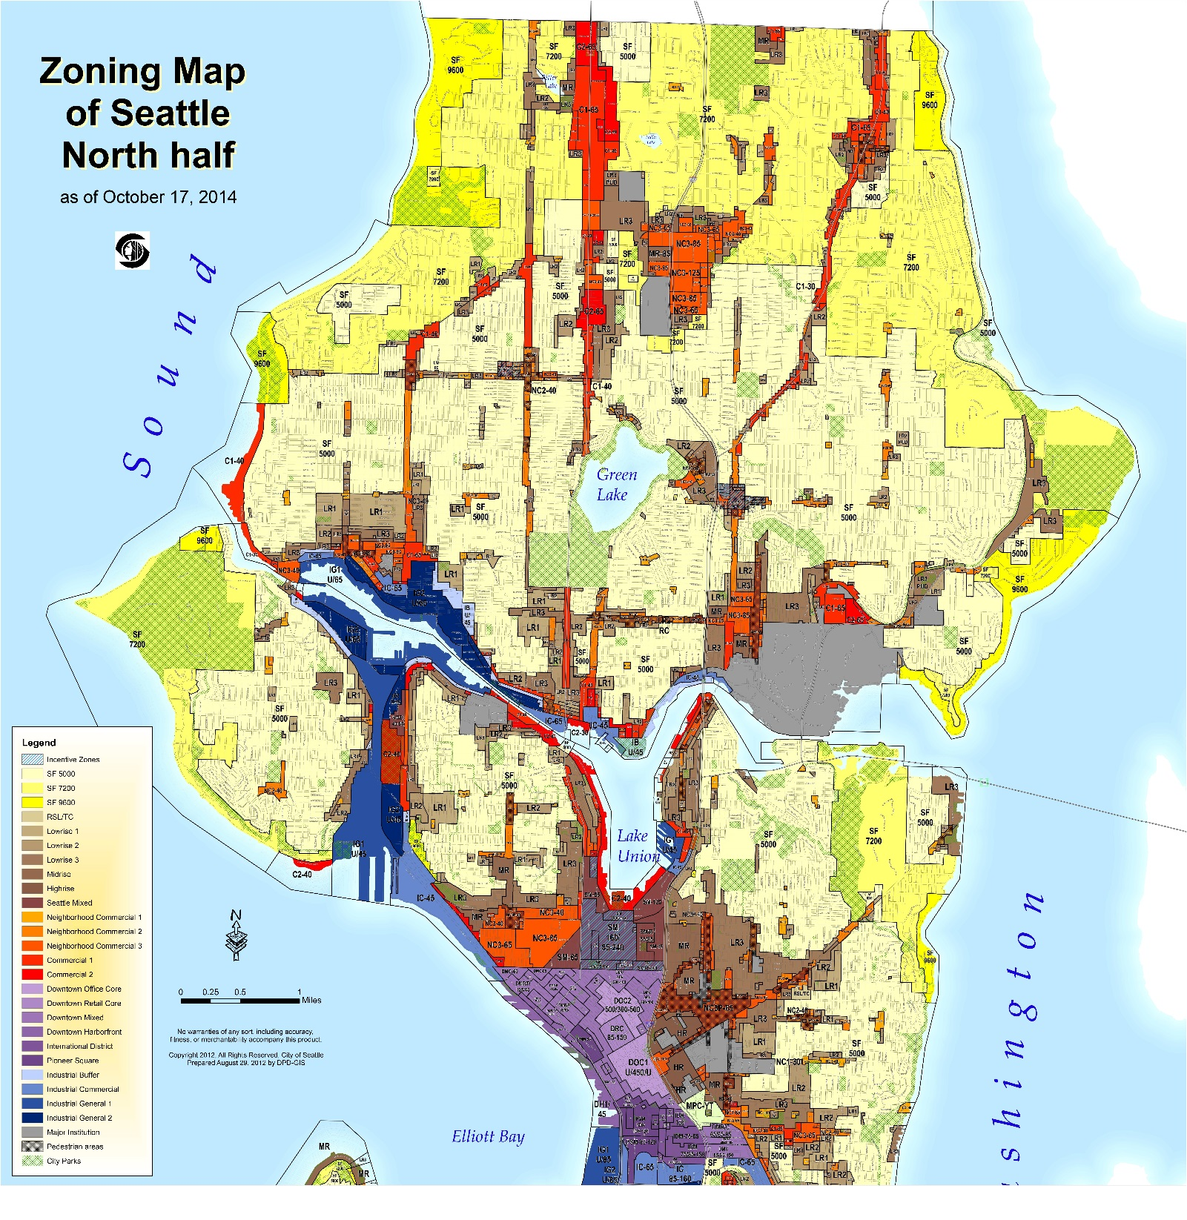
The zoning map
The zoning map covers the entire city and includes many different zoning designations.
Notes:
The actual zoning map for Seattle is quite complicated and detailed. It must address conditions everywhere in the City. It includes more than 40 zoning classifications.

Slide 6
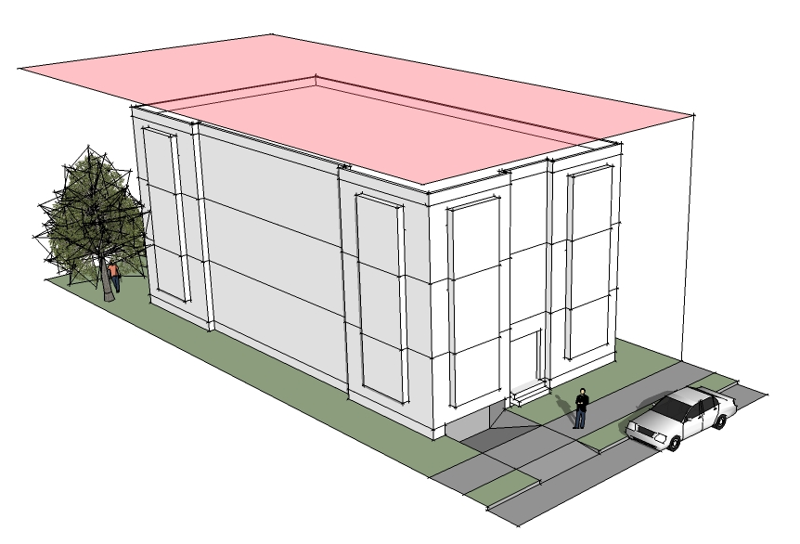
The zoning code
The zoning code contains development standards that limit the uses and sizes of new buildings that can be built in any zone.
Lowrise Multifamily (LR) example
Allowed Use
Only residential (housing) is allowed
Height limit
How tall a new building can be
Setback
How far a new building must be from a property line
Parking
The amount and location of required parking
Notes:
The zoning code is contained in the Seattle Municipal Code. The regulations limit the uses and sizes of new buildings. Let’s take a look at how that would work for an example in a Lowrise Multifamily zone. The zone only allows for housing uses. There is a maximum height limit that determines how tall a building can be, shown here in pink. The zoning code contains required setbacks that specify how far a new building must be from a property line. And the zoning code determines how much parking is required to be built with the new building and where that parking must be located. Some zones do not require new parking to be built with new development. In general the zoning does not regulated the kinds of housing units that would be provided in building (like 2BR units vs. studio apartments).

Slide 7
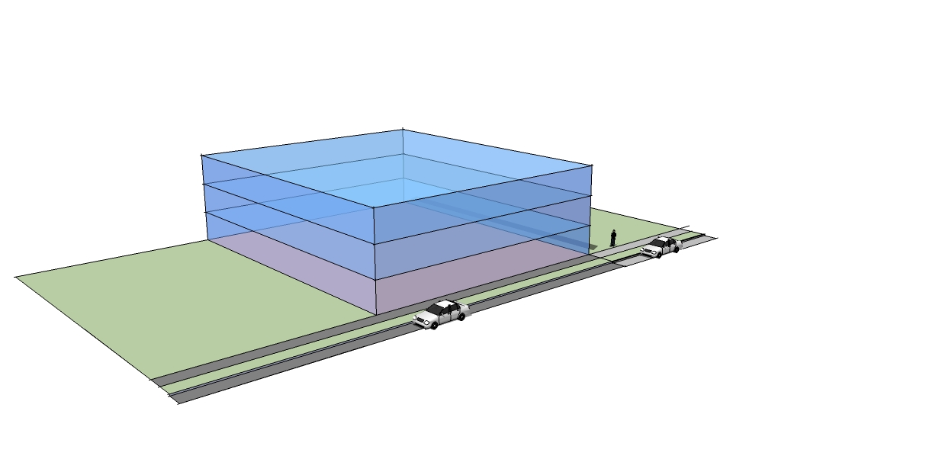
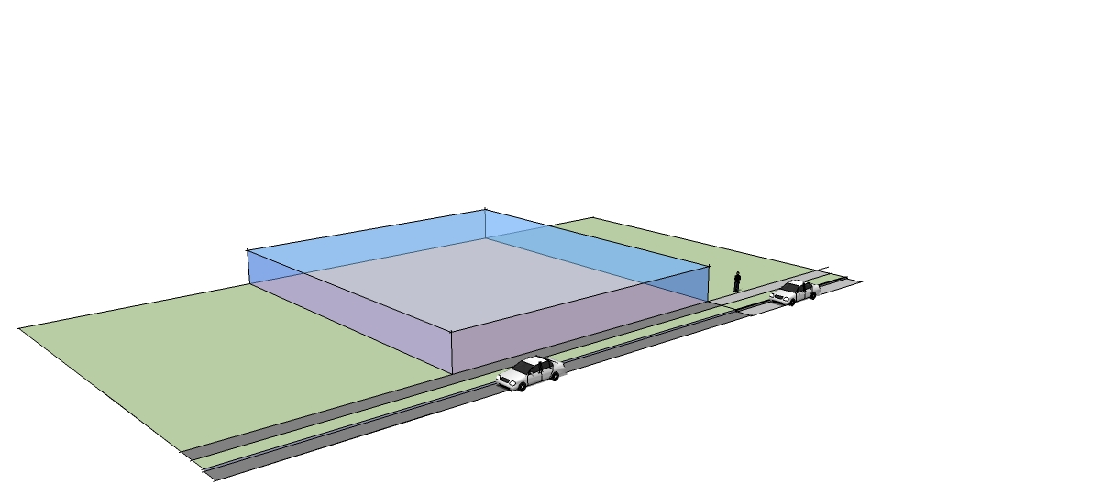
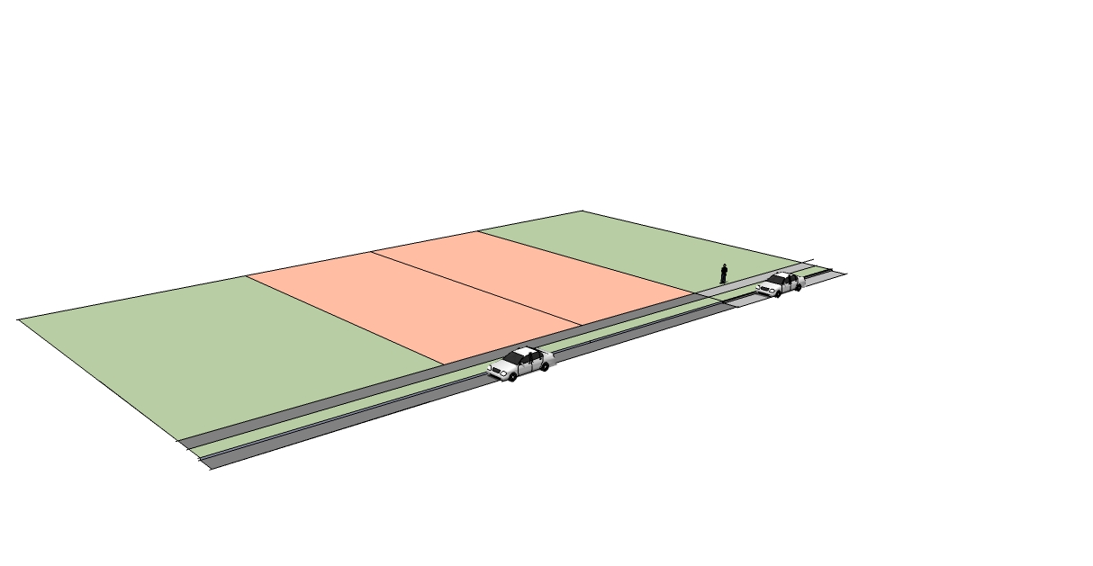
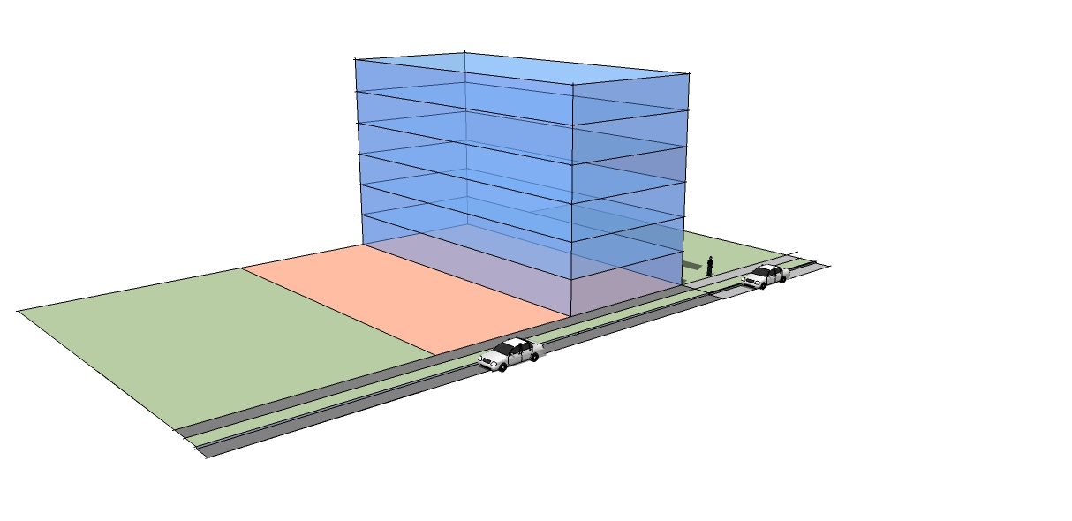
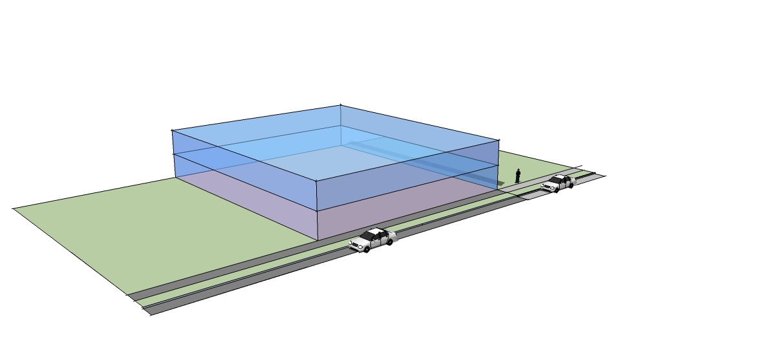
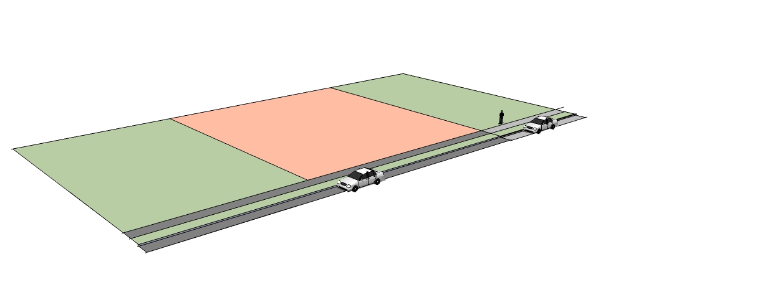
Floor area ratio (FAR)
FAR is the amount of floor area that may be built as a ratio to the size of the site.
FAR = 1.0
10,000 sq. ft. of floor area
The whole site is covered with one floor.
FAR = 3.0
30,000 sq. ft. of floor area
The whole site is covered with three floors.
FAR = 2.0
20,000 sq. ft. of floor area
The whole site is covered with two floors.
FAR = 3.0
30,000 sq. ft. of floor area
Half the site is covered with six floors.
If a building covered only half of the site...
Site Footprint: 10,000 sq. ft.
Notes:
Floor Area Ratio or FAR is an important tool in Seattle’s zoning. Often community members focus on height limits when talking about zoning, but FAR is equally important in determining what can be built on a site. Let’s take a minute for an overview of how FAR works. FAR is the amount of floor area that may be built as a ratio to the size of the site. So let’s

Slide 8
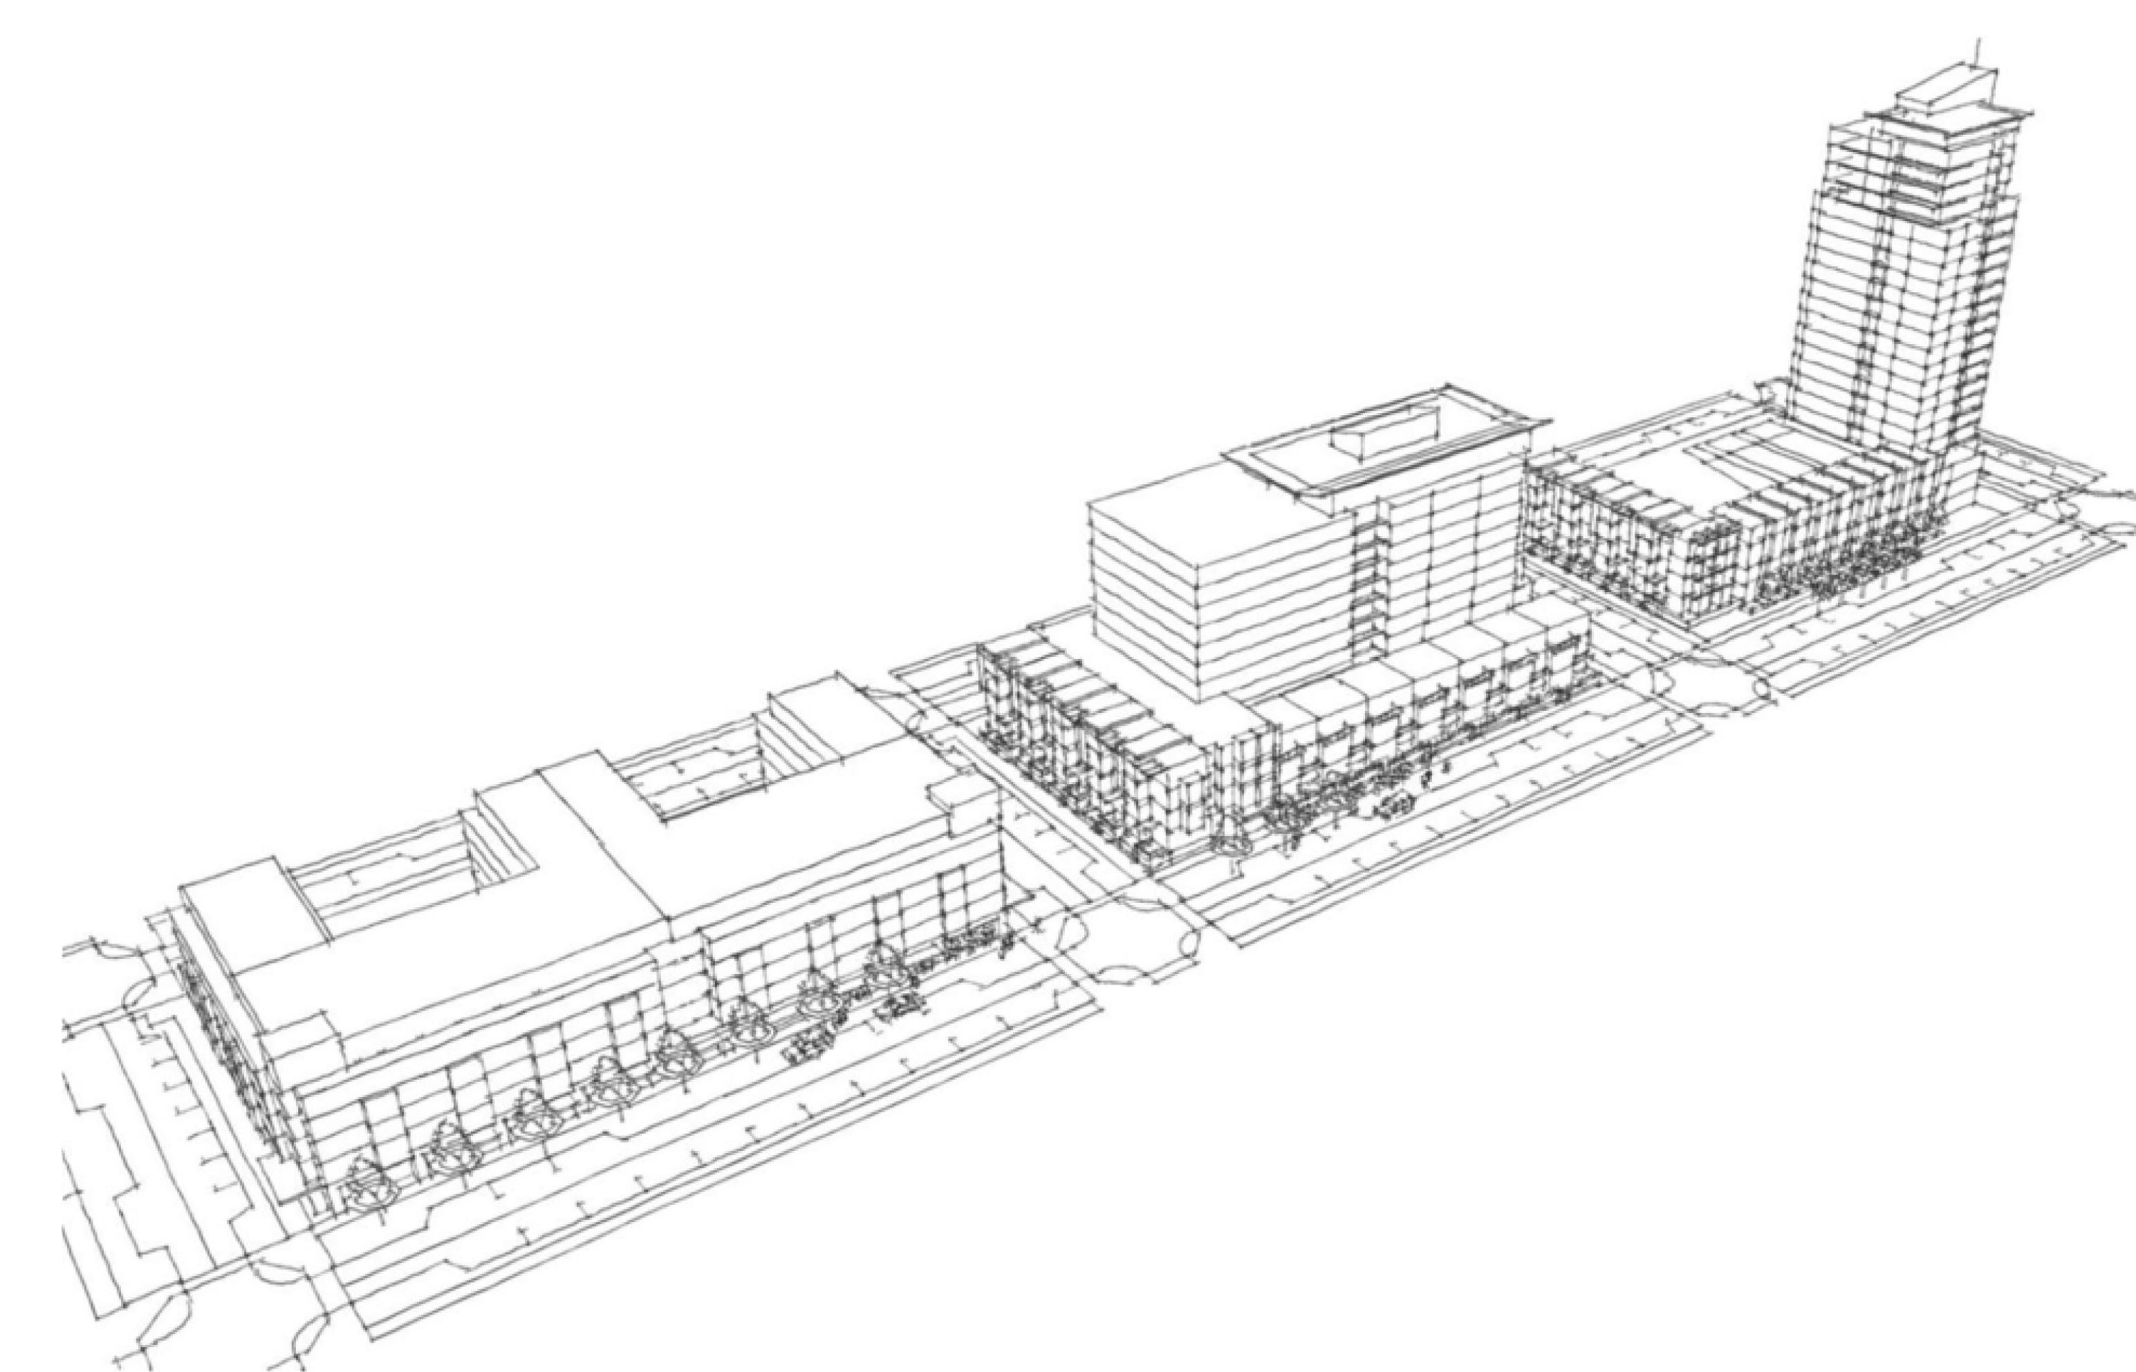
Floor area ratio (FAR)
These three buildings all have the same FAR but have different shapes and heights.
Notes:
So, FAR as a zoning standard allows for varied forms, shapes and heights of new buildings while regulating the total amount of development that can occur. IN this example, each of the 3 blocks have the same FAR (of about 7), but have different shapes and heights.

Slide 9
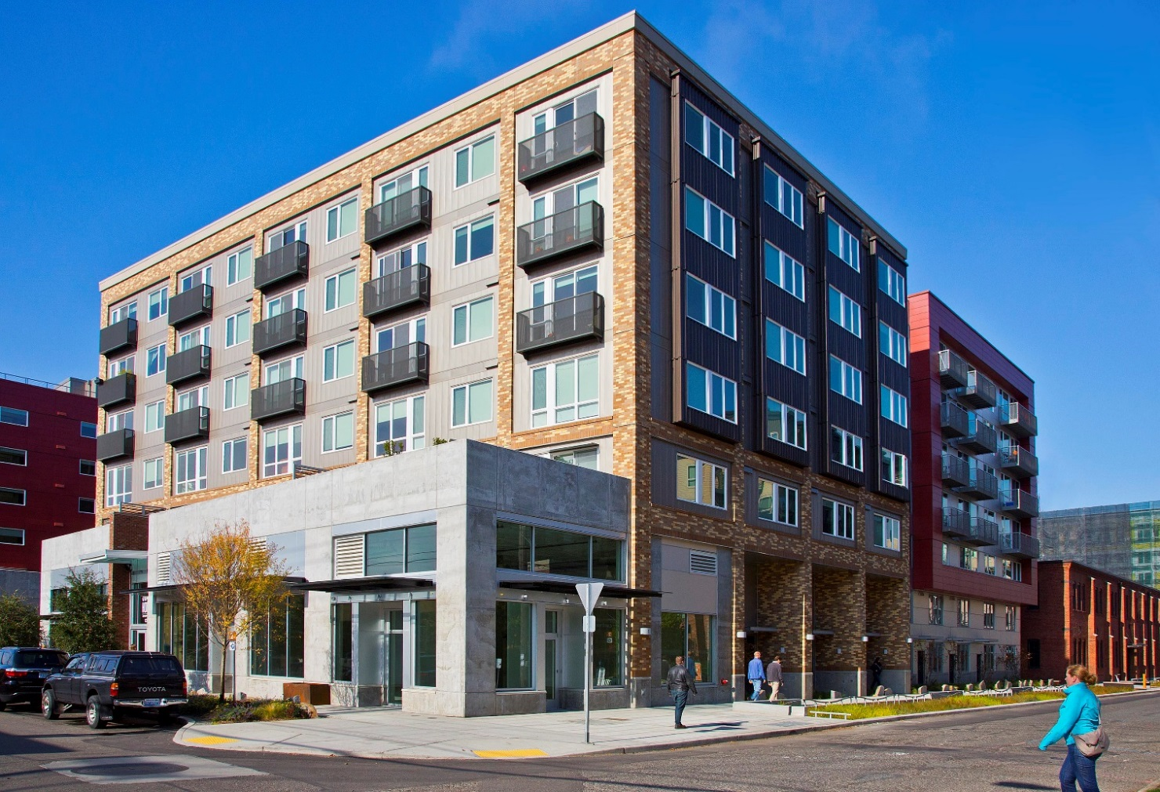
Development standards
Supports good design, livability, and sustainability.
Residential amenity area
Modulation
Upper-level
building setback
Active ground-floor use requirement and façade transparency
Green Factor
landscaping requirement
Notes:
In Seattle’s zoning code there are many detailed standards all intended to support public policy goals. These include standards for good design so new buildings that are compatible with existing neighborhoods; standards to ensure buildings are comfortable and habitable for tenants; and standards to ensure buildings do not hurt the natural environment. This image has a few examples. The upper level setback requirement ensures more light makes its way down to the public street. A required residential amenity was placed by the developer on top of the setback portion of the building – and is for use by building tenants. The ground floor is required to have shops and services that contribute to a lively street environment. A requirement for modulation breaks up the width of the building’s long façade which reduces the appearance of bulkiness to the building. And a heavily landscaped area and rainwater harvesting swale in the sidewalk is a part of the building’s green factor landscaping requirement.

Slide 10
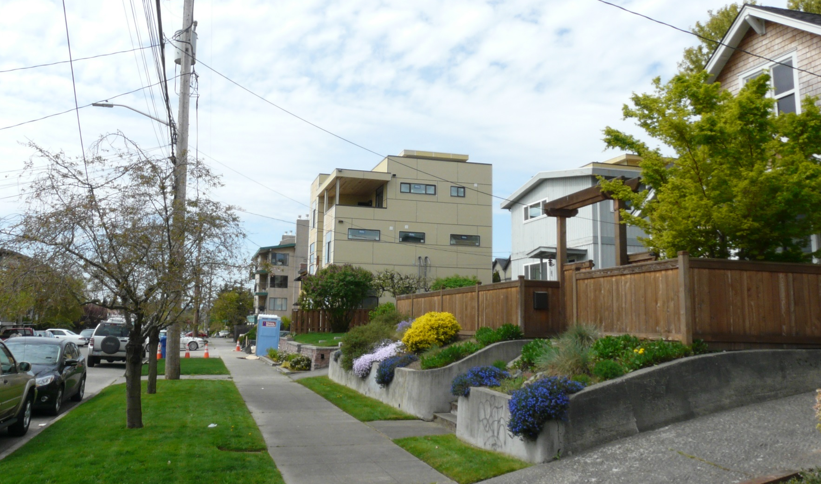
Things to consider
Zoning doesn’t require a property owner to change their property or develop it.
In this example, properties have been zoned Lowrise Multifamily for many years, but only some owners have chosen to develop multifamily housing.
Notes:
An important consideration is that zoning doesn’t require or compel a property owner to make any change to their property or to develop it. There are often a variety of types of buildings and uses in a zone, because changes happen slowly over time. This photo is an example of a lowrise multifamily zone where some of the properties have been converted to multi-family apartments or condominiums, while some of the properties remain as single family homes.

Slide 11
Things to consider
Review of other codes happens along with the zoning review when development is proposed, including:
Environmental review (SEPA)
Design Review
Building code review
Street and infrastructure improvements
Changes to zoning must be approved by the Seattle City Council.
Notes:
Zoning is not the only regulation of new development. New development must undergo other reviews including environmental review, design review, a building code review, and street improvements review at the time a project is proposed. Also keep in mind, that any change to zoning must be approved by the City Council.

Slide 12
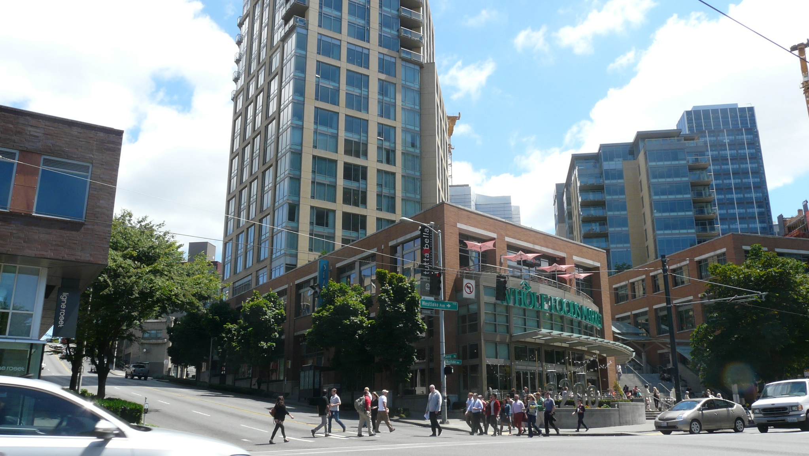
Thank you

