Slide 1
Land Use 101: Affordable Housing
Housing Affordability and Livability Agenda

Slide 2
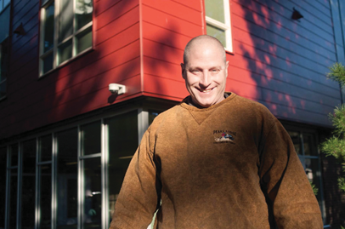
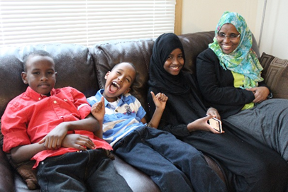
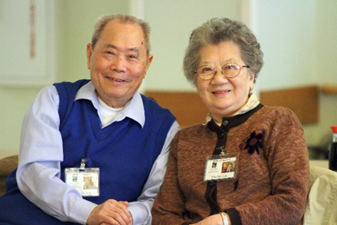
What is affordable housing?

Slide 3
What is affordable housing?
Housing affordable to individuals and families costs no more than 30% of the household’s income.
Example: $2,000/month ($24,000 annually)
$600/month spent on housing (rent, utilities, etc.)

Slide 4
What is affordable housing?
Housing affordable to individuals and families costs no more than 30% of the household’s income.
With a monthly income of $2,000…
If you pay more than $600/month (30%): Cost Burden
If you pay more than $1,000/month (50%): Severe Cost Burden

Slide 5
What is affordable housing?
In Seattle today, 1 in 5 households is severely cost burdened.

Slide 6
Who needs affordable housing?
Low-income families and individuals
Seniors, families with children, and people of color disproportionately face housing affordability challenges
Emphasis on providing affordable housing to those earning 80% or less than the area median income (AMI)
Some programs focus on those earning 60% or less
for an individual
for a family of 4
income
income
AMI
AMI

Slide 7
The need for affordable housing is increasing in Seattle
More than 45,000 Seattle households are severely cost burdened: they pay more than half their income for housing.
19% increase in homelessness in King County between 2015 and 2016
Average rent for a 1-bedroom apartment in Seattle has increased 35% in the last five years.
Children who lack the stability of a home lag behind their peers academically and are more likely to be in poor health and suffer developmental delays. Health and educational outcomes improve when children have the security of an affordable home.
Students lose 4-6 months of academic progress each time they move schools.
In January 2016, 2,942 people were without shelter in Seattle.
Seattle businesses have a harder time recruiting and retaining workers if they cannot afford to live near jobs or transit.

Slide 8
The need for affordable housing is increasing in Seattle
More than 45,000 Seattle households are severely cost burdened: they pay more than half their income for housing.
19% increase in homelessness in King County between 2015 and 2016
Average rent for a 1-bedroom apartment in Seattle has increased 35% in the last five years.
Children who lack the stability of a home lag behind their peers academically and are more likely to be in poor health and suffer developmental delays. Health and educational outcomes improve when children have the security of an affordable home.
Students lose 4-6 months of academic progress each time they move schools.
In January 2016, 2,942 people were without shelter in Seattle.
Seattle businesses have a harder time recruiting and retaining workers if they cannot afford to live near jobs or transit.

Slide 9
The need for affordable housing is increasing in Seattle
More than 45,000 Seattle households are severely cost burdened: they pay more than half their income for housing.
19% increase in homelessness in King County between 2015 and 2016
Average rent for a 1-bedroom apartment in Seattle has increased 35% in the last five years.
Children who lack the stability of a home lag behind their peers academically and are more likely to be in poor health and suffer developmental delays. Health and educational outcomes improve when children have the security of an affordable home.
Students lose 4-6 months of academic progress each time they move schools.
In January 2016, 2,942 people were without shelter in Seattle.
Seattle businesses have a harder time recruiting and retaining workers if they cannot afford to live near jobs or transit.

Slide 10
People of color are disproportionately cost-burdened
Households that spend more than half of their monthly income on housing costs are considered severely housing-cost burdened. About 22 percent of households of color and close to one-third of African American households are severely housing-cost burdened.
Share of Seattle households that are severely housing-cost burdened
by race/ethnicity of person who owns/rents a home
Broad race/ethnic categories
Largest groups of color
Source: 2006-10 ACS CHAS special tabulation, US Census Bureau

Slide 11
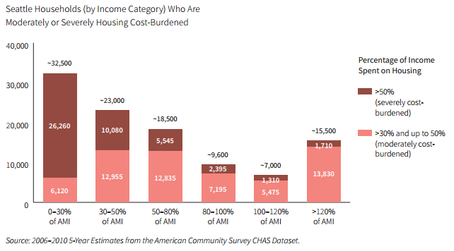
Low-income households are struggling
¾
of low-income Seattle households are cost burdened

Slide 12
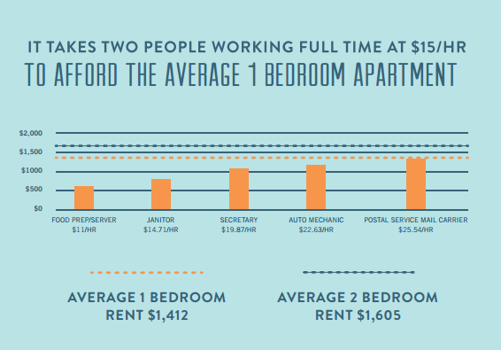
City of Seattle housing programs

Slide 13
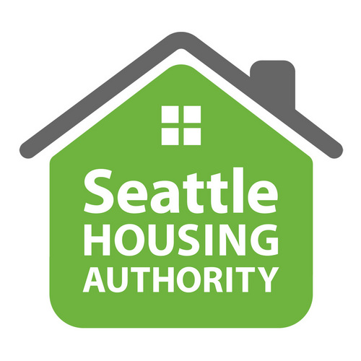
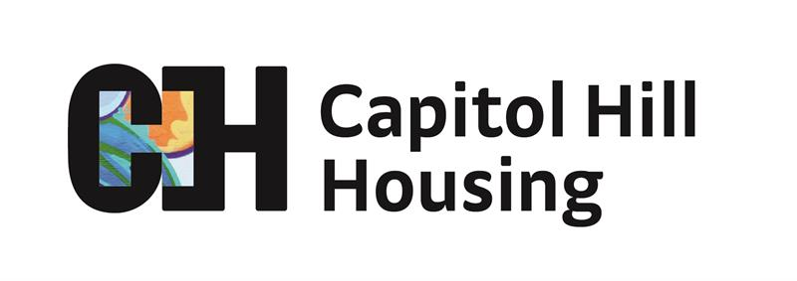
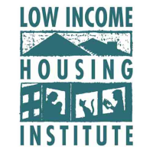
Programs contributing to housing affordability in Seattle
Public agencies
Non-profit developers & property owners

Slide 14
City of Seattle housing programs
Rental Housing Production & Preservation
Homeownership Assistance
Multifamily Tax Exemption (MFTE)
Incentive Zoning (IZ)

Slide 15
City of Seattle housing programs
Incomes Served by Percent of Area Median Income (AMI)
0
30
60
80
Rental Production & Preservation
Direct investment prioritizes our most vulnerable residents and low-income homeownership.
Operating Support & Rental Assistance
Low-Income Weatherization
Homeownership and Home Repair
Multifamily Tax Exemption*
Incentives address lower-wage workers.
Incentive Zoning (Performance)*
* Includes rental component of program only.

Slide 16
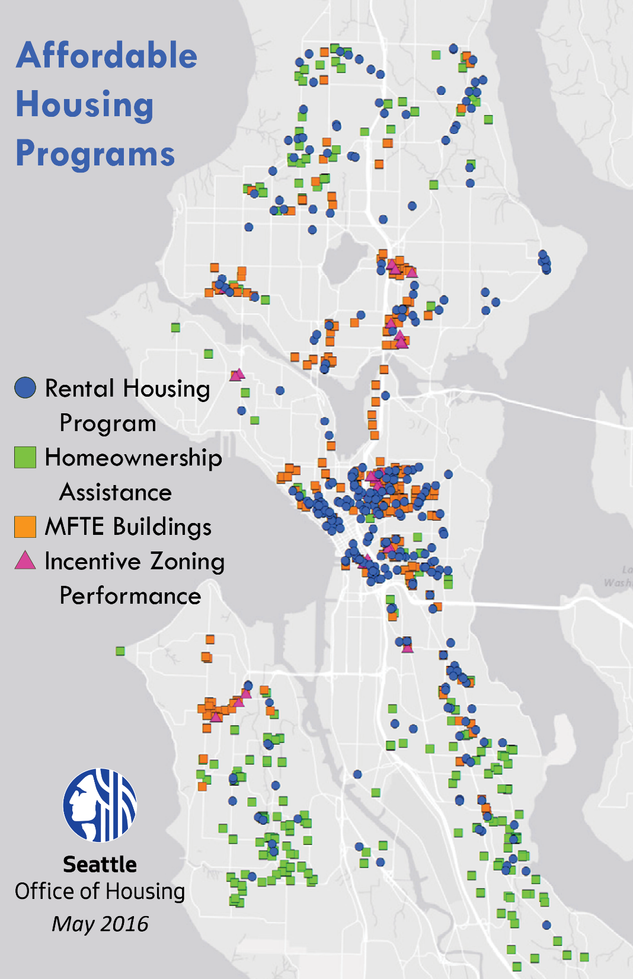

Slide 17
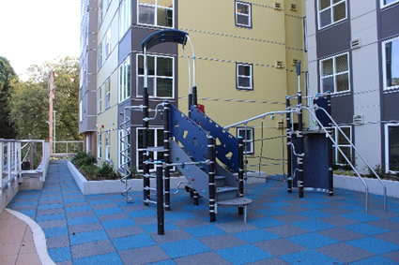
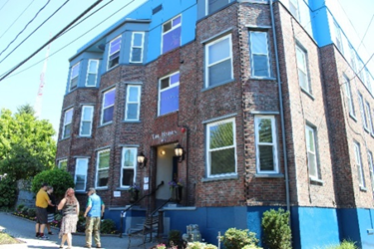
Rental production and preservation investments
Funding process
35-year track record
Funds awarded competitively
Evaluate project location, population, scale/efficiency, organizational capacity
Strategically invested throughout the city
City dollars typically leveraged 3:1
Community partnerships
Project types
New construction and acquisition/rehab
Reinvestment in affordable housing
Rental housing portfolio at a glance
301 buildings, 12,533 City-funded units
4,477 units regulated to serve homeless
53% of units for extremely low-income households
Served 22,079 people in 2014

Slide 18
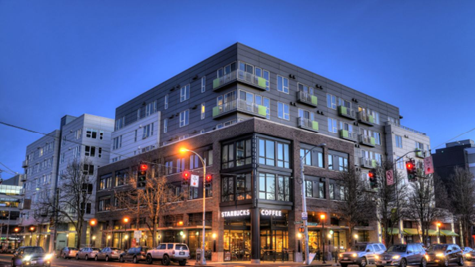
Multifamily Tax Exemption Program
Funding process
Affordable housing incentive program since 1998
Provides a property tax exemption in exchange for offering at least 20% of units at affordable rents
Housing affordable for 12 years
Serves incomes from 40% to 90% of AMI
Used in a broad range of buildings:
located throughout the city
both rental and owner-occupied homes
both market-rate and subsidized projects
Renewal of MFTE in 2015 created incentives for family-size units, expanded program geography, and strengthened tenant protections
Production at a glance
Approved: over 250 buildings with almost 7,000 affordable units
In operation: over 130 buildings with almost 4,000 affordable units
Notes:
Market-Rate: Almost 5,000 affordable; Non-Profit: Almost 2,000
Affordability depending on unit type and timing of MFTE application

Slide 19
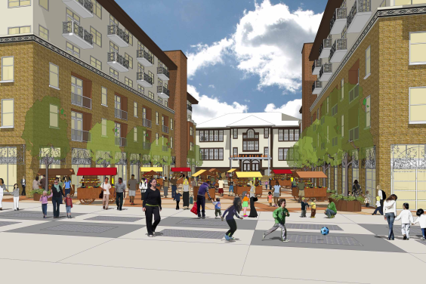
Incentive Zoning
Funding process
Existing affordable housing incentive program
Allows extra developable floor area for commercial and residential developers when they provide affordable housing
A voluntary program available primarily in Downtown, South Lake Union, and First Hill
Developers can build affordable units on-site or make a payment to the Office of Housing for affordable housing
50-year duration of affordability
Production at a glance
Rental performance: 28 projects with 327 affordable units
Payment: $70.26 million in funds committed to rental/ownership
For rental, $68.05 million in payment-in-lieu funds invested in 32 projects with 2316 affordable units
Without IZ, 948 of these rental units would otherwise not have been built
For ownership, $2.21 million in payment-in-lieu funds invested in 41 units
Notes:
IZ Markets:
-Commercial Core
-Denny Triangle
-Belltown
-South Lake Union
-First Hill
-Chinatown/International District
-Pioneer Square
-North Beacon
-Capitol Hill
-Pike/Pine
-12th Ave
-University District NW
-Ballard
-West Seattle Junction
-Roosevelt
-Interbay
This estimate is based on restructuring that actual historical spending data AS IF the city had invested the bonus money only in 4% LIHTC projects. This approach is consistent with Rick Jacobus’s analysis in “Seattle’s Incentive Zoning Program” analysis completed in February 2014.
Rental Off-site performance in rental housing: 2 projects with 195 affordable units

Slide 20
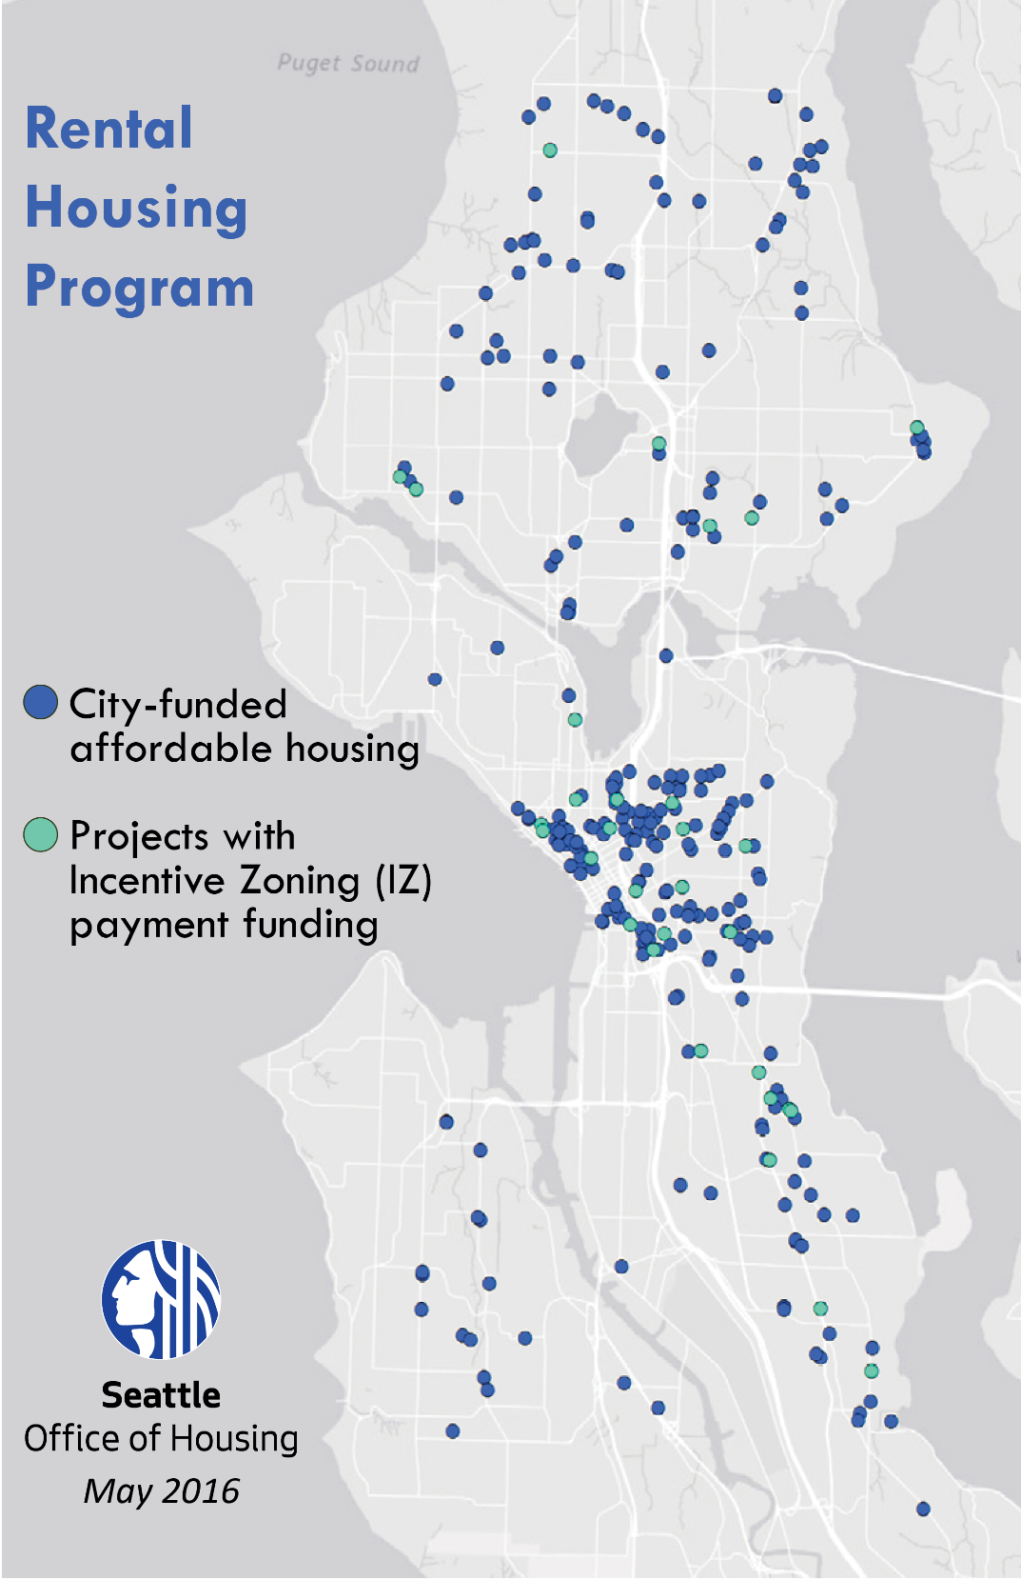
Strategic investment of Incentive Zoning payments
Equity
Investments can mitigate displacement and stimulate economic development
Used in partnership with community-based organizations
Preservation of existing at-risk housing
Creates family-sized units and resident service programs
Quantity
Funds leveraged 3:1
Yield a greater number of units at 60% of AMI than would be produced on-site
Location
Neighborhoods throughout Seattle
Supports fair housing choice and opportunity
Addresses displacement
Supports City strategies to promote growth near transit and in urban centers and villages
Sustainability
Long-term stewardship for 50 years
Evergreen Sustainable Development Standard

Slide 21
Thank you
Notes:
IZ Markets:
-Commercial Core
-Denny Triangle
-Belltown
-South Lake Union
-First Hill
-Chinatown/International District
-Pioneer Square
-North Beacon
-Capitol Hill
-Pike/Pine
-12th Ave
-University District NW
-Ballard
-West Seattle Junction
-Roosevelt
-Interbay
This estimate is based on restructuring that actual historical spending data AS IF the city had invested the bonus money only in 4% LIHTC projects. This approach is consistent with Rick Jacobus’s analysis in “Seattle’s Incentive Zoning Program” analysis completed in February 2014.
Rental Off-site performance in rental housing: 2 projects with 195 affordable units

