Slide 1
Priority Hire Construction Training and Retention Services RFP

Slide 2
Construction Worker Training & Retention Services
Agenda
Welcome & Introductions
Priority hire & RFP Presentation
Question and Answer Session
RFP Collaboration Session

Slide 3
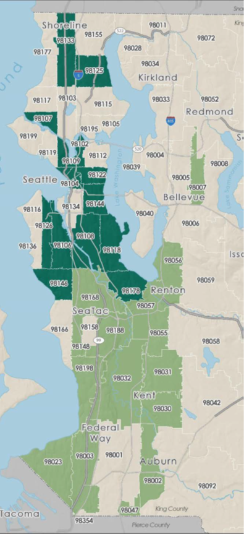
Construction Worker Training & Retention Services
What is Priority Hire?
Creates equitable access to construction training and employment
Builds family-sustaining careers through access to public works projects
City construction projects of $5million or more:
Requirements for priority workers, apprentices & pre-apprentice graduates
Aspirational goals for women and people of color
Implemented through a master community workforce agreement (CWA)

Slide 4
Construction Worker Training & Retention Services
Why Priority Hire?
 | PAST PERFORMANCE ON CITY PROJECTS | VOLUNTARY EFFORTS (Rainier Beach Community Center) | PRIORITY HIRE PROJECTS
SEATTLE RESIDENTS | 5% | 2% | 12%
DISTRESSED ZIP CODES | 12% | 3% | 25%
APPRENTICES | 13% | 12% | 16%
WOMEN | 5% | 6% | 11%
PEOPLE OF COLOR | 25% | 24% | 27%
^{1]}Past Performance on City Projects is based on hours from a sample of projects from 2009-2013. Sources are the Worker Profile in City of Seattle Construction Projects report and City of Seattle – Construction Workforce Diversity Report.
^{[2]} Percentages listed under Rainier Beach Community Center reflect UCLA Labor Center analysis of employee data, 2014.
^{[3]} Percentages listed in the Community Workforce Agreement column reflect Seawall hours in LCPtracker through September 30, 2015

Slide 5
Construction Worker Training & Retention Services
Apprenticeship Completions
Source: Port of Seattle, 2017.

Slide 6
Construction Worker Training & Retention Services
Construction Workforce Demand
Source: Port of Seattle, 2017.

Slide 7
Construction Worker Training & Retention Services
Worker Shortage
Source: Port of Seattle, 2017.

Slide 8
Construction Worker Training & Retention Services
RFP Purpose
Identify regional strategies that increase and diversify the construction workforce, particularly for residents of economically distressed ZIP codes, women and people of color.

Slide 9
Construction Worker Training & Retention Services
Regional Public Owners
The RFP is hosted by the City of Seattle, with the Port of Seattle and King County joining as a multi-jurisdictional effort
Agencies may evaluate proposals separately or jointly
Agencies intend to enter separate contracts
Agency | 2018 | 2019 | Bi-Annual Est. Total
City of Seattle | $380,000 | $380,000 | $760,000
Port of Seattle | $199,000 | $199,000 | $398,000
King County | $50,000 | $0 | $50,000
Est. Total | $629,000 | $579,000 | $1,208,000

Slide 10
Construction Worker Training & Retention Services
RFP Timeline
Schedule of Events | Date/Time
Solicitation release | November 15
Optional pre-submittal workshop | November 20
Repeat optional pre-submittal workshop | November 28
Deadline for questions | December 13 by 4:30 pm (PST)
Proposals due | December 21 by 4:30 pm (PST)
Anticipated date for announcement of interviews | January 3
Anticipated interview dates | January 9 & 10
Anticipated announcement of winning proposers | January 12
Anticipated contract execution | January 30

Slide 11
Construction Worker Training & Retention Services
Minimum Qualifications
There are no minimum qualifications
Pre-apprenticeship and apprenticeship programs must be Washington State Apprenticeship & Training Council (WSATC)-recognized or in process of obtaining recognition at contract award
Organizations must meet all other applicable licensing requirements immediately after contract award or the City may reject the Consultant

Slide 12
Construction Worker Training & Retention Services
Scope of Work
Pre-apprenticeship Construction Training
Train women, people of color, and/or those from economically distressed ZIP codes and place them in a construction apprenticeship or construction employment
Proposals may offer:
New programs
Support services
Additional training slots
Continued support with existing training slots
Other strategies to increase the likelihood of such individuals entering and/or being retained in construction

Slide 13
Construction Worker Training & Retention Services
Scope of Work
Apprentice and Journey-level Retention Services
Address barriers to entry and increase graduation and retention in apprenticeship and journey-level work
Proposals may offer:
Apprentice support or training
Journey-level assistance that address retention barriers
This focus would be on women, people of color, and/or those from economically distressed ZIP codes in apprenticeship or journey status
Proposers are encouraged to provide proposals that provide retention services for 12 months or more post-placement. Actual retention timelines will be negotiated in contract.

Slide 14
Construction Worker Training & Retention Services
Reporting
Pre-apprenticeship Construction Training Metric Report
Number of:
Individuals who enter pre-apprentice program
Individuals who terminate and the reason for the termination
Number of graduates
Placements into construction apprenticeships and/or employment
Enrollments from Priority Hire outreach providers
Graduation rates
Retention rates for graduates that were placed into construction

Slide 15
Construction Worker Training & Retention Services
Reporting
Apprentice and Journey-level Retention Services Metric Report
Number of:
Apprentices
Apprenticeship cancellations
Apprenticeship completions
Any additional metrics relating to the services proposed (e.g. number mentored, tutored with math skills, etc.)
Retention rates for apprentices and/or journey-level workers
Factors that lead to apprentice cancellation or journey-level drop-out and strategies used to address these factors

Slide 16
Construction Worker Training & Retention Services
Proposal Submittal
Electronic Submittal
Subject Line: FAS Construction Training and Retention Services
PDF format
Preference for submittal in one email to LaborEquity@seattle.gov
In Person Submittal
Address: Seattle Municipal Tower: City Purchasing and Contracting Services, 700 Fifth Ave, Suite 4112 Seattle, WA 98104
Sealed envelope
Mail Submittal
Address: City Purchasing and Contracting Services, P.O. Box 94687, Seattle, WA, 98124-4687
Sealed envelope

Slide 17
Construction Worker Training & Retention Services
Selection Process
Initial Screening
Proposal Evaluation
Evaluation Criteria | Points
Agency capacity and organization | 10
Agency experience | 30
Agency proposal and application | 30
Cultural competency | 15
Proposal cost | 15
TOTAL | 100
3. Interviews – 20 points
4. Selection

Slide 18
Construction Worker Training & Retention Services
Proposal Support
Two Pre-submittal Workshops
Nov. 20, 2017, 10:30 a.m.-12:30 p.m.
Nov. 28, 2017, 10:30 a.m.-12:30 p.m.
Questions
Julianna Tesfu
LaborEquity@seattle.gov or 206-684-4570
November 15 through December 13, 2017 at 4:30 p.m.
www.seattle.gov/priorityhire
Proposals due December 21, 2017, by 4:30 p.m. (PST)

