Slide 1
Seattle Neighborhoods Actively Prepare
Presented by Seattle Office of Emergency Management

Slide 2
Meeting Goals
Meet neighbors and establish connections
The first and most important goal of SNAP is to meet and get to know your neighbors. Establishing connections that can be utilized during and after disasters and emergencies is the key to responding together.
Learn what to do to be better prepared
You will learn some basic tips & tricks and general guidance on what you, your household, and your neighbors can do to be better prepared for disasters and emergencies of all kinds.
Learn how to stay safe during an earthquake and through COVID-19
Learn important information on Seattle's biggest threat- earthquakes, and how you can stay safe and respond as a neighborhood to mitigate hazards. Additionally, you will learn how you can stay safe during COVID-19.
Know your top three response priorities after an earthquake
You will learn what your top priorities are as a neighborhood when responding after a disaster. You will start the process of getting organized as a group to respond to any potential hazards and help those who may be vulnerable.

Slide 3
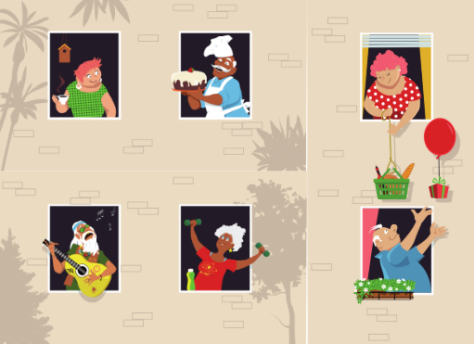
Introduce Yourself
Who are you?
Where do you live?
Why are you here?

Slide 4
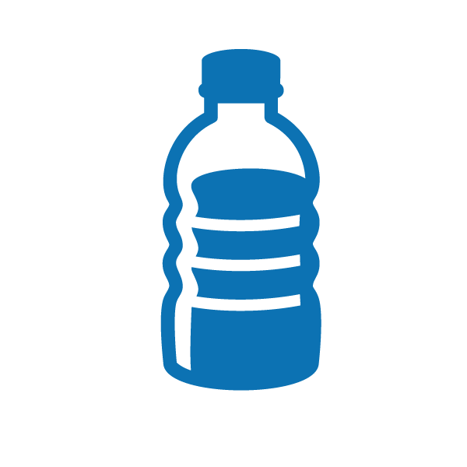

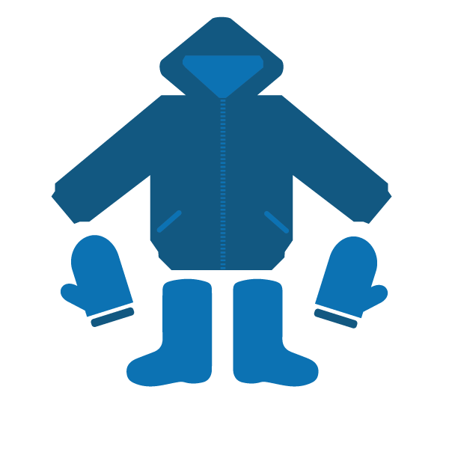


Life Safety Essentials
1. Water
2. Food
3. Staying warm & dry
4. Safe Light Source
5. Personal sanitation products

Slide 5
Custom Items
A custom item is anything that is unique to you and your situation that you will want to ensure is kept in emergency stock or in a safe place in case of emergency. Examples of these may include:
Medications and medical health insurance program information
Copies of personal information (virtual and/or physical)
Comfort items
Connections - Phone numbers, names, addresses and other forms of contact for important people in your life including family, friends, neighbors, caseworkers, etc.
A Note on Life Safety Essentials and Custom Items:
Some disasters will require preparation and storage of certain items such as water and food. Others, such as the COVID-19 pandemic, will not require the storage or hoarding of these supplies as it can be reasonably assumed that access to grocery stores and clean water will be maintained. Be prepared for earthquakes, but do not hoard emergency items or take more than you reasonably need.

Slide 6
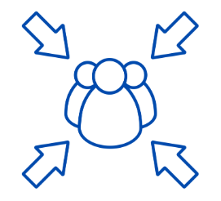
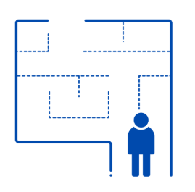

Make a Plan
Meeting Place
Determine a meeting place for if you and your household need to evacuate your home. Determine a meeting place for your building or neighborhood in case of a larger disaster.
Evacuation Routes
Make sure everyone in your household is familiar with multiple evacuation routes from your home or building.
Planning in Advance
Know emergency plans at your children's school, your place of work, and in your neighborhood.

Slide 7

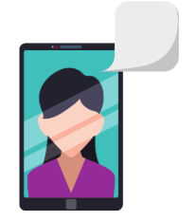
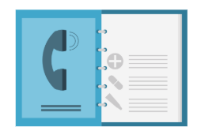
Communications Plan
Neighborhood Meeting Place
Choose a place to meet in your neighborhood that is familiar, safe, away from traffic, and easy to access for those who may have functional disabilities and where you can maintain safe social distancing.
Traditional Emergency Contact Lists
Keep written lists of important emergency contacts. Consider an out-of-area contact for your household in case phone services are overwhelmed in your area.
Social Media and Video Calling
In certain emergencies, social media and video calling can be a lifeline between you and those you care about most. Look for free and easy-to-use video chatting services such as FaceTime, Facebook Messenger Video, WeChat, and WhatsApp.

Slide 8
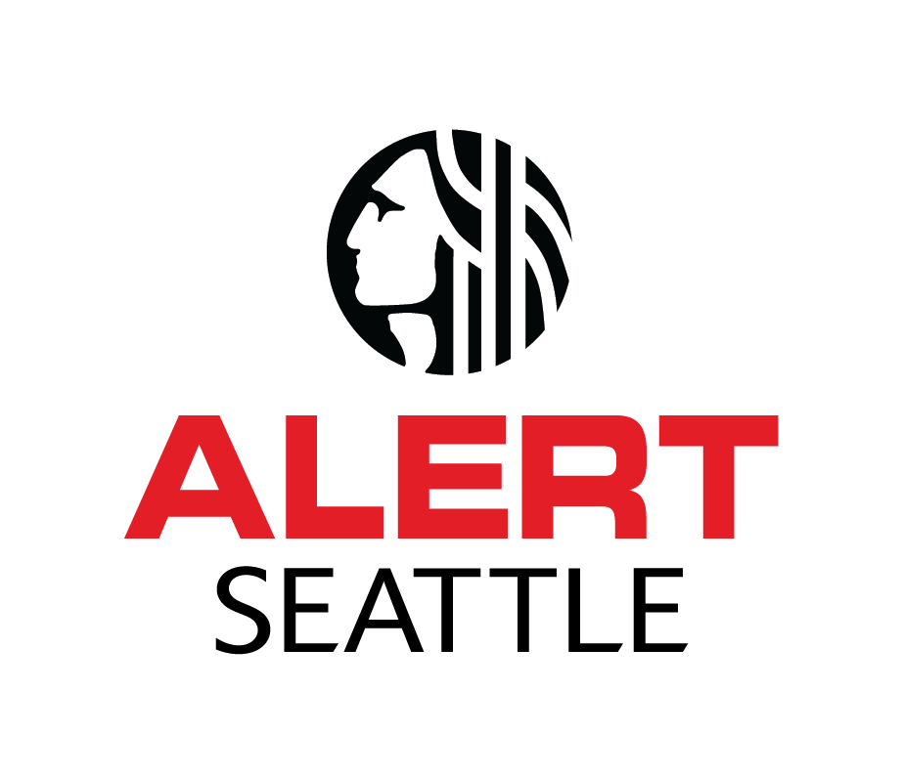

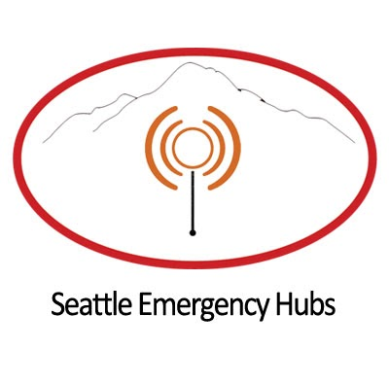

Stay Informed
Get AlertSeattle messages by signing up online at alert.seattle.gov or text ALERTSEATTLE to 62783 to opt-in to free emergency alert text notifications.
Follow City departments on social media.
@oemseattle @alertseattle @cityofseattle
Tune into local television, if available.
Use emergency radio stations to stay up-to-date on information:
AM 710
AM 1000
FM 97.3
FM 90.7
Find your nearest Community Emergency Hub as a resource for information following a disaster. You can find yours by visiting the Neighborlink Map here: https://bit.ly/2ZD2f2j

Slide 9
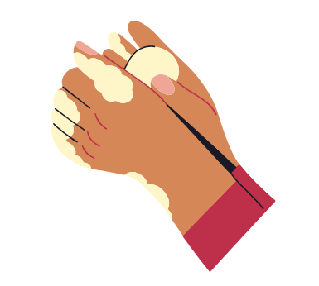
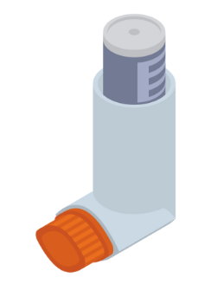
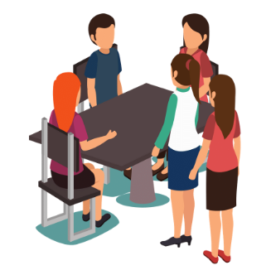
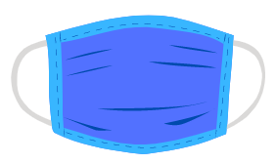
COVID-19 Guidance
Wear a face covering whenever in public or leaving your home. Face coverings are mandatory in public statewide as of June 25, 2020.
Continue practicing good hygiene habits, such as washing your hands for at least 20 seconds each time you leave and return home. If you are out and do not have access to handwashing, use hand sanitizer.
Stay home if you have any underlying medical conditions that may make you more susceptible to complications from COVID-19.
Gather with no more than 5 people for recreational activities outside of your household per week.

Slide 10
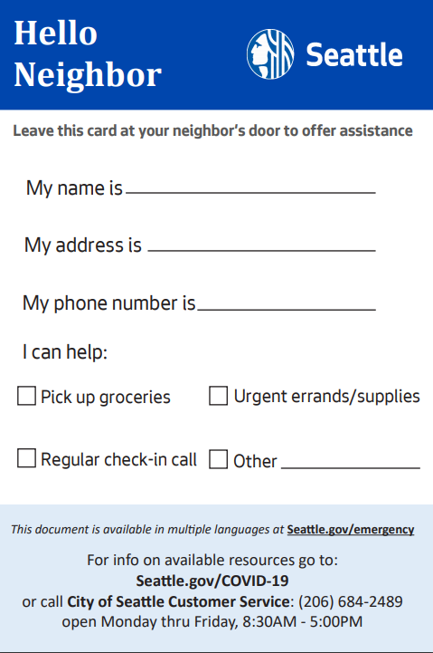
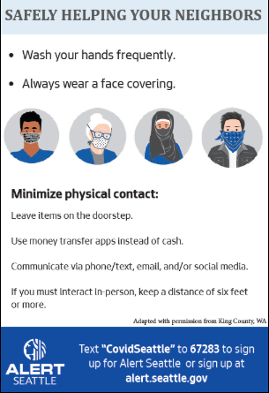
Helping Your Neighbors During COVID-19
Use our Hello Neighbor card to offer assistance to neighbors. While COVID-19 is still present in our community, it is important for those most vulnerable to stay at home. Offer to go grocery shopping or run other errands for those remaining at home, or simply offer to check-in with a regular phone call. A little bit goes a long way!
Download the card here. Other languages are available at the link above.

Slide 11
When the ground shakes…

Slide 12

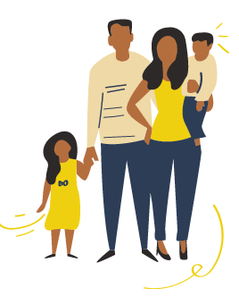
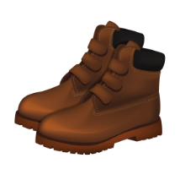
After the Earthquake
Check yourself and those in your household
Check your home, unit, or building and personal property for damage
Place your Help/OK sign in your window or on your door and dress for safety
Go to your neighborhood meeting spot

Slide 13
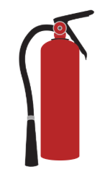

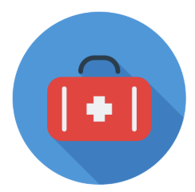
Top 3 Neighborhood Response Priorities
Control Utilities and Prevent Fire
After that: Damage Assessment (Homes, streets, utilities)
Check on People (Search and Rescue)
After that: Communications (Listen to radios and connect with your nearest Community Emergency Hub)
Take Care of Injuries (First Aid)
After that: Shelter and Take Care of Each Other

Slide 14

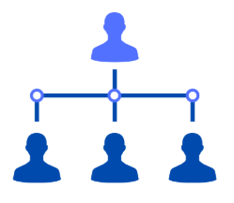
Organizing for Success in Advance
Identify a SNAP Coordinator(s) and a SNAP Contact(s)
Determine Roles and Responsibilities
Utility Control Team
Search and Rescue Team
First Aid Team/Hygiene Team
Determine a Meeting Place

Slide 15

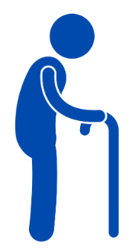
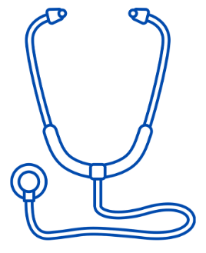
Head Start
Who has children, pets, lives alone, or works from home?
Who has special needs?
Who has special skills?

Slide 16
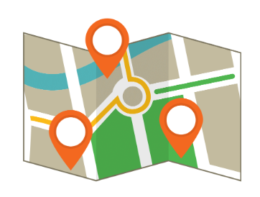
Make a Map
Neighborhood Map
Idea: Create a map of your neighborhood - Mark your meeting place, who lives where, homes with natural gas and the meter locations.
Meeting Place
Gas Meters
First Aid Station

Slide 17
Final Review: Putting it all together
Before the earthquake:
Quake safe actions
Personal and household preparedness
After the earthquake:
Check on yourself, your household, and living space
Post Help/OK sign, go to meeting place
Organizing with others:
First, focus on top response priorities
Control utilities/prevent fire, search & rescue, first aid
Then, designate other teams/tasks:
Shelter & care, damage assessment, communications, hubs

Slide 18
If a disaster happens tomorrow…
Where are the earthquake safe spots in your home, unit, or building?
Where is your neighborhood meeting place?
Follow-up items:
Do you have neighbors that aren’t here tonight?
Who will take or email presentation materials and information to them?

Slide 19
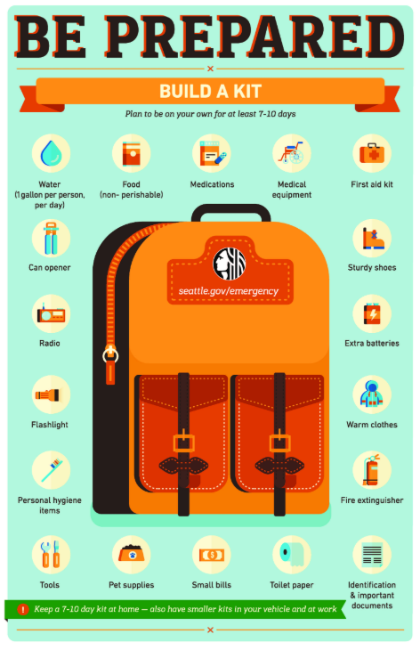
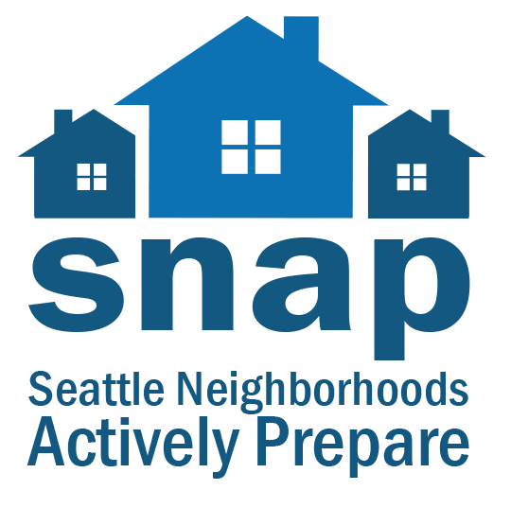

More Resources
Download this presentation and get more SNAP information here:
www.seattle.gov/snap
Learn disaster skills like utility control, how to use a fire extinguisher, and how to shut off your water with our videos here:
https://bit.ly/2ZePGtP
Get more preparedness resources and information here:
https://bit.ly/2W70bNI
Find multi-language resources here:
https://bit.ly/2OeVHRa

Slide 20
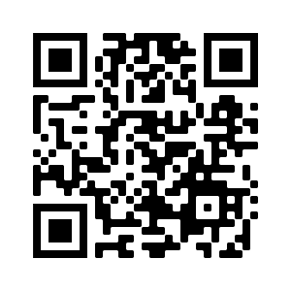
Give us feedback!
https://www.surveymonkey.com/r/oemprepare

